Slide 1
选必4 U2单词2

Slide 2
4班暑假作业反馈：
优质：
焱堃，禹尧，子佳子宜姐妹，欣宜，之翼，子淳，一诺，l³, 雨辰，佳琪，文宣
部分认真：
钰晴、粟予、炳、JQ、昊宇（套题），梓炀（套题听力），陈沐（只有套题，其余没交），鹏博（7次练字，其余没交），承浩、林航、马赫（练字），天娇（练字听力），Q（套题很认真，但语篇填空错得有点多）
质量较差：
+4+（3次练字，未交套题），冠儒，宇轩（只交一套卷子），奕博（卷子貌似没对答案），单禹（几张练字，两套题）
特别表扬（写了日日清）：
122, 小胡，晟熙，梓睿，CZ

Slide 3
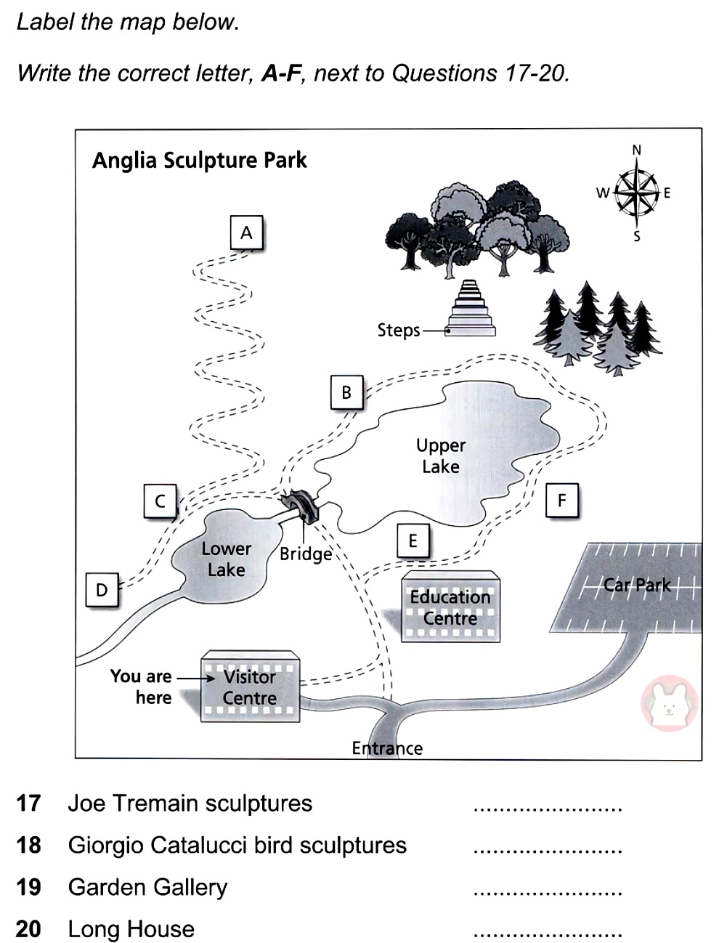
听力中的位置题（来自雅思听力地图题）

Slide 4
7. freedom自由
记忆：boredom, wisdom
其他需要记忆的特殊名词：
revelation, publication (注意区分publicity), perception, reception, suspicion, clarification

Slide 5
8. domain领域、范围
(高难度完形)
In the heart of the city, where concrete towers clawed at the sky, there lay a forgotten gate. Its iron bars were 41 with ivy, and the lock had long surrendered to rust. To most, it was merely a 42 in the wall.
One rainy afternoon, a child paused before it. Her fingers traced the 43 patterns on the gate, and something within her stirred, a 44 she couldn’t name. Pushing it open, she stepped into a 45 untouched by time.
41. A. choked B. polished C. painted D. broken
42. A. shadow B. relic C. decoration D. rule
43. A. modern B. faded C. glowing D. digital
44. A. fear B. song C. call D. doubt
45. A. chaos B. domain C. machine D. storm

Slide 6
假定你是李华，口语课上外教要求学生就“To listen to CD records or to attend live concerts”这一话题写一篇发言稿，内容如下：
1. 你的观点；2. 你的理由。
While some argue that listening to records at home offers superior audio quality, I firmly believe that attending live concerts provides a more profound and meaningful musical experience. The primary advantage of live performances lies in their emotional authenticity. When artists perform on stage, their raw energy creates magical moments that polished studio recordings cannot replicate.
Live events create multidimensional immersive experiences, although recordings may deliver flawless sounds. The visual spectacle of lighting, the physical vibrations of notes, and the spontaneous interactions between performers and audience combine to create something truly extraordinary that exists only in that moment.
Moreover, sharing space with thousands of passionate fans creates collective memories and emotional bonds that last a lifetime. The roar of a crowd singing in unison generates a powerful sense of belonging that headphones cannot match. This communal aspect elevates music from mere entertainment to a shared human experience.
Listening to records or attending live concerts is a domain where the rule “Beauty is in the eye of the beholder” applies. But for me, attending live concerts resonates with me more deeply.

Slide 7
9. sponsor倡议、赞助；赞助者
与“赞助、资助”有关的词汇：
patron多指艺术方面的资助人，patronize资助艺术
endorse=advocate公开赞同、公开支持（endorse引申为广告代言）
subsidize资助、补助（涉及到钱）
champion坚定支持
As a renowned environmental activist, she has consistently championed the global transition to renewable energy, not only by funding cutting-edge solar research but also by mobilizing youth networks worldwide to advocate for policy changes, demonstrating that true leadership means championing causes beyond mere financial support.

Slide 8
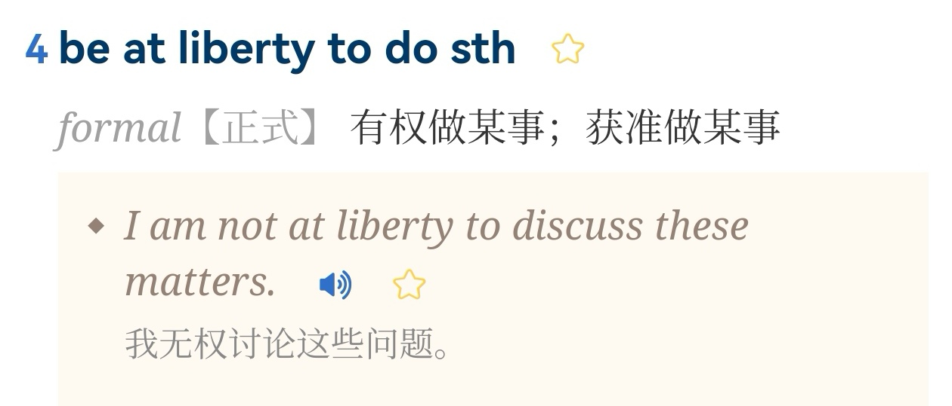
10. liberty自由
be at liberty to do sth.
（无奖竞猜）

Slide 9
11. sample样本、样品
(中难度完形)
Walking through the bustling night market, I realized food was more than sustenance; it was a 41 to cultures. At the first stand, a vendor handed me a wooden toothpick to 42 a spicy coconut dumpling. The 43 of flavors made me understand why locals perceive this as a breakfast staple.
As I moved deeper into the market, the 44 of grilling meats mixed with different seasonings. A chef noticed my 45 and invited me to bite into his newest creation: durian-packed chocolate. Though 46 , I took a small bite. “Let your taste buds 47 the layers,” he advised.
41. A. goodwill B. gateway C. timeout D. green light
42. A. smell B. reject C. purchase D. sample
43. A. explosion B. absence C. upgrade D. complexity
44. A. warmth B. rhythm C. fragrance D. light
45. A. curiosity B. embarrassment C. aggression D. strength
46. A. delighted B. angry C. panicked D. hesitant
47. A. forget B. analyze C. ignore D. resist

Slide 10
Pu-erh can get expensive. Since the tea is formed into a compressed shape, you have to buy it 56 fixed amounts. While many vendors offer smaller samples of their pu-erhs, those samples come 57 a substantial markup (溢价). Those big name teas? Some of them can command 58 (astronomy) prices: four or five figures for less than a pound of tea.
The good news is that quality pu-erh costs less than many other quality teas. So even pricey pu-erh can come out cheaper per cup than some other 59 (celebrate) tea styles. So it’s worth buying your pu-erh with care, which is why I typically do so from vendors who specialize in it and 60 either press their own cakes or have long-established relationships that have a 61 (prove) track record of quality.

Slide 11
12. a flock of birds 一群鸟
A flock of birds erupted from the tree and scattered to the ground where they darted between rice grains.
The sudden rustle of wings sent leaves trembling. The ground became a dance floor of hungry beaks.
A feathered cascade spiraled downward and descended to forage for scattered rice grains.
Feathered rain poured from branches, harvesting rice grains.

Slide 12
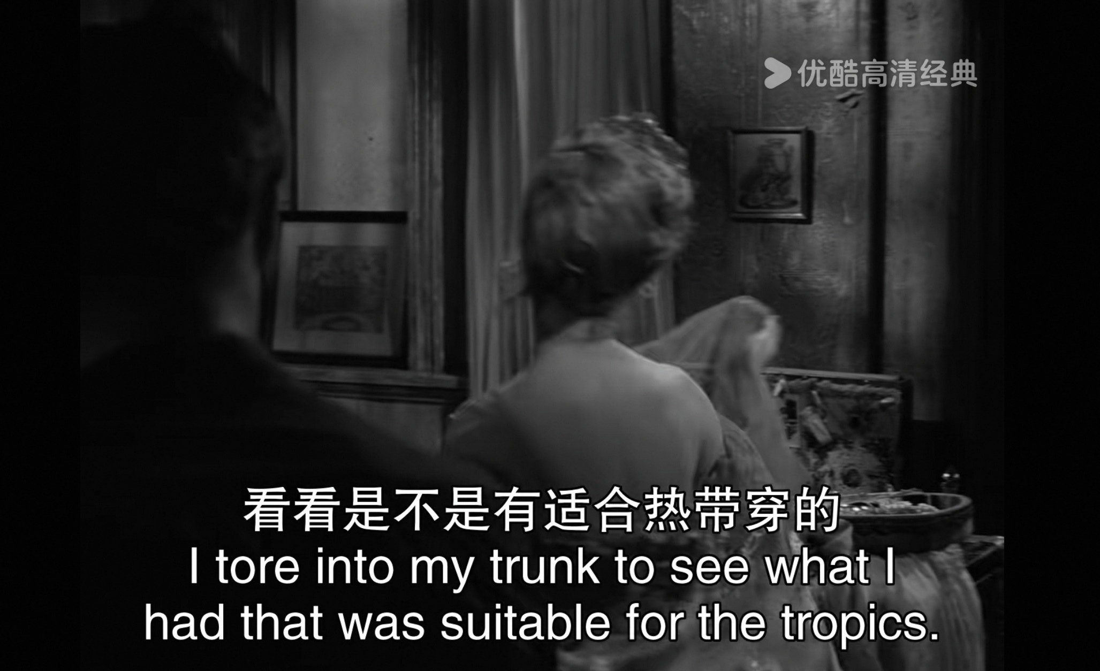
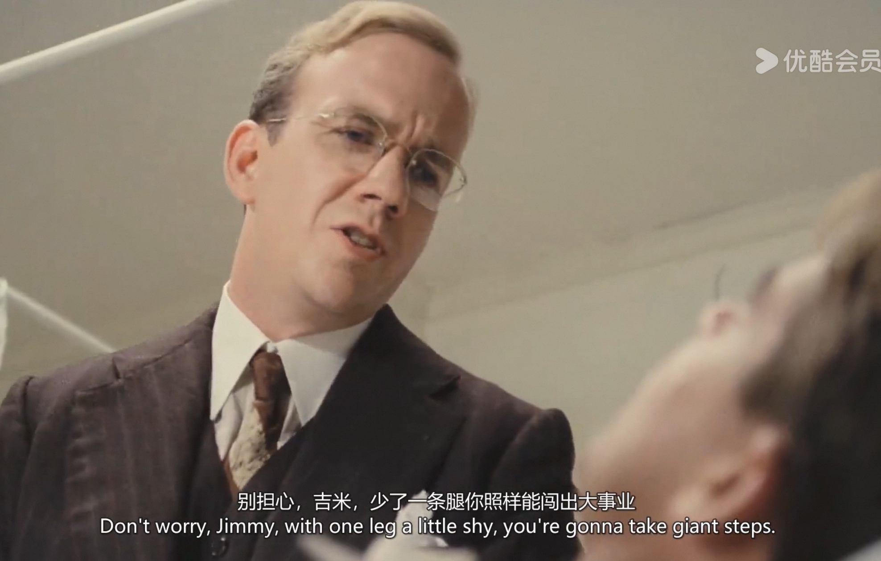
13. distribution分配、分布
The population in China is unevenly distributed, with eastern regions densely populated.

Slide 13
14. temporary / permanent
(应用文）
假定你是李华，你校校报现就“The Internet has displaced museums and art galleries”这一话题征稿。请根据以下内容投稿：
1. 你的观点；2. 你的理由。
While the Internet has democratized access to artifacts and artworks, museums and art galleries still remain irreplaceable. My reasons are listed below to justify my argument.
First, originals possess a unique feature that is lost in pixels. Digital reproductions may dazzle the eye temporarily, yet to stand before an original artwork is to be immersed in a symphony of textures and scales that vibrates in one's heart long after leaving the gallery.
Second, museums and art galleries serve as hubs for community engagement and education. By hosting immersive forums, interactive seminars and hands-on workshops, they cultivate the public’s aesthetic sensibility and cultural awareness.
Rather than becoming obsolete, museums and art galleries are adapting to the digital age by incorporating such technology as virtual tours to enhance the physical experience. I firmly believe that the Internet is an enhancement instead of a replacement of museums and art galleries.

Slide 14
15. phase时期、阶段
phase out逐步淘汰...
chicken out胆怯
tease out找出隐藏信息；套出秘密
roll out推出新产品；出发
pan out（事情）发展

