Slide 1
选必4U5单词2

Slide 2
9. attend to照顾、处理
(来自dicksuck)
The microscope was a gateway to world invisible to the naked eye. Eliza’s fingers trembled slightly as she prepared the 41 . She carefully placed a drop of pond water onto the glass, knowing that within that tiny 42 , mysteries awaited discovery. As she peered through the eyepiece, a complex ecosystem 43 . Tiny creatures darted and swirled, their movements both chaotic and graceful. Suddenly, she noticed a strange organism. She knew she must 44 this discovery meticulously; haste could mean missing crucial details.
Each movement of the creature was captured in perfect 45 . Eliza reached for her notebook, her pencil 46 across the page as she documented every detail. She worked with 47 concentration, unaware of the fading light outside the lab windows.
41. A. solution B. slide C. sample D. frame
42. A. machine B. brick C. reaction D. universe
43. A. expanded B. collapsed C. emerged D. swung
44. A. attend to B. forget about C. wipe out D. throw away
45. A. clarity B. haste C. chaos D. shape
46. A. rocketing B. flying C. hitting D. coming
47. A. casual B. reluctant C. occasional D. intense

Slide 3
“动词+to” 构成的短语：
come to苏醒过来
amount to总计、相当于
Her answer amounted to a complete (refuse).
Their actions amount to a breach of contract.
take to养成习惯、开始喜欢
relate to有关、理解、(relate sth. to sb.)
Our product needs an image that people can relate to.
commit to致力于、承诺

Slide 4
10. purse女士钱包
purse one’s lips噘嘴（表示反对)
raise one’s eyebrows (brows)扬起眉毛（表示反对或惊讶)
I beg to differ（礼貌表示）反对
not see eye to eye with sb.看法不一致

Slide 5
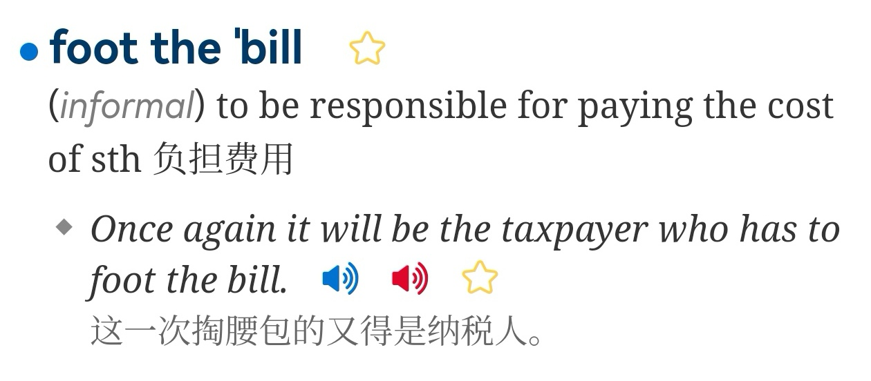

Slide 6
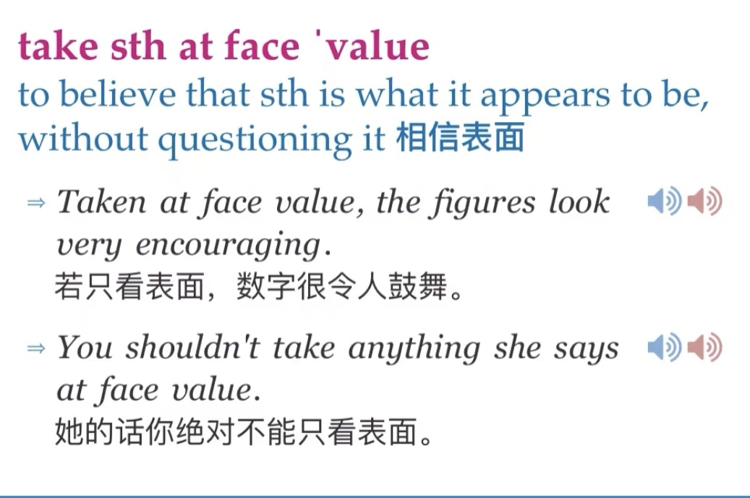

Slide 7
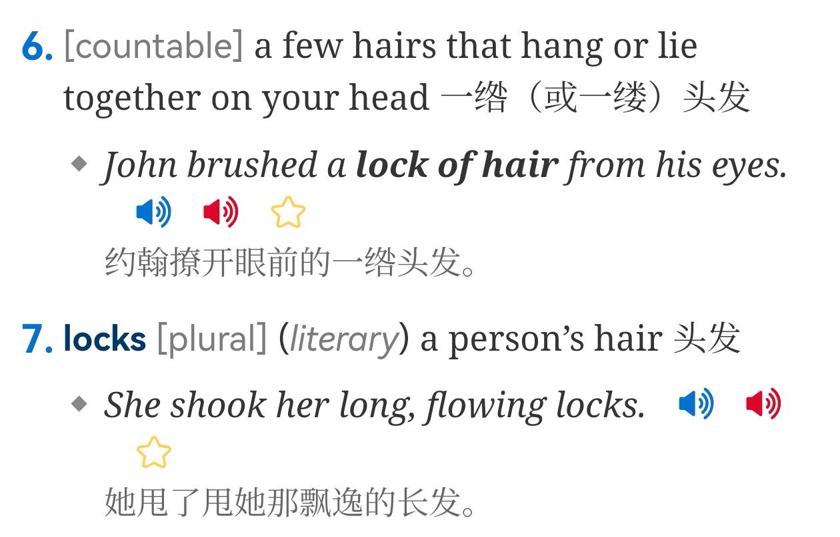

Slide 8
11. priority优先
prior先前的
prioritize放在最重要的位置
-ize结尾的动词
clarify (clarity, clarification)
intensify加强
visualize可视化、想象（envision）
maximize / minimize / optimize

Slide 9
请就“The cellphone is a bad invention because it cuts people's communication."这句话发表自己的见解并举自身事例说明。
While some argue that the cellphone cripples communication / isolates people, I believe it is not the invention itself but the way we use it that truly matters.
Personally, my smartphone has deepened my connections. It allows me to maintain close contact with my grandparents through daily video calls, something letters or landlines could never achieve as vividly. It also helps me visualize moments of joy with friends abroad, sharing experiences instantly despite the distance.
The issue lies not in the device, but in our choice. To optimize its value, we must balance digital interaction with genuine human engagement, ensuring technology enhances rather than replaces meaningful communication.

Slide 10
12. acquire获得、得到
n. .
enquire / inquire n. .
require n. .

