Slide 1
选必4U4单词3

Slide 2
11. pan平底锅
pan的两个重要短语：a flash in the pan, pan out
(2024新高考2) Campbell’s point is to wake up those responsible for AI, the technology companies and world leaders, so they are on the same wavelength as all the experts currently developing it. She explains we are at a “tipping point” in history and must act now to prevent an extinction-level event for humanity. We need to consider how we want our future with AI to pan out. Such structured thinking, followed by global regulation, will enable us to achieve greatness rather than our downfall.
Q: What lesson can we learn from Campbell’s words?
A. Make hay while it shines. B. Take caution beforehand.
C. Better late than never. D. Two heads are better than one.

Slide 3
W: Did you see that new graffiti artist everyone's talking about? His first piece got over a million likes, but his recent work feels so empty.
M: Exactly. He’s just a flash in the pan—all hype, no depth. Real art takes years to develop, not just one viral moment.
W: True. Meanwhile, that quiet sculptor down the street… her pieces aren’t flashy, but they last.
M: Yeah. She’s the real deal. Substance over style, always.
Q₁: What is the man’s attitude toward the new artist?
A. Favorable. B. Critical. C. Impartial.
Q₂: What are the speakers talking about?
A. A drawing way. B. An art program. C. An artistic comparison.

Slide 4
你校校报举行“我给妈妈做了一道菜”主题征文活动，你打算参加。请根据以下内容投稿：
1. 做饭的过程；2. 妈妈的反应。
Last Sunday, I decided to surprise my mother with scrambled eggs with tomatoes, the very dish she used to make for me after school.
I carefully chopped ripe tomatoes and beat the eggs until they turned into a smooth golden liquid. As the oil shimmered in the pan, I poured in the eggs. They sizzled and bloomed like a sunny flower. I added the tomatoes, and their juicy redness blended gently with the fluffy eggs. A pinch of salt, and our kitchen was filled with an aroma of warmth and love.
When I served it, my mother’s eyes lit up with surprise and tenderness. She took a bite, and her smile deepened. “It tastes like sunshine,” she said softly. In that moment, I saw a tear glisten at the corner of her eye. Seeing this, I felt deep inside my efforts were worth it.

Slide 5
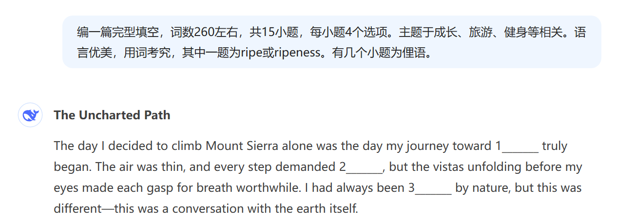
12. ripe成熟的
ripeness, ripen

Slide 6
Halfway up Mount Sierra, I met an elderly hiker with eyes that held decades of wisdom. He offered me a piece of fruit from his pack, perfectly 41 , and said, “Some things can’t be rushed.”
As I continued, my body protested, aches settling into my muscles, and doubt creeping into my mind. But I remembered his words and refused to 42 . Step by step, I felt myself growing not only stronger but wiser, as if with every scent, I was 43 an old version of myself.
On my descent, I encountered a group of young climbers struggling with their heavy gear. I found myself saying, “Don’t 44 . Just take it one step at a time. You’ve already 45 by coming this far.”
41. A. bitter B. fresh C. sweet D. ripe
42. A. bite the bullet B. hit the road
C. throw in the towel D. break the ice
43. A. strengthening B. shedding C. using D. comparing
44. A. push the envelope B. burn the midnight oil
C. sweat the small stuff D. mend the fence
45. A. hit the jackpot B. gone the extra mile
C. found your feet D. become the underdog

Slide 7
13. drag拖拉
(读续短语）drag oneself费力行走
Tom dragged himself home, still battling with the intractable math problem. A sudden pat on his left shoulder jerked him back to reality. Raising his head, he was surprised to see it was Peter who was incompatible with him. Peter first broke the ice with a big grin, saying: "What are you thinking about? It seems you are in low spirits." Although Peter's intention to bury the hatchet was so obvious, Tom was determined not to give him the chance...
区分以下单词：
stagger=stumble走路不稳，东倒西歪
drag oneself=trudge艰难行进、吃力行走

Slide 8
14. plug塞子、插头、插座、堵住
pull the plug on sth. 结束... (plug的最主要短语)
plug one’s ears塞住耳朵
cup one’s ear
prick up one’s ears
be all ears
turn a deaf ear
wet behind the ears

Slide 9
(语篇填空)
Every weekend, Mark and his dog Max would climb the mountain. These two 56 (adventure) spirits tapped this chance to bond better. The mountain stood before them, its peak hidden in the morning mist like a 57 (mystery) giant waiting to be challenged.
At a steep section, Max paused, looking back at Mark with 58 (question) eyes. “You can do it, buddy!” Mark encouraged. “Remember what we always say: Paws before pause!” Max seemed to understand, scrambling up the 59 (rock) section with renewed determination.
They reached a beautiful overlook where an elderly was resting. “Beautiful day for it,” the man remarked. “I have been a climbing 60 (practice) for 40 years and my wife tells me to pull the plug on these adventures.”

Slide 10
你校校报就“To travel a thousand miles or to read a thousand books, that is the question”这一话题进行征稿。请根据以下内容投稿：
1. 你的观点；2. 你的理由。
The choice between journeying across lands and reading through pages presents not a division but a harmony. I believe that while reading plants the seeds of knowledge, traveling makes them blossom into wisdom.
Through books, we inherit the collective wisdom of centuries: We walk with philosophers in ancient Athens and stand with scientists in modern labs. Yet it is through travel that abstract concepts become living truth. Reading about the Taj Mahal’s symmetry cannot compare to witnessing the dawn paint its marble walls in golden light.
But we should never pull the plug on reading in favor of pure experience. The magic happens when both experiences intertwine. Reading prepares the mind for travel, while travel gives context to reading. The thousand books become our compass, and the thousand miles become our map. Together, they enlighten our minds and souls.

Slide 11
读书和旅行关系：
♛Every book is a journey; every journey is a book.
♛Reading is virtual travel; travel is physical reading.
♛Books give us eyes to see, but travel teaches us how to look.
♛The world is a book, and those who do not travel read only one page.
♛Reading is traveling through the mind; traveling is reading with the senses.
♛The best-educated people are those who have read widely and traveled wisely.
♛Reading without travel makes theorists; travel without reading makes tourists.
♛Where reading describes, travel demonstrates; where reading explains, travel immerses.

Slide 12
15. disabled
（2016全国1) Larry works with Transport Drivers, Inc. One morning in 2009, Larry was 41 along 165 north after delivering to one of his customers. Suddenly, he saw a car with its bright lights on. As he got closer, he found another vehicle upside down on the road. One more look and he noticed 42 shooting out from under the 43 vehicle. Larry pulled over, set the brake and 44 the fire extinguisher. Two good bursts from it and the fire was put out.
41. A. walking B. touring C. traveling D. rushing
42. A. flames B. smoke C. water D. steam
43. A. used B. disabled C. removed D. abandoned
44. A. made for B. pulled out C. come across D. brush aside

Slide 13
A cascade of orders flooded in, and Grandma stood utterly mesmerized by the power of the Internet. Just as joy swept through the room, the screen abruptly went dark. A collective gasp hung in the air. Yet Peter remained calm despite the disabled computer. Reassuring the anxious villagers, he first checked for a power outage, then carefully dismantled the machine to pinpoint the fault. After what felt like an eternity, the screen flickered back to life, glowing steadily once more.（网络卖水果后续)

Slide 14
16. resign辞职、顺从于（resign oneself to)
resigned顺从的、无奈的
拓展：动词+oneself+to
apply oneself to专心致志
commit (dedicate, devote) oneself to致力于
abandon oneself to放纵于

Slide 15
Then drew near my 4th weekend fulfilling school community hours when I encountered Mrs. Bandona. The public library’s story room, where I’d been mechanically shelving books like 41 , gradually transformed into a choking cage. My social media was flooded with friends’ delicate meals, each update sharpening my 42 sigh.
“Fiction shouldn’t mix with cookbooks,” a voice remarked. Mrs. Bandona 43 her thick glasses, her gesture revealing lifelong commitment. Her method engaged my attention. While I 44 damaged books roughly, she smoothed 45 pages gently, explaining how even torn books could spark imagination. “Every volume has value,” she said thoughtfully. “Even outdated books 46 forgotten wisdom.”
41. A. a hard nut B. a wet blanket C. a wind-up toy D. a calorie burner
42. A. excited B. resigned C. tuneful D. cracked
43. A. adjusted B. measured C. purchased D. swung
44. A. tore B. flipped C. handled D. resisted
45. A. faded B. yellowed C. elegant D. wrinkled
46. A. shift B. preserve C. replace D. compare

Slide 16

17. tune曲子、曲调、调音、调频道
tune in收听、收看、理解、体谅
tune out不受听、不收看、不理睬
注意：
tone语气、（乐器或人) 音调、色调（skin tone)、（肌肉或皮肤）紧实度
note音符
(读续) He stroked the strings with deliberation and elegance, from which beautiful tunes wafted, captivating all the audience. Tom eyed the violinist with awe, amazed by the pacifying power of music. He felt his worries and grievances that once churned inside his chest dissolved as if carried away on the notes.

Slide 17
18. criterion标准、准则（criteria)
名词复数不规则形式变化：
chief, proof, safe直接加s
photo, piano, studio, video, radio, bamboo, zoo直接加s
crisis, analysis, basis, emphasis, diagnosis, hypothesis, synthesis, oasis变is为es
合成词：standbys (后备人员、备用物品）bystanders（旁观者=onlookers=lookers-on)

