Slide 1
选必4U4单词2

Slide 2
6. circus马戏团；热闹的场面
circu-或circum-是周围的前缀
如：circular, circulate, circuit, circumstance, circumnavigate
Eli just became the new keeper of the zoo. His first task was the elephant, Anusha. Her enclosure, once a marvel, now seemed a poor 41 of the vast grassland she would never see. Her eyes held a deep, 42 wisdom that shamed him. Each day, he cleaned, fed and spoke softly to her, his voice a poor substitute for the 43 calls of her lost herd. He began to read, and the more he learned, the more the bars of every cage seemed to 44 around his own conscience.
The zoo’s director, a man 45 by tradition, sniffed at Eli’s ideas. “This is not a wildlife’s holy land,” he’d say, “It’s a business.” The words 46 in the air, ugly and revealing. Eli saw the man wasn’t evil; he was just blind to the silent 47 radiating from every captive animal.
41. A. imitation B. suburb C. celebration D. circus
42. A. joyous B. sorrowful C. vacant D. useless
43. A. melodic B. chilling C. remote D. superior
44. A. stick B. jump C. beat D. tighten
45. A. honored B. enlightened C. chained D. preserved
46. A. hung B. faded C. shook D. shrank
47. A. curiosity B. contentment C. despair D. excitement

Slide 3
你打算参加题为“Is it necessary for us to keep a circus as an amusement?”的演讲比赛。请根据以下内容写一篇演讲稿：
(1). 你的观点；
(2). 你的理由。
Today, I stand before you to express my firm belief that it is unethical to keep a circus as a form of amusement.
True amusement should never come at the expense of another’s suffering. Wild animals in circuses are often subject to confinement, training through fear, and a life stripped of natural behaviors. Their dignity is reduced to a performance, their freedom to a cage.
Moreover, as humanity progresses, so should our forms of recreation. We now have abundant alternatives, from technology and art to sports, that offer wonder and joy without exploitation. A society that values compassion over spectacle is a society that ruly amuses itself with wisdom and grace.
Let us choose wonder without cruelty, and amusement without regret. Thanks for listening!

Slide 4
7. chemist化学家、药剂师、药房
英语中的各种“家”
物理学家（区分内科医生），生物学家
地理学家，心理学家（区分精神科医生）
剧作家，骑行的人，汽车司机，活动家
打字员，乐观主义者，悲观主义者

Slide 5
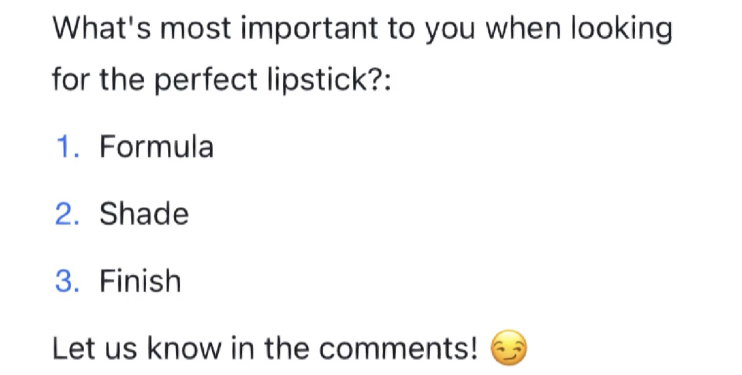
8. shade(重要的一词多义单词）
W: Your plan is a shade premature; we should wait for more data before moving forward.
M: I like it when people cut to the chase. You know, when I consulted Tom, he just threw some shade about my plan.
Q: What can we know from the conversation?
A. The plan is well grounded.
B. The man praised the woman.
C. Tom never beats about the bush.

Slide 6
(ds编写的语篇填空)
The practice of ink wash painting is far more than technique; it is a 56 (philosophy) journey where the mind guides the hand in a sacred dance. The mastery lies in controlling the ink’s dilution (浓度). A skilled painter can create multiple 57 (shade) of blackness within a single stroke. The perfect balance between water and ink determines whether a bamboo stalk will appear powerful 58 delicate.
When completed, the artwork becomes a dialogue between spirit and form. This is the true legacy of Chinese artistic tradition where 59 (simple) reveals profound depth, and a single brushstroke contains universe.

Slide 7
9. jaw下巴
jaw-dropping惊掉下巴
breathtaking令人惊叹的
backbreaking非常繁重的
time-consuming耗时间的
mouth-watering令人垂涎欲滴的
thought-provoking发人深省的
hair-raising使人毛发直竖的
mind-blowing使人兴奋的（吃惊的);印象深刻的
nail-biting使人焦躁不安的

Slide 8
（原创完形)
The mountain had always been there, a silent witness to my childhood. Yet, it wasn’t until my grandfather’s passing that I felt its silent 41 . His old hiking boots sat by the door, a(n) 42 reminder of paths untaken. With a heart full of 43 , I decided to climb it alone.
The initial trail was deceptively gentle, a stroll in the park through woods. But soon, the path turned 44 , the air thinning with each step. My lungs burned like they were on fire, and my resolve threatened to 45 . “This is an uphill battle,” I muttered, questioning my sanity. But I reached the summit. The view was simply 46 . It was a moment of awe.
41. A. pulse B. pull C. push D. sneeze
42. A. in-your-face B. down-to-earth
C. heart-to-heart D. off-the-wall
43. A. cold feet B. cold shoulders
C. an iron will D. a weak spot
44. A. flat B. even C. steep D. narrow
45. A. bite the bullet B. throw in the towel
C. walk on eggshells D. swallow the bitter pill
46. A. jaw-dropping B. mouth-watering
C. skin-crawling D. time-consuming

Slide 9
10. wrinkle皱纹；起皱
背诵：Years may wrinkle our skin, but giving up enthusiasm wrinkles our soul.
(读续) Consumed by the head-scratching problem, he tossed and turned on the bed, sleep eluding him. Suddenly, he had a light bulb moment.
读续中“愁容满面”的表达方式：
Her forehead was knitted / furrowed with worry.
She wore a grim / gloomy expression.
A sigh escaped her lips, betraying her inner turmoil.
His shoulders slumped in defeat.
A frown creased / crumpled her forehead.
Her face was clouded / shadowed with anxiety.

