Slide 1
选必4U4单词1

Slide 2
1. jam果酱；堵塞
He jammed his fingers in his ears. 他用手指使劲堵住耳朵。
(区分) He plugged the hole in the pipe with an old rag. 他用一块破布堵住了管子上的洞。
M: We won the first prize! I think we should have a jam session to celebrate!
W: You bet! And I think I should take some credit. But for me, all of you would have pulled the plug on attending the competition.
Q: What can be known from the conversation?
A. The woman wants to have a bet.
B. They intend to play musical instruments.
C. The man determined to join in the contest.

Slide 3
Every Friday evening, my father said that he would teach me how to repair my bike on the weekend. But weekends 41 , filled with urgent chores and unexpected errands. “Next weekend for sure,” became our family’s running joke, a classic case of 42 .
But August, my bike had developed a worrisome wobble. I’d stare at the 43 wheel, imagining my father’s strong hands straightening the spokes (辐条). One afternoon, 44 waiting, I dragged the bike to our driveway and attacked it with a hammer. The wheel bent further.
41. A. picked up B. wore on C. set in D. took off
42. A. jam tomorrow B. green eyes C. red tape D. silver tongue
43. A. upgraded B. accelerating C. twisted D. stable
44. A. obsessed with B. holding on to
C. satisfied with D. fed up with

Slide 4
2. dust灰尘；擦灰尘；撒粉状物在...上
dusty布满灰尘的
I came across Grandmother Lee’s frying stand in Chinatown several days ago. She moved through clouds of steam, working a wok (锅) of oil so deep it could drown sorrows, 56 chicken pieces swam until their skins turned to golden hue.
57 hands that knew sixty years of fire, she lifted the pieces onto wire racks. Then came the magic: from an old tin can, she began to spread them with spices. I then ate the 58 (dust) pieces, cross-legged, on a plastic stool, rain kissing my ankles. The first bite exploded, crunch giving way to juice. Between pieces, I sipped sugarcane juice just 59 (counter) the grease (油腻).
At midnight, when the rain stopped, the oil still bubbled. In that moment, I understood street food isn’t just about 60 (sustain); it’s the art of bringing happiness to others.

Slide 5
-y结尾的形容词：
smoky烟雾弥漫的、冒烟的
a smoky house, a smoky engine (此时的smoky相当于smoking)
但：smoked fish / meat熏鸡、熏肉
sticky粘的、棘手的（=tricky)、吸引人的（专指网站)
sticky air, sticky issues, sticky websites
cheeky厚脸皮的、无礼的
a chubby five-year-old with a cheeky grin
cheesy 劣质的、不诚恳的
nosy好管闲事的、爱打听别人事情的
edgy紧张的、赶时髦的
rosy粉红色的、美好的
pricy (pricey)价格昂贵的
wordy冗长的
flowery辞藻华丽的
bossy专横的
toasty温暖舒适的

Slide 6
3. chorus合唱；齐声说
"What impressed you most in the experiment?" My question sparked a chorus of murmurs among the students, their faces still shadowed by yesterday's crushing defeat. When Tom's hand shot up like a flare, I knew this was the moment. "The burning ..." he said, voice gaining strength. "How the magnesium kept shining before it turned to ash." A chorus of snapping fingers rippled through the lab as his words ignited recognition.
"You burned just like that magnesium on the court," I affirmed. The analogy worked like a catalyst: My boys' slumped shoulders straightened and sparks in their eyes blazed anew. "Let's burn like magnesium, pals," came Tom's resounding voice, followed by a spontaneous chorus of applause. The experiment let them understand that true brilliance lies not in perfection achieved, but in exertion involved.
(看片段猜电影作品：The Chorus)

Slide 7
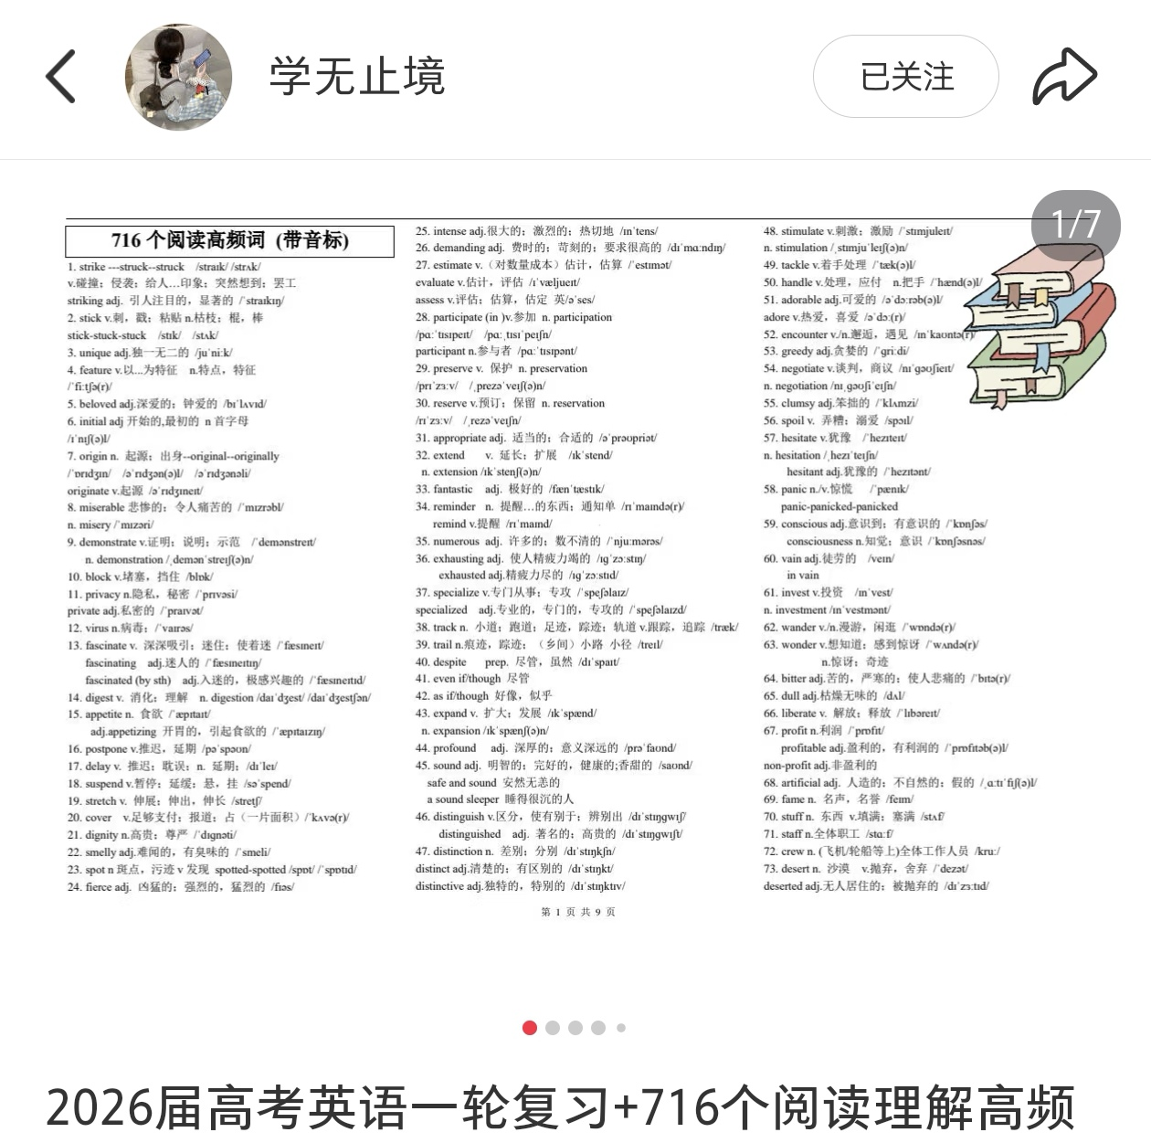

Slide 8
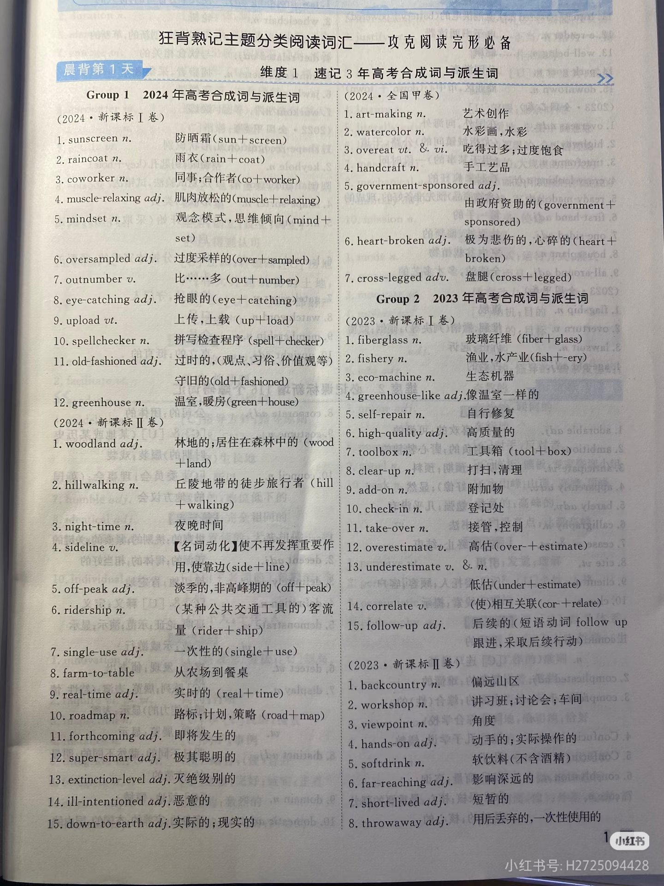

Slide 9
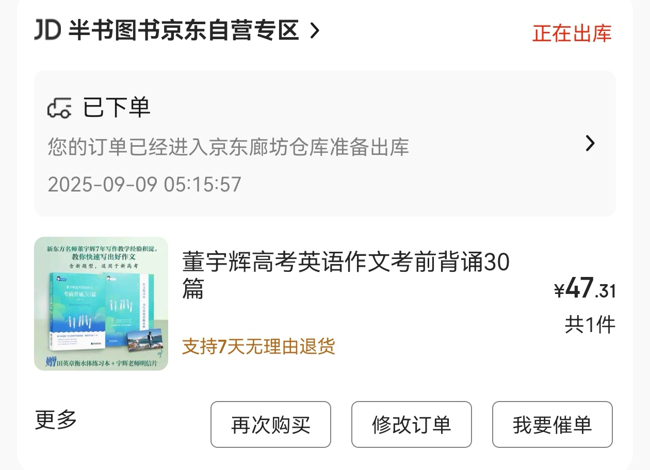

Slide 10
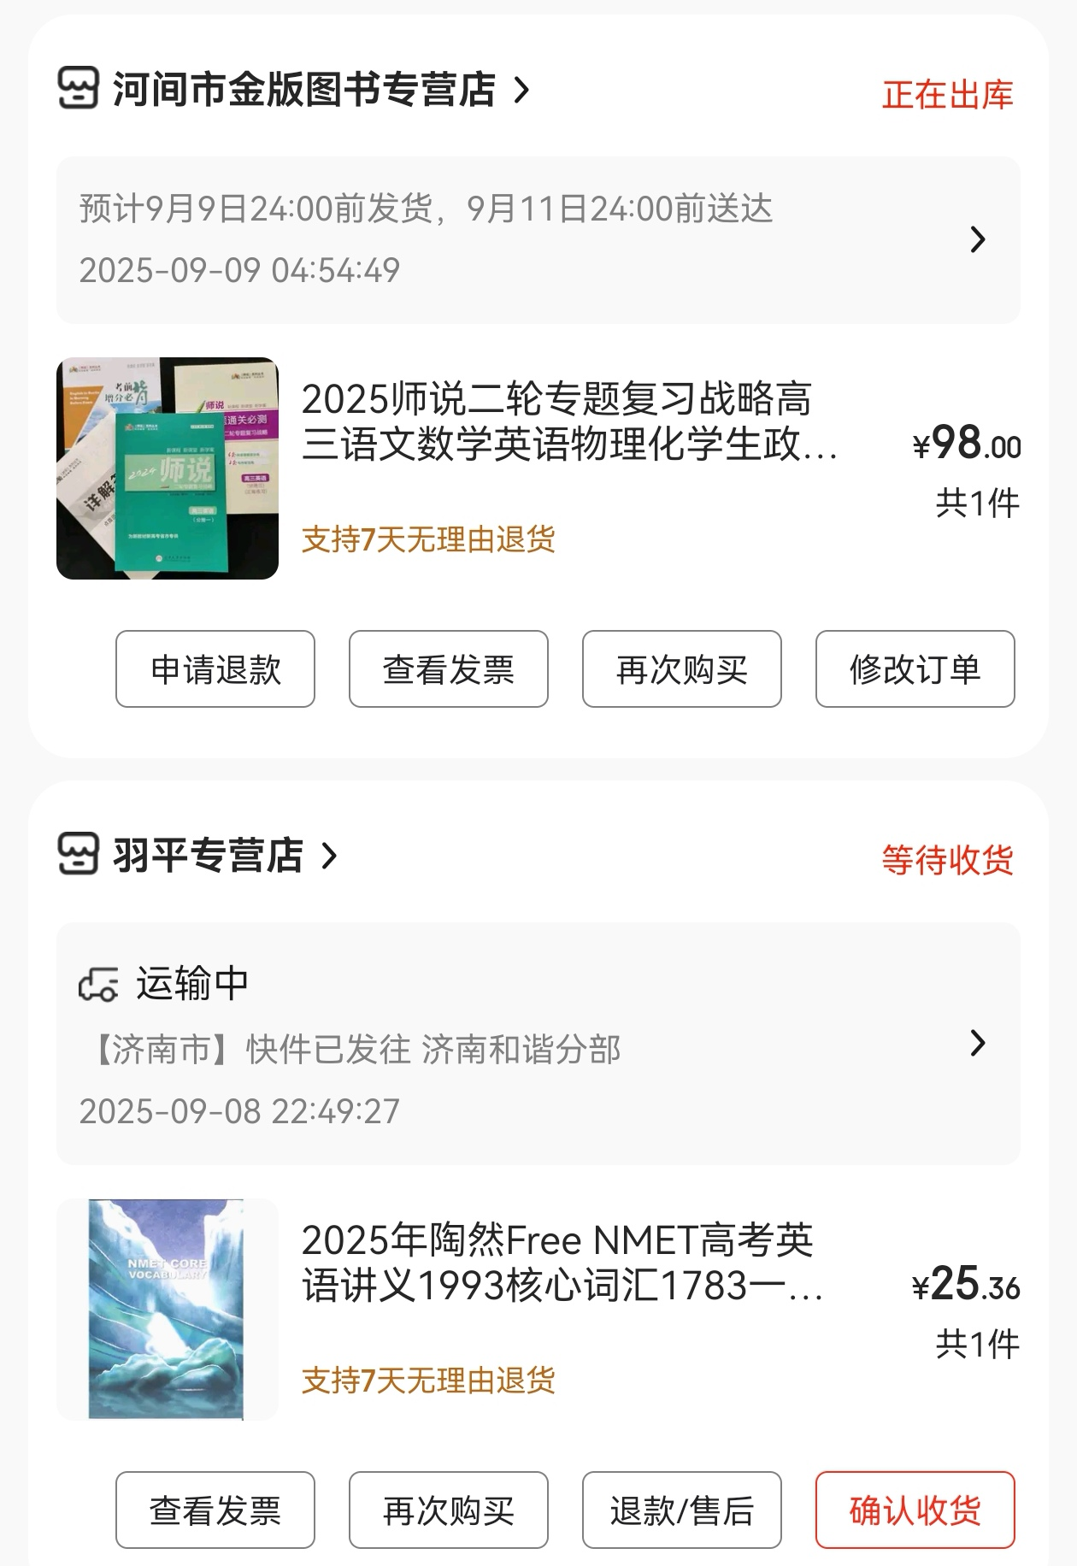

Slide 11
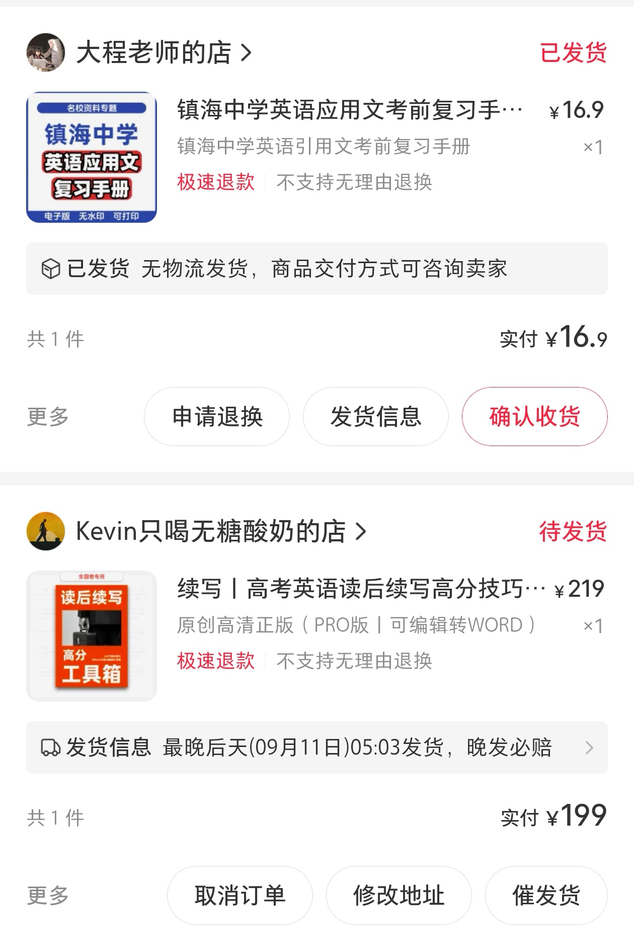

Slide 12
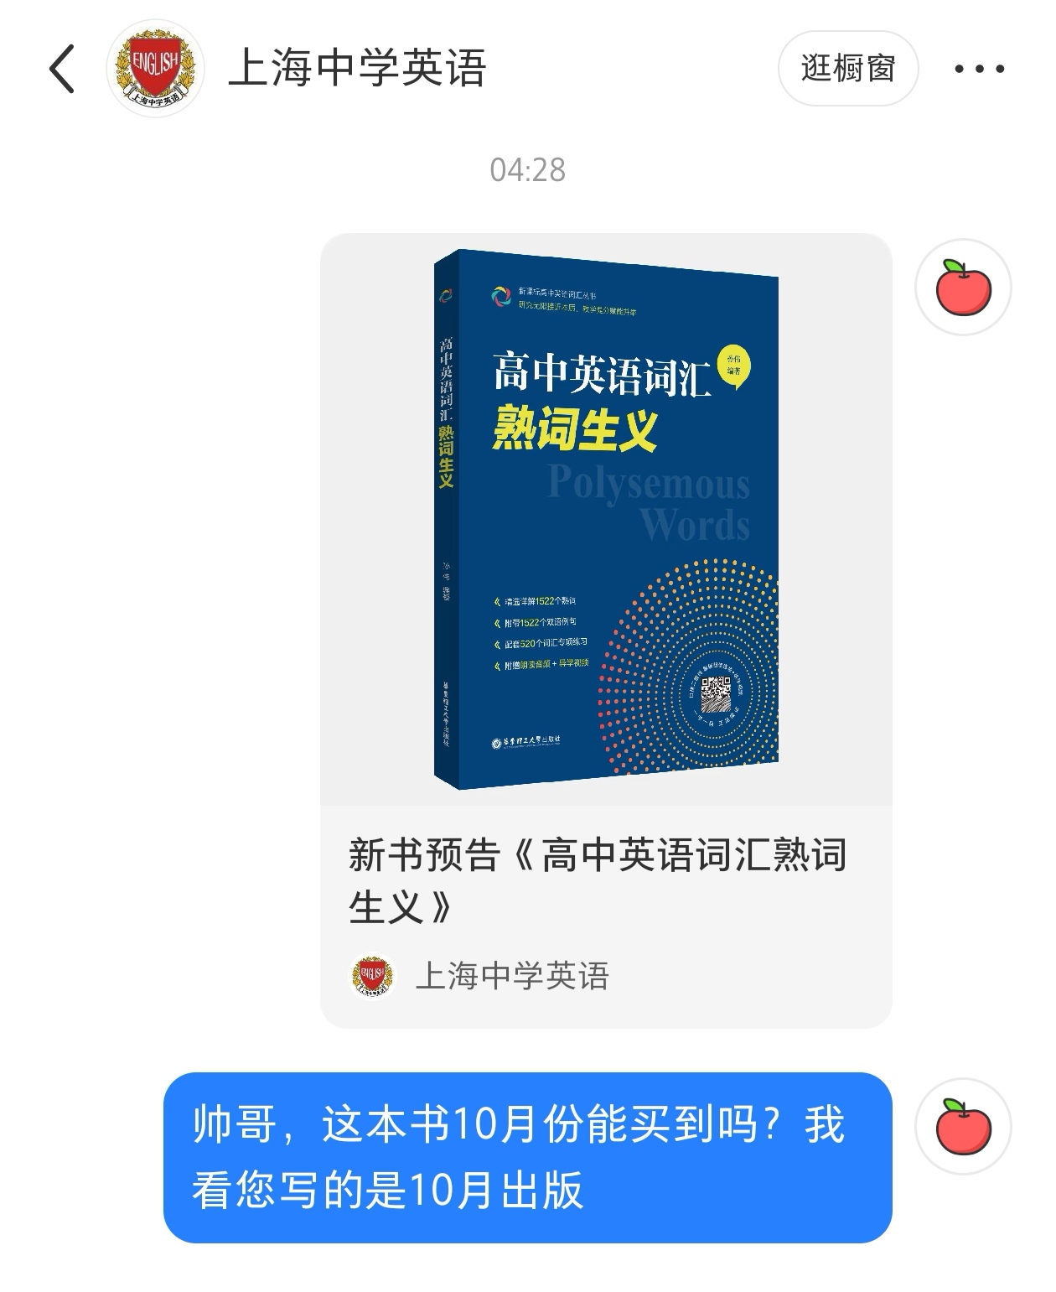

Slide 13
4. tablet平板电脑；药片；墓碑
-et（变体ette, let) packet, ballet, booklet, casette, cigarette
-ling seedling, duckling ... (可以自己造词)
(NPR)
Simone Dinnerstein has toured the world as a concert pianist, but she struggled for decades with performance anxiety. She was 41 about the expectation for soloists to perform from memory, without sheet music. “I had 42 during her Carnegie Hall debut in 2005, playing Goldberg Variations. That experience scarred me,” she says.
She is 43 her silence on her embarrassment, and how she ultimately overcame it, in the hope that it might help others and 44 what she calls rigid classical music conventions. Her way is to bring a tablet on stage with her, which she 45 with saving her career.
Musicians tend to use the iPad Pro, which has a larger screen closer in size to sheet music, and turn the pages using a Bluetooth pedal so they can have full use of their hands and perform without a page turner for 46 that can easily fill a hundred pages.
41. A. excited B. cautious C. worried D. enthusiastic
42. A. rewards B. recognition C. slips D. communication
43. A. maintaining B. breaking C. proceeding D. strengthening
44. A. soften B. integrate C. use D. analyze
45. A. credits B. obsesses C. romanticizes D. confuses
46. A. passages B. issues C. papers D. scores

Slide 14
5. rigid死板的、僵化的
rigidity死板、僵硬
其他-ity结尾的易错名词：
curiosity, generosity, gravity, equality, security,
intensity, flexibility, visibility, stability, liquidity,
complexity, simplicity, originality, purity, maturity,
priority, universality, validity, vitality

Slide 15
(2025届宝山一模)
假如你是李华，学校在招募解说员来接待英国学生。从体育馆、图书馆和食堂三个场所中选择其一应聘解说员，写一份解说稿。内容包括：
1. 选择的场所及特点；2. 你的同学喜欢这个场所的哪些方面及原因。
Good morning, everyone! I am Li Hua. On behalf of all the students and teachers at our school, I extend our warmest welcome to you. We are now standing before our newly built library — a structure that impresses not only with its striking architecture but also with its vast collection of resources and advanced facilities.
Although it has many commendable qualities, what we students appreciate most can be summarized in three key aspects. First, the five-story building is an architectural marvel. Its cylindrical design is both modern and functional, encircling a peaceful garden at the heart of the structure—a perfect spot to relax during breaks. Second, the library is exceptionally well-resourced, holding over 200,000 physical books and an even larger number of digital titles. Finally, this is truly a multi-functional space, equipped with dozens of study rooms, hundreds of brand-new computers, and even a state-of-the-art cinema.
That said, it’s important to note that the library is not a rigidly traditional learning environment. Instead of rigid rules and layouts, it offers flexible, modern spaces that encourage collaboration and creativity. While the exterior may appear formal, the interior is designed to adapt to various learning styles and activities—proving that functionality doesn’t have to come at the expense of flexibility.
So in our eyes, the library is not only artistic in design, abundant in resources, and efficient in service—it’s also thoughtfully designed to avoid the rigidity often found in conventional academic buildings. Now, let’s step inside and experience it for ourselves!

Slide 16
（2025.04海淀一模）
假设你是李华，你的英国好友Jim正参加主题为“信息时代中学生如何阅读”的项目式学习。他发邮件对你进行访谈。请根据以下内容给他回复，内容包括：
1. 信息时代对阅读的影响；2. 你的阅读方式和理由。
I am truly thrilled to learn about your thought-provoking project. As digital natives, we enjoy boundless access to diverse reading media. Yet, such fragmented consumption often scatters our attention and erodes critical thought.
To counter this, I embrace a hybrid reading strategy. At school, I maintain a rigid focus on intensive, exam-oriented print books, valued for their accuracy and depth. This disciplined approach ensures structured learning. At home, however, I transition to extensive digital reading, especially classics, which broadens my horizons.
While digital reading is invaluable, in-depth engagement must not be marginalized. I hope my reflections contribute to your meaningful work, and I wish it tremendous success.

Slide 17
-ence结尾：
absence, presence, emergence, occurrence, preference
essence, insistence, existence
-ance结尾：
appperance, attedance, acceptance, annoyance, assistance
resistance, disturbance, insurance, tolerance, maintenance
sustenance, guidance, ignorance, reliance, observance

