Slide 1
选必4U3单词2

Slide 2
6. withdraw撤回
withdrawn内向的
withdrawal撤回
翻译：
I accidentally posted spoilers, so I quickly deleted it, but someone screenshot it. Now I wish I could recall it like an email!
(读续)
Despite recognizing the gravity of our one-month communication breakdown, I was reluctant to swallow my pride and initiate contact. My hand hovered over the door and then withdrew.

Slide 3
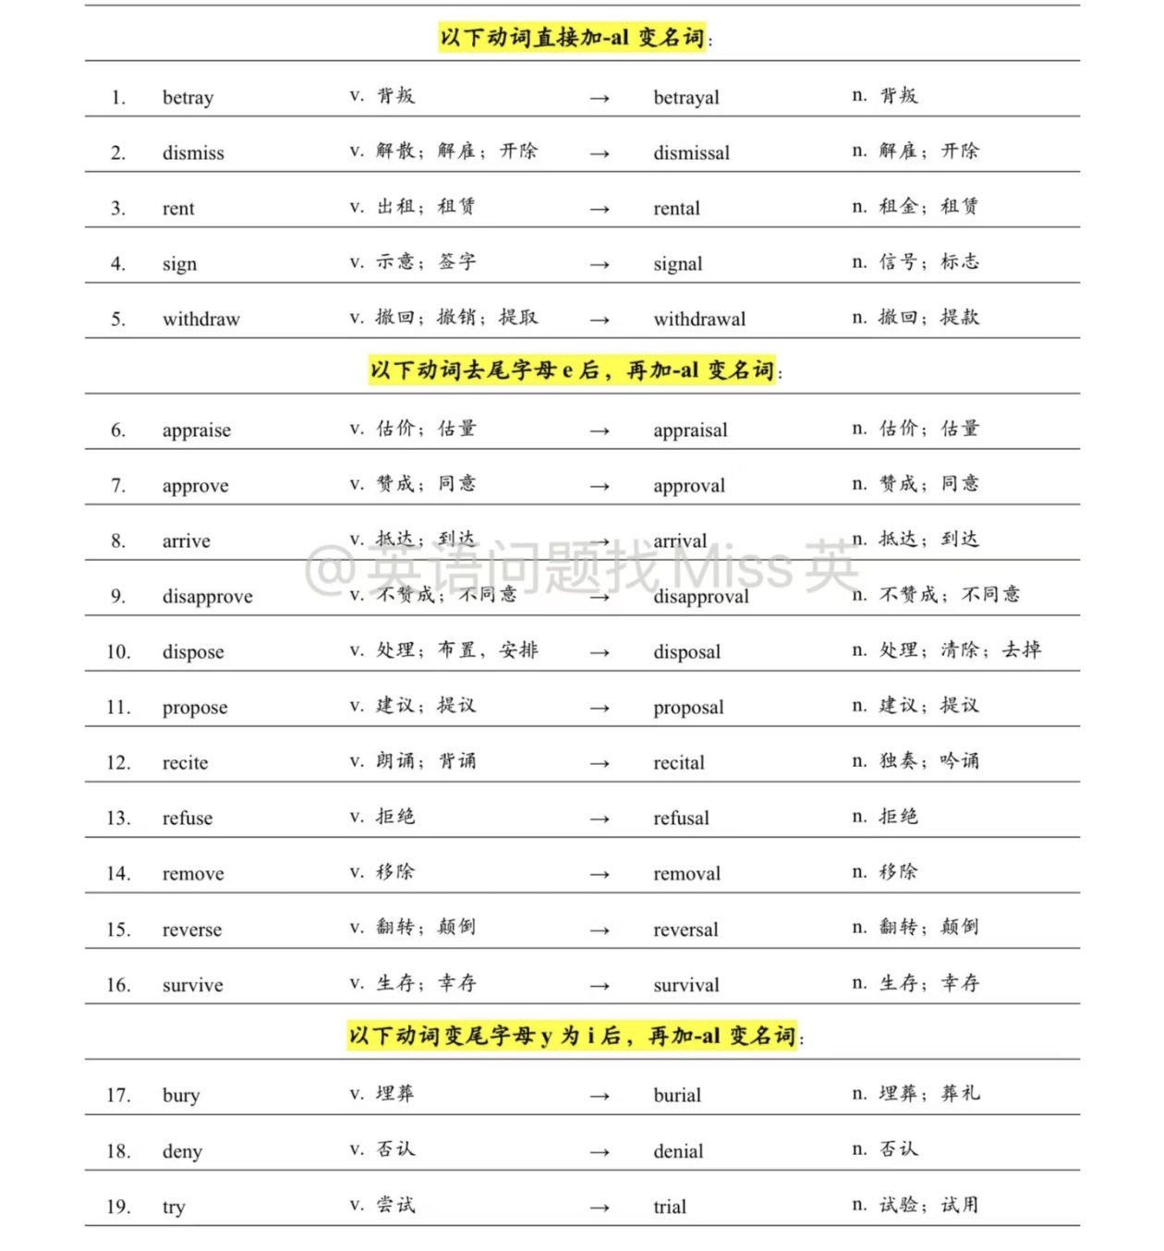

Slide 4
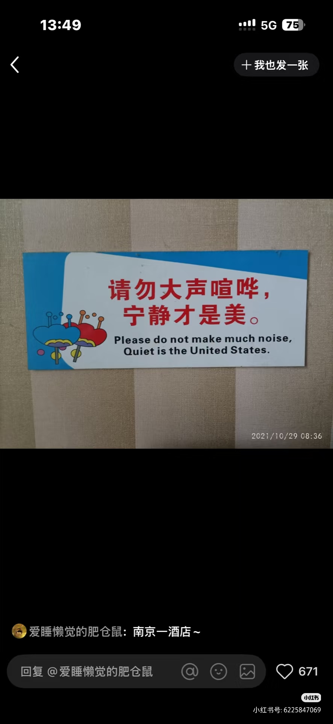
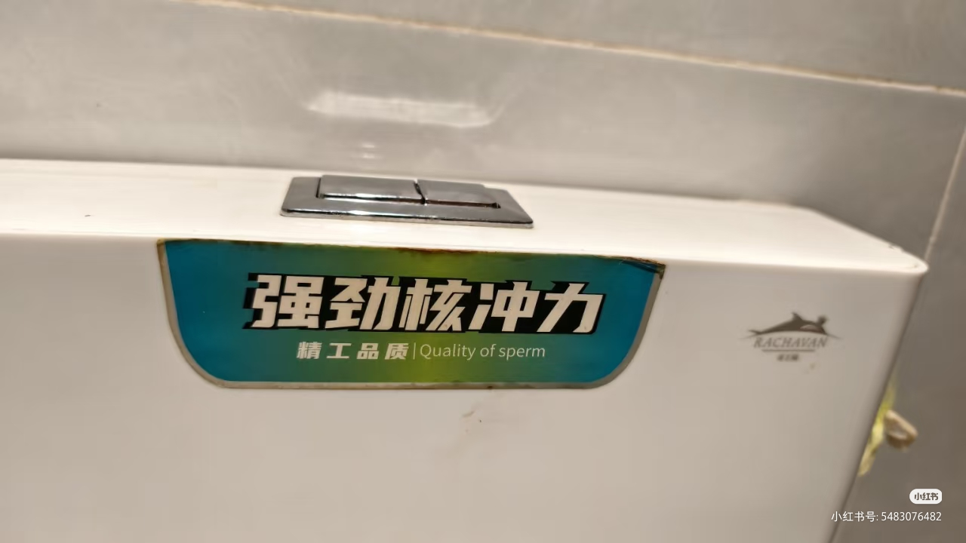

Slide 5
7. channel航道；海峡；频道；贯注（一词多义）
He channels his aggression into sport.
比较独特的一词多义
shrink心理医生、精神医生（spin doctor公关高手)
family dynamics家庭互动关系
score a great deal抢到好物
keep up the fiction维持假象
a prescription for success成功秘诀
form a protective ring形成防护圈
leave no thread of evidence behind蛛丝马迹
emotion cloud his judgement情绪干扰判断
the footprint of the house房屋占地面积
key in the password输入密码
champion a cause支持一项事业
walk with deliberate steps从容不迫地走

Slide 6
(必3U1课文2)
chair a meeting
deposit valuables
exercise rights
fan an emotion
have a fast
(选必1U1单词2)
the sheep pen.
a curious phenemenon
a twist in the story
in a constant squeeze
the patient in the theater
a spell of boredom
adopt a road

Slide 7
(选必1U5课文)
check the balance
at short notice
dust the strawberries with sugar
a purple solution
some frames of a movie
high resolution TV
coin a new term
(选必2U1课文)
an air of tension
in dramatic fashion
try the case
fetch a lot of money
a work of scholarship

Slide 8
(选必2U2课文1)
read feeds
place an emergency call
celebrate their heroic action
spread throws over the sofa
relate stories to children
(选必2U3课文)
have a different take / stand
field many complaints every day
have a fierce row

Slide 9
(选必2U4单词3)
exhaust废气
adopt采用（某种举止、说话方式)
adopt an accent, adopt an air of confidence
resource机敏
station安置、驻扎
source从...获取
appreciate升值
let出租
industry勤奋
rocket迅速移动
project突出、伸出
slip小错误；纸条

Slide 10
8. bond 纽带；形成关系
bond / bind / bend / band
forge a bond (读续25分短语)
Had Mr. Smith not nipped the conflict between them in the bud, there would have been a withered instead of forged bond.
be in a bind处于困境
But for the mutual trust that bound them, they would have been stuck in a bind.
bend down弯腰
He bent down to ruffle the boy’s hair affectionately, a testament to their closer bond.

Slide 11
9. laptop笔记本电脑（放在大腿上面的)
bottleneck瓶颈（My English has hit a bottleneck / plateau.)
platform平台
flagship store
high-end products
assembly line
streamline
semiconductor
superconductor
supply chain
hotspot
mosaic
backfire

Slide 12
10. coverage新闻报道；覆盖
翻译：
Yesterday's press conference featured breathless coverage as the anchor delivered a rapid-fire account to journalists.
(2024届深圳一模：鹦鹉被偷了还是退休了？）
To my surprise, Ashley insisted on reporting the “Deerfield Stole Perry” story. Ashley's eyes gleamed with ambition as she defended the fabricated story. "This will be our most explosive coverage yet," she declared. The newsroom's silence was deafening, thick with ethical tension. That night, I scrutinized the photo and ultimately uncovered “Perry” was a trophy's curved handle. When I presented the evidence at dawn, Ashley's resolve wavered. "The truth matters more than clicks," I urged. Grudgingly, she assented to my way of coverage.
On Thursday, the paper came out with the headline “Bye-Bye, Perry” on the front page. Students lingered at bulletin boards, tracing their fingers over photos of Perry, their laughter mingling with tears. As you could easily imagine, our circulation numbers blossomed like spring flowers－nourished not by the fertilizer of sensationalism, but by the sunlight of authenticity. As dusk gilded Perry's vacant perch, the realization crystallized: No viral story could ever tip the scales of journalism when integrity stands on the other side.

Slide 13
The art room's windows trembled as construction equipment roared outside. Our beloved century-old oak tree, its trunk bearing generations of carved memories, faced forthcoming 1 . Mia, our yearbook photographer, studied the architect's 2 drawings of the planned parking structure, her fingers tightening around her camera. "There has to be an alternative," she 3 , her voice could barely be heard over the noise.
During lunch break, I discovered Mia 4 construction plans with the head groundskeeper. "The root system is compromising underground utilities," Mr. Delgado explained. Mia's shutter clicked methodically, documenting each 5 with professional precision.
When the school paper arrived next morning, Mia's 6 dominated the front page: intimate portraits of the tree's weathered bark, students laughing beneath its 7 canopy, and close-ups of historical carvings. The 8 ignited campus-wide concern: By midday, colorful ribbons decorated the ancient trunk like jewelry, while a student-organized petition (请愿书) 9 over 600 signatures.
1. A. removal B. restoration C. decoration D. transplantation
2. A. vague B. technical C. abstract D. faded
3. A. declared B. murmured C. protested D. joked
4. A. reviewing B. altering C. deserting D. concealing
5. A. flaw B. moment C. measurement D. angle
6. A. editorial B. coverage C. advertisement D. fiction
7. A. sprawling B. bare C. artificial D. flowering
8. A. rumor B. feature C. debate D. policy
9. A. collected B. rejected C. lost D. ignored

Slide 14
11. applaud鼓掌；称赞
applause鼓掌
By the early 20th century, the tomato 56 (break) free of its role as a Western-only food and entered other Chinese restaurants and homes, leading to its eventual 57 (marry) with scrambled eggs in the 1940s.
Turn to Chinese entertainment and tomato-and-egg is used as a standard 58 which celebrities' readiness for committed relationships is evaluated. It’s almost a rite of passage at this point: famous actors like Jin Dong, who passed his tomato-and-egg test to enthusiastic applause, and Huang Xiaoming, who bombed 59 (he) on an episode of Chinese Restaurant to much criticism online, are expected to be able to whip up a passable version of tomato-and-egg at a moment’s notice.
在中国娱乐圈，番茄炒蛋已成为衡量明星是否适合婚姻生活的标杆。这道家常菜俨然成了明星们的"成人礼"：当红演员靳东曾完美通过番茄炒蛋测试，赢得满堂喝彩；而黄晓明在《中餐厅》里搞砸这道菜时，立刻引发网络群嘲。人们默认明星必须能随时端出一盘像样的番茄炒蛋。

Slide 15
12. a manned capsule=a crewed capsule载人舱
manned可理解为a.,也可理解为被动语态
类似：canned apples, steamed fish, marketed strategy, engineered vehicles, dried tea, the clocked car (被改过里程数的汽车), the measured bridge, a penned poem, a frequented bar, taxed income ...

Slide 16
13. opponent反对者；竞争者
proponent支持者
关于纸书和电子书的争论
Proponents of prints argue that prints’ superiority lies in delivering a multi-sensory reading experience. The crisp texture of pages beneath fingertips, the fragrance of ink, and the rustle of turning pages create a tactile intimacy no e-readers can replicate. Print media isn’t obsolete; it’s an antidote to digital fatigue. Paper books will evolve rather than vanish, transforming from mass commodities to cherished artifacts, like fountain pens or mechanical watches.

Slide 17
14. log / leg / lag
log in / on to the Internet登录网络
the final leg of the tournament锦标赛的最后一个赛段
jet lag, lag behind

Slide 18
15. arrest逮捕；阻止；抑制；吸引
The aroma of cooked meat drifted out of the kitchen and arrested my footsteps, so I just stopped in my tracks and inhaled crazily.
The aroma of sizzling meat wafting from the kitchen froze me mid-step. I stood motionless, drinking in the scent with deep, hungry breaths.
The scent of searing meat spilled from the kitchen, rooting me to the spot. I inhaled, slow and deliberate, as if the very air could be devoured.

