Slide 1
选必4U2单词3

Slide 2
16. trunk树干；象鼻；后备箱
(2022新高考1)
Huddled on the ground with his back pressed to the trunk, David radiated frustration. Tom crouched beside him and ventured a conversation, “What’s up, pal?” David then looked up and their gaze locked. “I don’t want to attend the running race,” he said, tearful, resignation and diffidence palpable in his tone.
(2025.01浙江)
Tom refrained from confronting the burglar head-on after sizing up the situation. His father’s words echoed in his mind: The lion’s courage lies not in its claws, but in choosing when to use them. // Courage is strategy in action, not impulse in motion. So he took a step back. Seeing his cowardice, the burglar smirked and sneaked out the window with a big trunk.

Slide 3
17. frequency频率
同类t-cy
accuracy, delicacy, fluency, privacy, consistency, efficiency, intimacy
frequent经常被用作动词（vt.)
The storage of valuables in the run-down house led to it (frequent) by thieves and targeted by local police.
The river bank dates from 1860 and (frequent) ever since.

Slide 4
18. hatch孵化；酝酿
(比赛类读后续写)
Though the plan to craft a poster was hastily hatched, they miraculously finalized it before the deadline, breathing life into it. For its originality, the judges unanimously crowned them the undisputed winner.
(涉及到阅读、读书类话题)
The true brilliance of soul-stirring novels lies in their power to hatch ideas within us, first captivating the heart, then educating the mind. Reading is the compass that helps us navigate through the wilderness of ignorance.

Slide 5
19. capacity能力；容量（一顶帽子盖住一座城市）
Please indicate in what capacity you have known the applicant.（猜测词义）
capacity职位、职责
请说明您以何种身份认识申请人。
(听下面一段独白，回答第18-20三个小题）
提示：With brains the size of sesame seeds, honeybees have to work together in different capacities to maintain a healthy nest.
18. How do bees know their functions?
A. It is carved in the stone.
B. It is ruled by humans.
C. It is determined by drones.
19. How many drones does a queen bee mate with?
A. 100. B. 20. C. 4.
20. What do we know about worker bees?
A. They are the most dangerous.
B. They are short-lived creatures.
C. They carry out a thankful job.

Slide 6
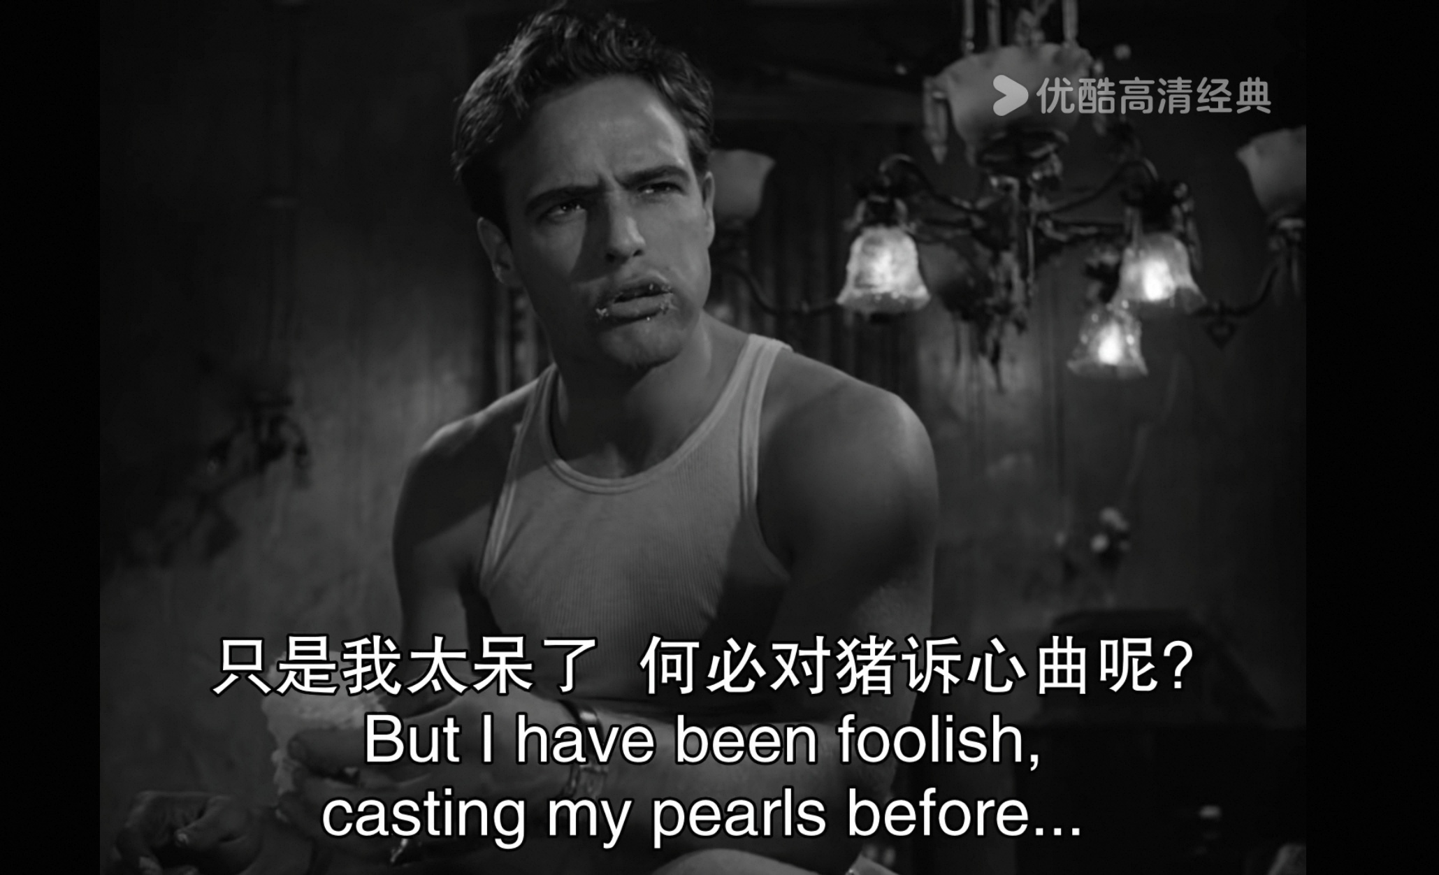
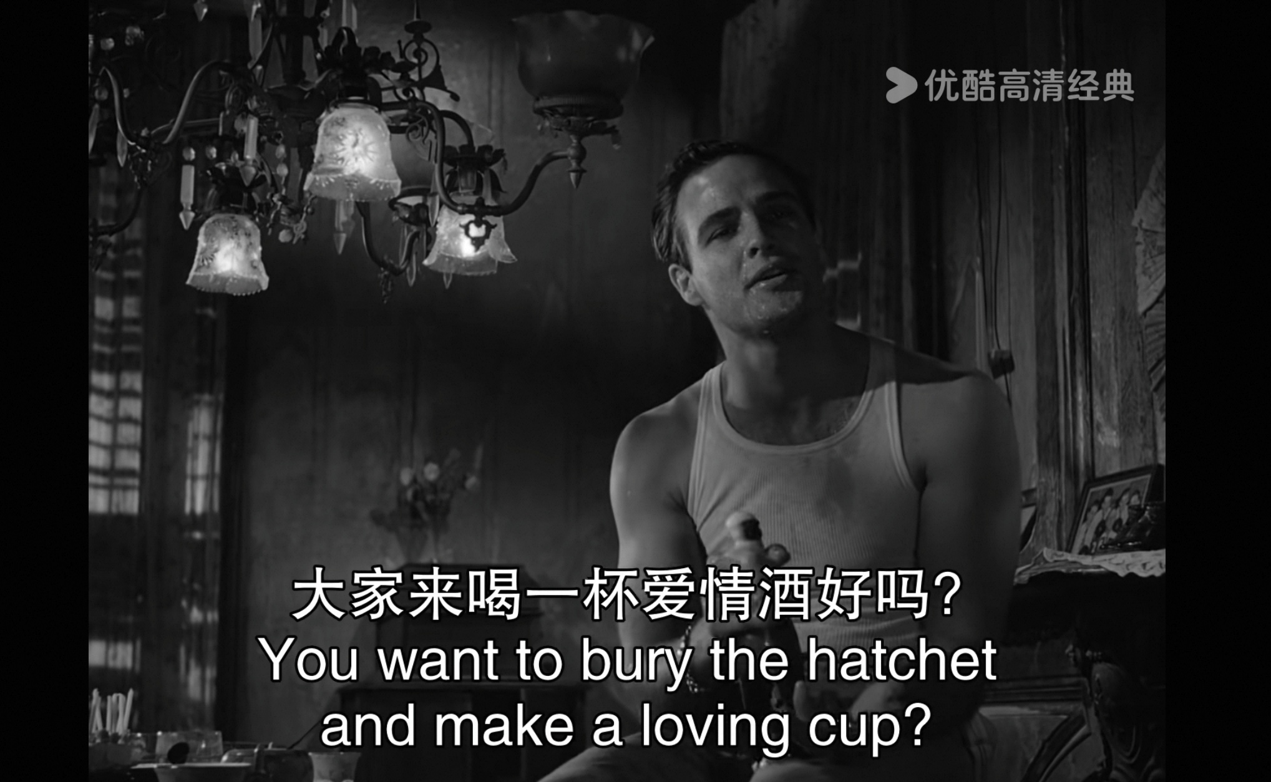
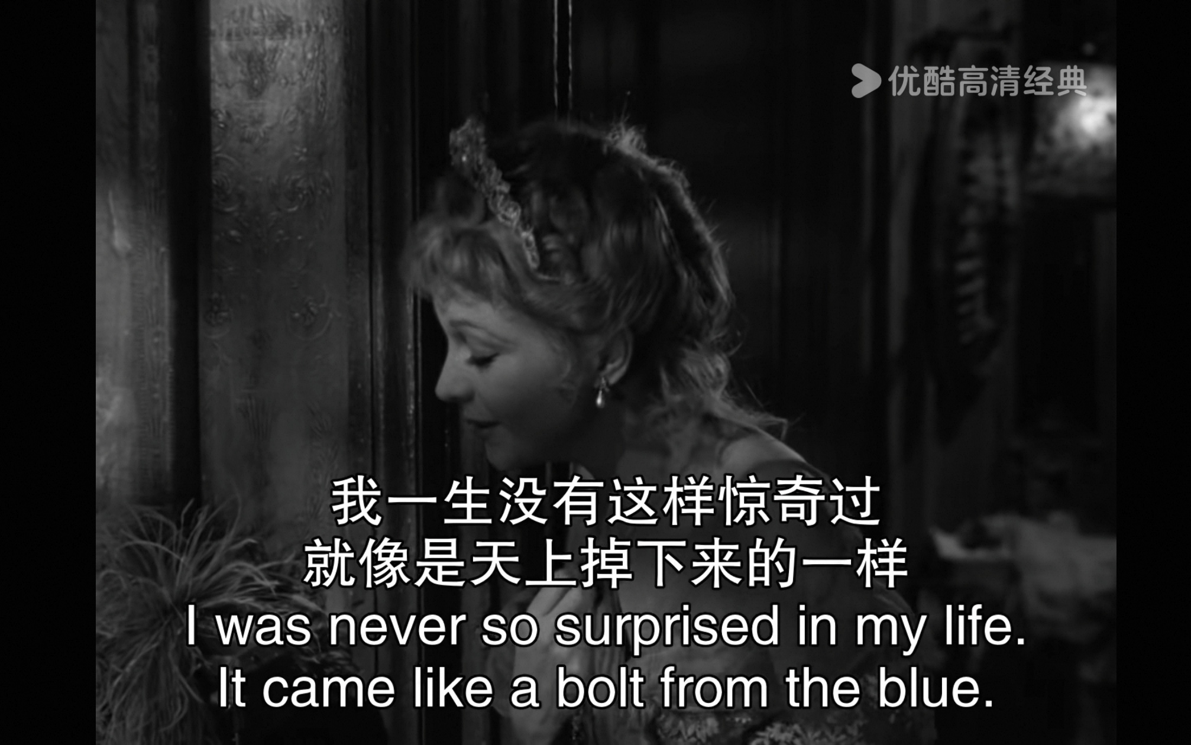
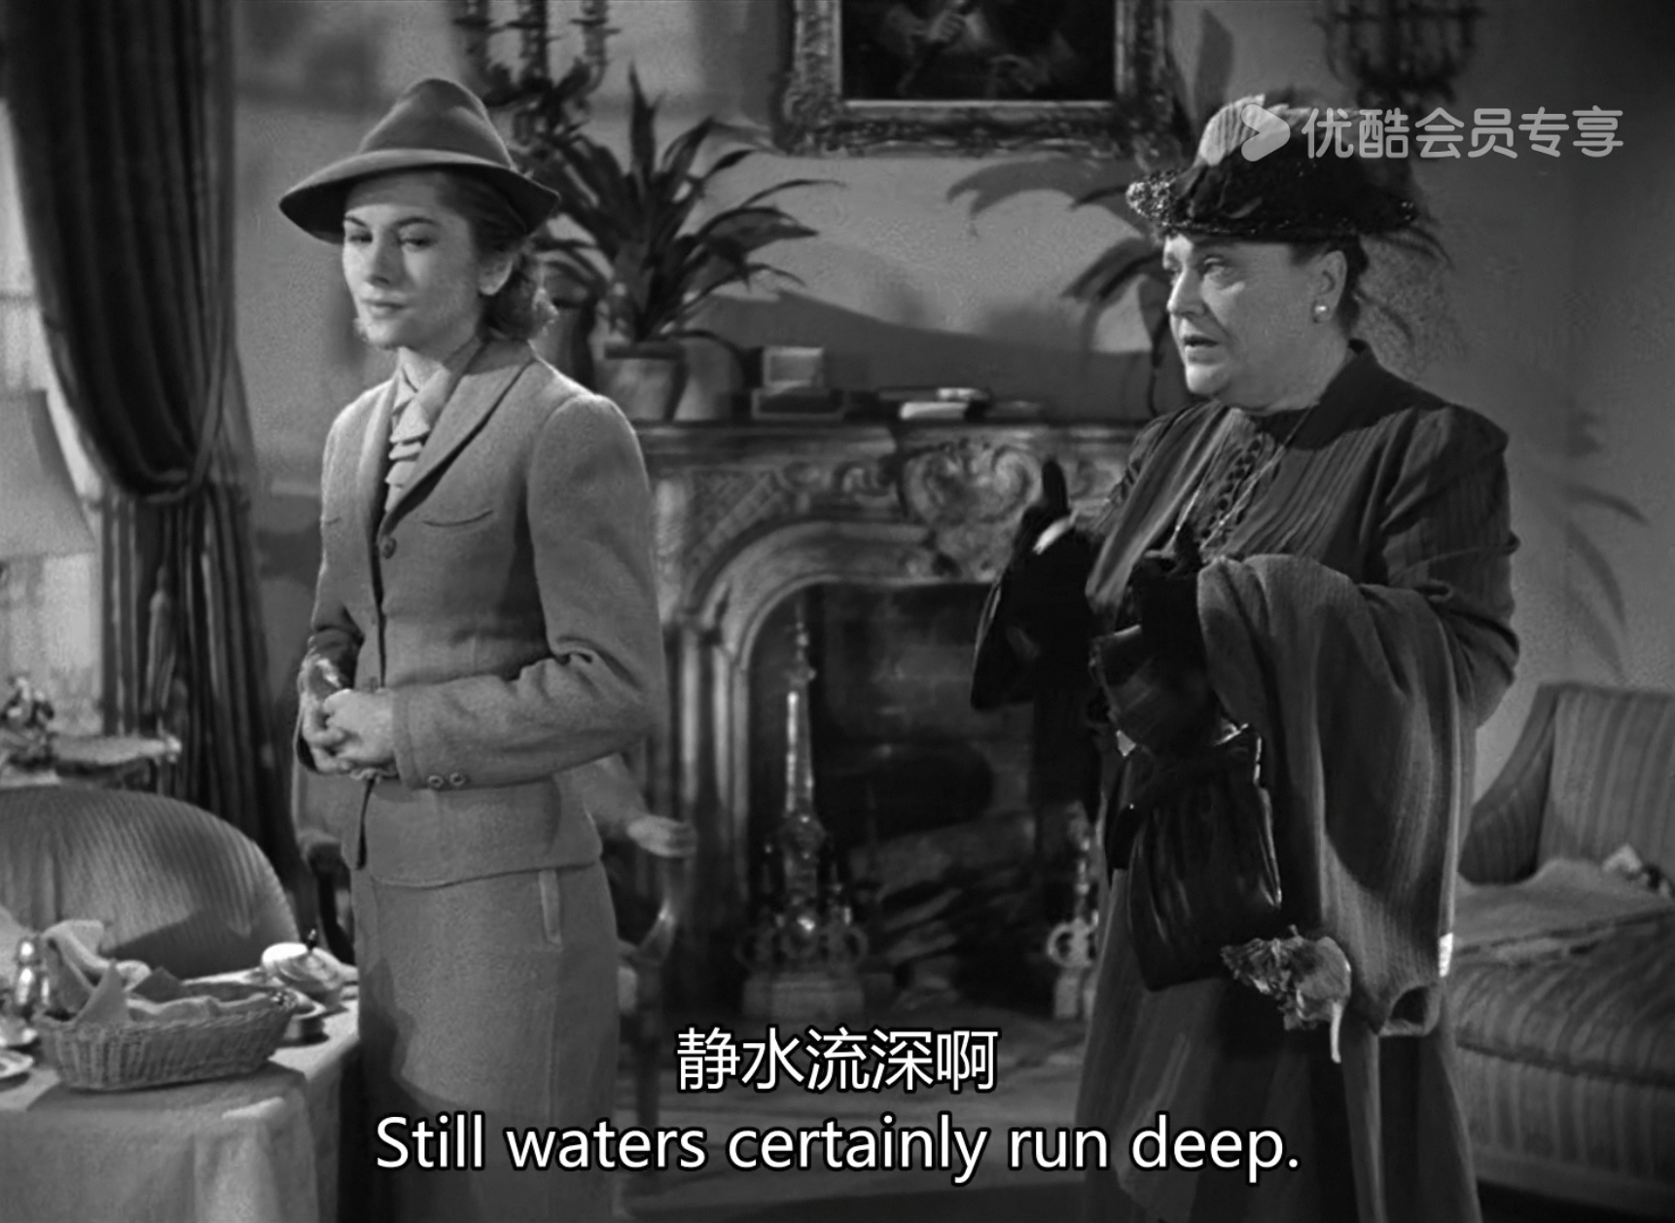
20. fence栅栏、围栏
(听力短语) sit on the fence犹豫不决；骑墙（fence-sitter)；mend fences修复关系

Slide 7
21. grand宏大的
grand的名词：grandness (较少使用）/ grandeur
（读续好句)
☺The photo derailed my train of thought when my eyes lingered on the photo. I was transported back to our time in the grand library when every page turned is a pleasure discovered.
☺The grandeur of courage lies not in impulse in motion, but in strategy in action.
☺Life is not measured by the number of breaths we take, but by the grand moments that take our breath away.
☺The grandest dreams begin with the smallest steps, yet it is courage that turns the whisper of ambition into the roar of triumph.
☺A grand vision without action is merely a dream.

