Slide 1
选必4 U2单词1

Slide 2
1. located a. 坐落在
坐落在闹市的书店售卖插图精美的书籍，雅俗共赏，老少皆宜。
Located in the heart of the downtown area, this bookstore sells beautifully illustrated books that cater to diverse readers, from children to adults.
Nestled in the bustling city center, the bookstore offers exquisitely illustrated volumes that appeal to both refined and popular tastes, captivating readers of all ages.

Slide 3
(原创完形)
Lena stood on a weather-beaten stone, located between two ancient pines. She adjusted her camera, its leather belt 41 smooth from years of journeys. She had climbed five continents chasing perfect 42 , yet always found the most extraordinary moments came when she 43 chasing them. Below, a fog bank 44 inland, swallowing coastal cliffs whole. She hesitated, then set aside her tripod (三脚架).
An old fisherman appeared beside her, his face lined with salt and sun. “You see how the water changes color?” He pointed where currents 45 , creating liquid marble patterns. “That’s the sea breathing. No machine can steal its soul.” His cracked hands 46 an imaginary viewfinder. “Real pictures live here,” he 47 his temple, “and here,” his chest.
41. A. broken B. worn C. stuck D. softened
42. A. dreams B. world C. shots D. equipment
43. A. ceased B. continued C. envisioned D. tolerated
44. A. bounced B. collapsed C. rolled D. faded
45. A. danced B. shone C. shook D. collided
46. A. took B. tore C. measured D. framed
47. A. struck B. tapped C. rubbed D. squeezed

Slide 4
(seriouseats)
We stopped at a stand selling rou jia mo, which was located in a small alley. While the dough (面团)-man made the mo, the woman up front 1 (fish) out large chunks of pork from stewing liquid. I’d seen the woman in front of me ask for a particularly fatty bit of belly, and after some 2 (emphasis) pointing, I managed to score the same. There is an awful lot going on in there, though the dominant flavors are sweet and fatty, 3 just a touch of heat and freshness from the cilantro (香菜) and chilis. But it was the bread that stole 4 thunder, which was nicely crisp on the outside and 5 (stretch) on the interior.

Slide 5
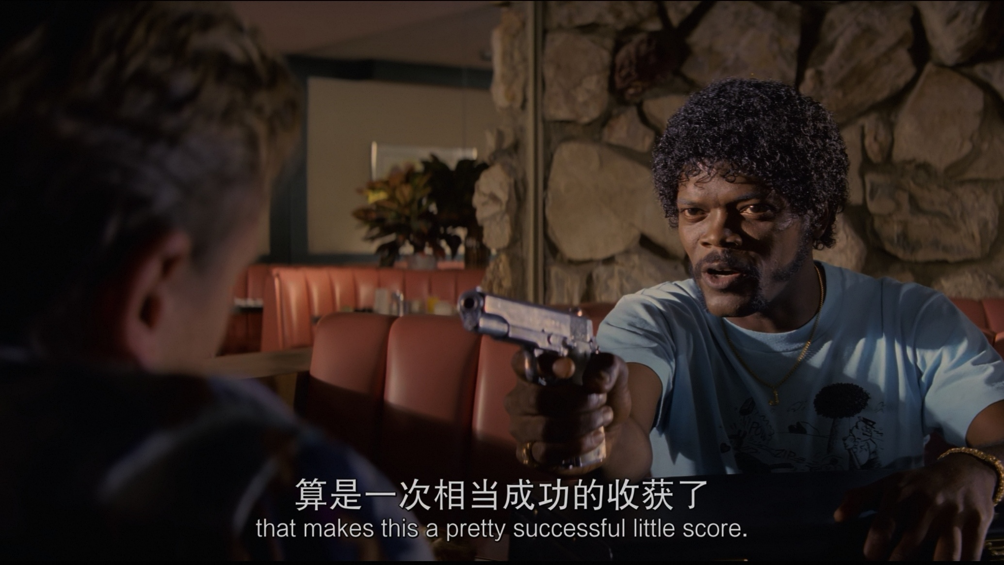

Slide 6
2. joint关节；路边摊；联合的
Like seeds breaking through concrete, their joint efforts blossomed into extraordinary success.
Their joint efforts paid off. Upon its debut, a chorus of praise came pouring in.

Slide 7
3. herb药草、草本
herbal medicine草药
medicinal herb药茶（注意：不是medical herb)
注意以下区分：
moment-momentous重大的, momentary暂时的
ceremony-
ceremonial 仪式的（客观描述）
ceremonious 过分讲究仪式的（修饰人）
及以下特殊形容词：
factual, habitual, textual, mechanical

Slide 8
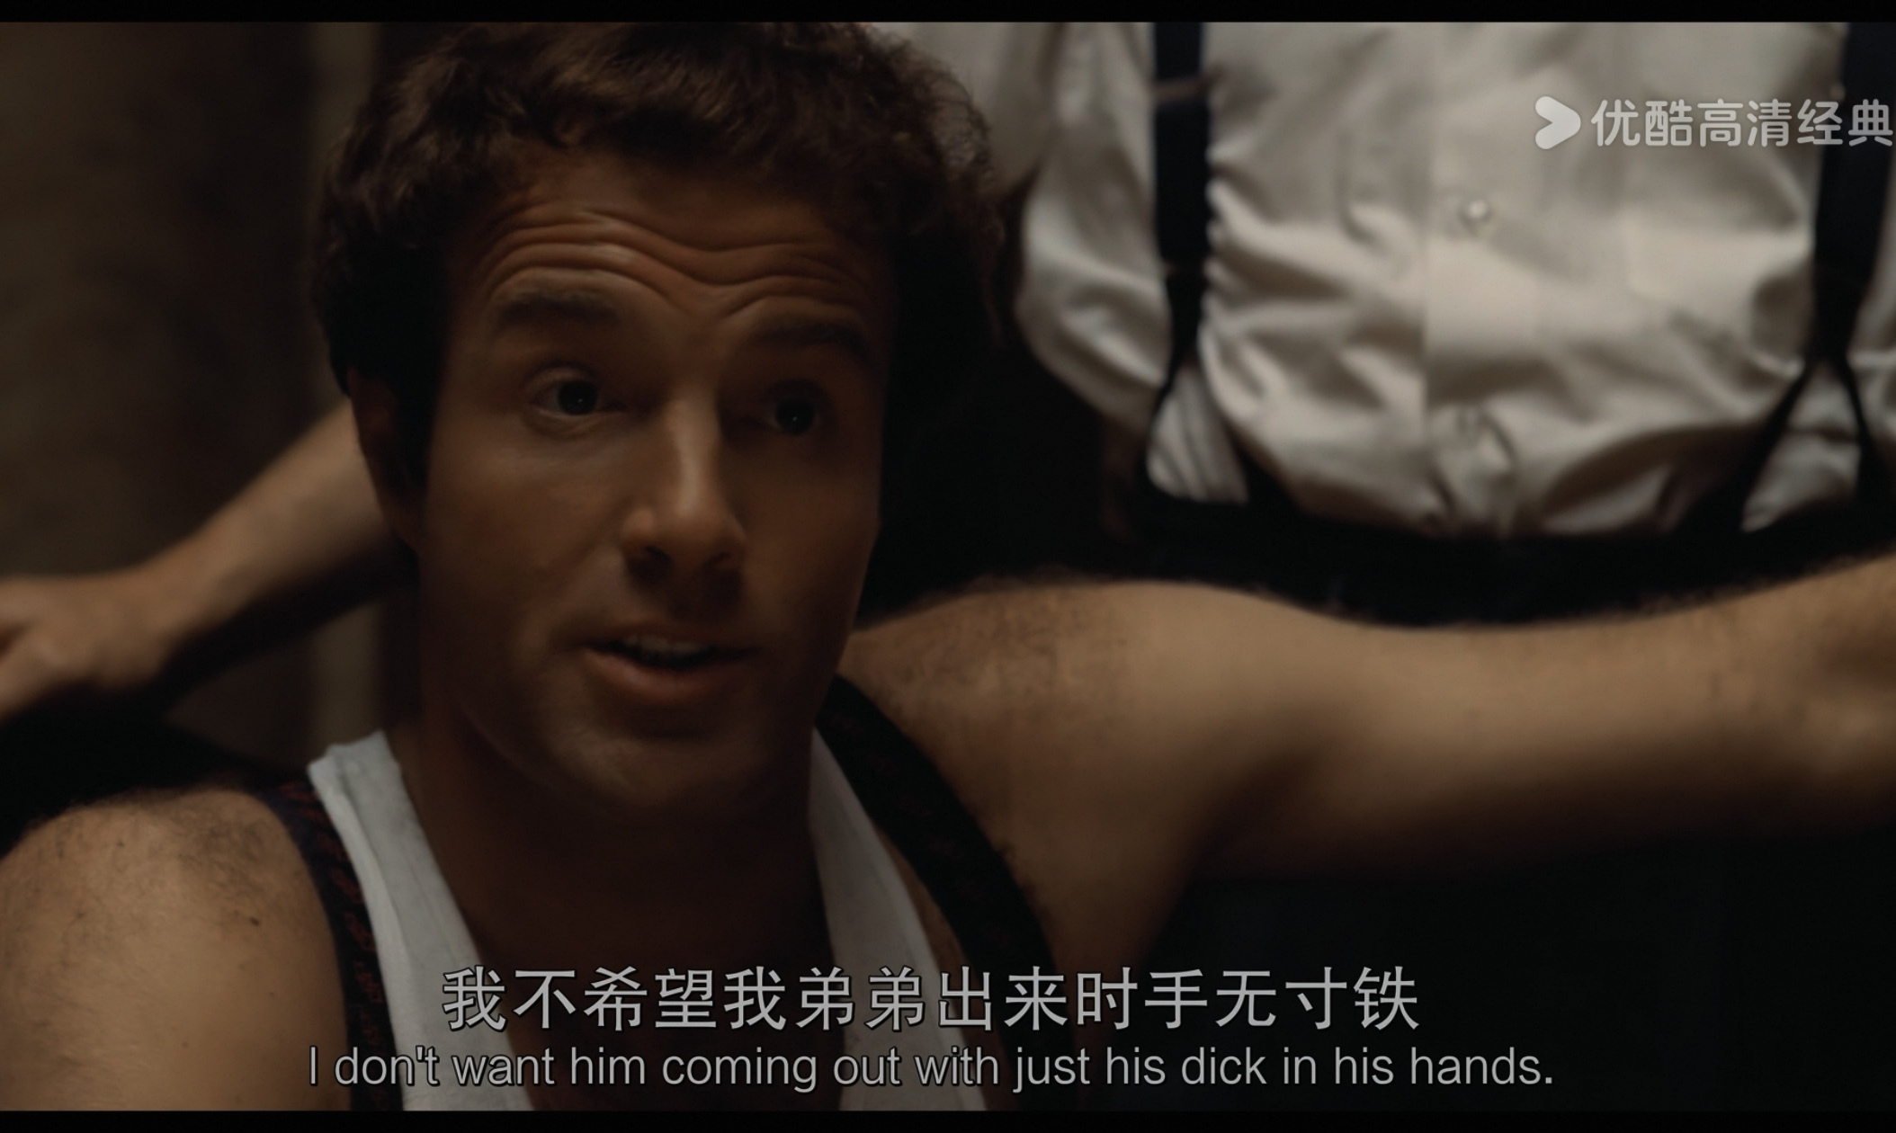
4. straightforward坦率的、简单的
听力中可能会出现的“直截了当”
cut to the chase // never beat about the bush // call a spade a spade

Slide 9
straightforward correlation直接的关系
用于与手机这一话题有关的作文
There is a straightforward correlation between prolonged screen time and diminished attention span.If left unregulated, the cellphones may become a Pandora’s box of distractions. Hence, moderate usage is not just preferable but imperative.
或There is a straightforward correlation between overusing cellphones and alienating relationships. Proponents cling to the belief that social media promotes superficial interaction instead of rewarding connection.

Slide 10
（新题型：名言类应用文）
苏格拉底（Socrates）说过：An unexamined life is not worth living.请结合自己的经历谈一下对这句话的理解。
Socrates’ wisdom transcends time because it highlights the imperative of introspection. It resonates with me deeply as I reflect on my battle with digital distraction during ninth grade.
Overwhelmed by grueling academic pressure, I initially turned to social media for harmless breaks. Yet soon, what began as five-minute scrolls turned into hours of compulsive browsing.My textbooks gathered dust while my screen time skyrocketed to 8 hours daily. I became a passive consumer of content, my attention span fractured into fragments. The turning point came when I encountered Socrates’ words during a literature class. The phrase pierced through my digital haze like a scalpel. I tried different ways and luckily, the craving for internet that had long ruled my heart began to loosen its grip.
An unexamined life is not worth living. Like a lighthouse piercing fog, Socrates’ words are a timely wake-up call for me to break free from the scroll captivity. (dicksuck评分8）

Slide 11
5. entitle给...命名；使享有权利
Article 12 entitles the buyer to a full refund if the product is defective.
The novel entitled Once Upon a Time in America masterfully depicts the interplay between betrayal and loyalty.

Slide 12
6. getaway适合度假的地方
(读续好句)
I bid farewell to my idleness and decadence, refusing to let anyone belittle my dreams. The library became my getaway, whose shelves, lined with books, held the crystallized wisdom of humanity, transcending time and space. When melancholy crept in, these books transformed into luminous beacons, their words dissolving my solitude like dawn dispelling night.
动词短语变来的合成名词：
comeback-stage (make) a comeback
make-up性格
leftovers剩饭
eye-opener使人大开眼界的经历
icebreaker暖场话
trade-off权衡
While we are spoilt for choice in modern food options, prioritizing convenience over nutrition remains a dangerous trade-off. Rather than passively accepting the status quo, we should pull the plug on the normalization of daily fast-food consumption. By treating it as an emergency fallback rather than a staple diet, we can reclaim control over our health and eating habits.

