Slide 1
专题二 语法

Slide 2
I. 并列连词（and, or, but / yet)
注意：yet既可用作副词，也可以用作连词。and yet相当于yet或but。
✦Though the series of steps is the only unnatural thing on your way up the Huangshan Mountain, still it highlights the whole adventure offers a place where you can sit down to rest your aching legs.
✦My bike was old and shaky did the job.
✦It is a distinct visual contrast that shouldn't work, somehow these two very different worlds make a good combination.
✦Wealthy people kept their collection at home until it got too big until they died, and then it was given to a museum.
✦We’ll be working rain shine.

Slide 3
II. 介词专项
真题探微
(2022新1) Giant pandas also serve an umbrella species, bringing protection to a host of plants and animals in the southwestern and northwestern parts of China.
(2023新1) You will find Xiao long bao prepared differently there, more dumpling and less soup, and the wrappers are pressed hand rather than rolled.
(2024新1) The Glasshouse stands a great achievement in contemporary design, to house the plants of the southwestern part of China.
(2025新1) A decent winner always tries to beat the opponent no more than one or two points as a gesture of respect for the other side.

Slide 4
under
under discussion / repair / construction / investigation / debate / guarantee / treatment
under pressure / stress
under the impression that ...
under one roof / under the same roof / under one’s belt / under one’s nose / under the weather
in
in the 1980s, in one’s thirties, in full bloom / blossom, in a row, in detail, in full swing, in essence, in line with, in one’s favor, in decline (on the decline), in progress, in one’s own right, in the wake of
(真题) Ecotourism has its origin with the environmental movement of the 1970s. It was not widely accepted as a travel concept 64 the late 1980s. During that time, increasing environmental awareness made it desirable.

Slide 5
on
on watch (keep a close watch (eye) on...)
on (the) air
on balance
on a diet
on a regular / first-name basis
on account of
on behalf of
on board
on ...occasion
live on / feed on (Drinks are on sb.)
be hard on
on the dot
on the blink
on the same page (wavelength)
model ... on / after ...

Slide 6
at
at high speed / price
at one’s disposal
have ... at one’s fingertips
at the mercy of
at heart
at regular intervals
at length
at large
at a loss
at a time (at one time)
jump at the chance
at a discount
at a loose end
at a standstill
at all costs / expenses
at issue
at large
at length
at liberty
at one’s request
at risk / stake
at odds with
at one’s convenience
at the entrance
at one’s peak
at will / random
at (one’s) leisure

Slide 7
to
be accessible to
stay true to
bear witness to
credit ... to ...
from ... to ...
be grateful to sb. for sth.
attach / tie ... to ...
reduce ... to ...
to (伴随：He left the stage to prolonged applause./ He woke to the sound of torrential rain.)
to one’s taste
be entitled to
act as a prelude to ...

Slide 8
by
by chance / accident
by design
by virtue of
by the dozen / the hour / the day / the meter / the handful
The girl was losing her hair by the handful due to the illness.
by weight / size

Slide 9
with
考试几乎围绕with复合结构展开：
But for all its ancient wonders, Beijing is also a place that fully embraces the fast-paced development of modern life, towering 21st century architectural wonders standing alongside the cultural relics of the past.
With the cultural importance of these murals (highlight), the exhibition symbolized the growing interest in China’s rich cultural and religious heritage on the global stage.

Slide 10
for
a demand / need / desire / longing / thirst / preference / enthusiasm for
a vehicle for (The play is an ideal vehicle for her talents.)
a reason for
account for
provide for
answer for
settle for
make for
send for

Slide 11
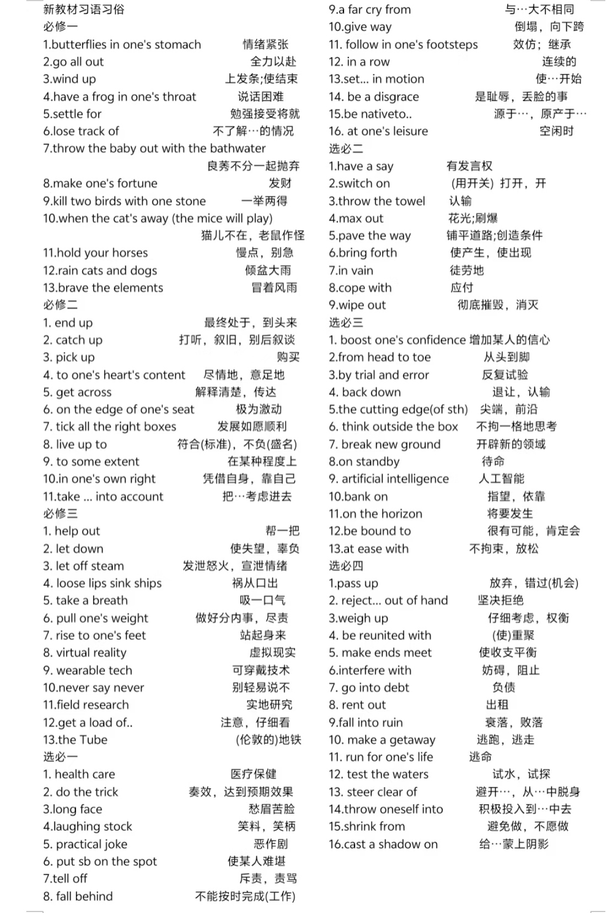
左边的短语来自外研版教材

Slide 12
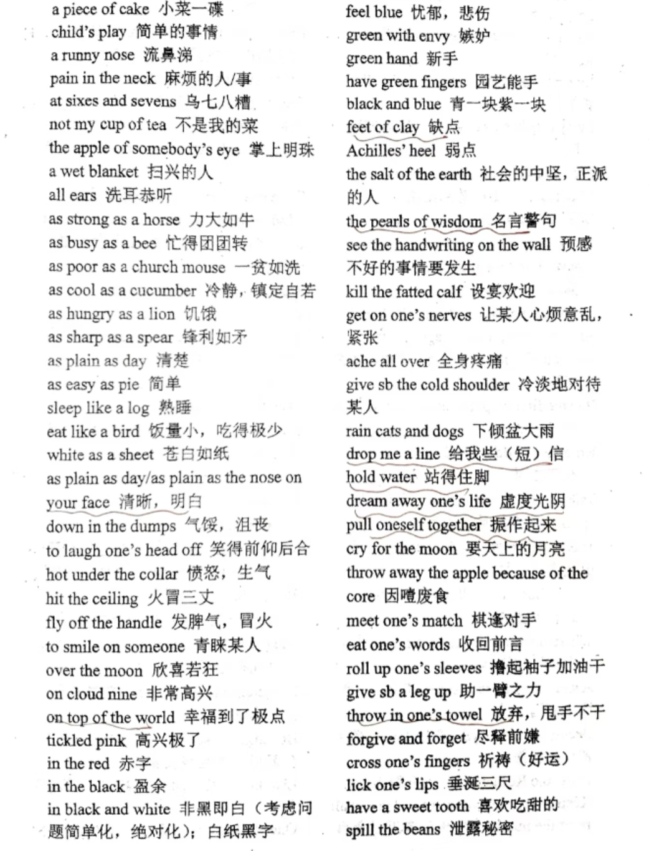
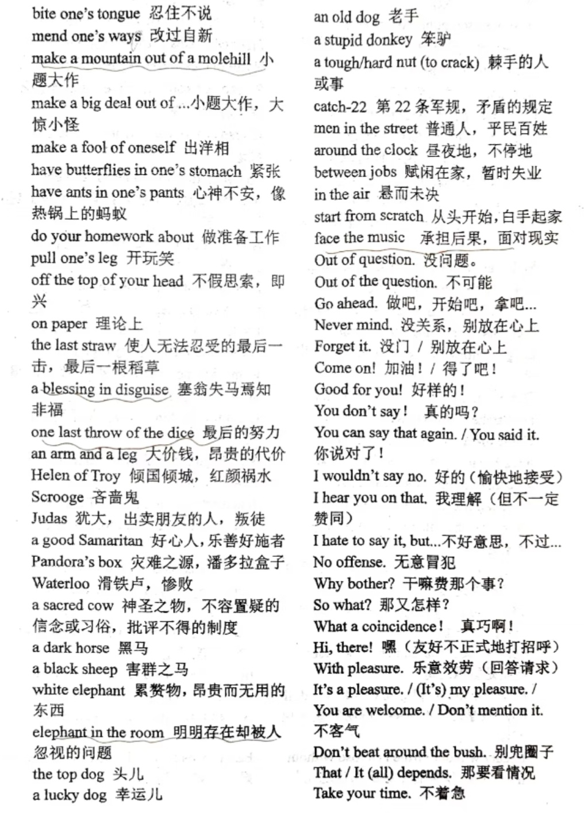

Slide 13
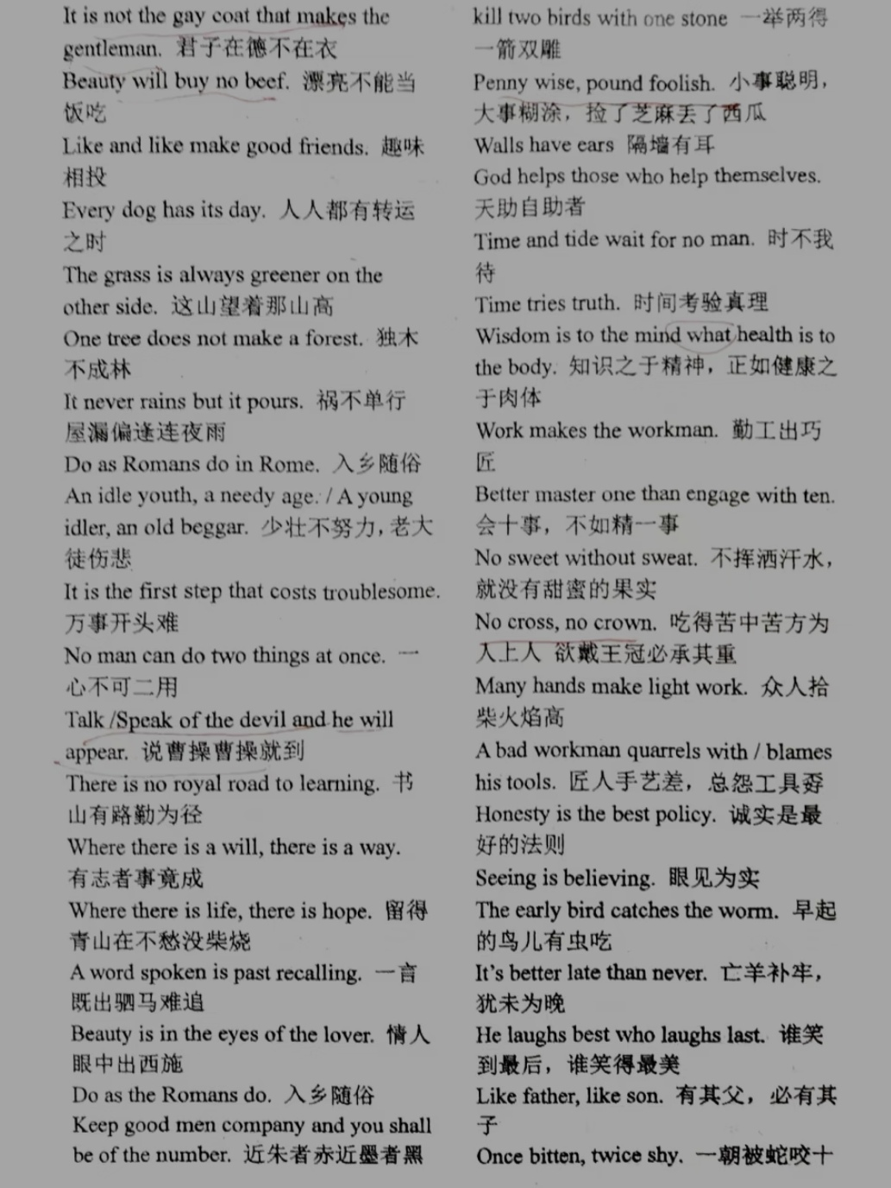
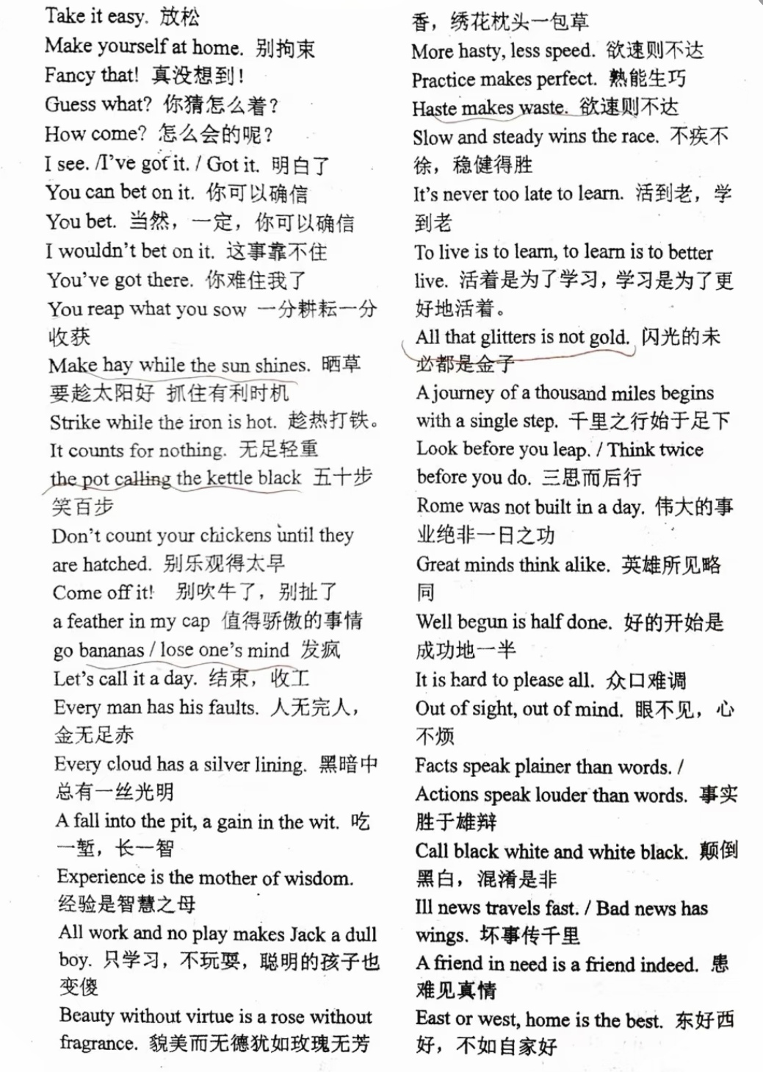

Slide 14
III. 非谓语
动词不定式的复合结构做主语：
To be frank, it is a great relief for us to have the task fulfilled in so short a time.
=For us to have the task fulfilled ... is a great relief.
For them to move to Elkhead, Colo. to instruct the children whose shoes were held together with string was a surprise.
For the goods to be packed in strong cases is necessary.
动词不定式的复合结构做宾语：
I meant (for) you to eat, son.
He was anxious for his younger brother to meet you.
动词不定式的复合结构做表语：
A solution would be for shops to open at noon and close at 9 p.m.
动词不定式的复合结构做状语：
For a vote to be valid, the representative must be present and vote in person.

Slide 15
动名词复合结构：
名词或代词+doing / being done做主语或宾语
做主语：名词’s，物主代词（有生命）；原形（无生命）
作宾语：名词’s或名词，物主代词或宾格；原形（无生命）
At a distance, the noise of desks (open) and closed could be heard.

Slide 16
形式主语it的句型：
It is no good / use doing sth. (There is no point doing...)
It pays to do sth.
It takes sb. / sth. to do sth.
经典题目：
Few students understand what it feels like (rank) the first among all the students.

Slide 17
接不定式的动词：
afford, aim, claim, choose, decline, demand, desire, determine, pretend, resolve, threaten, hesitate, long, tend ...
接动名词的动词：
acknowledge, admit, advocate, avoid, consider, delay, postpone, deny, escape, evade, fancy, imagine, envision, include, understand, involve, resist, risk, suggest ...
接to do和doing意思不同：
propose doing建议
propose to do或doing打算
cease doing暂停
cease to do彻底结束
chance doing冒险
chance to do碰巧
mean doing意味着
mean to do打算
regret doing后悔做了
regret to do遗憾地去做

Slide 18
to do和doing做状语的区别：
to do目的（句首，句中)。置于句中，无逗号。
意外的结果，也可以写成only to do，前面多加逗号。
doing自然而然的结果，前面必须加逗号。
He scurried to answer the door, only to find it was not the delivery man but a stranger. His heart sank and his face fell. "Are you Mr. Rolins?" the stranger ventured, rubbing his hands.
I articulated my full name and explained its meaning in detail, successfully arousing the deep interest of my classmates, who was glued to me, hands shooting up high. "I want a Chinese name," one voice exclaimed.

Slide 19
非谓语做补语：
find / catch发现（多为意外）
let / have / get / leave / set / send
Every step he took sent the pain shooting up his leg.
Peter had his pocket on his way home.
A. picked B. robbed C. stolen D. grasped
The little boy his granny had (assemble) the computer within one hour completed the task in advance.

Slide 20
能力提升
☃ 1 (dye) cloth is both body-damaging and time-consuming, which is gradually being done away with.
☃The great lengths Chinese government has gone to 2 (bridge) the gap between rich and poor deserve respecting.
☃They didn’t complete the task according to the plan. 3 (say) that, I didn’t think I could.
☃The square dance 4 (mean) to strengthen practitioners’ bodies has exploded in popularity recently.
☃The old man likes spending most of the day 5 (seat) in his armchair watching others playing chess.
☃He hopes to promote the development of traditional culture and contribute to our national art 6 (understand) by children, who will therefore develop genuine cultural confidence.
☃If you’ve never experienced the “sunshine scent” from a sheet or shirt 7 (leave) to sun for a day, well, you’re missing out on one of life’s wonders.
☃These educational efforts were so successful that boiling water is a 8 (give) almost anywhere you can find a water dispenser in China, as the idea that hot water’s the healthy option has become internalized over generations of Chinese.

Slide 21
IV. 时态
一般过去时态：
the other day, just now, last year, at the end of +过去时间 ...
现在完成时态：
since, up to now, thus far, so far, in the last / past +时间
过去完成时态：
by the end of +过去时间，by +过去时间，by the time +从句（一般过去时态）

Slide 22
I arrived in Yangshuo. A few hours , I’d been in Hong Kong, with its choking smog.
Li Qingzhao’s residence in downtown Lixia District, Jinan, (prove) more than appealing to visitors since it opened to the public.
特殊：
test positive / test negative
动词 (wash, write, read, wear等)+副词
weigh / measure
They admired Tiangong Space Station, which, (weigh) only 60 tons, was wholly designed by us.
consist of / date from / belong to
The repaired tower standing there (date) from the Tang Dynasty.
read / say
There was a note pinned on the door (read): Sorry to miss you. I will call later.

Slide 23
V. 定语从句
1. 只用that, 不用which;
2. 只用which, 不用that;
3. 只用as, 不用which；
4. where一定是高频考点；
5. 两个特殊句型需要注意：
介词+which+to do
介词+which+谓语+主语

Slide 24
能力提升
♞My best friend Betsy’s father was a manager at Hough Bakeries, 1 , at Easter time, made little bunny cakes for all its stores throughout Cleveland.
♞The experts found an efficient solution to the infection last month, by 2 time it had claimed more than 3, 000 lives.
♞The villagers underwent a severe flood, from 3 effect they are still suffering.
♞The severe flood and the damage 4 caused gave the villagers a hard time.
♞A typical skydiving trip costs around $5, 000, many of them ends in the adventurer being broke. Those that don’t 5 (burden) with debt.
♞Karagoz is a dramatic form of storytelling 6 shadows are projected onto a white screen, with a multitasking performer singing the tunes and words of the story and the lead puppeteer 7 (control) the movement of the puppets.
♞The exhibition provided a platform, 8 China, France and international communities had a dialogue on cultural heritage conservation.

Slide 25
VI. 倒装句
全倒装
1. 副词句首（最常见：in, out, up, down, now, then, then, there)
2. 介词句首
3. 过去分词，现在分词，形容词+be+主语
部分倒装
1. 否定词句首
not only ... but (also), seldom, never, not a single, not until..., hardly ... when..., no sooner ... than ...
2. so / such句首+that ...
3. only句首
4. 虚拟（去掉if, 提前should, had, where)

Slide 26
VII. 名词性从句
1. 连词and, but, or连接的两个宾从，第二个that不省略；
2. 形式主语和形式宾语的it句型
坚决要命；必须的、重要的
... has it that ...
put it to sb. that ...
take it that ...
owe it to sb. that ...
take it for granted that ...
depend on it that ...
see to it that ...
look to it that ...
answer to it that ...
3. A is to B what / as C is to D

Slide 27
1 civil servants in the Tang Dynasty used special ways to transport lychees over a long distance is a known fact.
The media had 2 that a female doctor in a university committed suicide due to academic pressure arising from “up or out” system.
The 20 apartment buildings, arranged in a special way 3 creates enclosed and open spaces, surround six courtyards, which shows a perfect integration of the Olympic culture and the traditional Beijing culture.

