Slide 1
完形专题（一）
基础知识

Slide 2
第一部分 一词多义
1. fashion
in a ... fashion
Please leave the building in an orderly fashion.
They could sit down and discuss things in a civilized fashion.
v. fashion
She deftly fashioned a box from a few old pieces of wood.
2. observe
熟记四个意思：观察、庆祝（=mark)、遵守、评论

Slide 3
3. subject
受试者
We need subjects between the ages of 18 and 25 for the experiment.
(君主制国家的）国民、臣民
a British subject
be subject to
Flights are subject to delay because of the fog.
The article is ready to publish, subject to your approval.
4. command
command sympathy / support
The headlines commanded her attention.

Slide 4
5. register
China has registered a protest over foreign intervention.
The thermometer registered -18。C. The temperature hit a record low.
Her face registered disapproval.
6. deliver
He delivered (on) his promise.
The team delivered a stunning victory last night.
The baby was delivered successfully.
She was delivered of a healthy baby.

Slide 5
7. entertain
He had entertained hopes of reconciliation.
(难句) Frank is like the overeager child who is too impatient for training wheels on his new bicycle. It’s only several falls and skinned knees later that he begins to entertain the possibility that he skipped some steps in his training.
8. train
train ... on / at ...
Numerous cameras were trained on her.
9. scale
登上、去鳞、去牙结石、缩放
（拓展）slides幻灯片，zoom in 放大图片或网页，zoom out缩小图片或网页，split the screen分屏，shoot the screen截屏或录屏，refresh the page刷新页面，projector投影仪, landscape横向打印，portrait纵向打印

Slide 6
10. engineer
Perhaps she could engineer a meeting between them two.
11. wind
Please wind the wire around the post.
12. secure
In the sports meet, he secured a runner-up position.
13. screen
It is now possible to screen babies for diabetes.
The match was screened live on TV.
Police are very careful when screening politicians’ bodyguards.

Slide 7
14. strike (超级一词多义单词）
You can’t help being struck by her kindness.
The man struck me as odd.
It’s difficult to strike a balance between you work and family.
Word came that the president struck a bargain / deal with the corporation’s chairman.
Jackie eventually struck gold with her third novel.
It’s time we struck a blow for women’s right.
15. respect
in this respect
16. drive
I still couldn’t understand what Tom was driving at.
They initiated a drive to crack down on paper waste.
Trump has got tremendous drive.

Slide 8
17. course
In the course of researching customer needs, we discovered how few families have adequate life insurance.
Relax and let nature take its course.
It seems that the boom in pop music has run its course.
Gorbachev changed the course of Soviet history.
She tightened the mainsail while holding the course.
The ticket includes entry and a four-couse meal.
18. court
The campaign team have tried to court the media.
To have admitted this would have courted political disaster.

Slide 9
19. row
They rowed about money all the time.
(诚知此恨人人有，贫贱夫妻百事哀）
20. fault
a geological fault
21. fine
fine print
22. weather
weather a crisis
23. valuables
Guests should leave their valuables in the hotel safe.
24. valley
After hitting a valley in sales during the recession, the company began its slow climb back.
25. home
The idea finally found its home in an unexpected market, where its features perfectly matched emerging needs.

Slide 10
26. accent
The new design features accent the company’s commitment to sustainability.
27. mushroom
The small startup mushroomed into a global enterprise within just three years, expanding rapidly beyond anyone’s expectations.
28. balloon
Paul ballooned after he got married.
29. harvest
The company harvest valuable insights from customer feedback surveys.
30. comb
The detectives carefully combed through years of financial records to find evidence of theft.

Slide 11
31. fossil
Traditional business practices have become fossils in today’s digital economy, preserved but no longer relevant.
32. magazine
She opened the magazine for the film before developing it.
33. map
The points at which stress and anxiety emerge can be mapped.
Her own future had been mapped out for her by wealthy and adoring parents.
34. vehicle
Education can be a powerful vehicle for social mobility and personal transformation.
35. avenue
The company explored every avenue to secure additional funding before launching the product.

Slide 12
36. bore
To build the tunnel they had to bore through solid rock.
37. carve
While remaining loyal to their partners, they also aim to carve their own career paths.
38. sandwich
With back-to-back meetings, I was sandwiched between deadlines and couldn’t catch a break all day.
39. fabric -fabricate
Strong leadership and open dialogue helped repair the social fabric of the community after years of conflict and mistrust.
40. battery
The weekend retreat helped her recharge her creative battery after months of writer’s block.

Slide 13
41. fiction
For years he managed to keep up the fiction that he was not married, even though his wedding ring was always in his pocket.
42. tail=shadow
A private detective had been tailing them for several weeks, as their suspicious behavior suggested they were hiding something important.
“Tails or Heads” starts a football match.
43. field
If we want to have a greater depth of field, we zoom out the lens.
44. plug
The comprehensive security update finally plugged the security gaps that had been causing problems in our network system.
45. restore
His kindness and sincerity restored my faith in human nature.
He unwillingly restored the delicately illustrated novel to me.

Slide 14
46. playground
His mind was a playground of ideas, constantly bursting with new thoughts like fireworks.
47. broadcast
She broadcast her lack of confidence in the way she avoided eye contact with anyone who might judge her.
48. best
He trained for months to best his rival in the final round of the competition.
49. snake
The roads snake through forested mountains, offering a glimpse of nature’s untouched beauty.
50. button
His speech pushed all the right buttons, inspiring the audience and sparking a wave of support for the new initiative.

Slide 15
51. settle
A nurse settled the old man into a chair.
When the children had settled, Miss Brown gave out the new reading books.
The crack in the wall is caused by the ground settling.
He was able to settle with his creditors, and avoid going to jail.
After endless hours of studies in English, he finally settled a score with it.
52. contest
His brothers are contesting the will.
53. wage
Last week we waged a campus-level war against random throw of rubbish.
54. natural
He is a natural in art, but he needs more work on it.
55. lift
The government plans to lifts its ban on cigar imports.
The words were lifted from an article in a medical journal.

Slide 16
56. culture
cultured meat
57. fence, fencing, fencer
58. cast
There stood a statue of a horse cast in bronze.
The producer finally cast Finsh in the male lead.
Clinton cast himself as the candidate of new economic opportunity.
59. let
The houses in the downtown near the underground are easy to let.
60. bid
The team made a final bid to score a goal in the last minute.

Slide 17
61. bill
The brand launched a national bill to attract young consumers.
The House of Representatives passed a new gun-control bill.
He pressed a five-dollar bill into my hand.
The bill of the bird was hurt by the sticking branch.
62. class
Her quiet class impressed everyone at the meeting.
63. inform
Your decision will inform our future plans.
64. compromise
Cutting corners on safety will compromise the quality of the project.
65. bloody
It’s bloody cold out there!

Slide 18
66. bandage
The latest government policy is nothing but a bandage when surgery is needed.
67. athlete
Athlete’s foot is common among runners.
68. bond
Time must be given for the mother to bond with her baby.
69. pronounced
He speaks with a pronounced Polish accent.
70. regular
The barman knows all the regulars by name.

Slide 19
71. reject
He entered a shop selling cheap rejects.
They felt they were society’s rejects.
72. religion
Football is a religion in my family.
73. replace
He replaced the book on the shelf.
I’ll replace the vase I broke as soon as possible.
74. report
Only Gordon’s direct reports are attending the course.
A loud report shook all the houses in the neighborhood.
75. physical
Such social media as Facebook don’t have physical product at all.

Slide 20
76. meter
A man came to read the electricity meter.
The taxi driver left the meter running while I ran in to pick up my bags.
All our water is metered now.
77. microfilm
Most of the daily newspapers are available on microfilm.
78. tour
The minister had been invited to tour the new factory.
79. toy
I’ve been toying with the idea of going to Japan to visit them.
Laura was toying with her food and looking increasingly bored.
80. example
Our teacher likes making an example of a student who breaks the rule.

Slide 21
81. collect
Smith collected his fifth Olympic gold medal in Sydney.
He went to the southern door to collect the package.
She paced onto the platform, collected.
82. complementary, complimentary
These two formats are complementary.
There was a complimentary bottle of champagne in the hotel room.
83. agent
He is an intelligence agent.
Soap is a cleansing agent.
Technological advances are the chief agents of change.
84. spot
He spotted me six points and he still won.
They carried out spot checks on the vehicles.
85. squeeze
The govenment is squeezing the railways’ investment budget.

Slide 22
86. telescope
The front of the car telescoped when it hit the wall.
The whole legal process was telescoped into a few weeks.
87. temper
The heat in this coastal town is tempered by cool sea breezes.
88. thumb
I thumbed a lift into town.
I began thumbing through the pages of a gardening catalogue.
89. reservation
But the car’s driving style quickly overcame my reservations, for no Uber driver ever piloted a vehicle so conservatively.
90. accommodation
We reached an accommodation between both parties.

Slide 23
91. undertake
On second thoughts, he undertook to polish the draft before handing it in.
92. plate
The plate theory rules regarding earthquakes.
93. plane
The two newspapers are on completely different intellectual planes.
He planed the edge of the door.
Plane geometry is covered usually in junior high school.
94. chart
A global study has been started to chart the effects of climate change.
95. check
He bought a checked / check shirt.

Slide 24
96. chip
The blow chipped the woman’s tooth.
97. choice
We select only the choicest apples for our apples.
He told us what he thought of the idea in a few choice words.
98. department
I’ll see what I can do, but it’s really not my department.
99. ease
She eased the key into the lock and tentatively turned.
100. message
The message of the film is that good always triumphs over evil.

Slide 25
第二部分 背诵短语
1. ride out
Most large companies should be able to ride out the depression.
2. single out
The wise mentor refused to single out any individual, framing the failure as an invaluable lesson for our entire team.
3. rule out
Police ruled out the possibility of adultery.
The mountainous terrain rules out most forms of agriculture.
He has been ruled out of the match with a knee injury.
4. bring about=result in
His carelessness brought about his failure
5. settle for
Due to the shortage of funds, they had to settle for a disqualified vase.

Slide 26
6. make do
Some students usually make do with slices of bread and milk.
7. make off
Thieves broke into the school and made off with computer equipment worth $40, 000.
8. pick up
9. take in
Bret is always taking in stray animals.
His eyes quickly took in the elegance of her dress.
They continued a few miles further to take in Hinton House.
10. call for
Success calls for diligence and persistence.
He went to the airport to call for his long separated boyfriend.

Slide 27
11. wear on
12. hand over
On his retirement, he handed the business over to his son.
13. come about
The opportunity to get into computing came about quite by accident.
14. come across
Your point really come across at the meeting.
He comes across as a very intelligent and sensitive man.
15. come by
Recently, jobs are hard to come by.

Slide 28
16. come down to
A company’s success comes down to the value of the brand and the kind of loyalty it develops among consumers.
17. come down with
18. stick around
He was on familiar terms with us and liked to stick around to talk.
19. cut in
She cut in on a red Ford, forcing the driver to brake heavily.
20. put sth. down
They had to put down the cat for the old age.

Slide 29
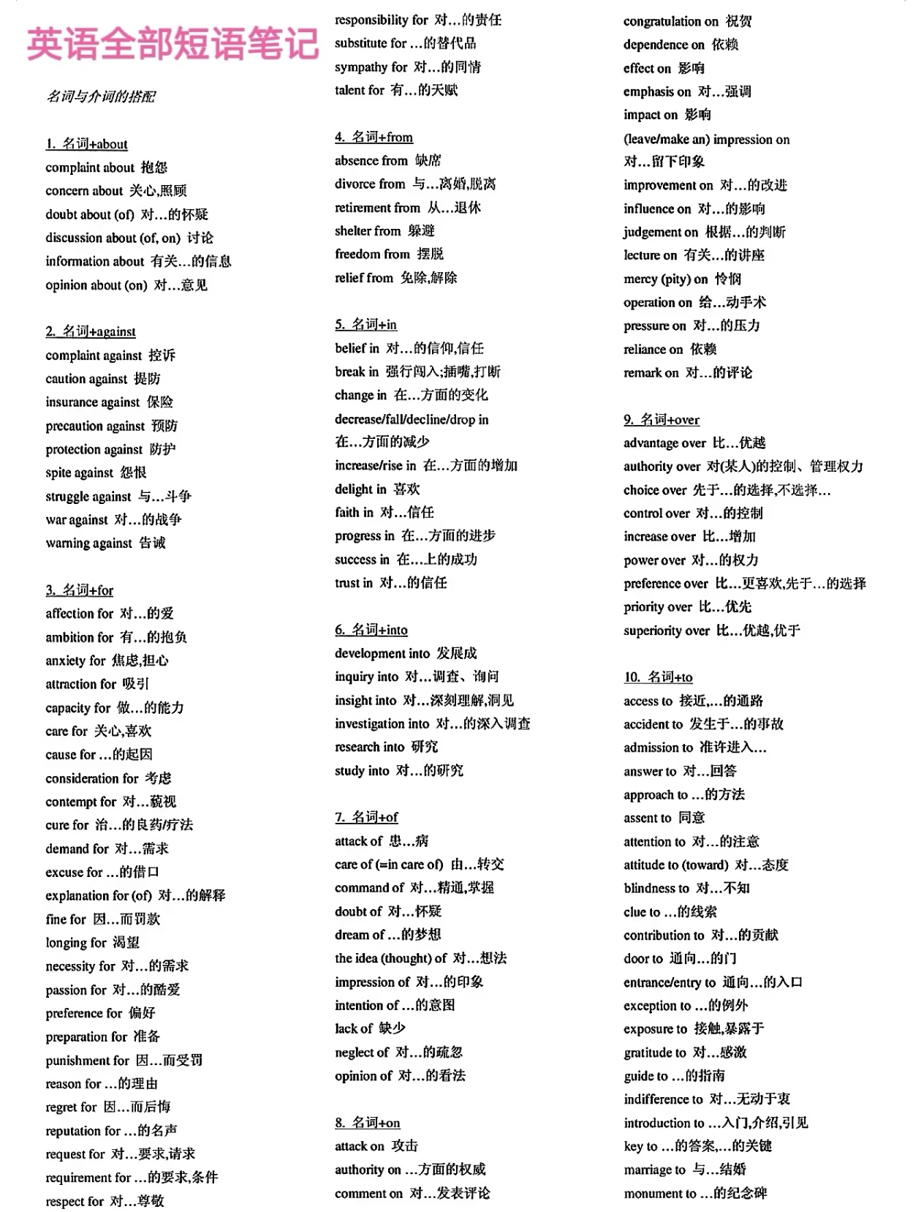
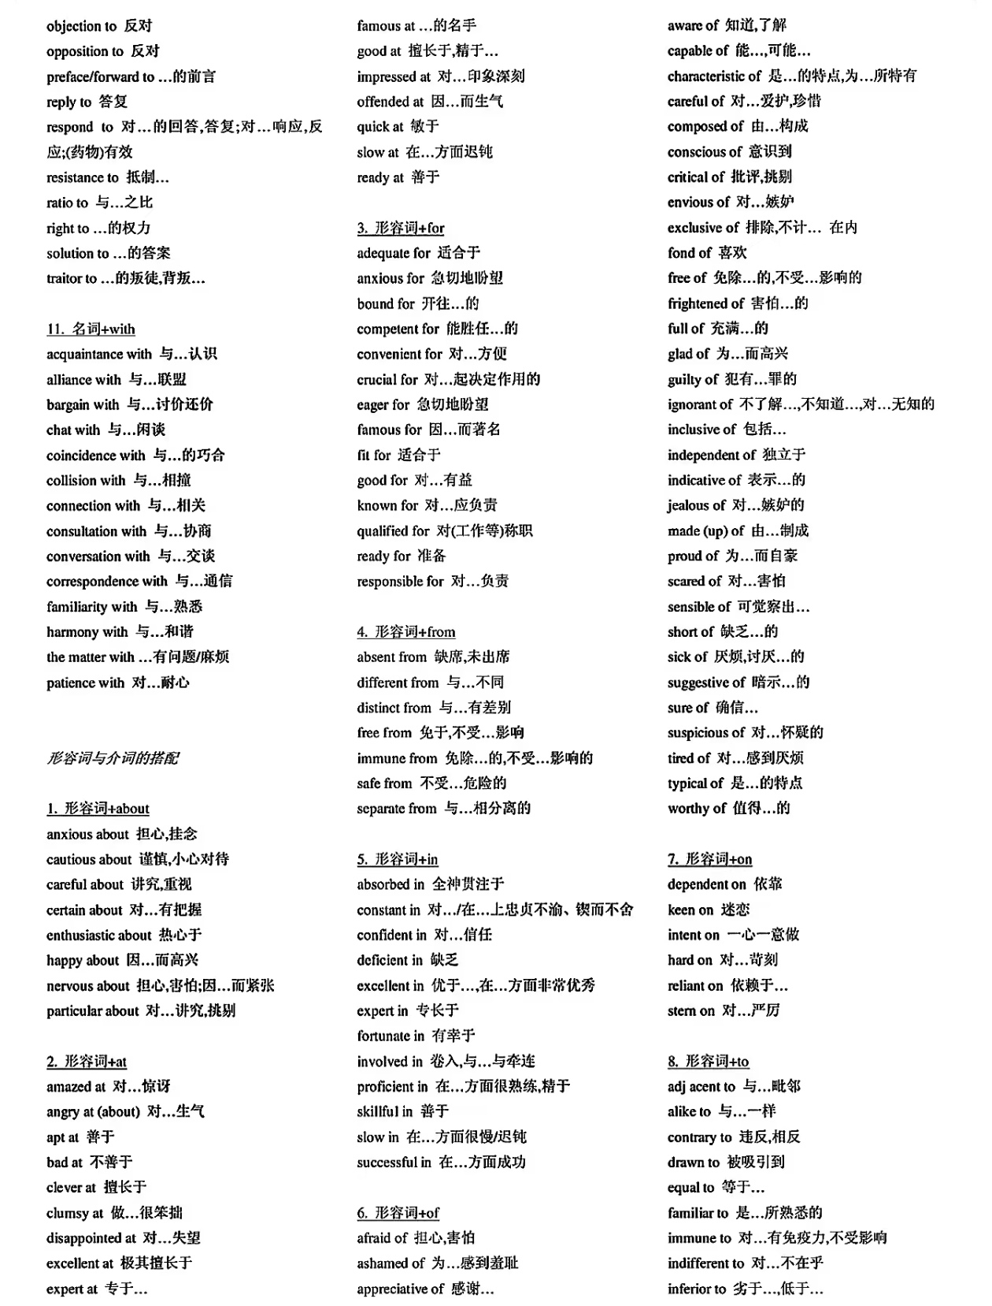

Slide 30
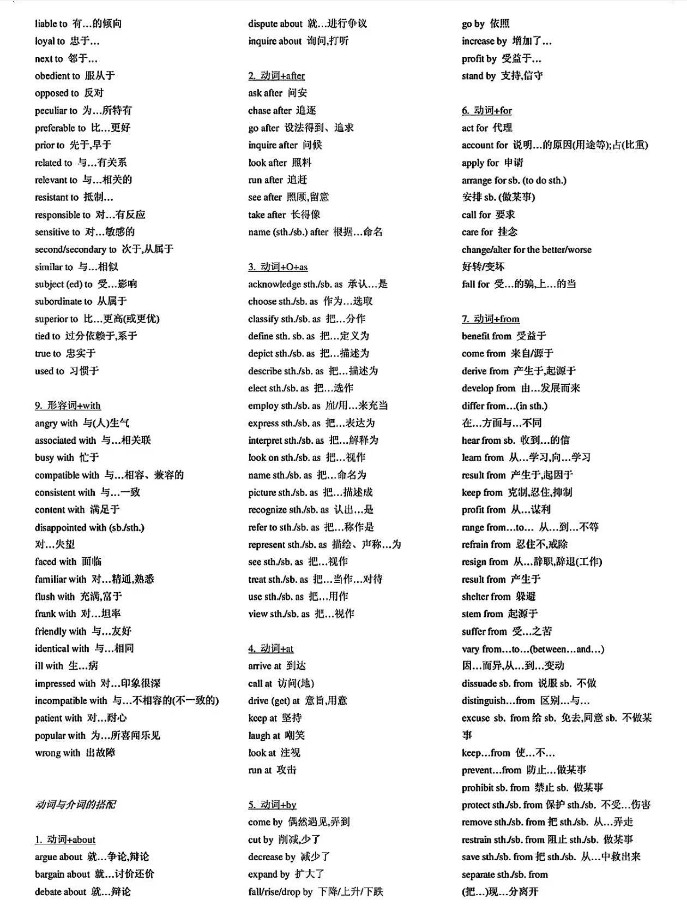
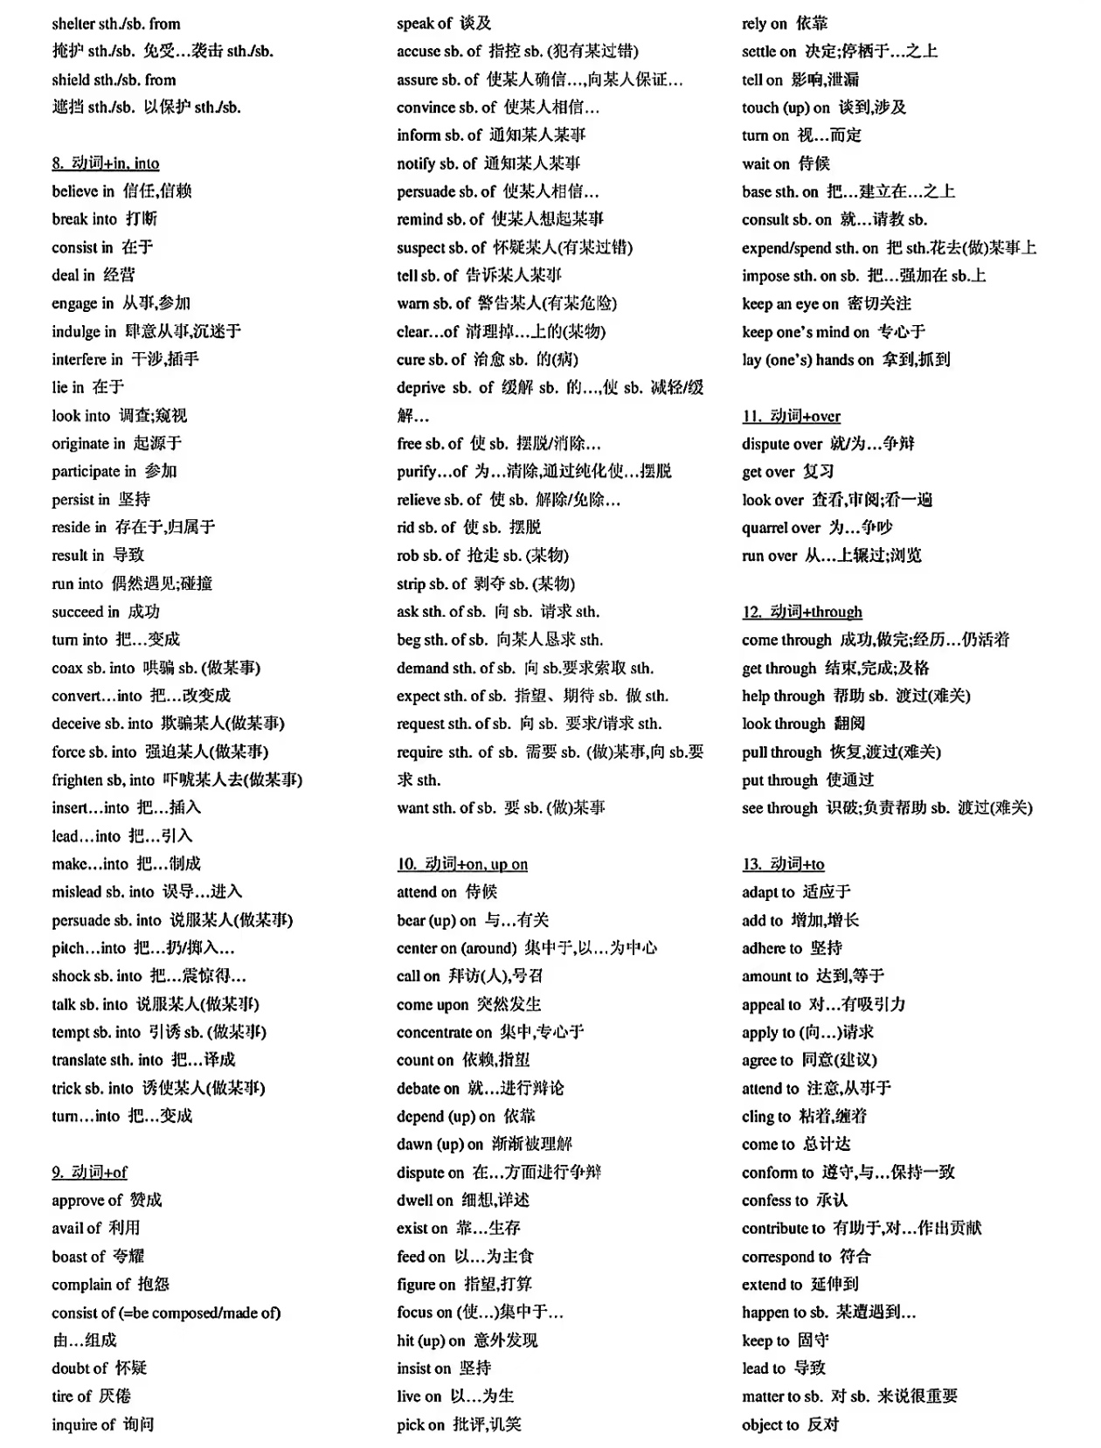

Slide 31
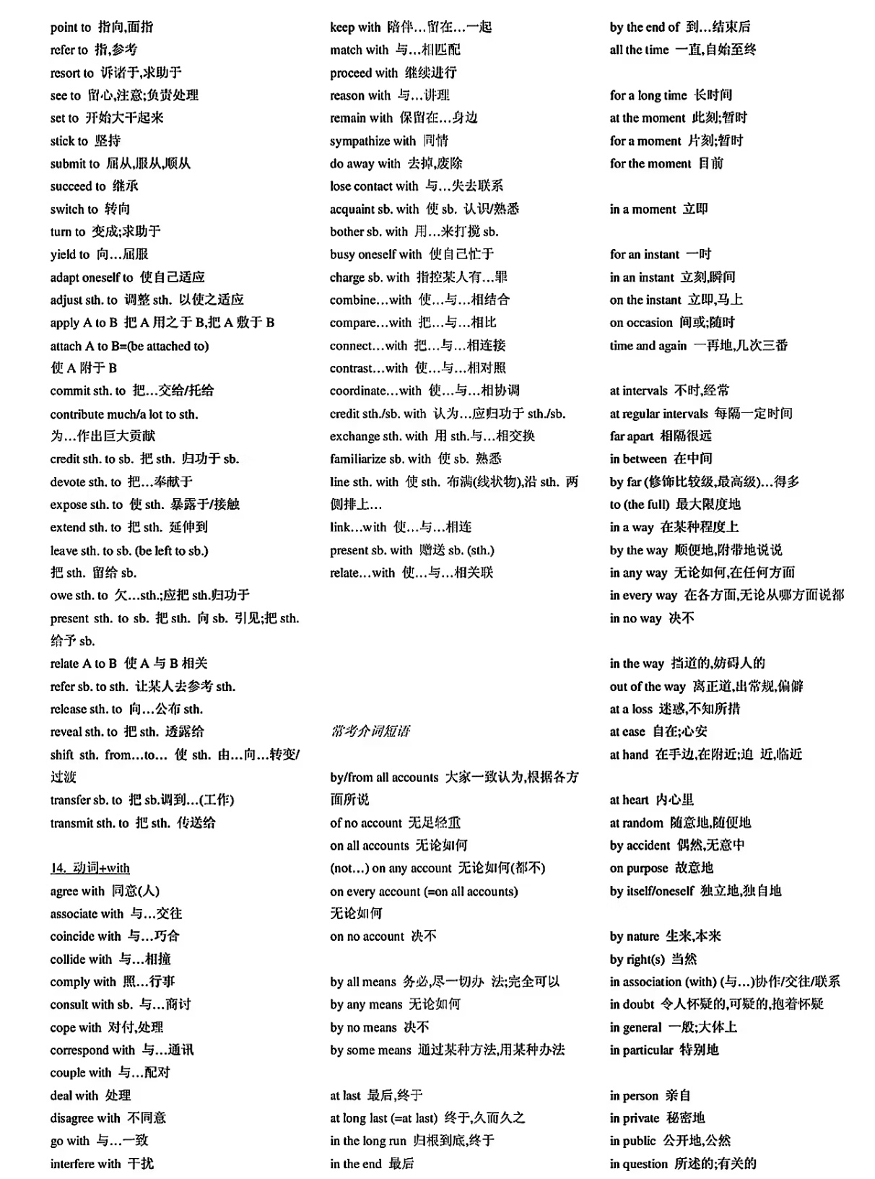
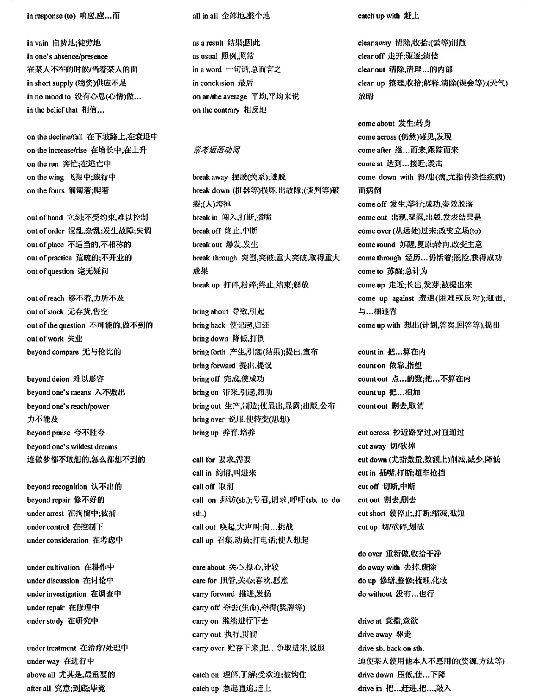

Slide 32
