Slide 1
专题七 图片类作文

Slide 2
一、变化、占比说明
上升：increase, rise, grow, ascend, surge, soar, rocket, skyrocket, spike
下降：dip, drop, fall, decline, descend, plunge, plummet
sharply / dramatically / significantly / markedly (大幅地)
steadily / gradually / consistently (稳定地、逐步地)
slightly / modestly / marginally (轻微地)
如：
The consumption of coal declined gradually in 2025.
There was a gradual decline in the consumption of coal in 2025.
2025 saw a gradual decline in the consumption of coal in 2025.
A downward trend was observed in coal consumption throughout 2025.
波动：fluctuate
峰值：reach a peak of +数字，peak at +数字
稳定：stabilize, level off, reach a plateau, maintain stability, remain constant
After peaking in 2020, the growth rate reached a plateau of 2%.
The number of public library users remained constant at around 10,000 from 2005 to 2015.
Following a period of fluctuation, the data for international tourists stabilized at 5 million per year.

Slide 3
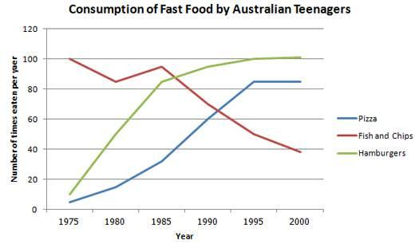

Slide 4
(总括) The line graph illustrates changes in the annual consumption of three types of fast food by Australian teenagers from 1975 to 2000. Overall, while the popularity of fish and chips declined over the period, pizza and hamburgers’ consumption witnessed a substantial rise.
(具体说) The consumption of fish and chips saw a plunge from 100 times in 1975 to 40 times in 2000 with minor pluctuation between 1975 and 1985. In stark contrast, the figures for pizza and hamburgers showed a consistent upward trend. Pizza consumption rose strikingly from about 5 times to 100 times, while hamburgers soared from 10 times to 100 times. Notably, the consumption of both foods stabilized at this high level of approximately 100 times after 1995.

Slide 5
二、饼图或棍图
比例：percentage, proportion, share, fraction (小部分)
占据：account for, take up, constitute
超过：outnumber, exceed, surpass
相反：on the contrary, conversely
分别地、各自地：respectively

Slide 6
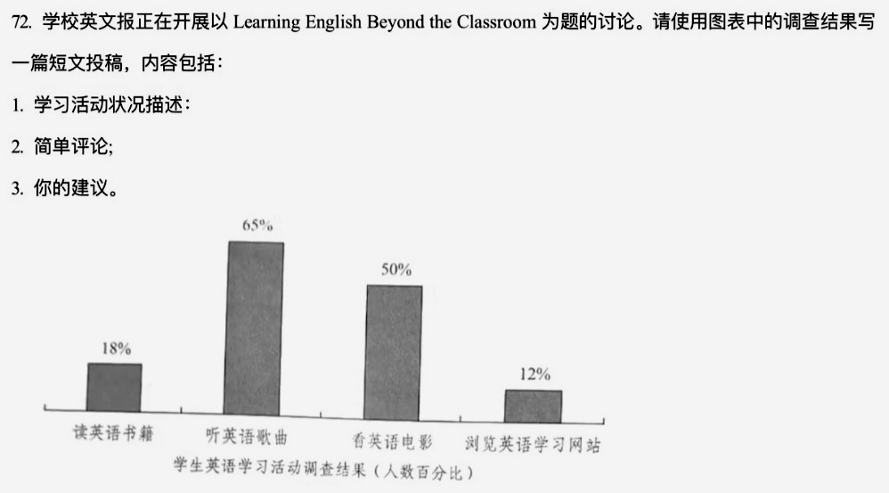

Slide 7
The survey reveals a striking disparity in the popularity of various English learning methods. 65% of students prefer listening to English songs, while 50% find watching English movies more appealing. What is particularly noteworthy, however, is that readers of English books and browsers of English websites constitute markedly smaller proportions, at just 18% and 12% respectively.
This pattern underscores the powerful appeal and influence of audio-visual materials among students. Conversely, the remarkably low engagement with reading suggests a potential lack of interest in activities that cultivate critical reading and analytical abilities.
To foster more balanced development, I would recommend integrating structured reading with popular media. For example, pairing film viewings with related literary works or analyzing song lyrics can effectively expand vocabulary and enhance comprehension. Adopting such a hybrid learning approach paves the way for a more comprehensive command of English.

Slide 8
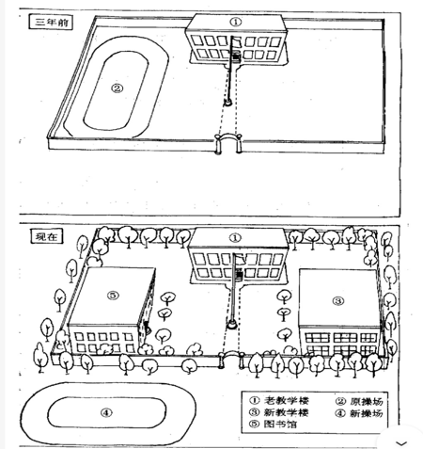
三、平面图介绍（罕见题型)
提示：无固定模板句式，特别需要注意主语的变化及句子的优美程度。
假设你是李华，你的美国朋友Smith写信询问你校的巨大变化。请根据下图给他回信。

Slide 9
I hope this letter finds you well. I'm writing to share with you the remarkable transformation our school has undergone since your last visit three years ago.
The campus now boasts a completely new look. The roadsides are lined with lush trees, breathing new life into the environment. Most notably, the old playground has made way for a grand library, granting us access to a vast collection of books. Right across from the library, a brand-new, spacious playground has been constructed, offering superior athletic facilities. Furthermore, to accommodate our growing student body, a modern teaching building has sprung up in the southeast corner, equipped with state-of-the-art amenities.
We are truly delighted with our transformed school and I sincerely hope you can visit someday to see these wonderful changes for yourself.

Slide 10
四、议论文
介绍图片的模板句式：
The pictures shows that ...
As is described / depicted / portrayed in the picture, ...
时态：无明确时间，使用一般现在时。

Slide 11
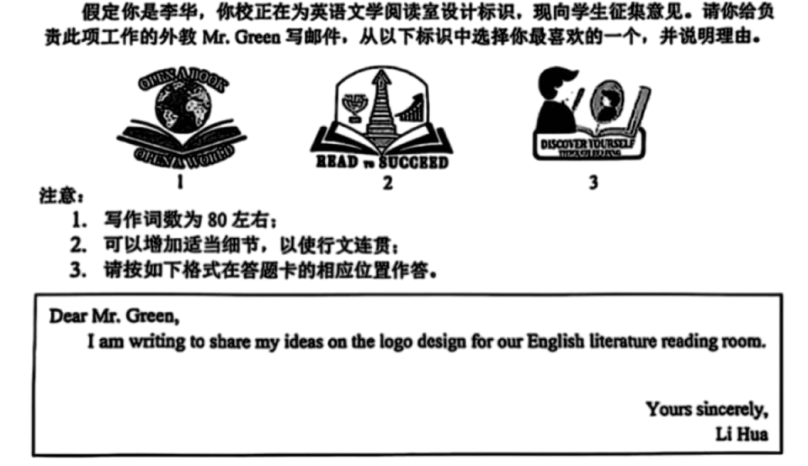
open a book / open a world, read to succeed, discover yourself

Slide 12
I am writing to express my preference for the logo design for our English literature reading room. After reviewing all options, I believe that logo 1, which depicts a globe resting on an open book, is the most suitable choice.
What makes logo 1 stand out is its elegant simplicity and profound symbolism. The open book represents the literature world while the globe positioned above signifies different cultures. It conveys the message that it is our immersion in reading literary books that expands our horizons. The composition is both visually appealing and intellectually stimulating.
Logo 1 is a perfect reminder that books can transport us across boundaries and cultures. So I never hesitate to recommend it to you and hope it can meet with your approval.

Slide 13
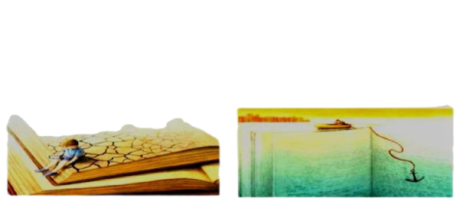
假设你是李华。你校图书馆要布置一个英语读书角，需要一张背景图片。请从以下两张备选图片中选择一张，并说明理由。

Slide 14
I am writing to voice my opinion regarding the two candidate pictures. After careful consideration, I would like to express my definite preference for picture A.
Depicted in picture A is a boy sitting atop a pile of books, engrossed in his cellphone. The books beneath him are cracked, abandoned, and forgotten. This image serves as a vivid reflection of a modern societal issue: the dominance of technology over reading. By displaying this picture in the English Corner, it would act as a potent wake-up call, urging students to resist the distraction of digital devices and rediscover the profound joy of reading. In contrast, picture B portrays a boy sailing on a sea of books, casting an anchor to soak up knowledge. While this vision is undoubtedly inspiring, its effectiveness as a reminder might be limited.
In conclusion, I believe picture A is the more compelling choice. Thank you for considering my perspective.

