Slide 1
《读后续写工具箱》精编（四）

Slide 2
取次花丛需回顾：
1. resist名词
2. 在那个场合
3. suspect名词
4. split, burst, cast过去式
5. arrest one’s footsteps
6. 踩刹车
7. a blessing or a curse
8. He authored a book.
9. compensate for
10. criterion
11. 发光的珠宝
12. origin形容词
13. an overturned basket
14. the last leg of the journey
15. mature名词

Slide 3
P₁₀₇ 第8章 悲伤
Grief settled in my chest like fine dust, folding itself into the corners of my breath silently.
(这个句子不能用，很抽象）
8.1 伤心与难过
grief, agony, anguish悲痛（底下的例句很无力）
Her mother's passing plunged her into an abyss of grief, her tears gushing uncontrollably. (Daiyu buries the fallen petals)
8.2 失落与失望
be disheartened by 沮丧、心灰意冷（底下的例句一般）
Despite his meticulous preparation, Tom failed the audition. The judge's comment, "Not quite what we're looking for," echoed in his mind.He was profoundly disheartened by the rejection. The dream of becoming an actor, which once burned so brightly, now felt distant and foolish. He placed his script in a drawer, unable to look at it.Days later, his drama teacher found him. "I heard what happened," she said gently. "One 'no' doesn't define your talent. I was rejected a dozen times before my first role." Her words rekindled a spark in his disheartened soul. Perhaps it was too soon to give up.

Slide 4
8.3无助与绝望
despair, desperation绝望
desperate绝望的
(底下的例句写得可以）He fell into despair when every plan collapsed without warning.
be crushed by被...压垮
He sat crushed by the weight of his losses.
Seeing his scholarship application rejected, he was crushed by the realization that his dream university was now out of reach.
The team was crushed by the last-minute goal that snatched away their championship title.

Slide 5
8.4内疚与后悔
regret后悔、遗憾
regretted过去式，regretful遗憾的、后悔的
regret doing后悔做过，regret not doing后悔没做，regret to do遗憾地去做
（底下的例句一般）
remorse懊悔、深切的自责
She felt remorse for the harsh words she had spoken.
In hindsight, I felt remorse for not putting in more effort to address the seemingly insurmountable problem.
reproach oneself自责（底下的例句一般）(应该不常用，《心灵鸡汤》出现0次）
dwell on the past沉湎于过去（底下的例句一般）
One cannot embrace the future if they insist on dwelling on the past.
The price of dwelling on the past is missing the beauty of every day.

Slide 6
dwell on 可以加其他单词：
dwell on your mistakes纠结于错误
dwell on negative thoughts老想消极的事情
翻译：No need to dwell on the past; may the future bloom in splendor.
无须忆怜往，但祈繁椿章

Slide 7
P₁₁₅ 第9章 愤怒与恨意
Anger sat in my throat, sharp-edged, making everything tighter the longer it stayed.
(这个句子不能用）
9.1 受挫与恼火
irritated, annoyed, offended恼火、心烦
exasperated, infuriated极为光火的
disrupt打乱，disruptive扰乱的，disrupted未查到

Slide 8
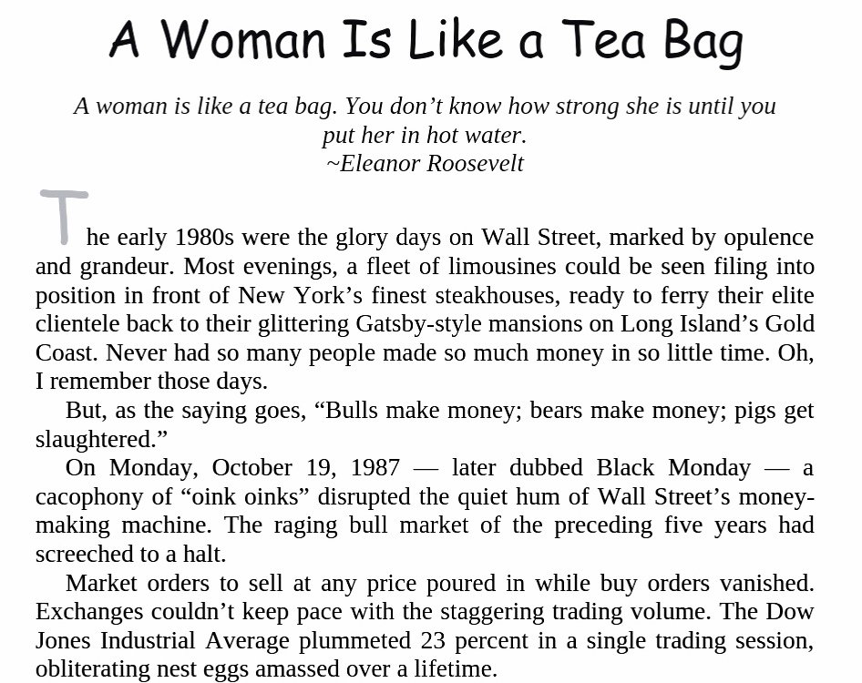

Slide 9
9.2 生气与敌意
furious抗怒的
She was furious when she found her work had been deleted.
链接一下：
Life is but a walking shadow. It is a tale told by an idiot, full of sound and fury, signifying nothing. -Macbeth
resent愤恨resentful愤愤不平的
She grew resentful after years of being excluded from decision-making. (这个写得还可以）
hostile充满敌意的
Her tone turned hostile when the topic shifted to the budget cut.
A wave of hostility greeted her directly she stepped into the classroom. She felt a cold shiver ran down her spine.

Slide 10
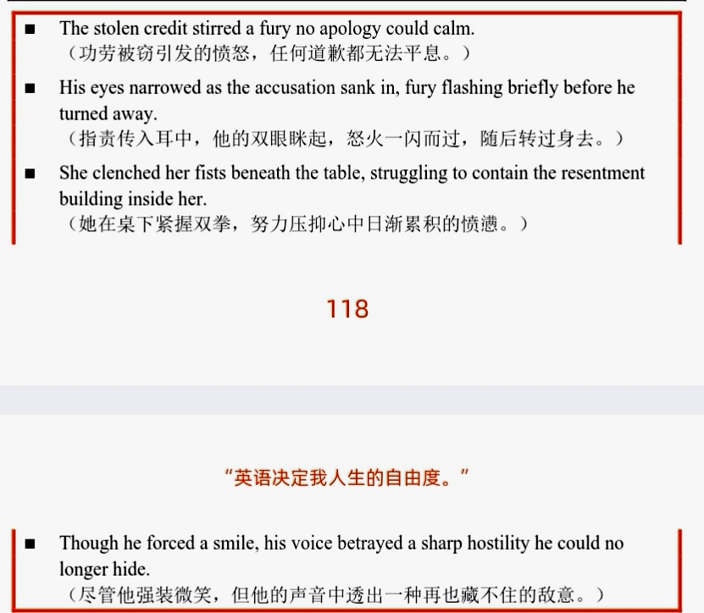

Slide 11
9.3 轻蔑与鄙夷
disdainful轻蔑的
distain蔑视（n.+v.)
(底下的句子写得一般）
scornful
scorn轻蔑、鄙视（n.+v.)
(底下的句子写得一般）
An overwhelming percentage of teenagers today hold a scornful attitude to fried cicadas, whereas people of my age consider them a mouthwatering delicacy. (新概念3仿写）
sneer at 冷笑、嘲讽
sneer, sneering, sneeringly
（底下的句子写得一般）

Slide 12
Sarah felt her cheeks burn. Being sneered at in front of her colleagues was a humiliation she had not anticipated. For a second, she considered backing down. But then she looked at the data on her screen, the data that solidly supported her proposal. She met his sneer with a steady gaze. "With all due respect, Mark," she began, her voice calmer than she felt, "let's examine the data before we dismiss any possibility."

Slide 13
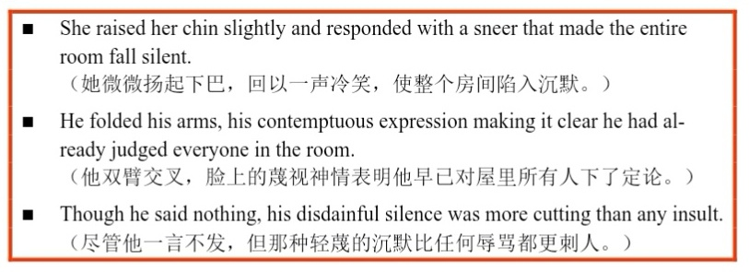
下节课从P₁₂₀开始，提前准备好

