Slide 1
《读后续写工具箱》（十四）+（十五）

Slide 2
1. eliminate skepticism
2. collaborate
3. monumental
4. mushrooming digital market
5. take delight in
6. dedicate oneself to
7. the circulation of currency
8. exceed one’s expectations
9. He surveyed the street with alertness.
10. an unbiased evaluation of the livestock

Slide 3
第15章 生理感受有关的情绪
15.1疼痛
throb with pain阵阵作痛
The twisted ankle throbbed with pain after each step.
或Every step sent a throb of pain through the twisted ankle.
My heart throbbed with excitement when I graded the excellent compositions.

Slide 4
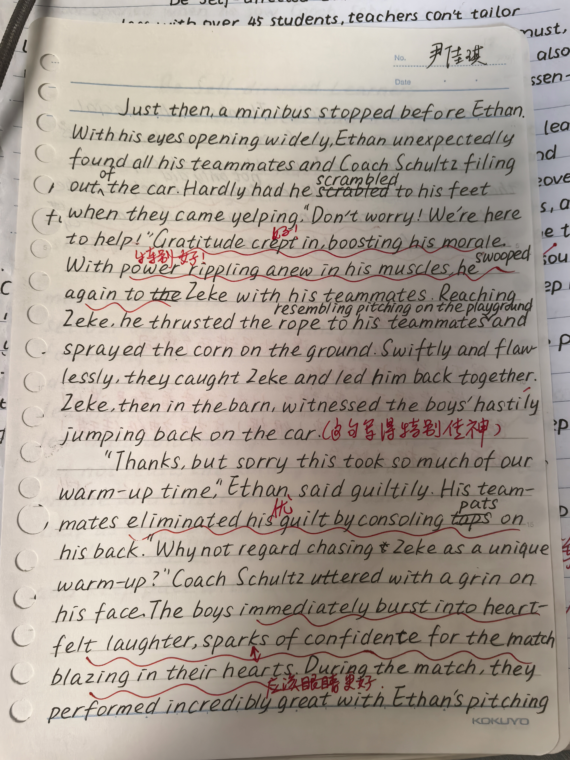
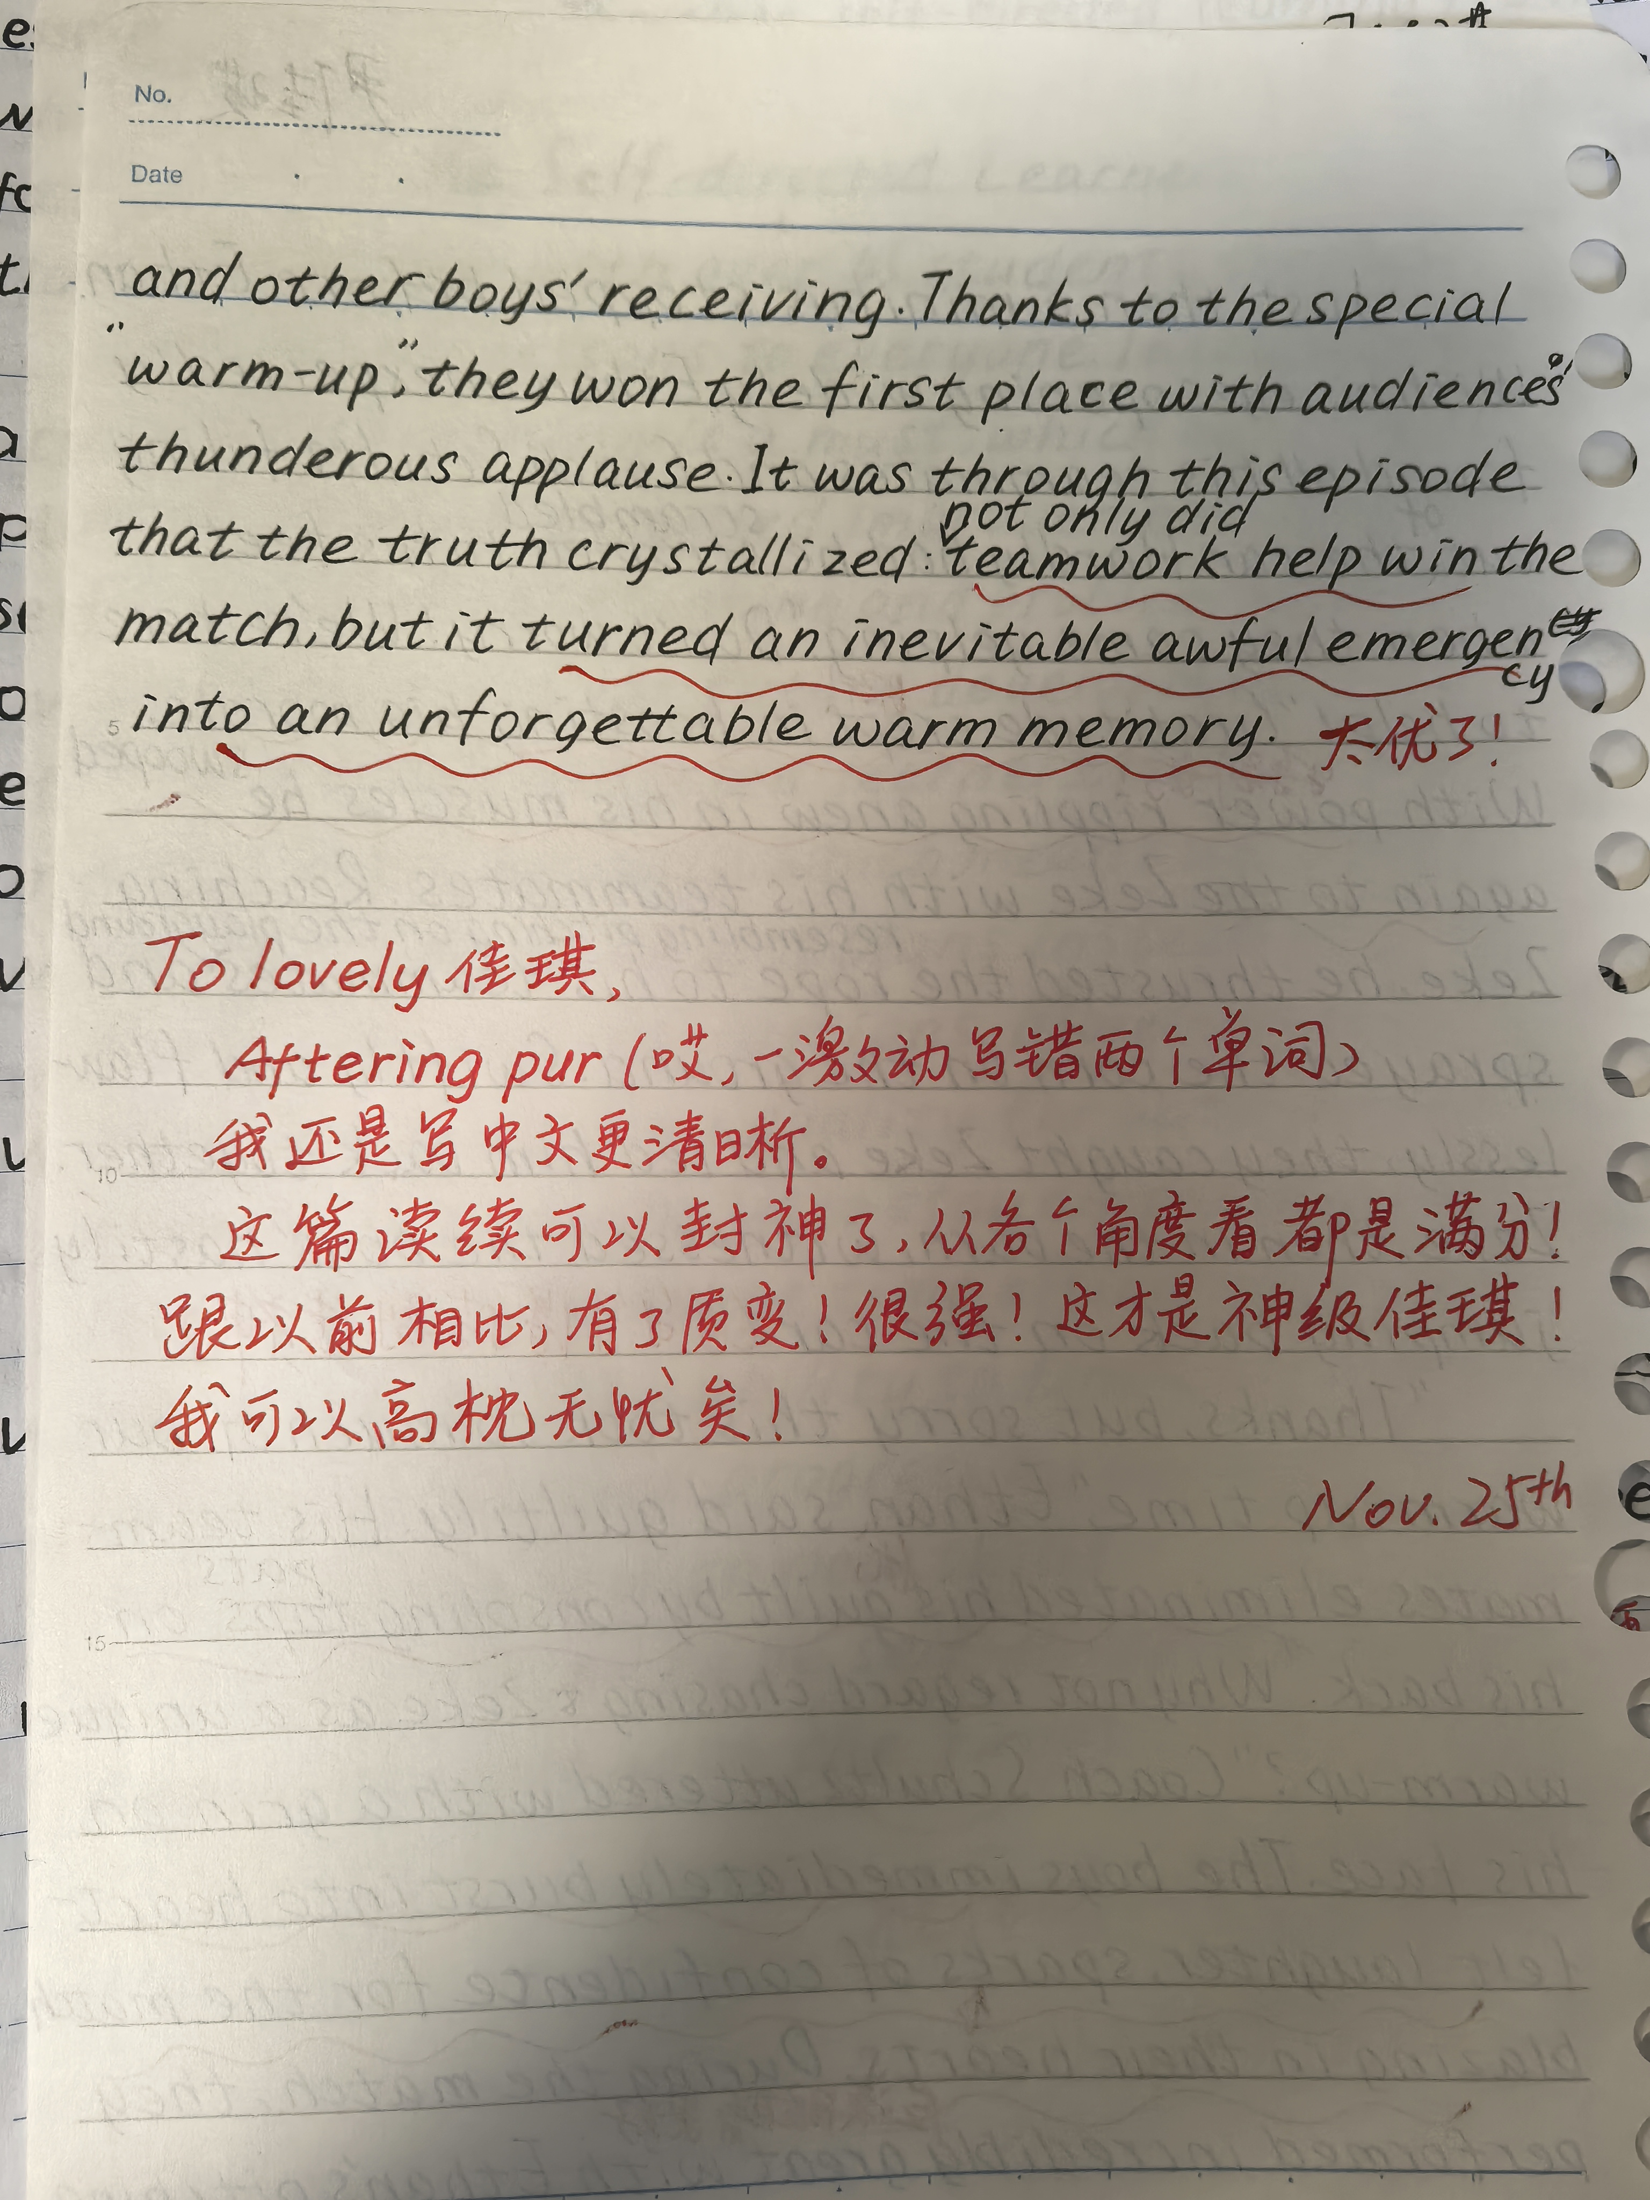

Slide 5
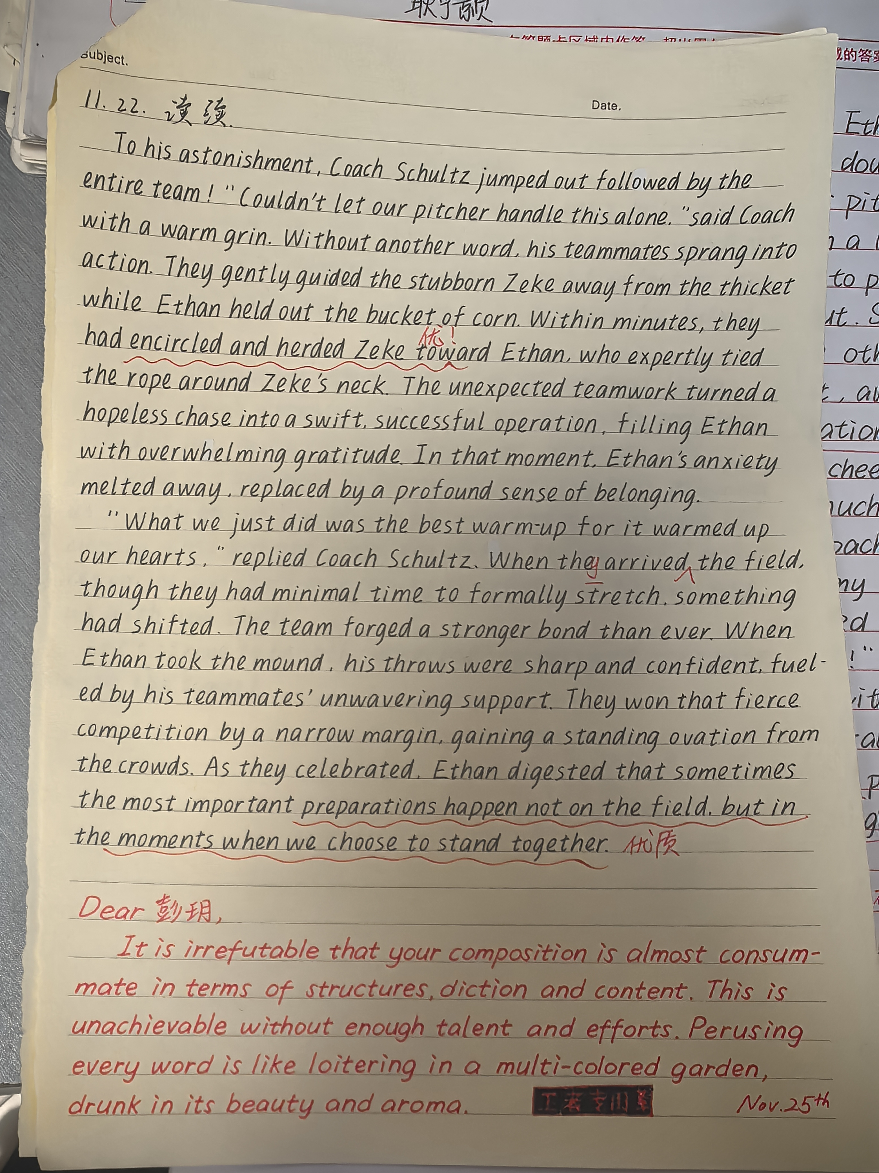

Slide 6
(2021届济南市一模，Falter的冲浪板被几千里地之外的Brane和他的孩子们捡到，一个冲浪板连接了两个文化的两人）
This fueled Falter to raise money for the kids.With profound compassion, he launched an online fundraising campaign, where he shared the incredible journey of his surfboard and Brane's selfless request. It wasn't long before the post went viral, as the story found a profound echo in the hearts of people, who dug into their pockets with generosity. Within weeks, his cellphone witnessed cascades of bank notifications popping on the screen. Finally, having raised enough money, Falter couldn't wait to tell Brane the good news and arrange their meeting.
The day finally came when the two men met for the lost "baby". When the two men met at the school, they embraced tightly and conversed happily. The gathering reached its climax when Brane's students presented him with their delicately crafted gifts and his beloved surfboard. Falter even taught these lovely kids how to use it. In that moment, the lost surfboard was no longer merely a missing object; it had been transformed into a vessel of cross-cultural friendship and educational opportunity.

Slide 7
sting sharply刺痛
The disinfectant hit the wound, and the skin stung sharply.
Each stroke brought a fresh sting of salt water to his eyes. All he could see was the distant, struggling shape of the child, and he swam toward it.
Carelessly, I disturbed the bees which were collecting nectar amid the petals. Before I knew it, throngs of these angry creatures charged at me and stung my face.
be sore to the touch碰一下就痛
The bruised shoulder was sore to the touch even hours later.
be stiff and painful僵硬又酸痛
After hours of sitting, the neck was stiff and painfully locked.
The company faces stiff competition from its rivals.
Age has stiffen his wits as well as his limbs.

Slide 8
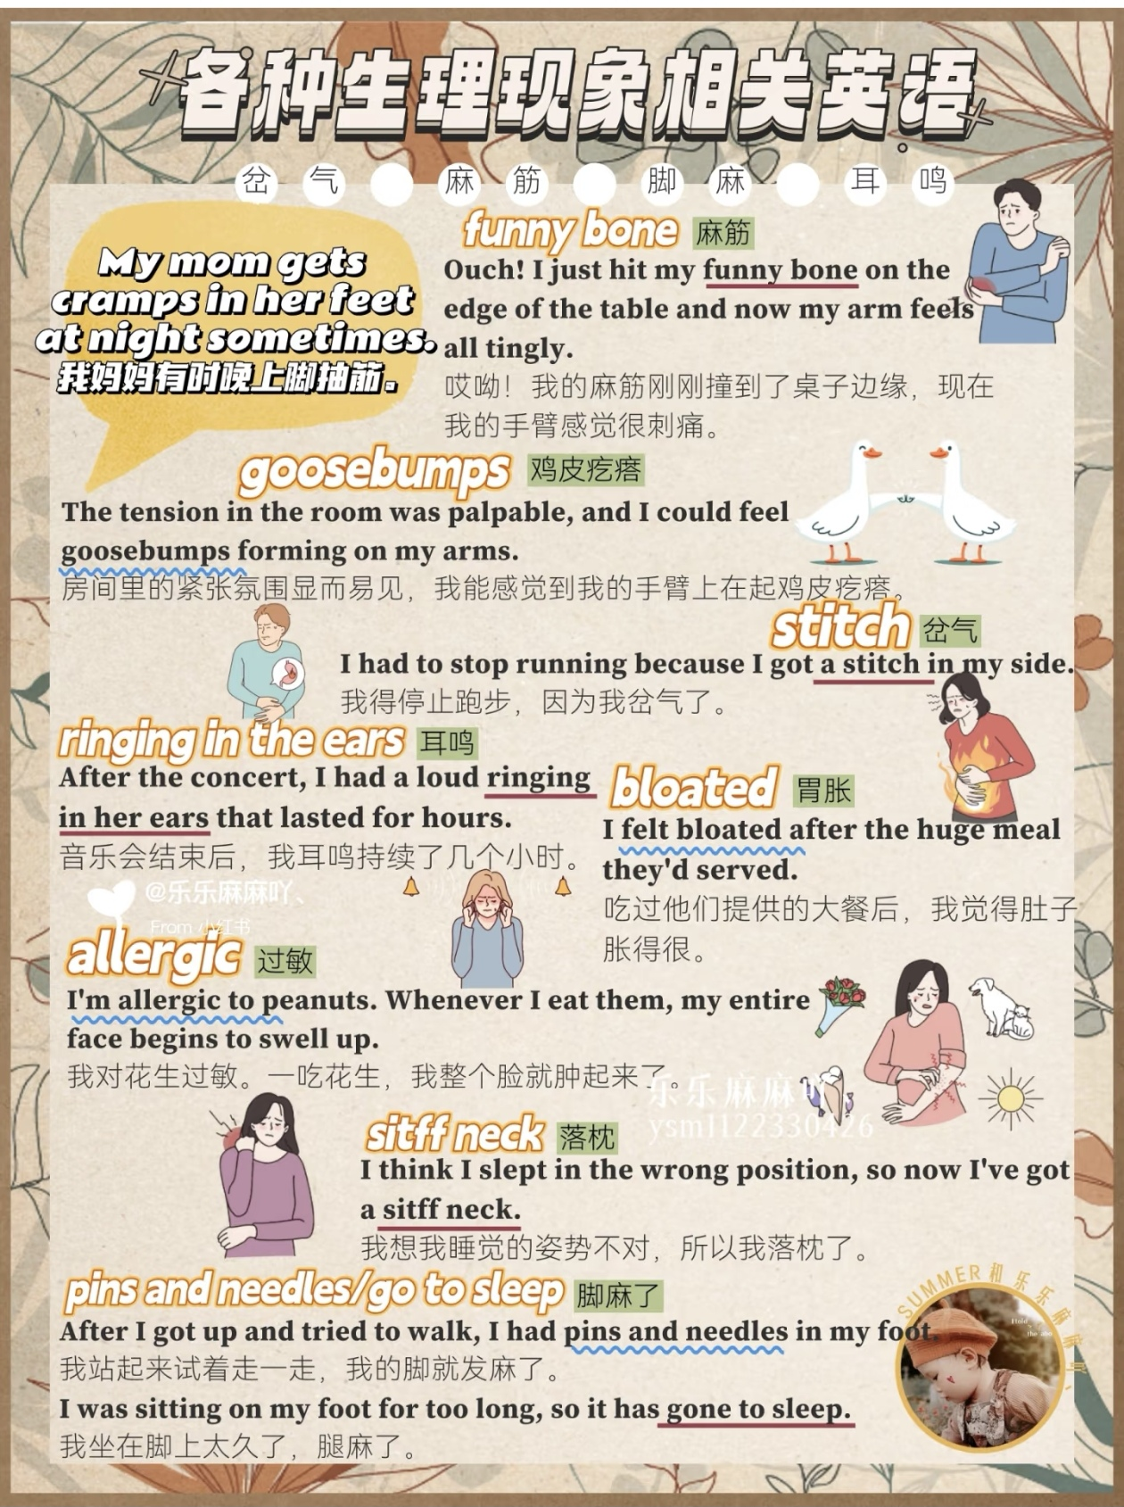
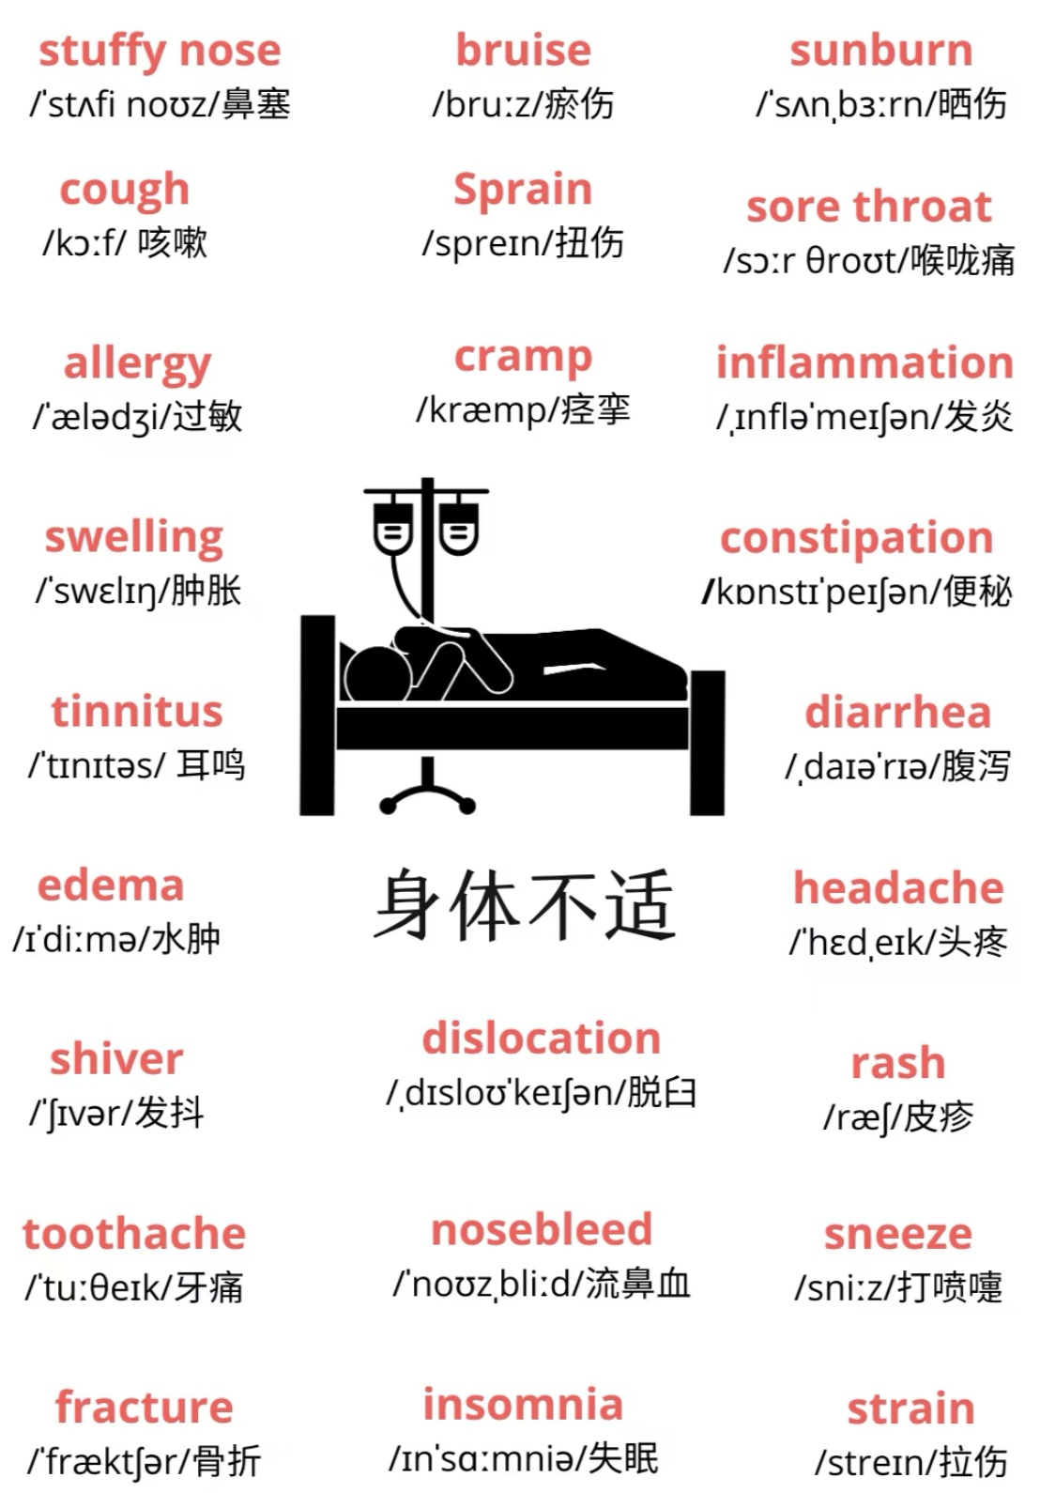
各种伤及疼痛

Slide 9
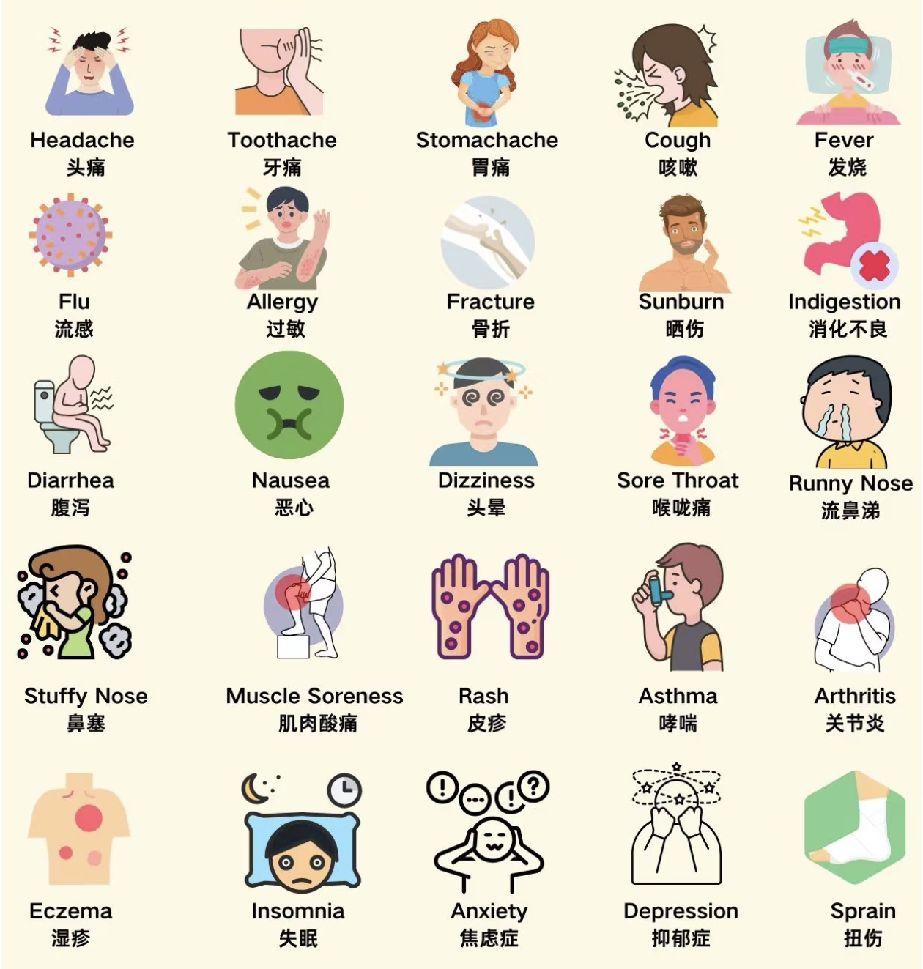
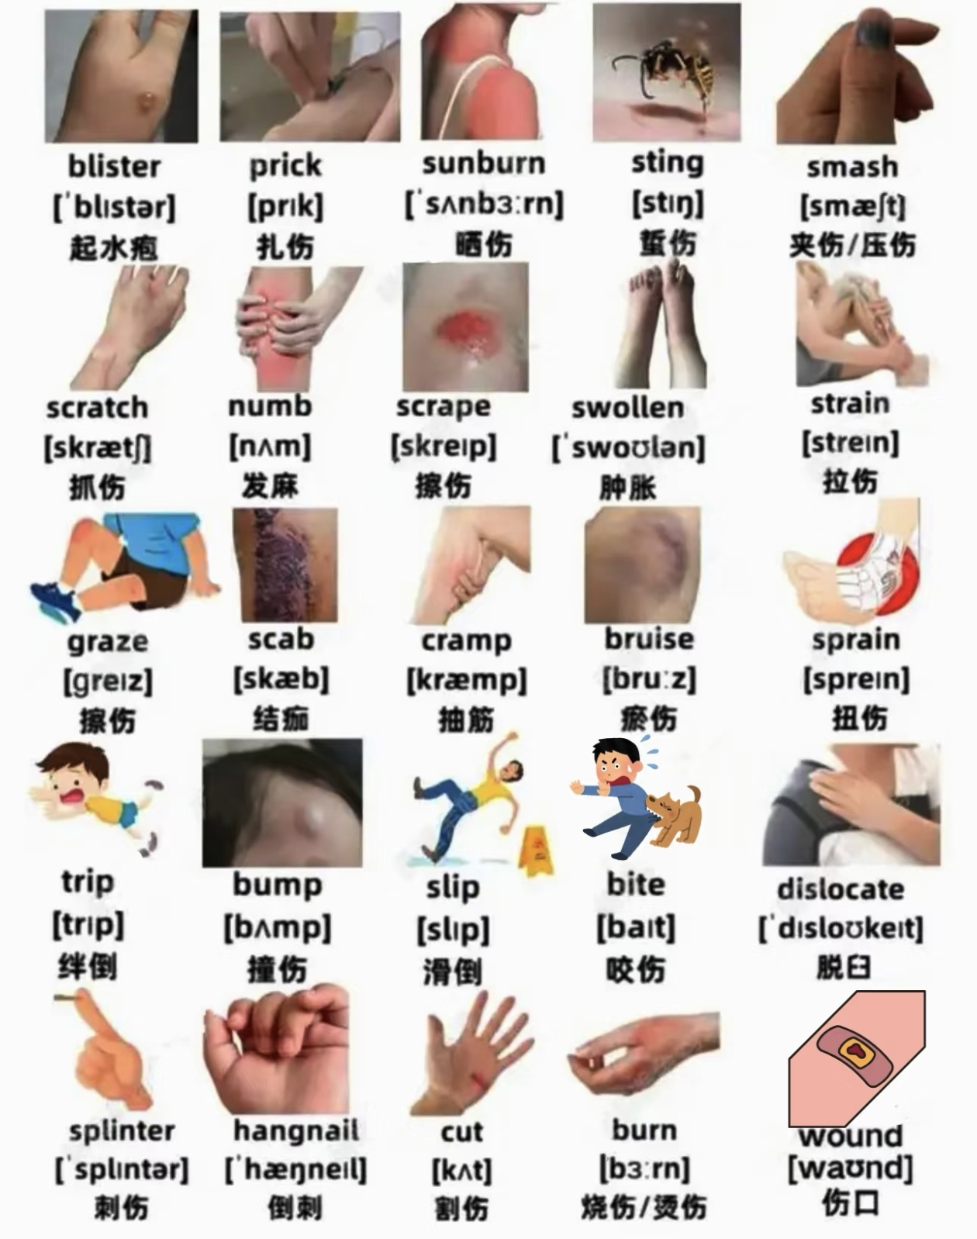

Slide 10
15.2疲劳
be drained of energy精力耗尽（底下的例句无力)
He promptly drained the money, for it always burned a hole in his pocket.
The Internet led her down the rabbit hole and drained her energy.
feel physically and mentally exhausted身心俱疲
She felt physially and mentally exhausted after the long rehearsal.
struggle to stay awake
The lecture blurred at the edges as the mind struggled to stay awake.
be weighed down by fatigue被疲劳压得喘不过气
The arms hung heavy, weighed down by fatigue.

Slide 11
（补充）疲劳
be worn out
Working double shifts has left me totally worn out.
be burned out / burnout
run-down
be wiped out
The intense iron pumping left me completely wiped out.
beat / dead beat
be spent
weary / weariness
To our utter surprise, he bounced through the door not weary, but vibrating with energy. “Can you believe it? I earned 50 bucks today!” he exclaimed, eyes ablaze and arms waving triumphantly.

Slide 12
15.3舒适
soak in warmth浸润在温暖中
The body slowly soaked in warmth, every muscle easing in silence.
She soaked in the warmth of their reunion, tears glistening in their eyes.
They sat there, sipping coffee, soaking up the atmosphere.
Dragging my leaden legs and drenched (soaked) in sweat, I struggled across the finish line, greeted by the cheers and applause of the spectators.
其他：
be soothed by comfort
find solace in one’s words
The grieving widow found solace in her friend’s kind and understanding words.

Slide 13
be consoled by the thought of ...
The laid-off worker was consoled by the thought of finding a better job in the future.
Companionship of Books (节选)
A good book may be among the best of friends. It is the same today that it always was, and it will never change. It is the most patient and cheerful of companions. It does not turn its back upon us in times of adversity or distress. It always receives us with the same kindness, amusing and instructing us in youth, and comforting and consoling us in age.
take comfort in shared memories
be heartened by acts of kindness
be reassured by a calm presence
The nervous patient was reassured by the doctor’s calm presence during the examination.
be lulled into a sense of comfort by gentle rhythms
The baby was lulled into a sense of comfort by the gentle rocking of the cradle and the soft lullaby.

Slide 14
15.4 挑战与刺激
heart race with excitement心跳加快
My heart beat fast.
I could feel my heart pounding / hammering in my chest.
My heart hammered against my ribs.
Her heart fluttered like a captured bird.
My heart leapt into my throat.
Fear sent my heart into a gallop.
be alert and alive高度警觉、充满活力
With the exam looming tomorrow, he crammed into the night, fighting a losing battle against sleep. As his eyelids grew impossibly heavy, he forced himself up and brewed a pot of black coffee to maintain his alertness.

Slide 15
rise to the challenge迎接挑战
brave the challenge勇敢面对挑战
meet the challenge head-on正面接受挑战
The mountain was steeper than she’d imagined, her legs burning with fatigue. Yet, with the summit in sight, she gritted her teeth and rose to the challenge, taking one determined step after another.
Seeing his terrified younger sister, the boy’s own fear vanished. He rose to the challenge, stepping forward to confront the snarling dog.
The projector failed minutes before the presentation. Instead of panicking, she rose to the challenge, delivering her talk with such vivid description and passion that no one missed the slides.

Slide 16
15.5 虚弱、饥饿、口渴
be starving for food 饥饿
After a long day walking across the hills they had worked up quite an appetite.
have a dry throat喉咙发干
After the run, the throat felt dry and scratchy (itchy).
be parched with thirst口渴难耐
She licked her parched lips.
have a growling / roaring / grumbling / rumbling stomach肚子咕咕叫
hydrate补水
He hydrated himself after the workout to replenish lost fluids.
dehydrate脱水
After the 30-minute run, he was dizzy and weak from dehydration.

Slide 17
身体虚弱、病弱
sickly 病恹恹的
frail瘦弱体虚的(尤其老人）
feeble体弱的
limp无力的、无精神的
languid无精打采的、懒洋洋的
He exhaled a sigh of resignation because of the feeble signals of the cellphone. Darkness fell, and with it came a fear that tightened its grip on his chest. The only sound that answered the descending night was the increasingly insistent rumble of his own hunger.
(翻译古诗 Meeting is difficult, parting is hard as well. The easterly wind is feeble, leaving flowers withered all.)

Slide 18
