Slide 1
《读后续写工具箱》 十六+十七

Slide 2
P₂₀₂ 第16章 感官行为
16.1 视觉
gaze 凝视
She gazed at the old photo, a faint smile playing on her lips.
(play: 闪烁、浮现、略过) Sunlight played on the surface of the lake.
Her gaze steadied me. With newfound confidence, I delivered my speech, my lines flowing so spellbindingly that the audience hung on every word. My conclusion was met with an immediate standing ovation.
When my gaze landed on the faded photo, a wave of nostalgia washed over me.

Slide 3
fix / fasten one’s eyes on ...
glue one’s eyes to ...
(fasten是fast的动词，fast? He made the boat fast. Breakfast来源)
peer费力看（底下的例句不大行)
He peered at the fine print in the policy from the insurance company.
He peered into the fog, struggling to discern what lay ahead.
拓展：blur / obscure / cloak / shroud one’s vision
look intently（intently专注地)
He looked intently at the chessboard, calculating his next move.

Slide 4
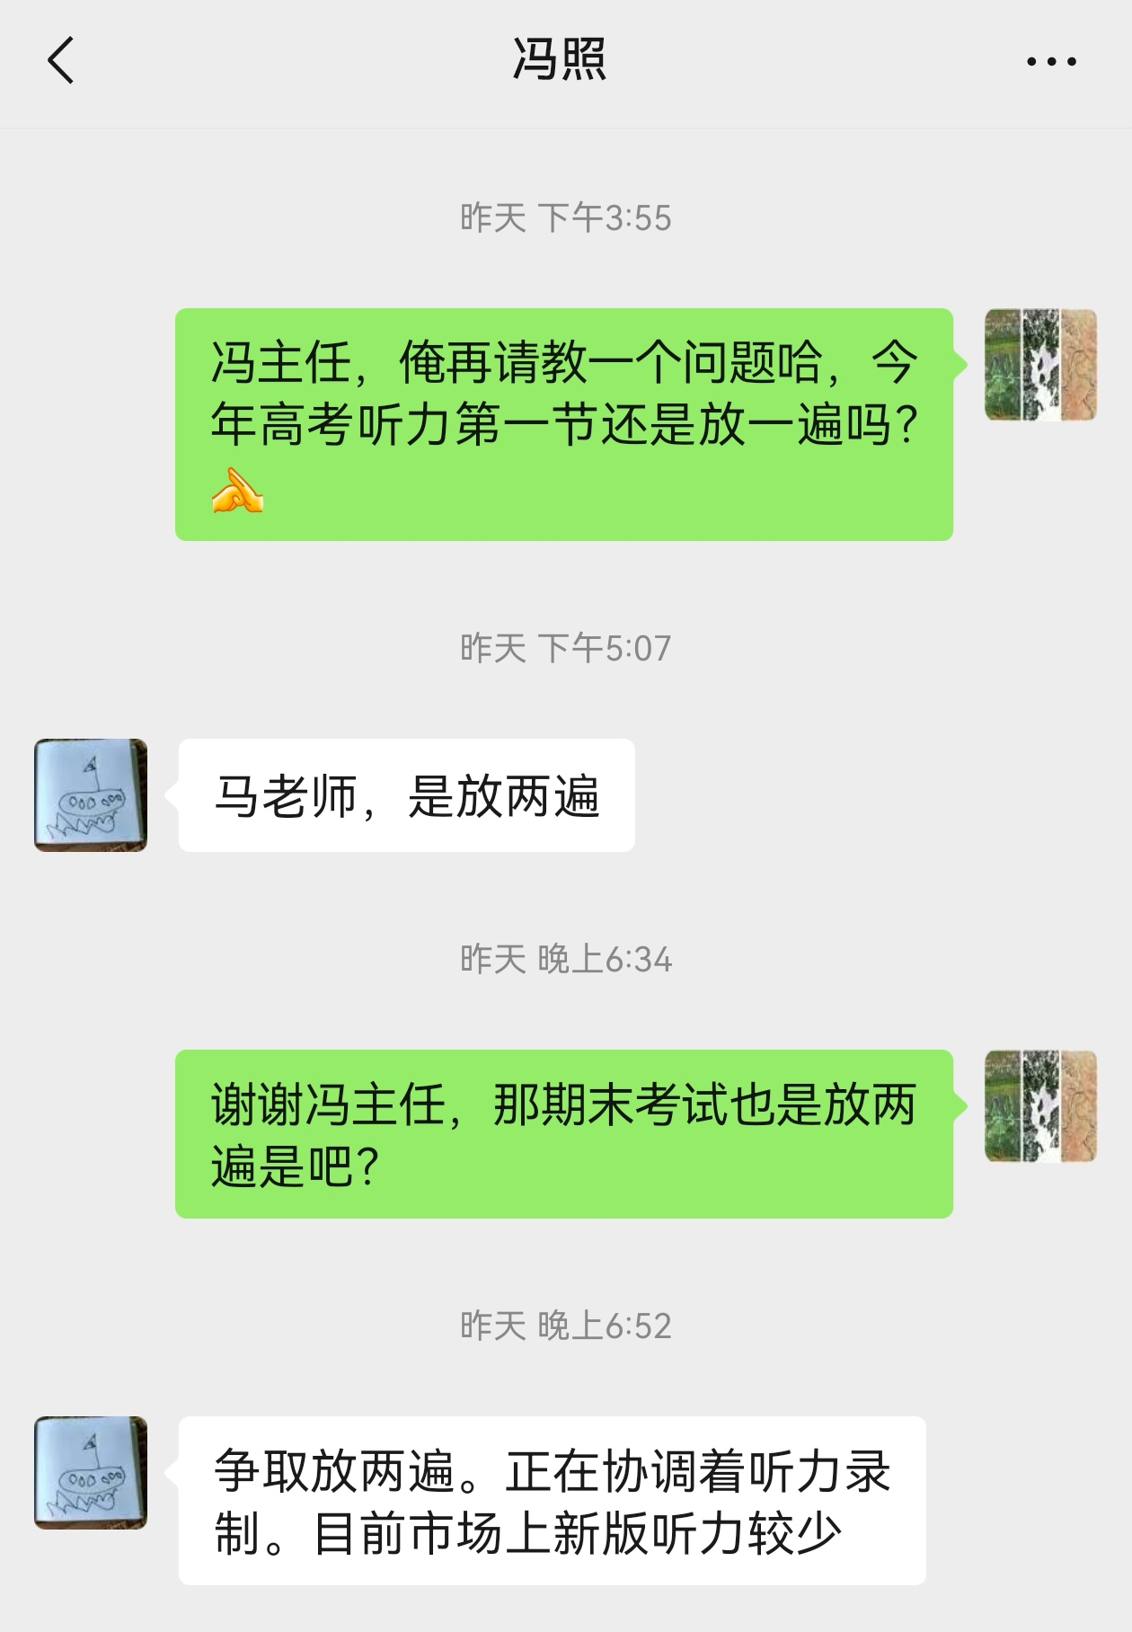

Slide 5
regard注视、凝视、端详
She regarded the old photo, her fingers tracing the faded faces.
The teacher regarded the repentant student sternly, but a hint of forgiveness softened his eyes.
scan扫视、仔细查看（来源于扫描)
She scanned the contract for any hidden clauses.
survey查看、审视（survey动词第一个意思）
The next morning we surveyed the damage caused by the fire.
flick one’s eyes over快速扫一眼 (flick轻弹、轻触) popcorn flick爆米花电影
flicker闪烁、闪现、快速抖动
eyes roam over眼睛游移不定
区分：wander / roam / stroll / loiter

Slide 6
偷看
peek / peep / peak
A fertive peek into the drawer revealed some coins. Immediately, he scooped them into his hands, unaware that they were Grandpa’s most treasured possession.
glimpse (无意识地一瞥)
I caught a glimpse of her before she melted / blended into the crowd.
(这个单词主要用在应用文里面)
Ice core samples drilled from Antarctica offer a glimpse into the Earth’s climate history over thousands of years.
Breakthroughs in genetic research offer a glimpse into the underlying causes of many hereditary diseases and potential pathways for treatment.

Slide 7
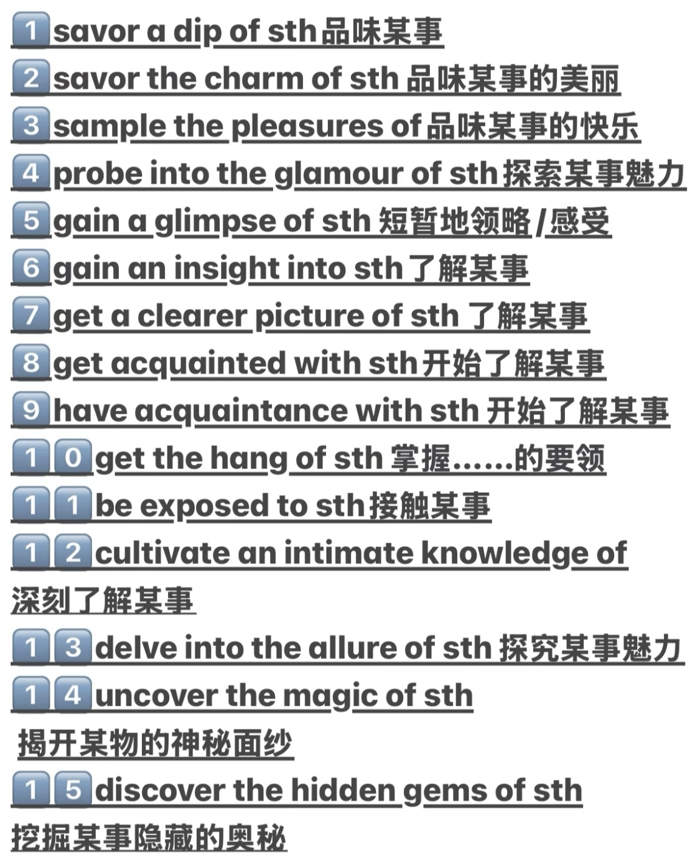
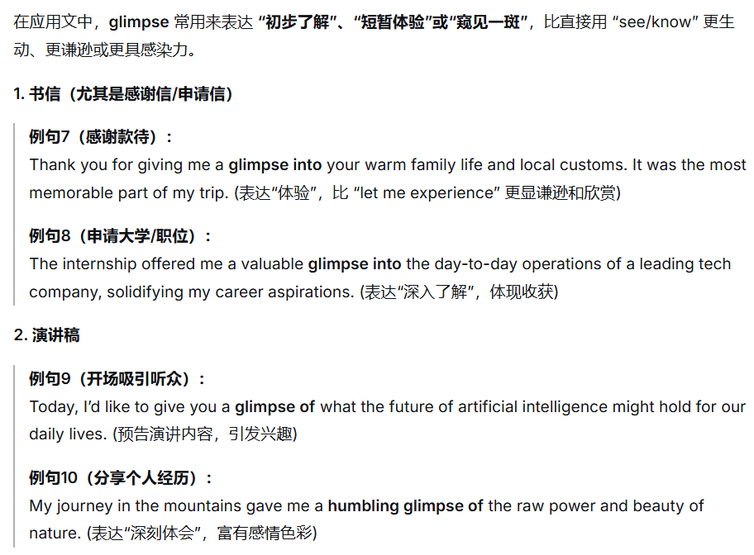

Slide 8
roll one’s eyes翻白眼
She rolled her eyes at his lame excuse.
squint眯着眼睛
He squinted into the blinding sun.
He raised a hand to shield his eyes, squinting against the sudden glare.
The land dropped away and the sea appeared. It stretched all the way to the grey horizon. Rusty fishing boats lined the harbor, and men hauled crates off them. Gulls circled the catch with begging beaks, as ice sloshed everywhere. I looked into the distance, and my heart thudded. Sandwiched in between the sea and sky was an island. If I squinted, it looked a bit like an inky smudge beneath the sun.

Slide 9
Rex stood frozen, squinting up at the shrinking figure of the pigeon, his earlier sneer replaced by stunned silence.
Together, they squinted into the distance, watching Blanche vanish into the horizon, until she became a tiny speck dancing with the clouds.
lock eyes with目光交汇
They locked their eyes across the room, neither of them blinking.
I locked eyes with my crush today, but there was no chemistry between us.
Our eyes locked and I saw suspicion and greed warred in his eyes.
Before stepping onto the stage, the nervous singer locked eyes with her teacher in the front row. Seeing the unwavering belief in those eyes, her fear melted away.
A low growl echoed in the silence. He froze, then slowly turned to lock eyes with the wolf lurking in the shadows.

Slide 10
眨眼
blink 眨眼（底下的例句不大行)
重要的两个短语：
in the blink of an eye / on the blink
对比：wink眨眼
(这两个单词在读续中使用频率较低)
rub one’s eyes揉眼睛
flutter one’s eyelids 眼睑颤动 / flicker one’s eyelids眼睑颤动
Her eyelids fluttered as she slowly regained consciousness.

Slide 11
P₂₀₇ 16.2听觉
被动听到（略）
倾听
tune in to专注聆听、理解或体谅他人（底下的例句不行）
Her words were cheerful, but I tuned in to the subtle tremor in her voice.
Feeling ashamed of my ignorance about him, I was eager to make amends. I began to tune in to his emotions, carving out time just to be with him.
更重要的是tune out不关注
lend an ear to倾听
He lent a sympathetic ear to her worries.
In Tim, I found a true confidant; to me, he never failed to lend a sympathetic ear.
Although I was quite willing to lend him an ear, I couldn’t follow his train of thought.

Slide 12
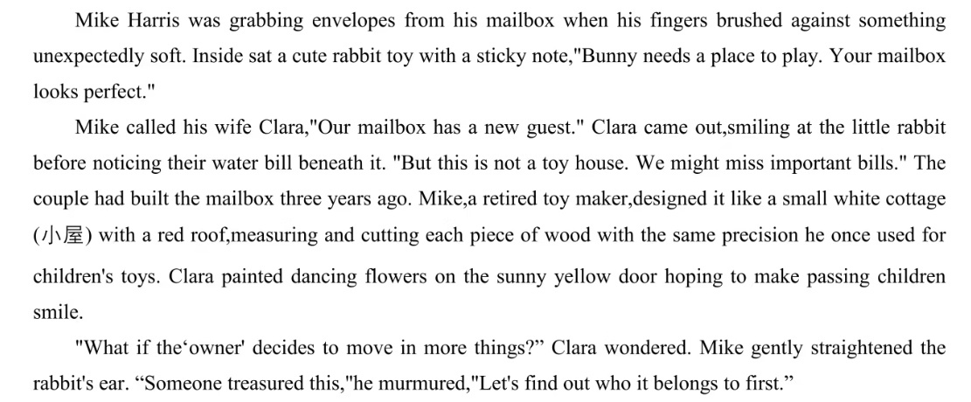

Slide 13
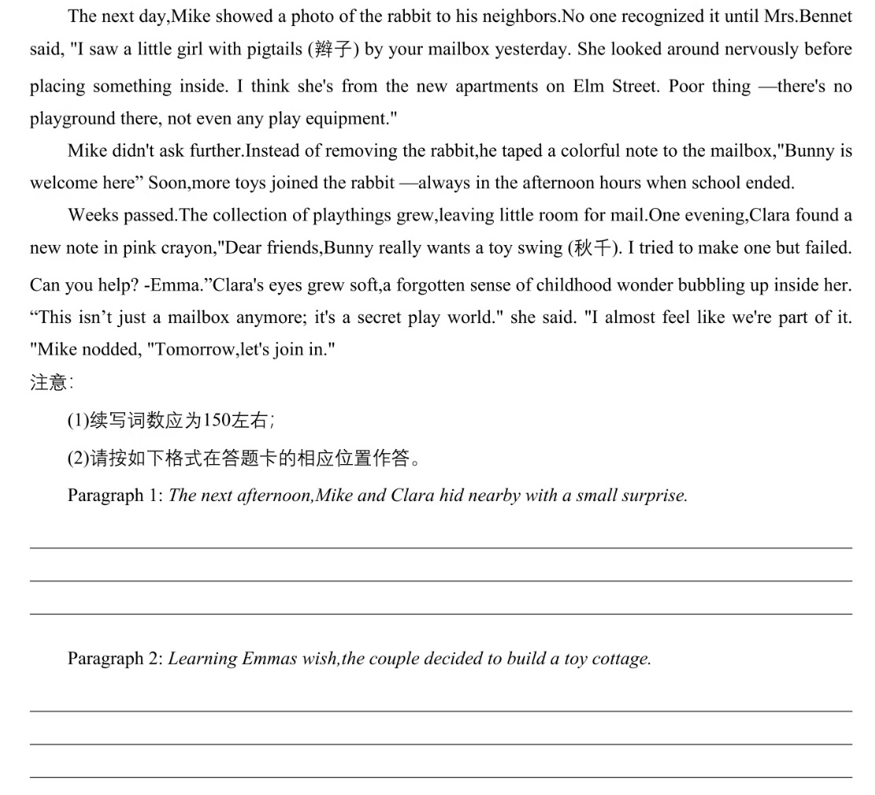

Slide 14
The next afternoon, Mike and Clara hid nearby with a small surprise. When a girl with pigtails approached, tiptoeing nervously toward the mailbox, they stepped forward with warm smiles. "Are you Emma?" Mike asked gently. The girl nodded, clutching her schoolbag tightly against her chest. Clara knelt down, unveiling a delicate wooden swing with intricate carvings. "For Bunny," she said softly. Emma's eyes sparkled like stars. With a joyful, silent gasp, she gently took Bunny from the mailbox, placed it on the tiny seat, and gave it a soft push. The swing swayed gracefully. "It's absolutely perfect!" she breathed. Then, gazing thoughtfully at the crowded mailbox, she whispered, "I wish all my toys had a cottage to play in."
Learning Emma's wish, the couple decided to build a toy cottage. Mike disappeared into his dusty workshop, his hands rediscovering the familiar rhythm of measuring and cutting wood with loving precision. Clara sketched imaginative designs: little windows, flowers dancing across a sunny yellow door. Days later, a mini masterpiece stood beside the mailbox. When Emma arrived, her jaw dropped. "A real toy house!" she yelled, tenderly arranging Bunny and others inside. Sunlight streaming through the tiny windows seemed to illuminate her pure joy. Watching her play, Mike felt his retired heart awakening, while Clara's eyes glistened with tears. They'd created something magical: not just a toy cottage, but a sanctuary where childhood wonder bloomed eternal.

Slide 15
The next afternoon, Mike and Clara hid nearby with a small surprise. As the school bus rumbled away, a girl with pigtails approached the mailbox. With bated breath, they watched her open the yellow door. Then Mike emerged, cradling in his palms a miniature swing. "Are you Emma?" he asked. The girl's nod sent her pigtails dancing. "It's for Bunny," Clara said merrily. Emma's fingers trembled as she placed the worn rabbit on the swing, which swayed in a gentle rhythm until her gaze drifted to the crowded mailbox. “I wish all this wonder had a proper house,” she murmured.
Learning Emma’s wish, the couple decided to build a toy cottage. Mike’s workshop, silent for years, hummed with the music of saw and sandpaper. Clara mixed paints into the hues of sunrise and garden. Together, they built not just walls and a red roof, but a realm. When Emma saw the finished cottage placed beside the mailbox, she jumped with joy. It stood as a testament to a profound truth:the most fleeting whispers of childhood, when met with a listening heart, can become the most enduring magic.

Slide 16
这篇读续的好句子（认真阅读2分钟）
1. The girl nodded, clutching her schoolbag tightly against her chest. Clara knelt down, unveiling a delicate wooden swing with intricate carvings.
2. Sunlight streaming through the tiny windows seemed to illuminate her pure joy.
3. They'd created something magical: not just a toy cottage, but a sanctuary where childhood wonder bloomed eternal.
4. With bated breath, they watched her open the yellow door. Then Mike emerged, cradling in his palms a miniature swing.
5. Emma's fingers trembled as she placed the worn rabbit on the swing, which swayed in a gentle rhythm until her gaze drifted to the crowded mailbox.
6. It stood as a testament to a profound truth:the most fleeting whispers of childhood, when met with a listening heart, can become the most enduring magic.

Slide 17
偷听（略）
充耳不闻
plug one’s ears (底下的例句不行）
To block out the incessant noise outside, he plugged his ears.
As he plugged his ears, the shrill noise outside muted into muffled hum.
turn a deaf ear to置若罔闻
turn a blind eye to熟视无睹
He who turns a deaf ear to advice must eventually lend a keen ear to regret.
He spilled out his grievances, but they just fell on deaf ears.
drown out（底下的例句不行）

Slide 18
The cheers of the crowd drowned out the referee’s whistle.
The thrill of adventure drowned out his initial flicker of fear.
Standing at the crossroads, she reminding herself: do not let others’ opinion drown out her inner voice.
The crowd’s roar drowned out my gasps and stirred up my energy.
分辨声源
trace追踪
discern观察、识别、了解、分辨出
pinpoint准确定位
The dog quickly pinpointed the source of the rustling noise.

Slide 19
inhale
He inhaled deeply, savoring the aroma of fresh bread.
exhale a sigh of relief / resignation / defeat
reek of散发出气味
The room reeked of cigarettes and stale coffee.
对比：rake, meek, leek
The croupier raked in the chips.
下节课从P₂₁₂ 味觉开始

Slide 20
背诵下列内容3分钟：（P₁₃₆)
1. correspond一致、通信 2. cater to迎合、适应
3. one’s blood boil怒不可遏 4. be entitled to travel first class有权利坐头等舱
5. ambiguous模棱两可的 6. aribitrary任意的、武断的
7. compulsory education义务教育 8. dampen one’s passion泼冷水
9. portable devices编写设备 10. steep profits暴力
11. start the project from scratch从头开始项目
12. wrestle with one’s conscience和良心作斗争
13. There is no substitute for honesty.诚实无价。
14. subscribe to every issue of the magazine订阅每一期杂志
15. zoom in the picture扩大照片，zoom out the picture缩小照片

Slide 21
16. legend形容词legendary 17. miracle形容词miraculous
18. patriotism爱国主义 19. poverty贫困
20. prosperity繁荣 21. reinforce the gates and windows加固门窗
22. rejuvenate Chinese civilization 复兴中华文明 23. transfer credits转学分
24. collaborative efforts合作 25. capture one’s imagination提高想象力
26. exceed one’s expectations超出期望 27. ceremonial sword仪式佩剑
28. shell the city轰炸城市 29. walk on eggshells如履薄冰
30. modify the proportion调整比例

Slide 22
1. zoom in the picture 2. miracle形容词
3. one’s blood boil 4. dampen one’s passion
5. subscribe to every issue of the magazine 6. poor名词
7. prosper名词 8. ambiguous
9. 和良心作斗争 10. 如履薄冰
11. rejuvenate Chinese civilization 12. modify the proportion
13. shell the city 14. arbitrary
15. 诚实无价 16. 迎合学生的需要
17. zoom in on the hot issue 18. 超出期望
19. be entitled to first class 20. start the company from scratch

Slide 23
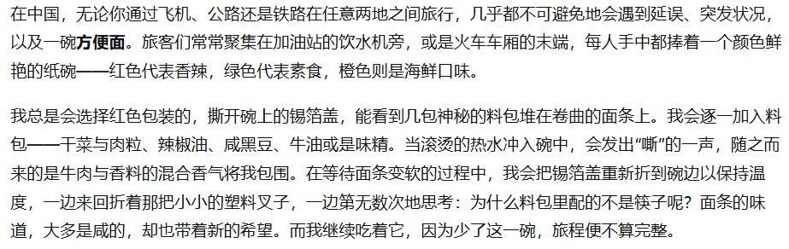
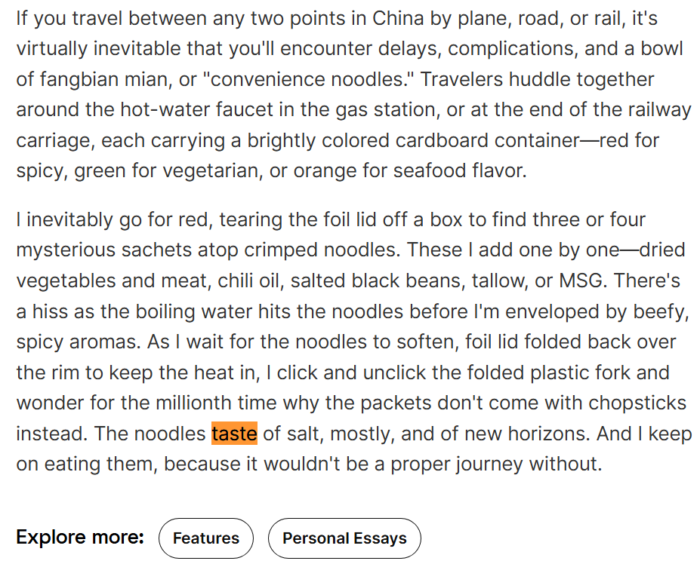
P₂₁₂ 16.4味觉
taste-He tasted the soup and nodded in approval.
He had tasted freedom only to lose it again.

Slide 24
try试吃
She tried the spicy dish hesitantly. (升级：Hesitantly, she tried the spicy dish.)
ad.置于句首是常见的手段：
Abruptly, the lights went out, plunging the entire hall into a silence.
Miraculously, the last seedling, which they had given up for dead, showed a hint of green.
Smilingly, she handed him the envelope that would unravel the mystery.
Pleadingly, the dog gazed at Tom, pawing at his arm.
With a pleading gaze, the dog pawed at Tim’s arm.

Slide 25
bite-He bite into the apple with a loud crunch.
sample品尝少量(底下的例句写得挺虚)
We sampled the apple sauce before modifying some ingredients.
I sampled Indian culinary delights for the first time.
savor-She savored every bite of the chocolate cake.
sip小口抿
He sipped the tea thoughtfully.
(反) He drank the tea in one gulp.
nibble小口咬，轻咬
tear into撕咬
He tore into the meat like a starving wolf.

Slide 26
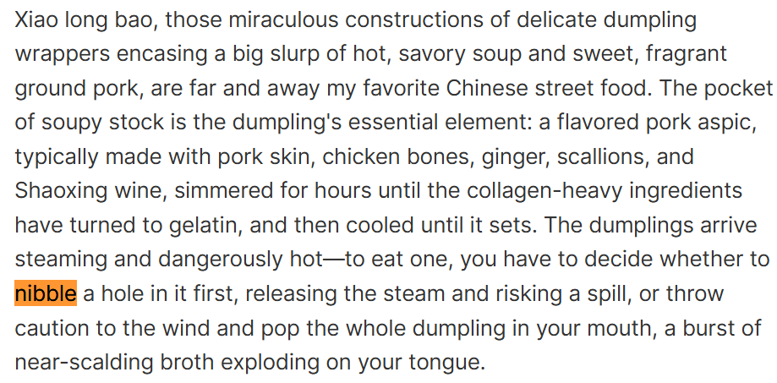
小笼包—这种堪称奇迹的构造：用纤薄的面皮包裹着一大口滚烫鲜美的汤汁以及香甜多汁的猪肉馅—毫无疑问是我最爱的中国街头小吃。那一包汤汁是它的灵魂所在：那是一种调味猪肉冻，通常用猪皮、鸡骨、生姜、香葱和绍兴黄酒熬制数小时，直到富含胶原蛋白的食材融化为明胶，再冷却凝固而成。小笼包上桌时热气腾腾，烫得危险—要吃它，你必须做出抉择：是先小心咬开一个小口，释放蒸汽，冒着汤汁洒出的风险；还是一鼓作气，将整个包子送入口中，让一股近乎滚烫的汤汁在舌尖瞬间迸发。

Slide 27
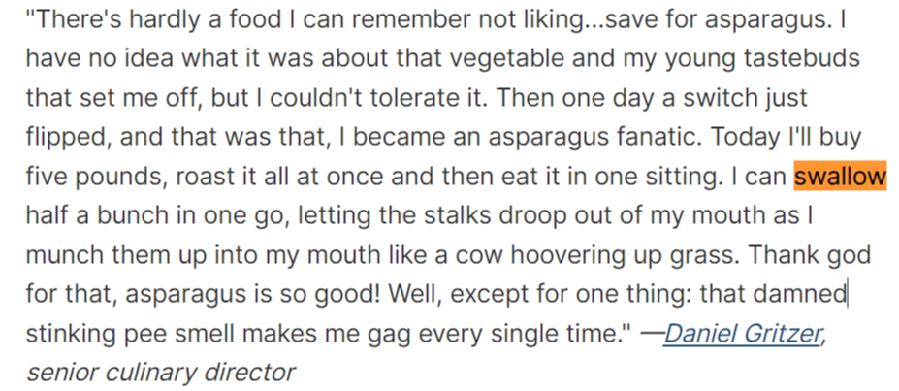
咽下
swallow吞咽、燕子
I swallowed my pride. I knew my brother’s daily routine and reasoned I could catch him at home around lunch time. So, I picked up a pizza and headed over to his house unannounced. His car was in the driveway, so unless he was out for a walk, he was bound to be at home. I walked up to the front door and rang the bell. As I stood there, I felt apprehensive. What would he say or do? How would he react to my impromptu presence? Would he scowl, swear, even close the door in my face?（高考题原文)

Slide 28
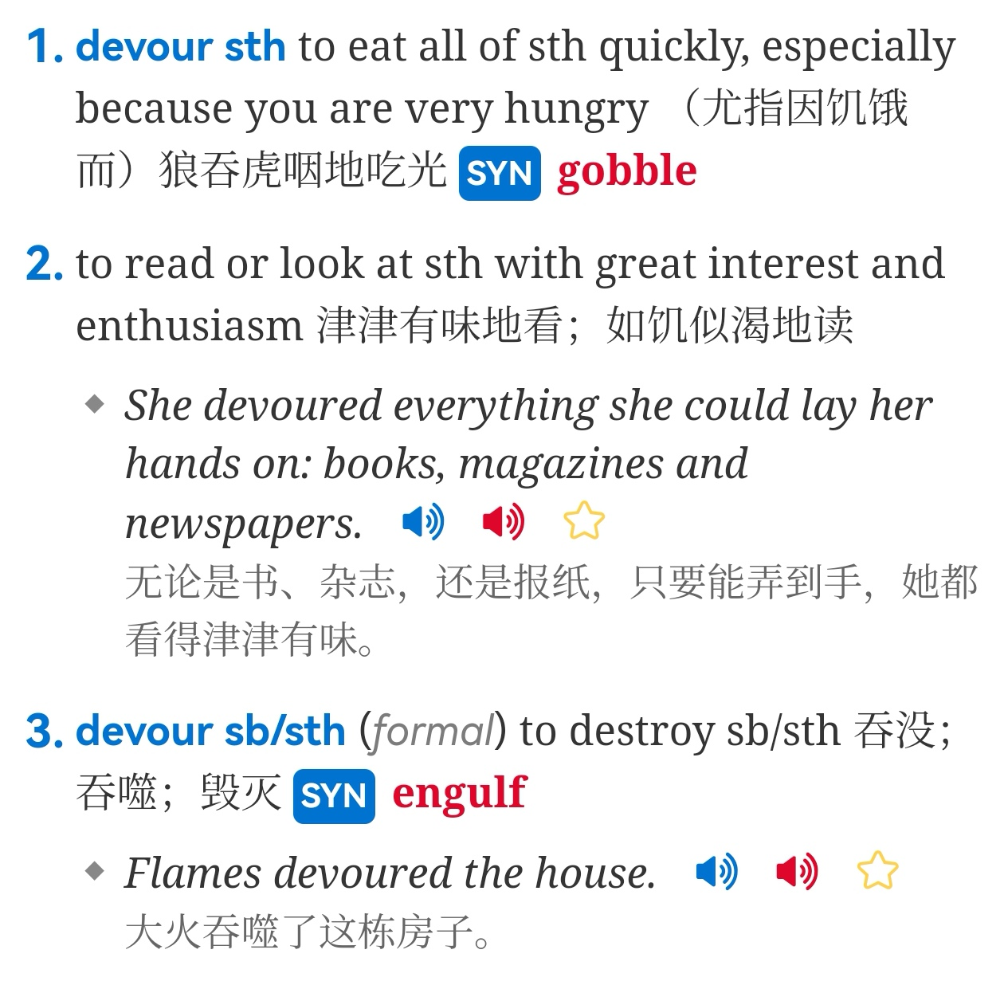
devour吞食

Slide 29
吐出 (P₂₁₄)
throw up呕吐
She felt sick and threw up on the floor.
16.5 身体感知
dizzy头晕的-dizzying使人头晕的
The sheer height of the tower dizzied me.
shaky = shaking发抖的
Her legs felt shaky after the run.
His shaky voice betrayed his nervousness.

Slide 30
pound心怦怦跳
His heart pounded in his chest.
After pressing triple 8, please hit the pound.
We went to the pound and saw dozens of cats of different breeds.
sweat出汗、汗水
He began to sweat under pressure.
The door flew open and my son burst in, dirty and sweaty. Before I could even ask about his day, he blurted out, “I earned fifty dollars!” His arms shot into the air, a triumphant grin beaming across his face. I gave him a huge thumbs-up and offered to cover the rest, but my determined boy shook his head, declining with a newfound pride.
(名言）Success is 1% inspiration and 99% perspiration.

Slide 31
gasp / pant for air / breath喘粗气
He gasped for air as panic took hold.
throb跳痛
His temples throbbed with tension.
tighten发紧
Her chest tightened with anxiety.
feel heavy发沉、沉重
Her eyelids felt heavy with exhaustion.
下节从P₂₁₇ 表达行为开始

Slide 32
回顾本节课需要注意的句子或短语（现在你有2分钟的时间阅读并尝试记忆这些句子）
plug one’s ears, turn a deaf ear to, turn a blind eye to, swallow one’s pride
He who turns a deaf ear to advice must eventually lend a keen ear to regret.
He spilled out his grievances, but they just fell on deaf ears.
Do not let others’ opinion drown out your inner voice.
exhale a sigh of relief / resignation / defeat
His shaky voice betrayed his nervousness.
Success is 1% inspiration and 99% perspiration.
He gasped for air as panic took hold.
Her eyelids felt heavy with exhaustion.

Slide 33
读续的好句子（你有3分钟的时间尝试去记忆）
1. The girl nodded, clutching her schoolbag tightly against her chest. Clara knelt down, unveiling a delicate wooden swing with intricate carvings.
2. Sunlight streaming through the tiny windows seemed to illuminate her pure joy.
3. They'd created something magical: not just a toy cottage, but a sanctuary where childhood wonder bloomed eternal.
4. With bated breath, they watched her open the yellow door. Then Mike emerged, cradling in his palms a miniature swing.
5. Emma's fingers trembled as she placed the worn rabbit on the swing, which swayed in a gentle rhythm until her gaze drifted to the crowded mailbox.
6. It stood as a testament to a profound truth:the most fleeting whispers of childhood, when met with a listening heart, can become the most enduring magic.
7. The door flew open and my son burst in, dirty and sweaty. Before I could even ask about his day, he blurted out, “I earned fifty dollars!” His arms shot into the air, a triumphant grin beaming across his face.

