Slide 1
《读后续写工具箱》 十六+十七

Slide 2
P₂₀₂ 第16章 感官行为
16.1 视觉
gaze 凝视
She gazed at the old photo, a faint smile playing on her lips.
(play: 闪烁、浮现、略过) Sunlight played on the surface of the lake.
Her gaze steadied me. With newfound confidence, I delivered my speech, my lines flowing so spellbindingly that the audience hung on every word. My conclusion was met with an immediate standing ovation.
When my gaze landed on the faded photo, a wave of nostalgia washed over me.

Slide 3
fix / fasten one’s eyes on ...
glue one’s eyes to ...
(fasten是fast的动词，fast? He made the boat fast. Breakfast来源)
peer费力看（底下的例句不大行)
He peered at the fine print in the policy from the insurance company.
He peered into the fog, struggling to discern what lay ahead.
拓展：blur / obscure / cloak / shroud one’s vision
look intently（intently专注地)
He looked intently at the chessboard, calculating his next move.

Slide 4
regard注视、凝视、端详
She regarded the old photo, her fingers tracing the faded faces.
The teacher regarded the repentant student sternly, but a hint of forgiveness softened his eyes.
scan扫视、仔细查看（来源于扫描)
She scanned the contract for any hidden clauses.
survey查看、审视（survey动词第一个意思）
The next morning we surveyed the damage caused by the fire.
flick one’s eyes over快速扫一眼 (flick轻弹、轻触) popcorn flick爆米花电影
flicker闪烁、闪现、快速抖动
eyes roam over眼睛游移不定
区分：wander / roam / stroll / loiter

Slide 5
偷看
peek / peep / peak
A fertive peek into the drawer revealed some coins. Immediately, he scooped them into his hands, unaware that they were Grandpa’s most treasured possession.
glimpse (无意识地一瞥)
I caught a glimpse of her before she melted / blended into the crowd.
(这个单词主要用在应用文里面)
Ice core samples drilled from Antarctica offer a glimpse into the Earth’s climate history over thousands of years.
Breakthroughs in genetic research offer a glimpse into the underlying causes of many hereditary diseases and potential pathways for treatment.

Slide 6
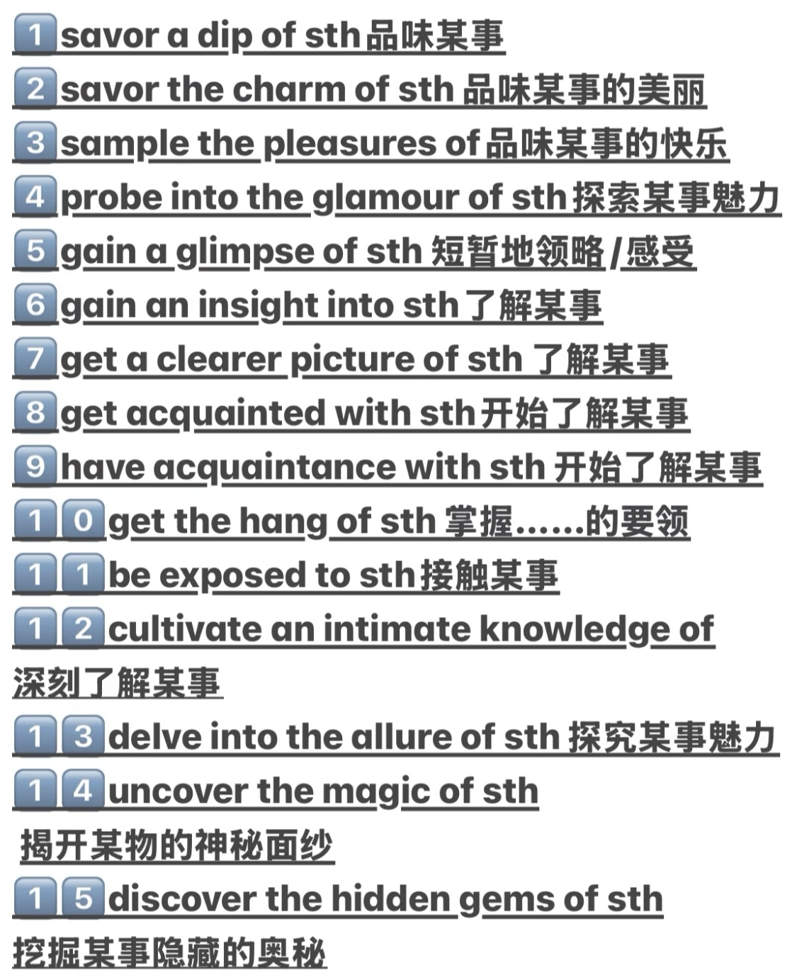
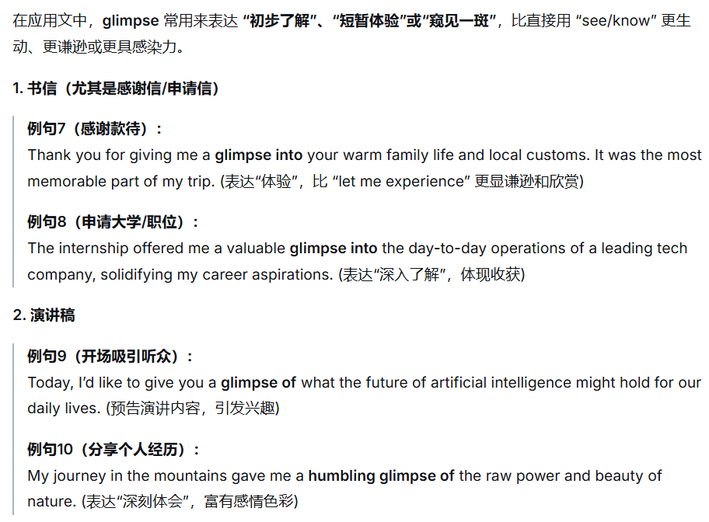

Slide 7
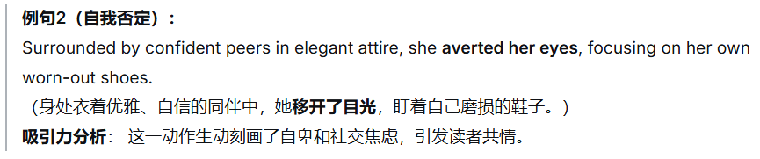
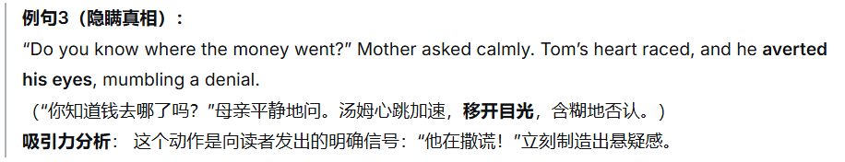
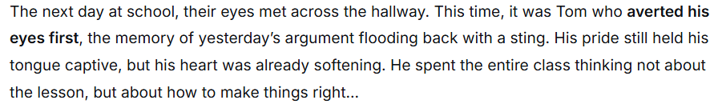
目光变化
avert one’s eyes避开视线

Slide 8
roll one’s eyes翻白眼
She rolled her eyes at his lame excuse.
squint眯着眼睛
He squinted into the blinding sun.
He raised a hand to shield his eyes, squinting against the sudden glare.
The land dropped away and the sea appeared. It stretched all the way to the grey horizon. Rusty fishing boats lined the harbor, and men hauled crates off them. Gulls circled the catch with begging beaks, as ice sloshed everywhere. I looked into the distance, and my heart thudded. Sandwiched in between the sea and sky was an island. If I squinted, it looked a bit like an inky smudge beneath the sun.

Slide 9
Rex stood frozen, squinting up at the shrinking figure of the pigeon, his earlier sneer replaced by stunned silence.
Together, they squinted into the distance, watching Blanche vanish into the horizon, until she became a tiny speck dancing with the clouds.
lock eyes with目光交汇
They locked their eyes across the room, neither of them blinking.
I locked eyes with my crush today, but there was no chemistry between us.
Our eyes locked and I saw suspicion and greed warred in his eyes.
Before stepping onto the stage, the nervous singer locked eyes with her teacher in the front row. Seeing the unwavering belief in those eyes, her fear melted away.
A low growl echoed in the silence. He froze, then slowly turned to lock eyes with the wolf lurking in the shadows.

Slide 10

眨眼
blink 眨眼（底下的例句不大行)
重要的两个短语：
in the blink of an eye / on the blink
对比：wink眨眼
(这两个单词在读续中使用频率较低)
rub one’s eyes揉眼睛
flutter one’s eyelids 眼睑颤动 / flicker one’s eyelids眼睑颤动
Her eyelids fluttered as she slowly regained consciousness.

Slide 11
P₂₀₇ 16.2听觉
被动听到（略）
倾听
tune in to专注聆听、理解或体谅他人（底下的例句不行）
Her words were cheerful, but I tuned in to the subtle tremor in her voice.
Feeling ashamed of my ignorance about him, I was eager to make amends. I began to tune in to his emotions, carving out time just to be with him.
更重要的是tune out不关注
lend an ear to倾听
He lent a sympathetic ear to her worries.
In Tim, I found a true confidant; to me, he never failed to lend a sympathetic ear.
Although I was quite willing to lend him an ear, I couldn’t follow his train of thought.

Slide 12


Slide 13
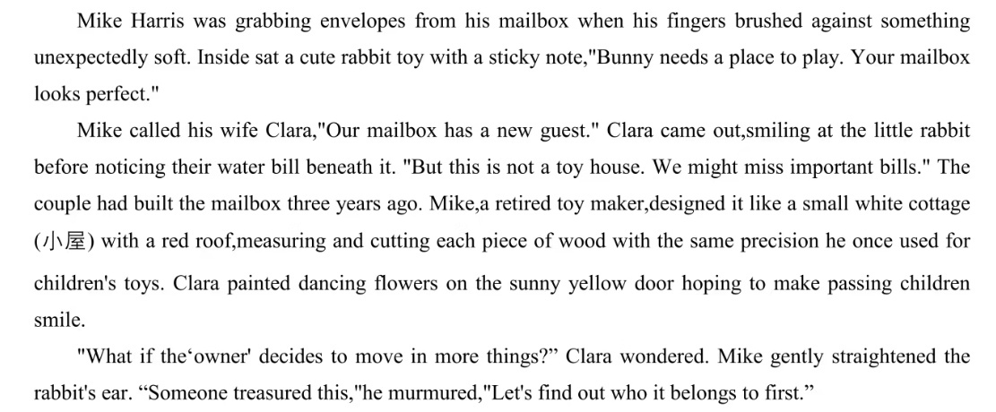

Slide 14
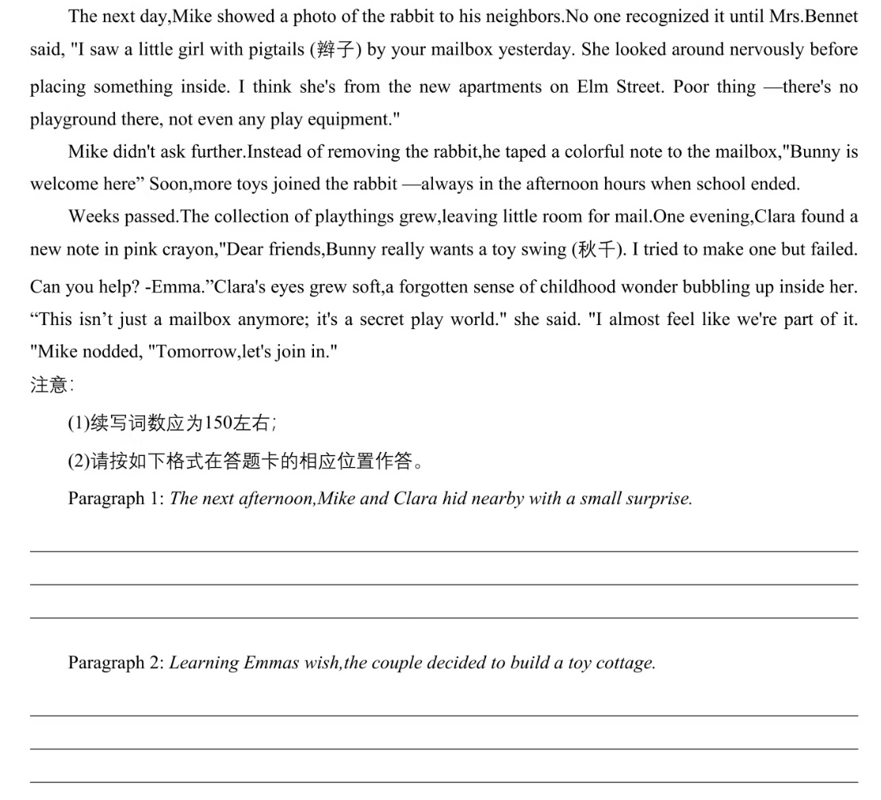

Slide 15
The next afternoon, Mike and Clara hid nearby with a small surprise. When a girl with pigtails approaches, tiptoeing nervously toward the mailbox, they stepped forward with warm smiles. "Are you Emma?" Mike asked gently. The girl nodded, clutching her schoolbag tightly against her chest. Clara knelt down, unveiling a delicate wooden swing with intricate carvings. "For Bunny," she said softly. Emma's eyes sparkled like stars. With a joyful, silent gasp, she gently took Bunny from the mailbox, placed it on the tiny seat, and gave it a soft push. The swing swayed gracefully. "It's absolutely perfect!" she breathed. Then, gazing thoughtfully at the crowded mailbox, she whispered, "I wish all my toys had a cottage to play in."
Learning Emma's wish, the couple decided to build a toy cottage. Mike disappeared into his dusty workshop, his hands rediscovering the familiar rhythm of measuring and cutting wood with loving precision. Clara sketched imaginative designs: little windows, flowers dancing across a sunny yellow door. Days later, a mini masterpiece stood beside the mailbox. When Emma arrived, her jaw dropped. "A real toy house!" she yelled, tenderly arranging Bunny and others inside. Sunlight streaming through the tiny windows seemed to illuminate her pure joy. Watching her play, Mike felt his retired heart awakening, while Clara's eyes glistened with tears. They'd created something magical: not just a toy cottage, but a sanctuary where childhood wonder bloomed eternal.

Slide 16
偷听（略）
充耳不闻
plug one’s ears (底下的例句不行）
To block out the incessant noise outside, he plugged his ears.
As he plugged his ears, the shrill noise outside muted into muffled hum.
turn a deaf ear to置若罔闻
turn a blind eye to熟视无睹
He who turns a deaf ear to advice must eventually lend a keen ear to regret.
He spilled out his grievances, but they just fell on deaf ears.
drown out（底下的例句不行）

Slide 17
The cheers of the crowd drowned out the referee’s whistle.
The thrill of adventure drowned out his initial flicker of fear.
Standing at the crossroads, she reminding herself: do not let others’ opinion drown out your inner voice.
The crowd’s roar drowned out my gasps and stirred up my energy.
分辨声源
trace追踪
discern观察、识别、了解、分辨出
pinpoint准确定位
The dog quickly pinpointed the source of the rustling noise.

Slide 18
inhale
He inhaled deeply, savoring the aroma of fresh bread.
exhale a sigh of relief / resignation / defeat
reek of散发出气味
The room reeked of cigarettes and stale coffee.
对比：rake, meek, leek
The croupier raked in the chips.
下节课从P₂₁₂ 味觉开始

