Slide 1
《读后续写工具箱》（十二）

Slide 2
14.11麻木
numb麻木的、无感的
be numb with cold冻麻了，be numb with shock极为震惊（极少使用)
She piled the branches and rags together and set them ablaze. As the flames grew, bright and crackling, the deep, biting numbness of the cold slowly began to loosen its grip.
emotionally drained情感耗尽的、心灰意懒的（使用频率较低）
14.12情绪失控、大爆发
impulsive冲动的，impulse冲动
=on the spur of the moment或a spur-of-the-moment decision
When children reach adolescence, a cascade of hormones are released, causing mood swings, impulsive behavior, and an unbelievable amount of eye rolling.

Slide 3
The moment I blurted out some harsh words on impulse, my elder brother’s face fell. Instantly, he turned to leave without a word. As I stared at his receding figure, the memory of his tender care washed over me. A sharp pang of regret shot through my chest. Without another thought, I dashed after him and caught his arm. “I’m so sorry,” I whispered, looking at him sincerely.

Slide 4
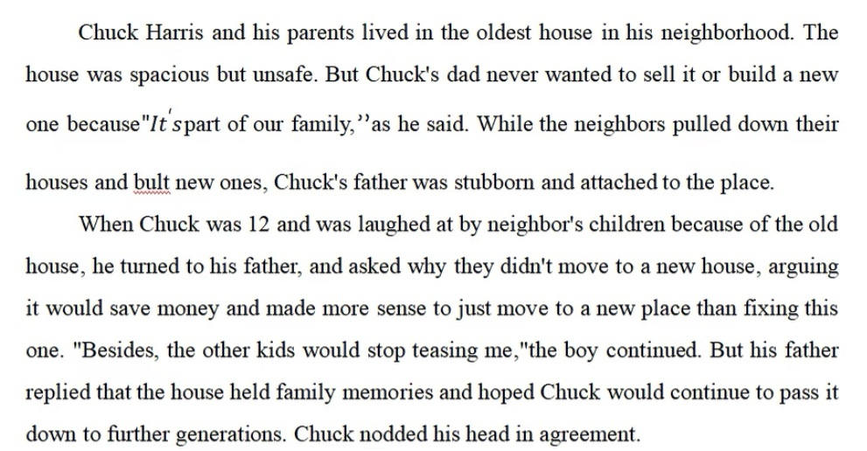

Slide 5
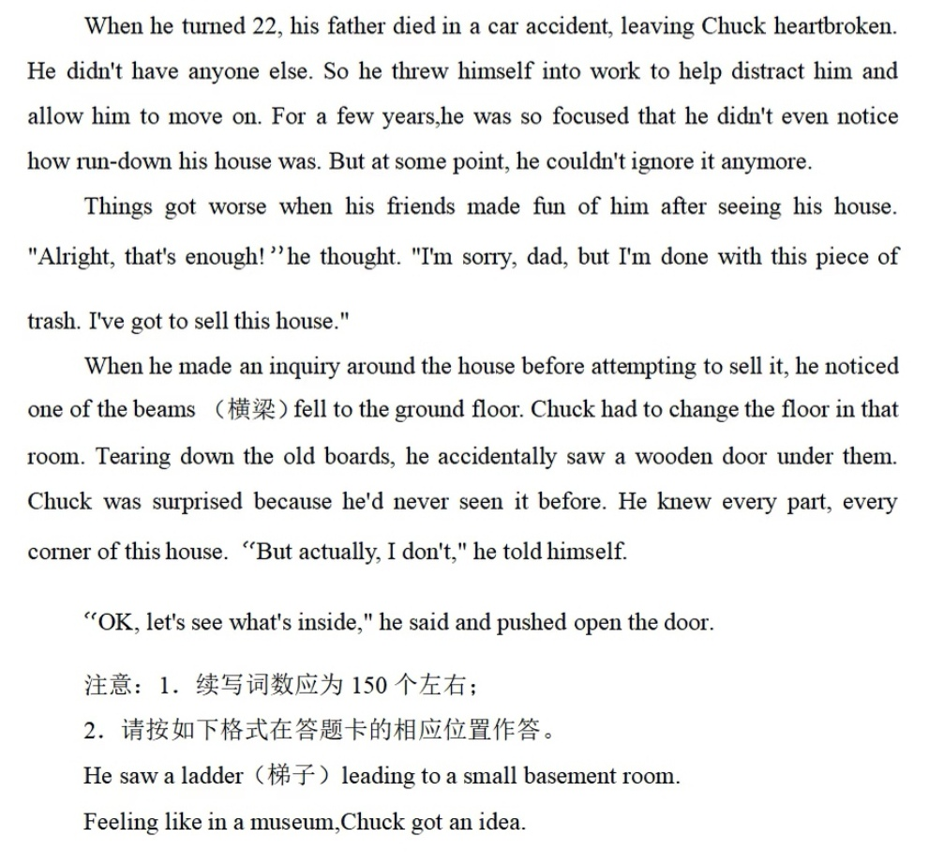

Slide 6
He saw a ladder leading to a small basement room. Driven by curiosity, Chuck grabbed a flashlight and descended slowly into the coo air. The beam of light shot across the dusty space, revealing shelves packed with vintage tools, old journals and his own childhood toys. He picked up a faded photo album, and fond memories came cascading into his mind. This wasn't just a hidden cellar; it was a treasure trove of his family's history.
Feeling like a museum, Chuck got an idea. In the following days, he painstakingly cleaned and categorized each artifact. Then he invited his friends. Their initial skepticism melted away the moment they stepped inside, replaced by stunned silence and then, awed whispers. “Chuck,” one finally exclaimed, “this isn't an old house. It’s a priceless treasure.” Hearing this, Chuck’s heart swelled with pride and profound relief. He felt immensely grateful that he hadn't sold the place on impulse.

Slide 7
snap突然崩溃、无法自持
He snapped after weeks of silent endurance.
My patience finally snapped.
Suddenly the rope snapped. (猜一猜)
yell / shout at the top of one’s lungs / voice扯着嗓子喊
burst (过去式原形) into tears / laughter突然大哭、突然大笑
melt down（本意为熔化金属）彻底崩溃（不建议使用）

Slide 8
14.13被排挤、被疏远
alienated感到被疏远的
She felt alienated from her classmates, as if speaking a language they didn’t understand.
excluded被排除在外的（底下的例句无力）
be left out被遗漏（底下的例句无力）
out of place格格不入
She stood in the corner, feeling completely out of place.
isolated被孤立的
He became more isolated as others drifted into tighter circles.
Temporarily isolated as she was, she held the conviction that as long as she adhered to genuine commmunication, she would blend in and had fun.

Slide 9
14.14空虚感、无意义感
empty空虚的
He smiled, but it felt empty, like a gesture rehearsed many times.
hollow内心空洞的
We are the hollow men / We are the stuffed men / Leaning together / Headpiece filled with straw. Alas!
(补充) void空白、空虚
The void left by his mother’s death was never filled.
devoid of缺乏
The letter was devoid of warmth and feeling.
Confined within the echo chambers, we are devoid of viewpoints and perspectives different from ours.
下节课从P₁₈₃ 14.15开始

