Slide 1
《读后续写工具箱》 十九+二十

Slide 2
复习上节讲过的重点句子（5分钟）
1. Without hesitation, I scooped her up and carried her to my truck. Once inside, the warm air blowing from the heater brought color to her pale cheeks.
2. I realized that our stars, one born of love and the other of discovery, kept us connected across any distance.
3. He slid the key in and turned. Then the car roared to life.
4. The girl nodded, clutching her schoolbag tightly against her chest. Clara knelt down, unveiling a delicate wooden swing with intricate carvings.
5. Sunlight streaming through the tiny windows seemed to illuminate her pure joy.
6. They'd created something magical: not just a toy cottage, but a sanctuary where childhood wonder bloomed eternal.
7. With bated breath, they watched her open the yellow door. Then Mike emerged, cradling in his palms a miniature swing.
8. Emma's fingers trembled as she placed the worn rabbit on the swing, which swayed in a gentle rhythm until her gaze drifted to the crowded mailbox.
9. It stood as a testament to a profound truth:the most fleeting whispers of childhood, when met with a listening heart, can become the most enduring magic.
10. The door flew open and my son burst in, dirty and sweaty. Before I could even ask about his day, he blurted out, “I earned fifty dollars!” His arms shot into the air, a triumphant grin beaming across his face.

Slide 3
P₂₁₈ 对话动作
elaborate on详细叙述
He elaborated on his plan in detail.
=expand on, enlarge on
deliberate on仔细考虑
“Could you elaborate on that?” he pressed, sensing there was more to the story.
(读续用give sb. a detailed account of ...)

Slide 4
(盐城2026届期中)
On a bright April morning, Ms. Bennett led her photography club to the hill by the lake. “Find what speaks to you,” she said, handing them each a turn with the school’s only camera. The lake shone under the gentle sun, and trees were clearly reflected on its surface.
Ethan, quiet but observant, waited patiently for his turn. He loved taking small details others often missed. When it was finally his turn, he lifted the camera and pressed the button just as sunlight broke through the clouds. The picture shone with warmth.
When the club packed up to leave, Ethan placed the camera on the bench beside him while helping to carry stands and boxes. He glanced back once and saw Tyler, another student, zipping his backpack.
Moments later, Ethan returned to get the camera. But the bench was empty. Panic tightened his chest. “Did you take the camera?” he asked Tyler, trying to keep his voice calm. Tyler looked surprised. “No, I didn’t even touch it.” Ethan wanted to believe him, yet the picture of Tyler walking away kept replaying in his mind. He searched the grass, under benches, even the nearby bushes — nothing.

Slide 5
Back at school, Ms. Bennett asked where the camera was. Ethan froze. “I — I don’t know,” he said nervously, unable to meet her eyes. He told himself he’d explain later, once he found it.
Days passed. The club’s energy faded. Tyler stopped talking to him, and Ethan’s photos lost their color. Each time he saw Ms. Bennett’s encouraging smile, guilt grew deeper inside him.
Then, one cloudy afternoon, the school cleaner entered the office holding something dusty and familiar. “Found this near the lake,” he said. Ms. Bennett’s eyes lit up. “Oh, thanks a ton!” But Ethan’s stomach sank. Relief didn’t reach him — only shame. That night, he couldn’t sleep. He thought over every second of that day, from the golden light on the water to the moment he lied. The beauty he once loved now felt heavy with regret. By morning, one thought remained clear: he had to make things right.

Slide 6
The next morning, Ethan knocked on Ms. Bennett’s office door.
Ms. Bennet answered it and let him in. Before she could say anything, Ethan poured out his carefully fabricated story, confessing that he had told a lie. He gave Ms Bennet a detailed account of how he lost the camera which later ended up on the lakeside. Ms Bennet didn’t see through his well rehearsed lines. "I am happy that you told me the truth," Ms. Benneth praised Ethan, adding that integrity counts in a person's character. She then told Ethan that they were going to have another club outing next Monday and asked Ethan to take care of the camera.
On the next club outing, Ethan walked up to Tyler.
Seeing Ethan approaching, Tyler was somewhat alert. But Ethan just wanted to talk about how to take good photos. Tyler was also a big fan of photography, so they chatted happily. When the tension dissolved, Tyler failed to suppress his guilty conscience any longer. "Sorry, Ethan, I took the camera last time," he murmured, daring not to meet Ethan's look. "It's ok, Tyler. Think nothing of it," Ethan said forgivingly. When the words tumbled out, the sun broke through the clouds. The two club outing experiences taught them that to err is human, to forgive, divine.

Slide 7
inquire询问（正式或礼貌）
用法：inquire (enquire) about sb. / sth., inquire (enquire) sth.
Nervous and expectant, I called the hotel to inquire whether they found a ring, only to be told nothing had been turned in.
I penned a letter to the local animal shelter, detailing how my dog looked like. Hearing my desperate inquiry about its whereabouts, the working staff promised to look for it to the best of their ability.
press逼问、追问
He pressed her for a answer.
Don’t let yourself (press) into doing something you don’t like. (牛津)
I was pressing my claim for custody of the child. (朗文)

Slide 8
demand质问、强烈要求
He demanded to know the truth.
(千万不要：demand sb. to do sth.)
reply / respond回复（主要为书信用词）
(不要用) I’d appreciate it if you could reply to me.
可以：I look forward to receiving your reply / response.
Thanks for your thoughtful and timely response. It was a great relief during a period of intense anxiety. I took your advice to heart, and it has made a real difference. In particular, I've been working on accepting that, with so many exams this year, it's impossible and unnecessary to outperform everyone every time. Instead of fixating on each mark, I'm learning to focus on my own progress and well-being, just as you suggested. This shift in perspective has been truly liberating. (给朋友写信，合适的语言)

Slide 9
retort反驳
He retorted, “That’s none of your business.”
同义词：contradict, counter
Flashing me a defiant look, he retorted, "Nothing beats the food in our canteen!" I was about to list some really delicious foods when he said with a grimace: "Pricewise, of course." Hearing this, I let out a bitter smile and said: "OK, you win! I rest my case."
interrupt打断
He interrupted her mid-sentence.
(disturb打扰: She awoke early after a disturbed night.)
(disrupt扰乱、打乱：Bus services will be disrupted tomorrow because of the bridge closure. + Obsessive use of a digital device is quite disruptive.)

Slide 10
snap厉声打断
He snapped, “Enough!”
“Don’t just sit around doing nothing,” he snapped.
Suddenly, the rope snapped and he fell to the earth with a dull thud.
(打车要求下车咋说？）
put me on earth, connect me to the earth, decrease me there, leave me alone, delete me from the car, extract me from the car, subtract me from the car, copy and paste me outside, I wanna see you from outside, promote me to pedestrian, install me there, install me to the earth, uncar me, divorce me from the car, unplug me from the car, break up with me there

Slide 11
echo随声附和
背诵：他的善举引起了人们的共鸣，人们纷纷慷慨解囊。
affirm明确肯定
She affirmed that he was right.
Both sides affirmed their commitment to the ceasefire.
He claims that modern physics affirms his Christian beliefs.
The court affirmed the right to free speech.
Do you copy? Affirmative!

Slide 12
P₂₂₁情绪语言
reassure=put / set one’s mind at ease / rest 安心、打消疑虑
They tried to reassure her, but she still felt anxious.
assure保证、确保
rest assured尽管放心
Please rest assured. Your concerns will not fall on deaf ears.
soothe抚慰
She soothed the crying child by humming a lullaby.
console安慰、抚慰
She put a consoling arm around his shoulders.

Slide 13
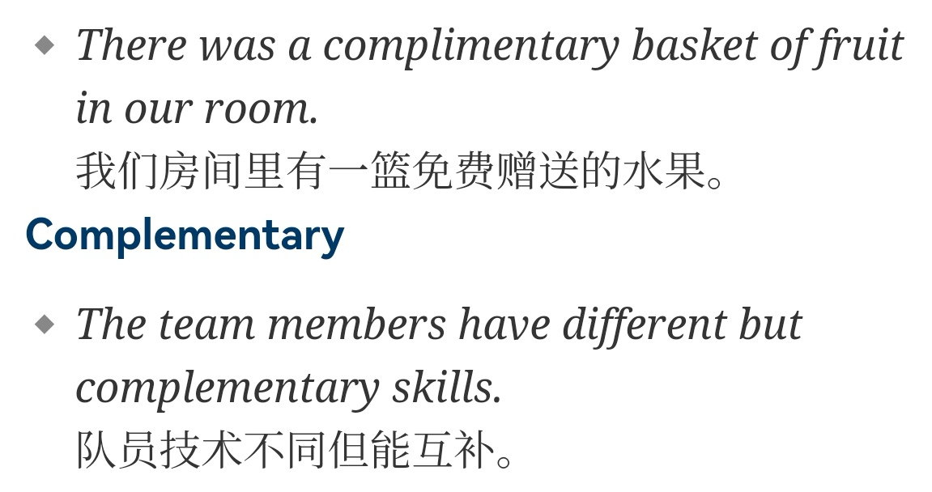
compliment恭维、赞美

Slide 14
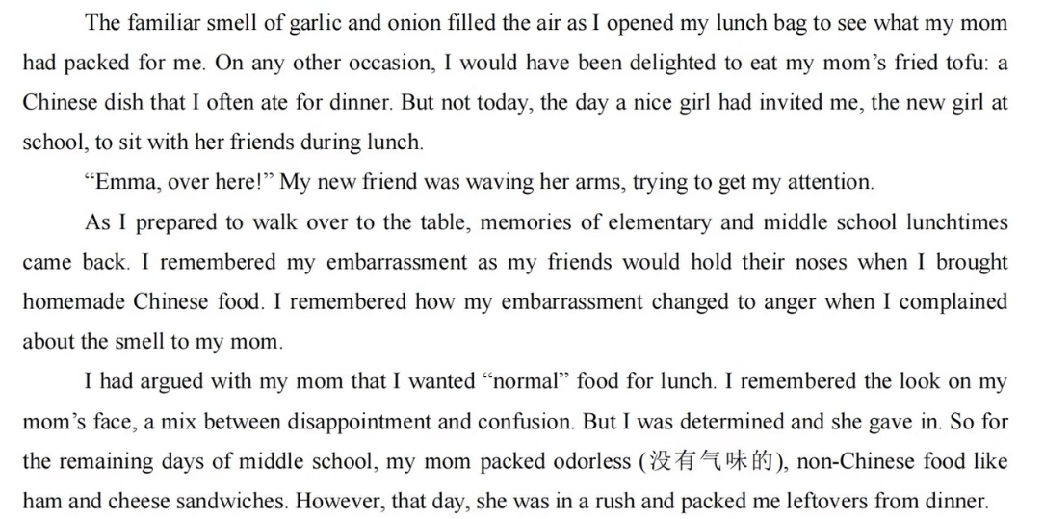

Slide 15
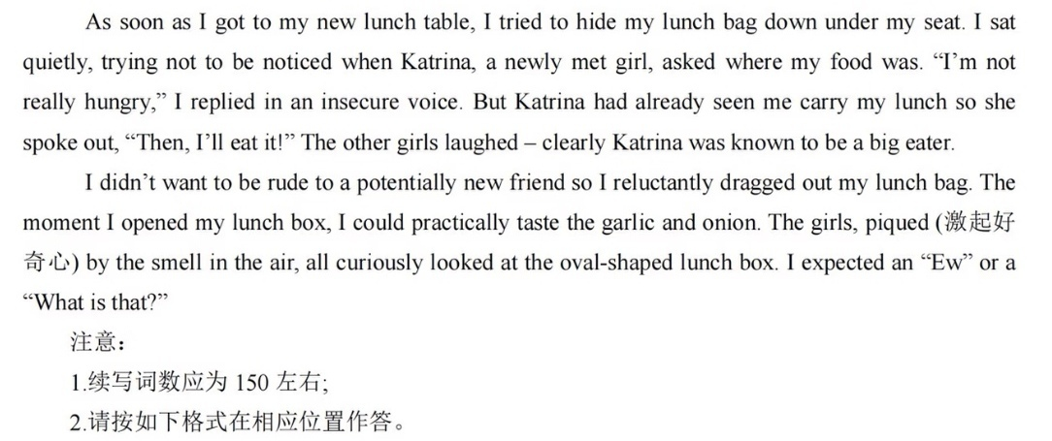

Slide 16
I thought they would walk away or tell me to leave.
Instead, Katrina leaned closer, her eyes widening with genuine interest. “That smells amazing!” she exclaimed. “What is it?” Before I could stammer a reply, the other girls gathered around. Hesitantly, I explained it was my mom’s fried tofu, a traditional Chinese dish. To my astonishment, Katrina wanted to try a bite. As she tasted it, she smiled broadly and offered a sincere compliment: “This is delicious!” The others followed, and my lunch became a shared feast. The afternoon passed in warm conversation, and when the final bell rang, I walked home with a light heart, eager to share the news.
When I arrived home, my mom asked how my day went.
With delight, I described the lunch: how the girls had embraced the food I once feared would isolate me. Mother sighed, her usual worry melting into relief. “Tomorrow, I’ll pack you something different,” she said, her eyes sparkling. “Let them fall in love with our food, bite by bite.” It was her simple pride that made me see the truth: my shame had never been about the food, but my own insecurity. That day, I learned that authenticity builds bridges and what makes us different can become what connects us most deeply.

Slide 17
make amends弥补过失
He tried to make amends by helping her clean up.
make amends to sb. for sth. 赔不是、赔偿、将功补过=make up for
relate讲述、讲起
She related how she overcame the challenge.
(relate是个一词多义单词，主要的一词多义是理解、认同：relate to)
We w away (消磨时间) the afternoon playing cards in front of the fire.
She gave permission to the plane to t (飞机滑行) into position and hold for takeoff.
She was s (穿戴、显摆) a T-shirt with the company’s logo on it.

Slide 18
deliver做演讲
She is due to deliver a lecture on genetic engineering.
He delivered his lines confidently.
The jury finally delivered its verdict.
He has promised to finish the job by June and I am sure he will deliver.
The team delivered a stunning victory last night.
The baby was delivered by Caesarean section.
address发表演讲
address a meeting在会议上发表演讲
address the opening (closing) ceremony在开幕、闭幕式上演讲

Slide 19
17.2 书面与符号表达
书写类动作
scribble / scrawl潦草地写
He scribbled a note before rushing out.
“I’ll pay you back,” I promised, hastily scribbling his number on a crumpled receipt before sprinting for the bus.
As we can see, in the first picture, the girl scribbled something on the paper using her feet while the second picture showcased the girl attentively wielded the brush to draw on the canvas.
draft起草
He drafted an apology but never sent it.
craft精心制作
All the furniture is crafted from natural materials.
drift漂流、漂移、陷入
Some people drifted into teachig.

Slide 20
绘画类动作
sketch素描、勾画
He quickly sketched the view from the window.
She sketched out (=outlined) her plan for tackling the problem.
depict描绘（正式用词)
The mural depicts scenes from village life.
记号类动作
underline划线=underscore, underlie
He underlined the main idea in blue.
highlight高光
He highlighted the deadline on the calendar.

Slide 21
check打勾
She checked all the items on the list.
Please check (=tick) the boxes beside the sentences.
cross out划掉
签名类动作
authorize授权签字
He was authorized to sign on behalf of the board.
stamp盖章
She stamped the certificate with the school seal.
inscribe题写、刻写
Many famous poets inscribed poems on Mount Tai.
下节从P₂₂₈开始

