Slide 1
《读后续写工具箱》（十三）

Slide 2
... Every instinct screamed at him to flee the approaching seniors, but the bird’s desperate fluttering mirrored the panic in his own chest. He saw himself in its trapped, helpless state. Taking a deep breath, he blocked out everything else. His slender fingers, usually skilled only at sketching delicate wings, now worked with frantic urgency to pick at the knots confining the creature. The messy tangle of string and debris finally gave way, and the sparrow, with a grateful chirp, shot into the dim hallway just as footsteps halted right behind him.
... He wasn’t smirking like others. Instead, he watched the sparrow disappear out of a high window before looking back at Leo, who was still crouched on the floor, braced for ridicule. “It takes courage to stop for something when you are running for yourself,” Mark said, his usually harsh voice turning soft. After this, he reached a hand to Leo and tugged him up to his feet. “Are we good?” The question was gentle, accompanied by a smile that disarmed Leo's lingering tension. It was at that moment that Leo understood his moment of vulnerability had unexpectedly bridged the gap between two different souls.

Slide 3
14.15被误解、被错怪
下边的表达不需要掌握
(拓展）容易被误解的短语：
busboy
dry goods
blind date
eleventh hour
personal remark
sweet water
confidence man
capital idea
red tape
dead president
service station
sporting house
rest room
horse sense
blue stocking

Slide 4
pull one’s leg
in one’s birthday suit
eat one’s words
an apple of love
handwriting on the wall
bring down the house
have a fit
make one’s hair stand on end
All his friends didn’t turn up.
He was only too pleased to let them go.
It can’t be less interesting.

Slide 5
14.16幡然醒悟
hit 突然想到
It hit / struck / occurred to me that I had been holding onto the wrong belief for so many years.
have an epiphany突然领悟（了解就可以，太难了）
connect the dots串联起点滴
At last, she connected the dots and understood how everything fit together.
wake up to the reality意识到现实

Slide 6
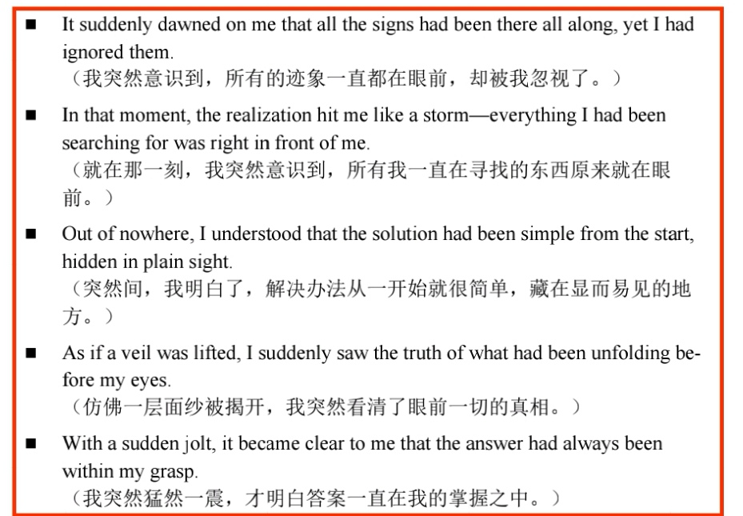

Slide 7
Several years ago, I went through a bad stretch. I was beaten down by loneliness and marriage problems, and our house was constantly going through construction. To top it all off, my epilepsy became so severe that I spent a life-threatening week in the hospital, part of the time in a coma.
After a miraculous escape from death, it dawned on me: My number should have been called, but I was still here. There must be a reason. I needed to set my life on a better trajectory. But what could I do? Plenty of things had to change, but most of the pieces were out of my control.

Slide 8
14.17被理解、被认可
feel validated感到被肯定
I realized that truth happiness lies not in seeking external validation but in finding inner tranquility.
resonate with someone引起共鸣（其他的表达？）
14.18 释然、放下、看开了
relieved松了一口气的
breathe / exhale / let out a sigh of relief
let go of放下、释怀
The art of life is to know when to let go and when to hold fast.
come to terms with逐渐接受
It took him a while to come to terms with the end of the friendship.
make peace with和解

Slide 9
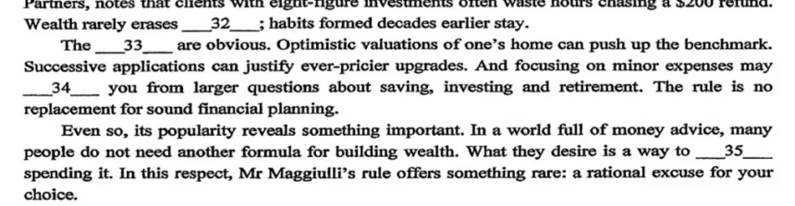
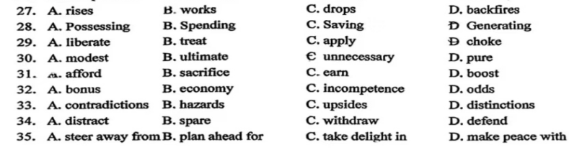

Slide 10
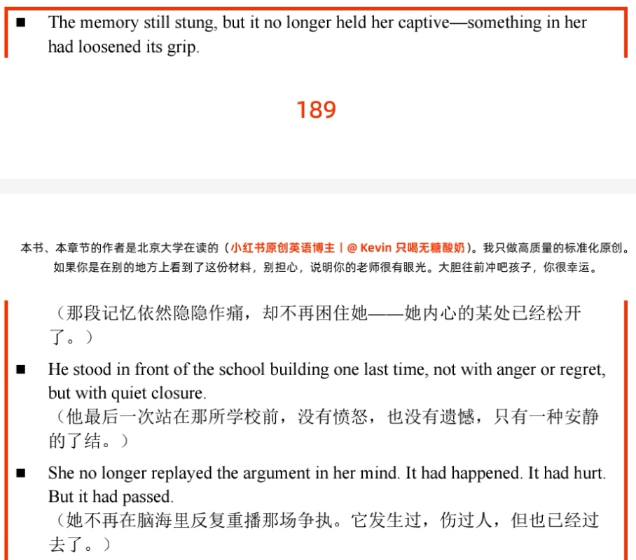

Slide 11
14.19成熟、成长、学会一课
reflect on one’s actions反思行为
He began to reflect on his actions and what they had cost.
沉思？
become more aware of更加意识到
下一节从P₁₉₁开始

