Slide 1
《读后续写工具箱》（十一）

Slide 2
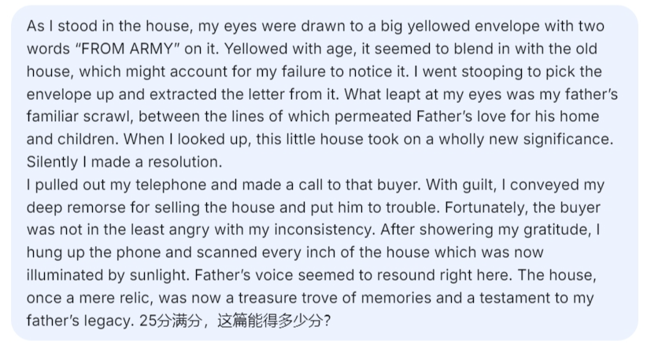
14.7怀旧
nostalgic / nostalgia (底下的句子写得不大行)
As her gaze lingered on the faded photo album, a wave of nostalgia washed over her.

Slide 3
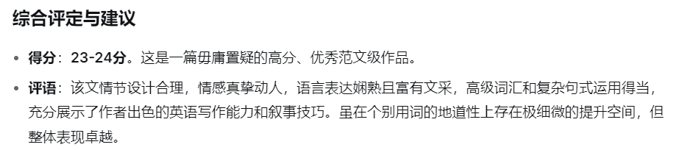

Slide 4
look back on追忆
He often looked back on those childhood summers with quiet fondness.
fondness喜欢、深情
He will be remembered by the staff with great fondness.
feel a pang of longing突然泛起的渴望或怀念
pang突然的身体或精神痛苦：a sudden pang of jealousy
A sudden pang of panic and despair seized Tim as the towering bear loomed before him. Its claws gleamed like razors, sending a shiver down his spine. Before he could even turn to run, the creature had spotted him and began to bear down.
yearn for the past渴望回到过去
be tinged (使带有情感) with sadness带点伤感
Her smile was tinged with sadness as she looked at the old photo.
tinge主要意思：着色 The light of the setting sun tinges the buildings with delicate colors.

Slide 5
猜一猜
She sways like a startled swan,
And glides like a soaring dragon.
Her brilliance outshines autumn’s chrysanthemum,
Her vigor surpasses spring’s pine.
...
Her natural fragrance needs no added perfume,
Her beauty wears not the faintest tinge of rouge.
Bright eyes sparkle beneath gentle brows,
Sweet dimples deepen near rosy cheeks.

Slide 6
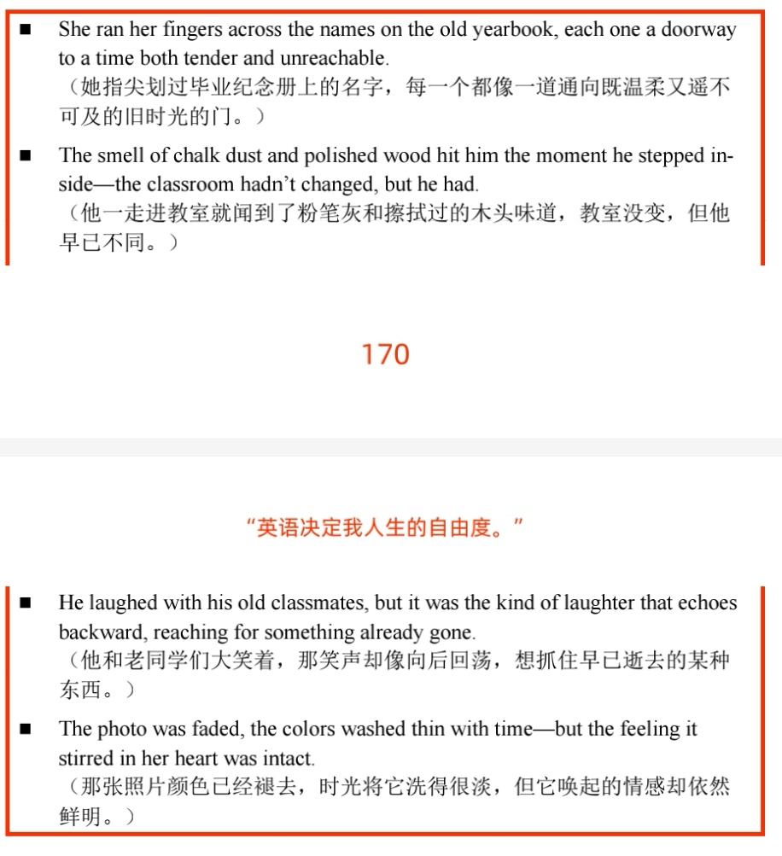

Slide 7
14.8困惑
perplexed困惑的、不知所措的
A perplexed frown appeared on his face as he scratched his head. The answer simply eluded him.
Perplexed, he scratched his head, trying to make sense of the contradictory clues.

Slide 8
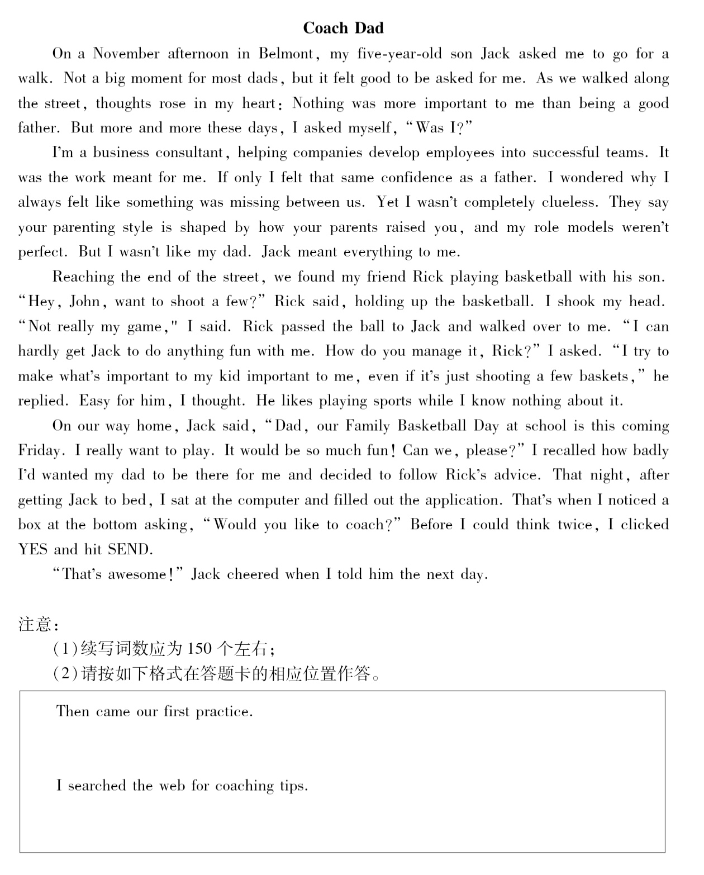

Slide 9
Then came our first practice. Excited and nervous, I gathered five kids, including Jack, at the school basketball court. I was about to explain some simple rules when these naughty pupils locked their eyes on the basketball and charged at it. Seeing this, I lost my composure and yelled: "Keep your line! Stay where you are!", only to be met with louder squeaks and laughter. This unexpected episode completely caught me off guard. After they were dismissed, Jack trotted to me, suggesting that maybe I could look up some workable strategies online.
I searched online for coaching tips. To my delight, it proved immensely helpful, offering me the most efficient strategy “Show, not tell”. When I again summoned them together, I showcased the skills of passing, shooting and dribbling. They did as told and practiced seriously. My son Jack flashed me a grin and gave me a big thumbs-up. As you could imagine, on the Family Basketball Day, the team I coached put on a terrific performance. When Jack gave me a tight embrace and whispered, "Dad, you are a great coach and a father. I love you!", tears of happiness welled up in my eyes.

Slide 10
feel disoriented感到迷失方向
She felt disoriented after reading the dense philosophical passage.
14.9 矛盾、纠结
ambivalent内心矛盾的（这个词太难了，了解就可以了）
She felt ambivalent about leaving home: excited for the future, yet tied to the past.
torn左右为难的
He was torn between telling the truth and protecting his friend.
As a housewife, I was always torn between keeping an orderly home and staying in shape.
conflicting emotions矛盾的情绪
wrestle (battle, struggle, grapple) with内心挣扎
David wrestled with the desire to buy the latest cellphone, but in the end, his vanity got the better of him. He raced to the store, produced the money, and bought it. With a pounding heart and trembling hands, he couldn’t wait to download the games, which were like swallowing vortexes. Two months later, his grades plummeted, and his ambitions lay forgotten, buried under the glowing screen.

Slide 11
weigh the pros and cons权衡利弊
Weighing the pros and cons comes before a wise decision.
14.10 压抑、克制
suppress压抑、强行按下（底下的例句写得不大行）
At the solemn ceremony, a childhood memory flashed in her mind. Her hand shot to her lips to suppress the giggle, her eyes darting around to see if anyone had noticed her moment of impropriety.
bottle up憋在心里
put on a brave face强装镇定
maintain composure保持镇定
She maintained her composure when the news caught her off guard.
mask one’s feelings掩盖真实情感
He masked his embarrassment with a smile.
swallow one’s anger忍下怒火，swallow one’s pride放下架子
下节从P₁₇₆ 14.11开始

