Slide 1
《读后续写工具箱》精编六

Slide 2
P₁₃₃
第11章 厌恶
The sight turned my stomach a little, but what lingered was a disgust I had no name for.
(这个句子写得有点奇怪）
People become quite illogical when they try to decide what can be eaten and what cannot be eaten. If you lived in the Mediterranean, for instance, you would consider octopus a great delicacy. You would not be able to understand why some people find it repulsive. On the other hand, your stomach would turn at the idea of frying potatoes in animal fat -- the normally accepted practice in many northern countries. The sad truth is that most of us have been brought up to eat certain foods and we stick to them all our lives.

Slide 3
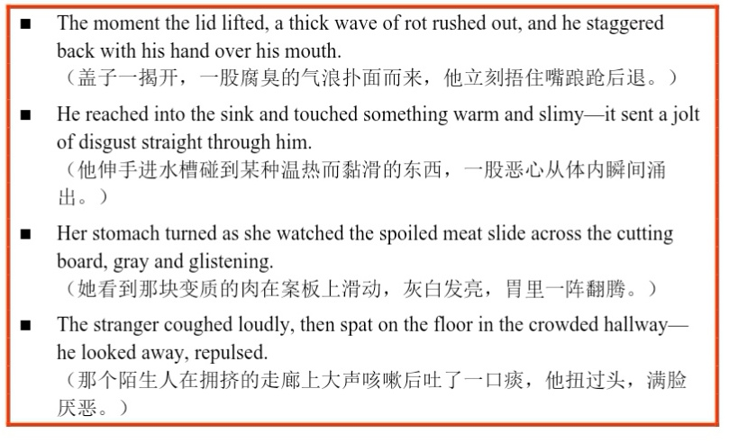
11.1 生理厌恶

Slide 4
11.2道德厌恶
contemptuous / contempt
She gave a contemptuous look when he bragged about cheating on the exam.
其他：sneer at, scorn, disdain
As the mocking laughter erupted around him, Li Ming looked up to see scornful looks directed his way.
He showed his carefully painted artwork to the class, only to see scornful looks on some students' faces, and his heart sank.
look down on / upon看不起
look up to尊敬
They looked down on anyone who bullied others for fun.

Slide 5

find something despicable认为...卑鄙可耻
He found it despicable that they spread rumors just to ruin his reputation.

Slide 6
一句话猜电影：
1. Redhead trades her voice for the ability to spread her legs.
2. An old man’s wife dies, and then his house floats away.
3. Giant purple sweet potato with a rock collection erases half the population.
4. Just a ton of sand. And some politics.
5. Everyone tries the ice-bucket challenge.
6. Leonard Decaprio wanders a frozen wasteland in search of a Oscar.
7. I always knew what the right path was... but I never took it. You know why? It was too damn hard.
8. So we beat on, boats against the current, borne back ceaselessly into the past.
9. Has not the count just told us that all human wisdom is summed up in two words?'—Wait and hope.'
10. After all, tomorrow is another day.

Slide 7
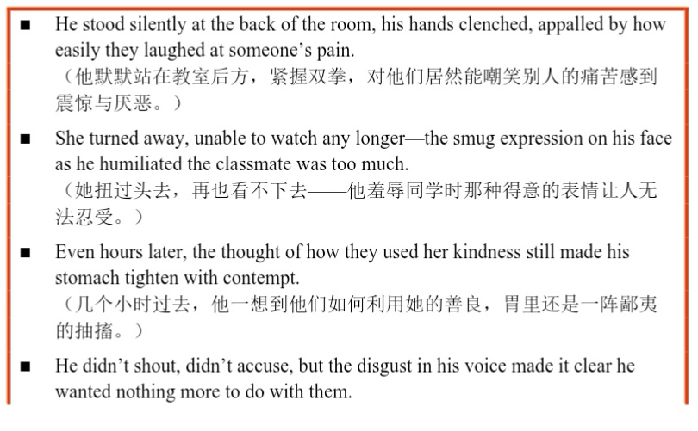

Slide 8
11.3 情绪厌恶
be tired of =be bored with厌倦
be fed up with=have enough of sth.
She was fed up with the endless drama that surrounded her friend group.
mentally drained精神耗尽的
He was mentally drained from dealing with the same conflict again and again.
feel suffocated感到窒息
He felt suffocated by the constant pressure to meet everyone’s expectations.
Standing at the canyon's edge, she felt suffocated by its breathtaking grandeur. The sheer scale of beauty before her stole the air from her lungs.
Winning the award was a dream come true, and for a moment, the weight of this immense honor suffocated him, leaving him speechless and overwhelmed with gratitude.

Slide 9
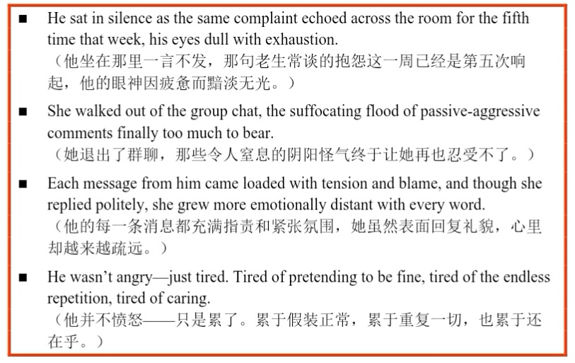

Slide 10
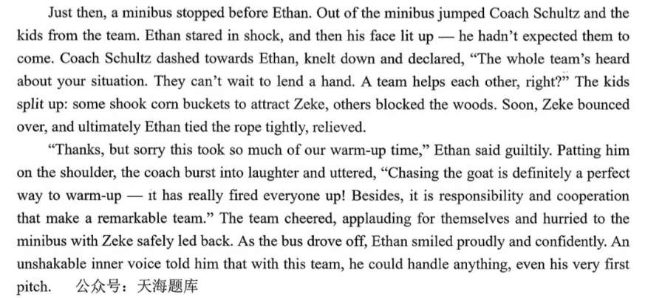

Slide 11
Just then, a minibus stopped before Ethan. Out jumped Coach Schultz, followed by the entire team. Ethan's eyes widened in disbelief, then lit up with a radiant smile. Coach Schultz dashed over, announcing, "We all heard, Ethan. No way we'd let you face this alone." Instantly, the team sprang into action—some lured Zeke with rattling buckets of corn, while others formed a human fence along the woods. Within moments, the goat came bounding toward them, and with a firm tug, Ethan secured the rope, his anxiety melting into overwhelming relief.
“Thanks, but sorry this took so much of our warm-up time,” Ethan said with guilt. Coach Schultz chuckled, clasping his shoulder. "Son, that was our warm-up! Nothing gets the heart pumping like a goat chase. And remember—it's responsibility and cooperation that build a truly great team." A roaring cheer erupted as the team applauded their shared triumph, then piled into the minibus with Zeke safely recovered. As the vehicle pulled away, Ethan stood tall, a confident smile gracing his face. Deep inside, an unshakable belief took root: with this team behind him, he was ready for that very first pitch.

