Slide 1
《读后续写工具箱》精编八

Slide 2
P₁₄₉
13.3感恩
be grateful to sb. for sth. 最常用的感激
My gratefulness is due to all those who helped me.
feel a deep sense of gratitude深深感激
Please accept my humble gift as a token of gratitude.
Tim choked out his gratitude to the boy, saying he would never have been reunited with his dog had it not been for the boy's considerate act.
feel / be indebted to sb. for sth. 感激
He felt deeply indebted to those who stood by him through hardships.
I am deeply indebted to my tutor for offering me discerning inputs and edifying instructions.

Slide 3
(红色方框）
The meal was simple, the gesture small, but something about it stayed and in that staying, gratitude found a home.
（hit a home run)

Slide 4
I stood in the batter’s box, looking out at the pitcher’s mound. Standing on the mound was none other than the legendary New York Yankees relief pitcher, Rich “Goose” Gossage. There were two outs, the bases were loaded,and my Philadelphia Phillies were trailing by three runs in the decisive Game7 of the World Series. As I dug into the batter’s box, the gravity of themoment was not lost on me. The Philadelphia crowd roared in anticipation, a sea of fans clad in red, and their last hopes were pinned on me and me alone.
Gossage glared with his signature menacing stare complete with his FuManchu mustache. He received his signals from his catcher, paused, and went into his windup before unleashing a 100-mile-per-hour fastball. Time slowed to a crawl. The ball cut through the chilly October air. I took a mighty swing that was followed by a distinctive CRACK. It’s the sound that only a baseball hitting a bat just right can make. The sound echoed throughout Veterans Stadium; it was so loud that it temporarily drowned out the 50,000 Phillies fans who were in attendance. The baseball soared into the night sky, clearing the left-field wall. The fans erupted, and I could hear the radio call from legendary Phillies announcer Harry Kalas.

Slide 5
13.4 尊重
respectful尊重的
He remained respectful throughout the debate, even when he strongly disagreed.
We were brought up to be respectful of authority.
admire敬佩、敬仰（admiring, admirable)
He genuinely admired his mentor’s integrity and clarity of thought.
hold someone in high regard高度敬重某人

Slide 6
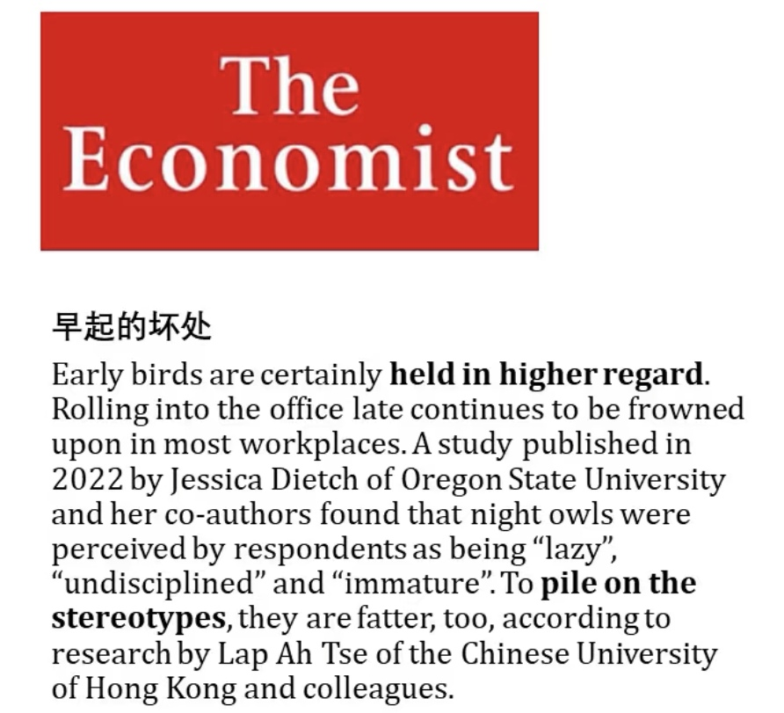

Slide 7
(补充) self-dignity=self-esteem
Like a gentle rain on parched earth, the old man's encouragement began to heal the deep, silent fissures in the boy's self-esteem.
Stung by his words, the boy slumped into his chair, silent tears tracing paths down his cheeks.
13.5 博爱、良知与同理心
compassionate有同情心的、表示怜悯的
He was allowed to go home on compassionate grounds.
empathy, empathetic共情的（高考新加词汇）
Her empathetic approach allowed her to connect with people from all walks of life.

Slide 8
Soldiers still represent the epitome of strength and bravery to me, but the foundational respect I feel for them now stems from an empathetic perspective of opportunity cost. The military is a place where sacrifice and success are the only things that reinforce each other. In the pursuit of success, incredible bonds are created, and the transformed perception of what our decorations truly mean often surpasses what I initially thought victory would feel like.

Slide 9
altruistic利他的，altruism利他主义
He was a living testament to altruism, devoting his time to reading initiatives that sparked a passion for stories in young minds.
humane人道的、仁慈的
The policy was praised for its humane treatment of displaced families.
conscience良知，conscientious有良知的、认真勤勉的
He is a conscientious citizen, who always speaks up against injustice.
stand up for the vulnerable为弱者挺身而出

Slide 10
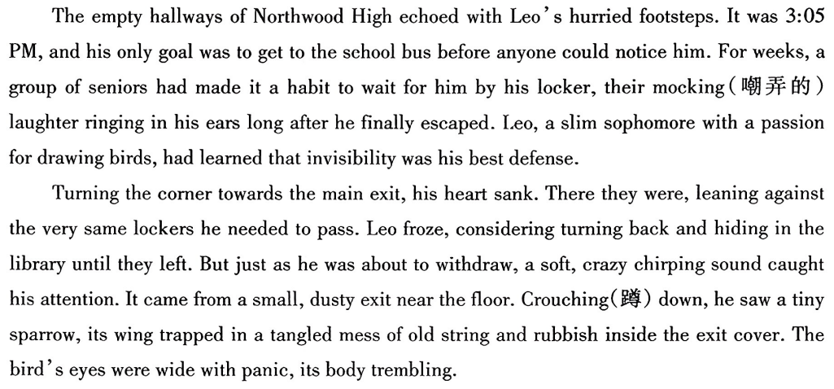
(2025.11泰安期中考试读续）

Slide 11
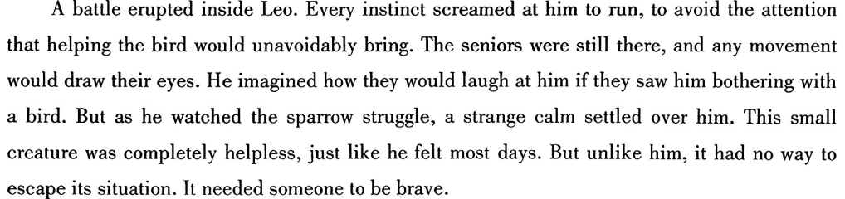

Slide 12
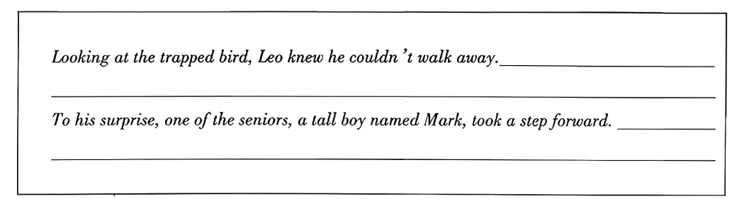

Slide 13
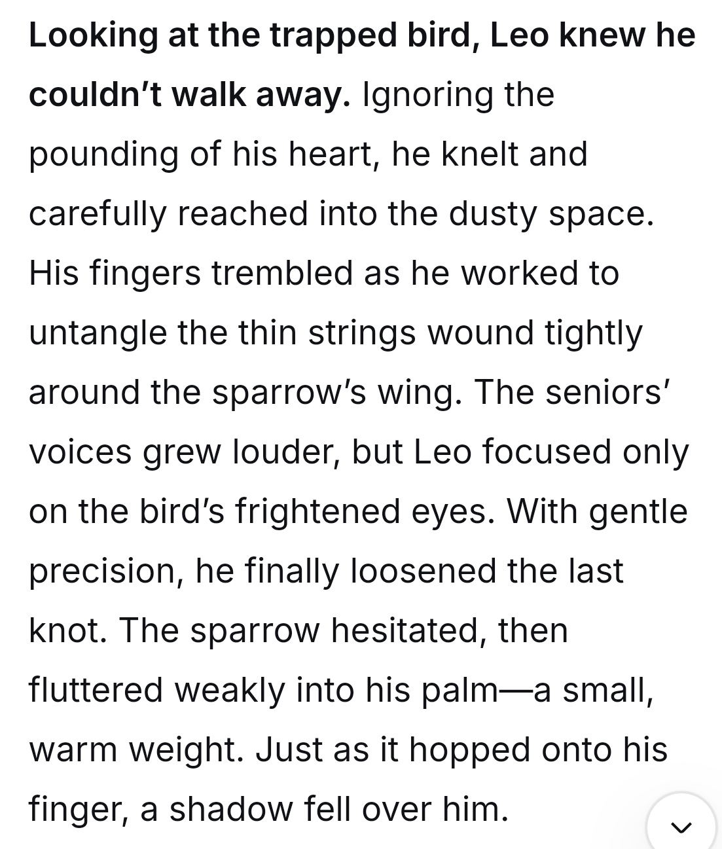
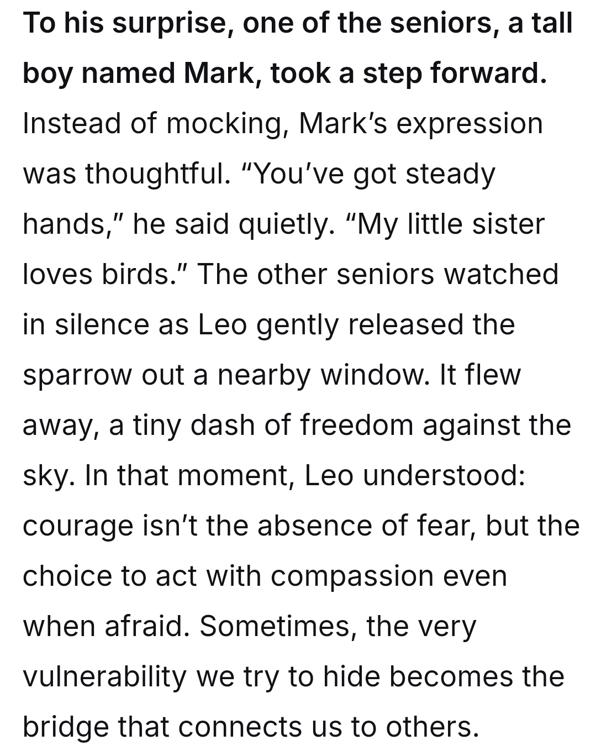

Slide 14
... Every instinct screamed at him to flee the approaching seniors, but the bird’s desperate fluttering mirrored the panic in his own chest. He saw himself in its trapped, helpless state. Taking a deep breath, he blocked out everything else. His slender fingers, usually skilled only at sketching delicate wings, now worked with frantic urgency to pick at the knots confining the creature. The messy tangle of string and debris finally gave way, and the sparrow, with a grateful chirp, shot into the dim hallway just as footsteps halted right behind him.
... He wasn’t smirking like others. Instead, he watched the sparrow disappear out of a high window before looking back at Leo, who was still crouched on the floor, braced for ridicule. “It takes courage to stop for something when you are running for yourself,” Mark said, his usually harsh voice turning soft. After this, he reached a hand to Leo and tugged him up to his feet. “Are we good?” The question was gentle, accompanied by a smile that disarmed Leo's lingering tension. It was at that moment that Leo understood his moment of vulnerability had unexpectedly bridged the gap between two different souls.

