Slide 1
《读后续写工具箱》精编五

Slide 2
P₁₂₀
9.4 怨恨与报复
harbor resentment 心存怨恨
He harbored resentment toward his former teacher who had humiliated him.
bear a grudge 记仇、怀恨在心
She bore a grudge for years after being excluded from the project.
grudge的重要派生词：ungrudgingly=willingly
Ungrudgingly, she offered me her help, pulling me back from the brink of a complete breakdown.
Ungrudgingly, she shared with me her tactics of learning math, guiding me through the labyrinth of my despair.
She offered her help ungrudgingly; it was the anchor I needed in my storm.

Slide 3
9.5 嫉妒与幸灾乐祸
jealous=envious嫉妒的
She was envious of her friend’s effortless popularity. (这个写得还行）
feel overshadowed / dwarfed / eclipsed by ...感到被比下去（底下的例句写得不大行）
In the presence of her eloquent and charismatic friend, she always felt overshadowed, her own voice seeming small and insignificant.
I had always felt overshadowed by Maria's brilliance, a thorn in our friendship, until the day she broke down, confessing that it was my resilience that she had always admired. In that moment of mutual vulnerability, the shadow dissolved, and we saw each other clearly for the first time.
take pleasure in one’s misfortune幸灾乐祸(底下的例句写得不行）
She pretended to offer sympathy, but the gleam in her eyes betrayed how she took pleasure in my misfortune.

Slide 4
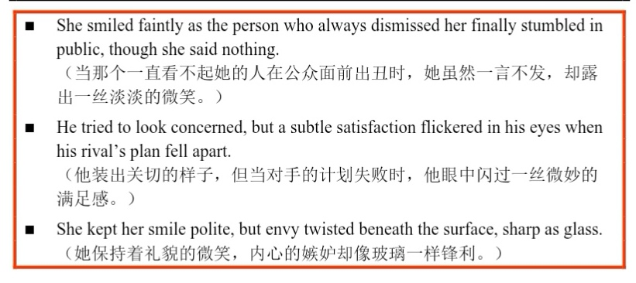

Slide 5
P₁₂₄
第10章 焦虑与恐惧
Anxiety pulled at the edges ... like a string winding toward a knot. (这个句子不背诵）
10.1 担心与焦虑
worried担心的
注意基础表达：worry about ..., be worried about ..., worry that..., be worried that ...
加强版：be worried sick特别担心
No matter how far a son may travel, his mother is worried sick about his safety and well-being.
uneasy心神不安的，unease / uneasiness 心神不安（底下的例句有点无力）
Unease preyed on her mind.
have butterflies in one’s stomach紧张不安
Standing before her, all his rehearsed words vanished, replaced only by the frantic flutter of butterflies in his stomach.
He took a deep breath, trying to calm the butterflies in his stomach, but the sight of the audience made them take flight again.

Slide 6
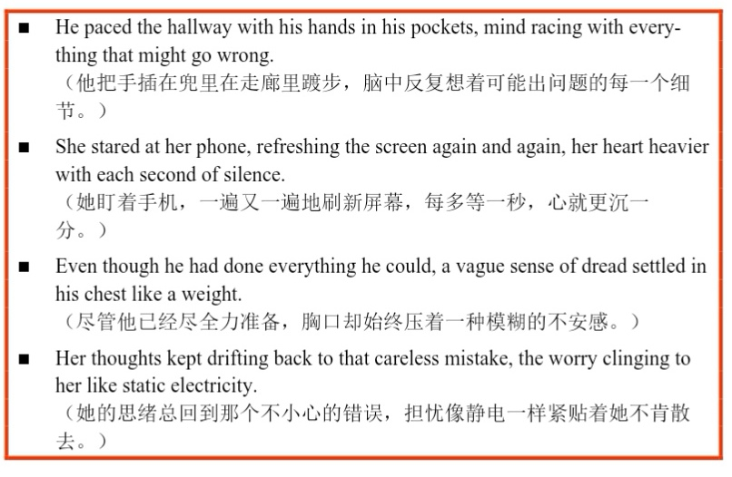

Slide 7
10.2 麻烦别人 不好意思
lean on someone依赖某人
She always offered him unwavering support, the one on whom he could lean for every solution.
make someone feel obliged让某人感到有义务（底下的例句有点虚）
Although three powerful pedal strokes would have secured me third place, I felt obliged to stop and help him, recalling the time when he went out of his way to fix my snapped chain.
turn red脸红（这个表达有点low了）
flush, blush, redden
A wave of rosy hue flew to her face instantly he pointed out the mistake.

Slide 8
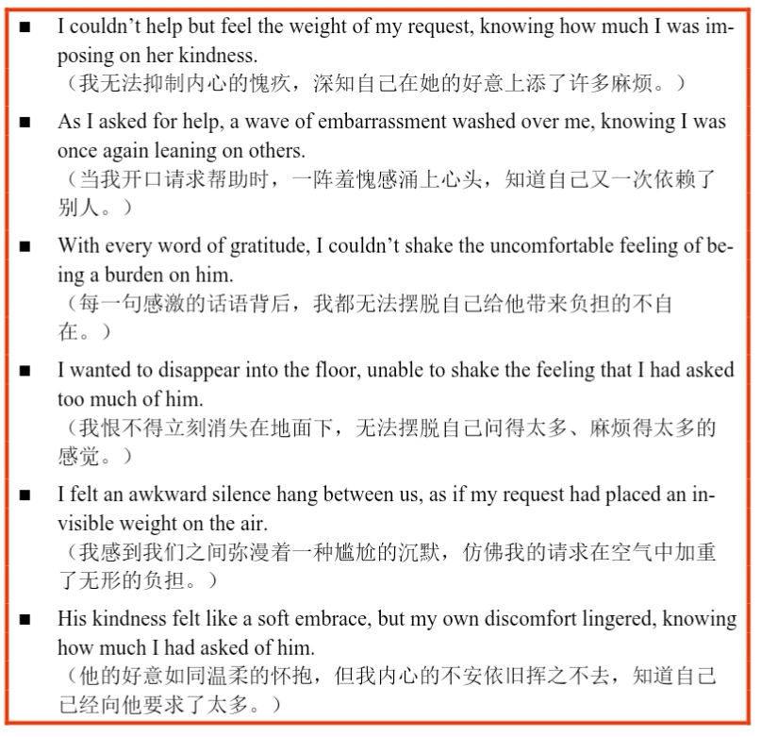

Slide 9
10.3 尴尬与羞耻
ashamed羞耻的（只做表语），shameful（可做定语）
Let your children feel ashamed of their small wrongdoings. A conscience that pricks them early for stealing a candy is what will guard them later from stealing a fortune.
blush脸红
He blushed deeply when she complimented him in front of everyone. (例句写得还可以）
flush with shame因羞愧而脸红
The mispronounced word echoed louder than it should have, and her cheeks flushed with shame. (这个例句写得也还行）
want to sink into the floor恨不得钻进地缝
When the microphone stopped working mid-song, he wanted to sink into the floor.(这个写得也还不错）

Slide 10
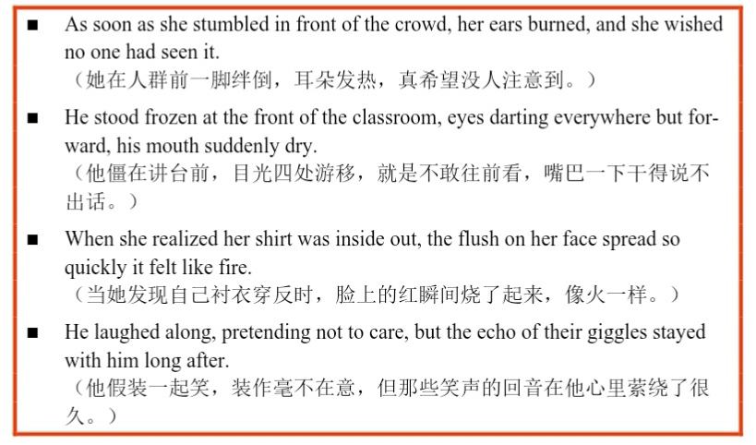

Slide 11
10.4害怕与恐惧
scared stiff吓呆了（底下的例句写得不行）
The sudden growl from the bushes left him scared stiff, his feet rooted to the spot.
He was scared stiff at the prospect of failing the exam, not because of the punishment, but because of the disappointment in his parents' eyes.
petrified惊呆的、石化般的恐惧
He stood petrified on the edge of the cliff, unable to take a stop forward. (这个还可以）
heart pounding心跳加速
His heart was pounding so loudly he could barely hear the footsteps.
be gripped by fear被恐惧攫住
shiver at the thought of一想到...就发抖（底下的例句不中）
The thought of the coming exam sent an uncontrollable shiver through him, a storm of thoughts raging in his head.

Slide 12
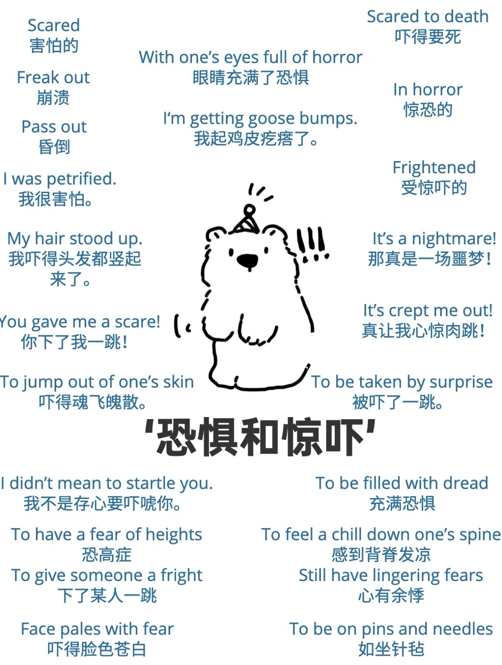
下节课从P133开始。

Slide 13
