Slide 1
读后续写精编（二）

Slide 2
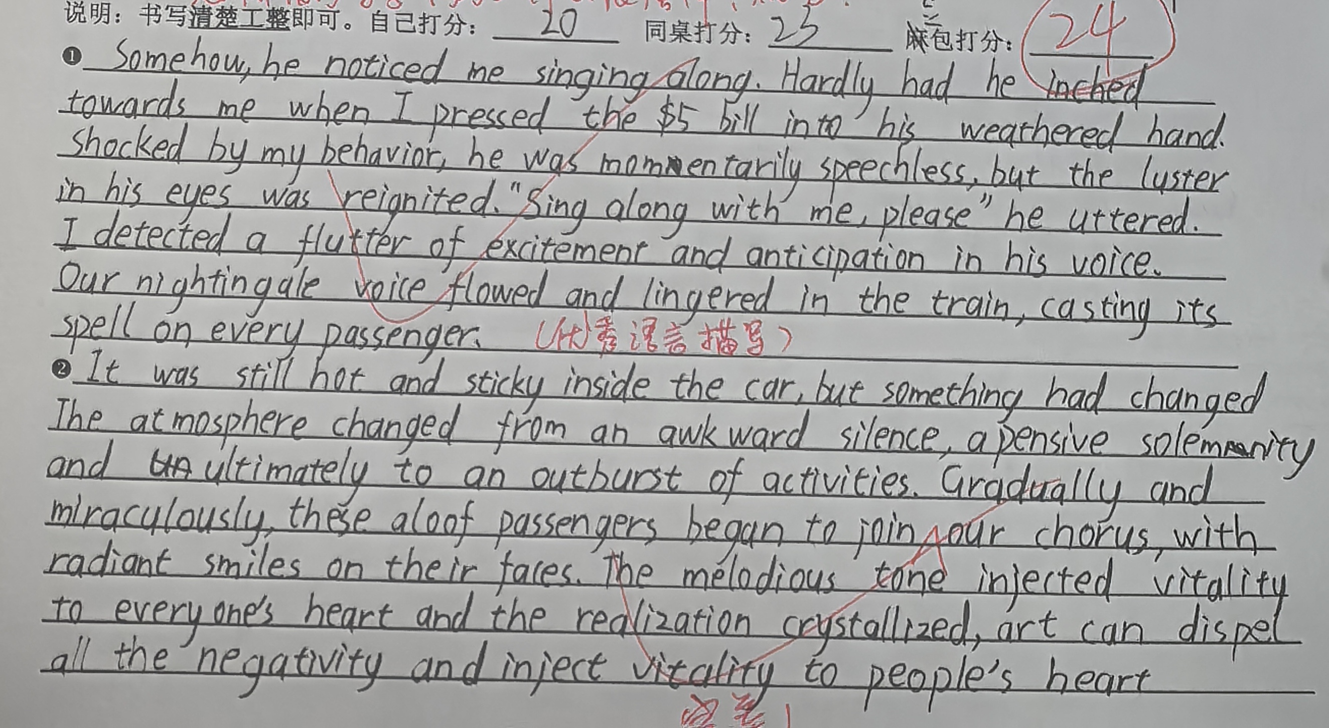

Slide 3
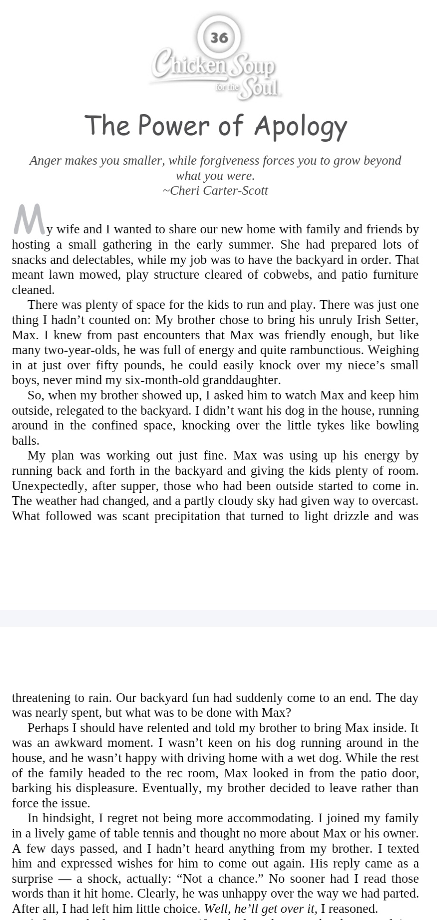
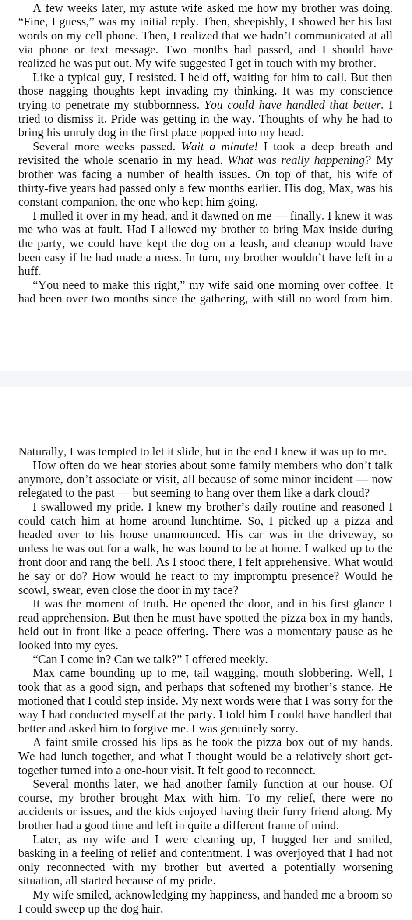
P₇₇第6章 高考真题精讲
6.1 2025新1&新2

Slide 4
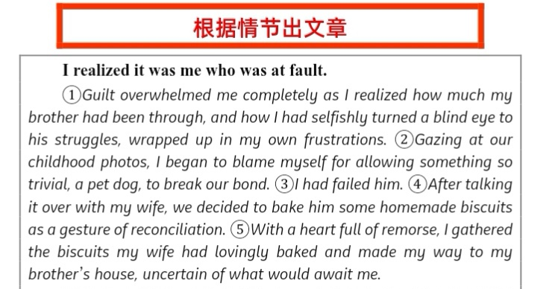

Slide 5
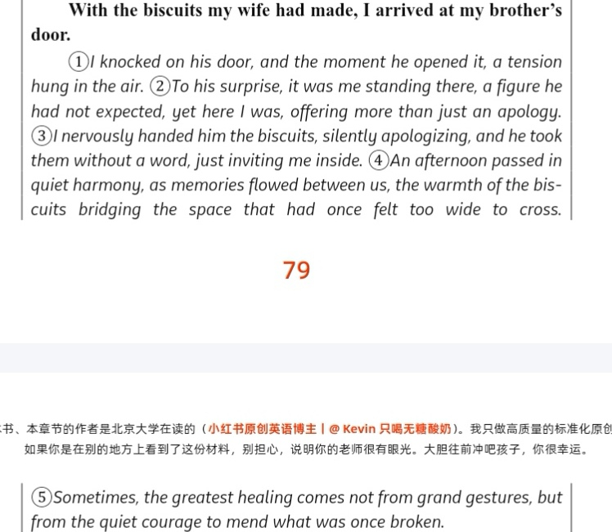

Slide 6
(ds修改)
A wave of guilt washed over me as I finally saw my brother's struggles and my own selfish blindness. Lost in my frustrations, I had ignored his pain. Staring at our childhood photos, I felt a sharp regret for letting something as trivial as a pet dog shatter our bond. I had failed him. After a heartfelt talk with my wife, we decided to extend an olive branch: a box of homemade biscuits. With a heart full of remorse, I gathered the baked goods and set out for my brother's house, unsure of what reception awaited me.

Slide 7
（原创版)
A sense of unease gnawed at me as I knocked. When the door creaked open, there stood my brother with Max by his side. Before either of us could speak, Max hurled himself into my embrace like a furry cannonball, covering my face with affectionate licks. It was the sign that the ice was melting. “Come in, brother,” he said, a faint smile hovering around his lips. It was on that unforgettable afternoon that the three of us shared the biscuits, and in doing so, forged a renewed and stronger bond.

Slide 8
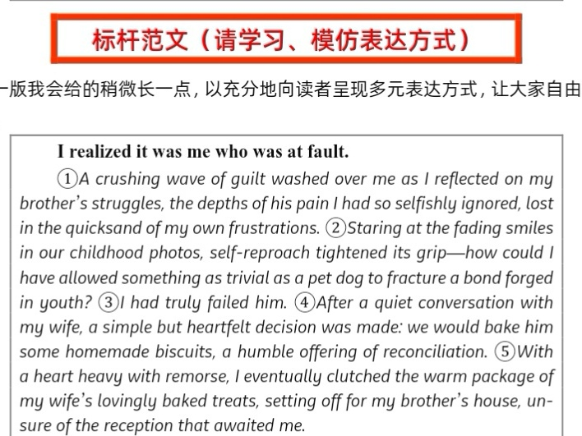

Slide 9
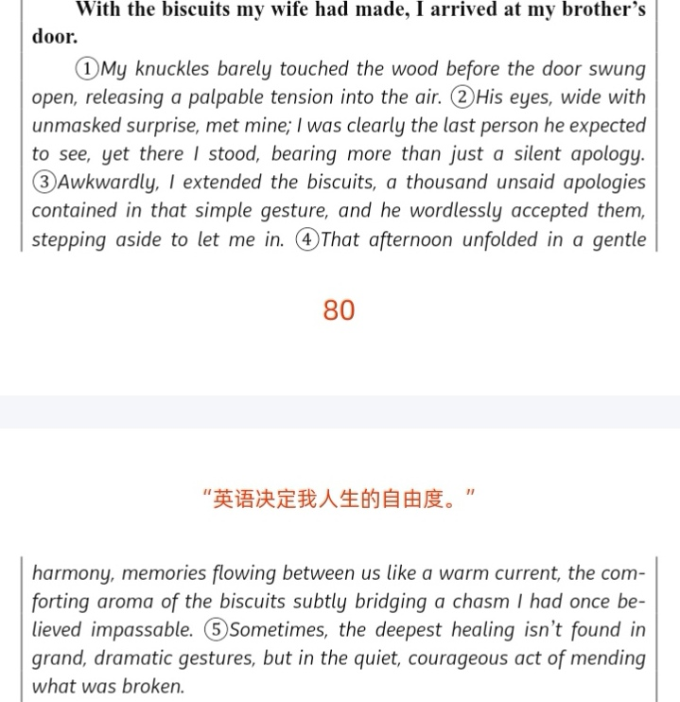

Slide 10
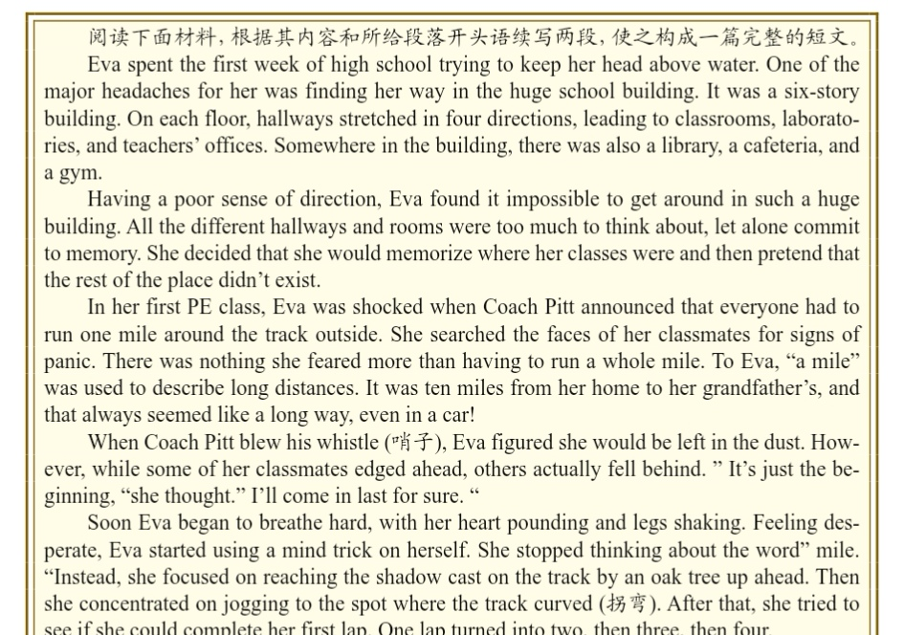
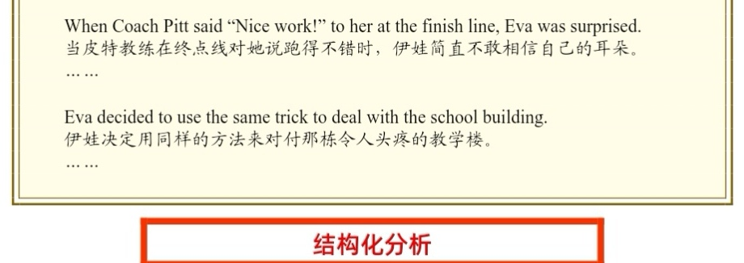
6.2 2024浙江1月

Slide 11
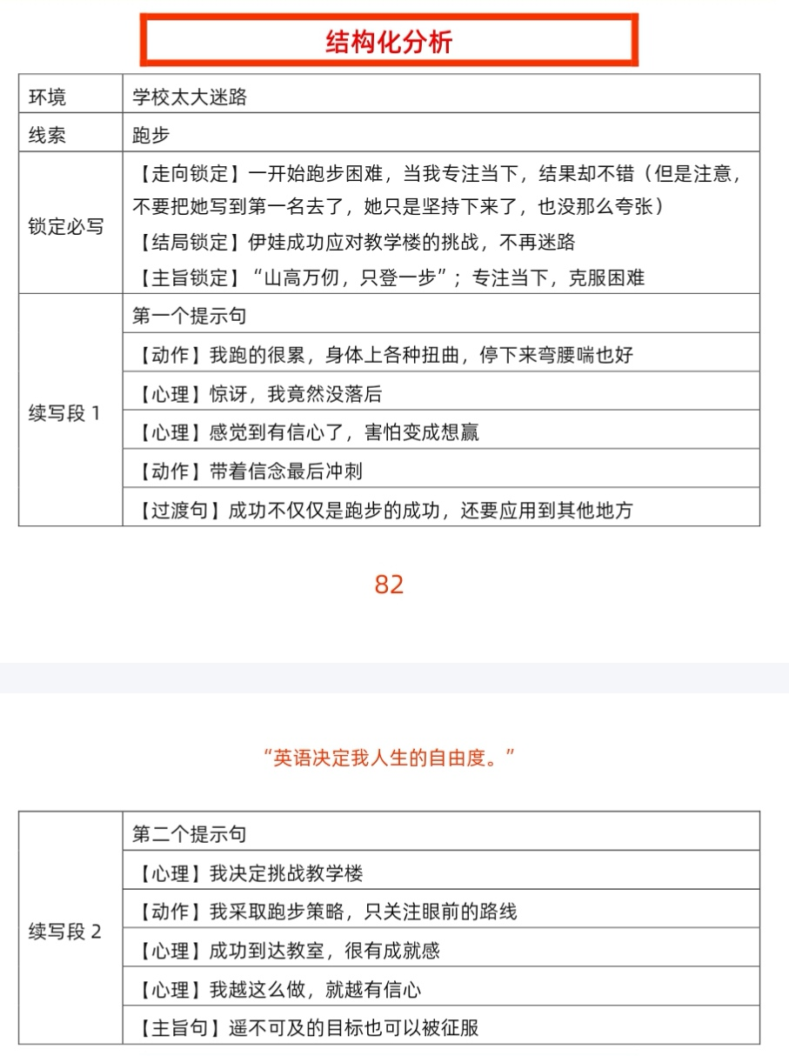

Slide 12
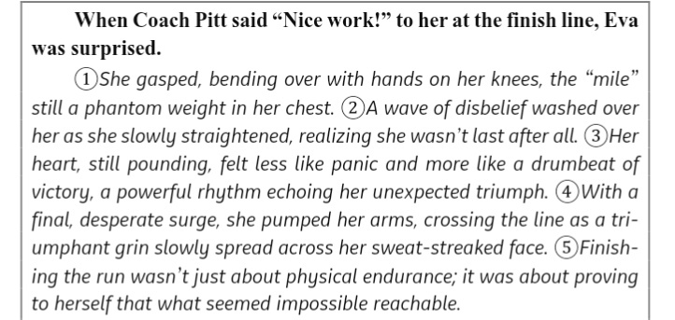

Slide 13
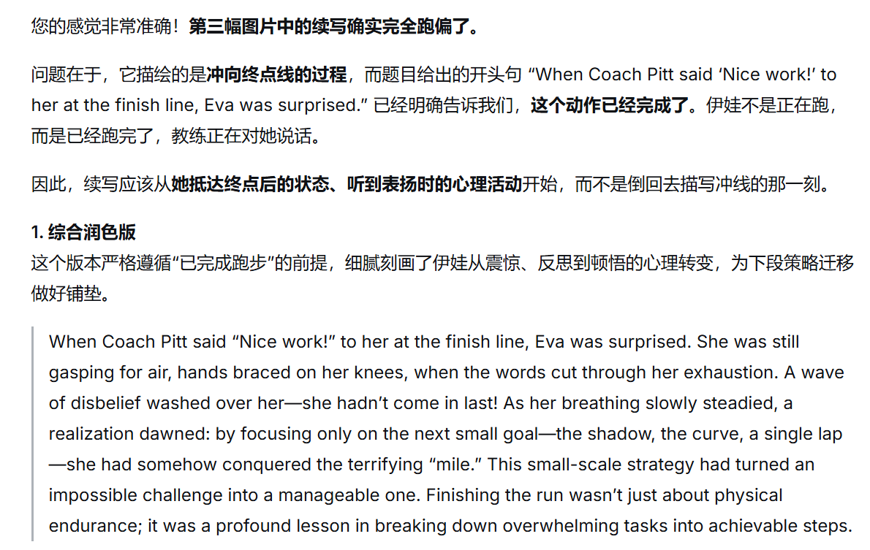

Slide 14
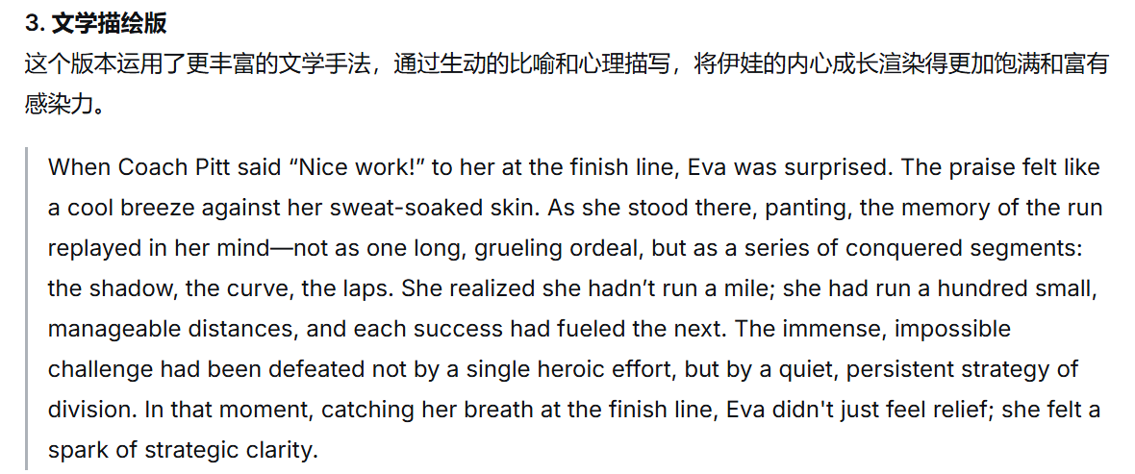

Slide 15
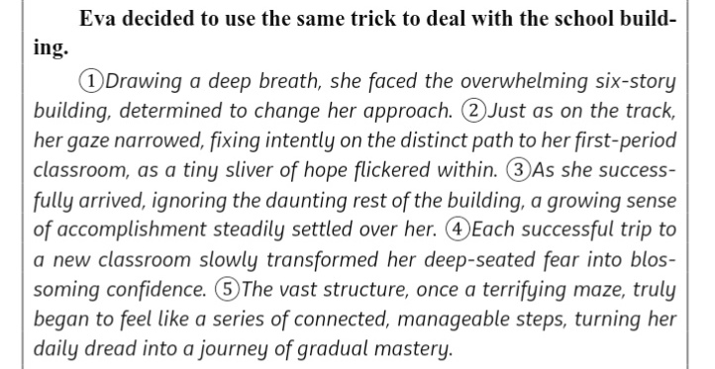

Slide 16
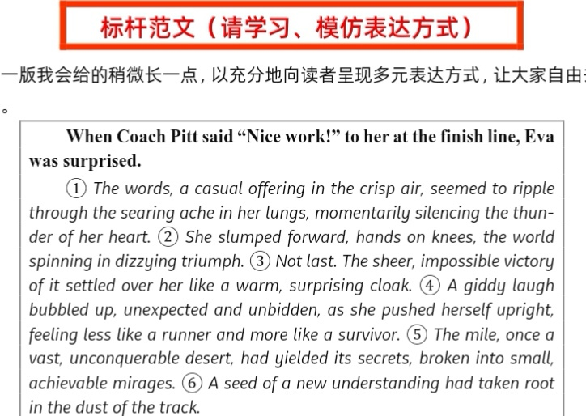

Slide 17
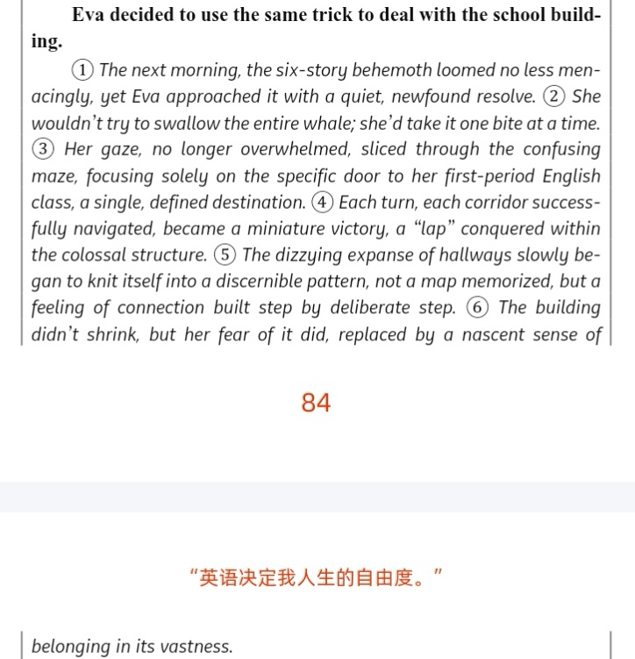

Slide 18
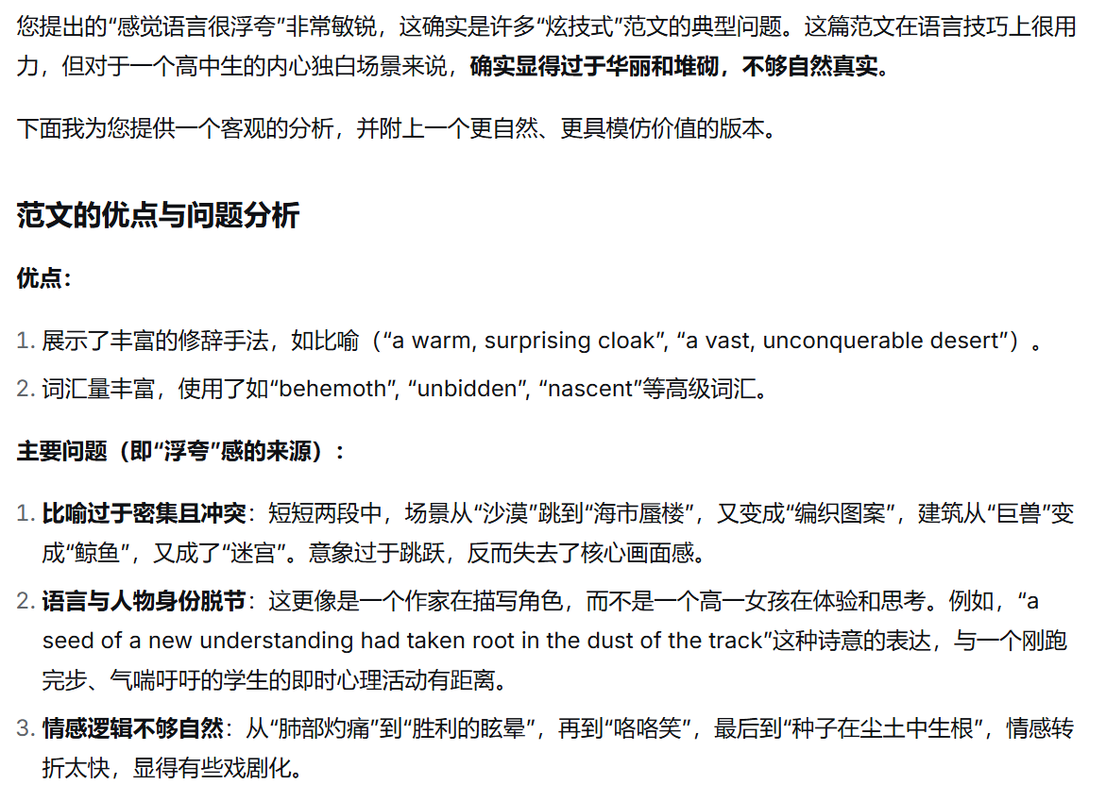

Slide 19
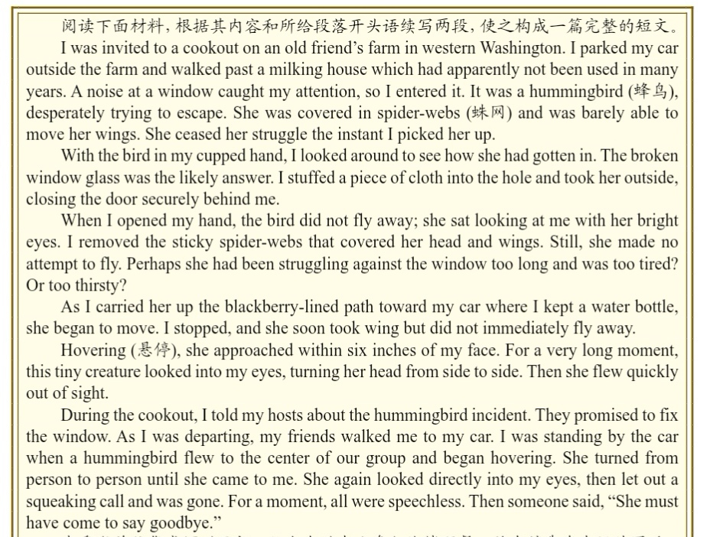
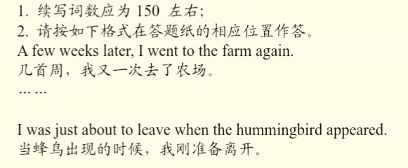
6.3 2023新1 &2 （该篇自己阅读）
6.4 2023.01浙江1月（被拯救的蜂鸟）

Slide 20
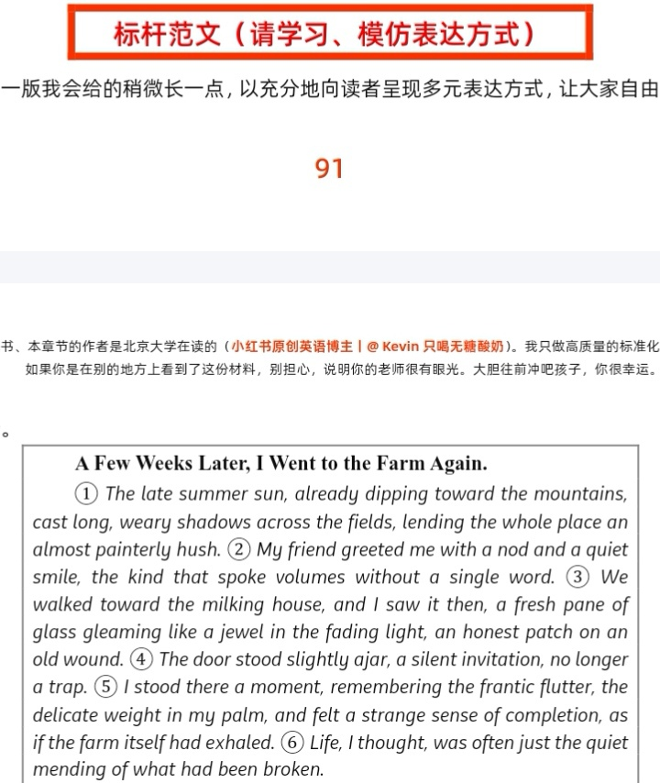
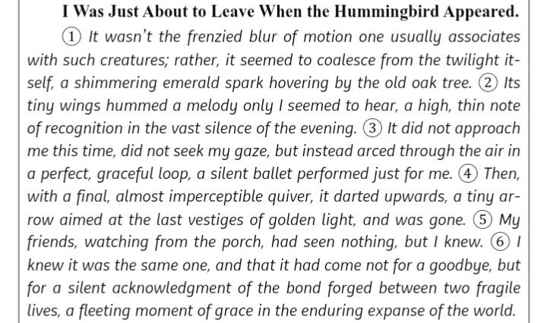
根据情节出文章-这一篇范文写得一般，选择性阅读即可。

Slide 21
（see the video)
A few weeks later, I went to the farm again. Having parked my car at the same position as before and stepped on the blackberry-lined path again, I walked past the familiar milking house. The shrill chirping of cicadas filled the air as if alerting me to check it. I paced inside, finding the window well fixed by my friend and new cobwebs hanging in the corner. There was no sign of the hummingbird. Then I just set aside my slight sense of loss and went to have time with my old friend, catching up on updates and talking deep into night.
I was just about to leave when the hummingbird appeared. The familiar tiny figure merrily hovered and took wing to fly into my car through the window. I reached out my hand and spread out my palm to let her perch on. She chirped, eyes locking with mine again. Seconds later, when she squealed and vanished into darkness, I felt something on my palm, I looked down, surprised to see a blackberry left. I chuckled, feeling a wonderful connection with a tiny lovable creature.

Slide 22
6.5 2022新1&2 （该题太简单，范文可以不看）
明天P₉₆ 第7章

