Slide 1
《读后续写工具箱》二十四

Slide 2
（2025届济南一模）
假定你是李华，你校拟举办题为“Confucius in My Eyes” 的短视频征集活动，请你给校英文报写一篇作品征集启事，内容包括：
（1）活动目的；
（2）作品要求。
（2024届九省联考）
你校英文报计划举办主题为“携手行动，节约粮食”的作文比赛。请你写一则活动通知，内容包括：
（1）活动目的；
（2）参赛要求。

Slide 3
To deepen our understanding of traditional culture through contemporary creativity, our school English newspaper is launching a short video campaign titled "Confucius in My Eyes."
This initiative aims to bridge ancient wisdom with modern perspectives. We encourage you to explore how Confucian ideals, such as benevolence and the joy of learning, remain relevant in today's digital age. Your personal reflection and creative expression are highly valued.
Submission requirements are as follows: original content, a maximum duration of 5 minutes, and clear English caption. All formats, including animation, documentary-style interviews, and digital storytelling, are welcome. Please submit your video to cz@school.edu by January 1st, 2026. We eagerly anticipate your insightful contributions.

Slide 4
To bridge traditional wisdom with modern creativity, our school English newspaper invites you to a short video campaign "Confucius in My Eyes."
We hope to explore how Confucian values，such as benevolence and lifelong learning, resonate in today’s world. Your unique perspective and creative interpretation are what we seek.
Please submit an original video under three minutes, with English caption. All creative approaches are encouraged, whether through animation, documentary-style interviews, or personal reflective narratives. Send your work to cz@school.edu by January 1st, 2026. We look forward to your thoughtful and imaginative contributions that bring classical philosophy to life.

Slide 5
（2026届雅礼月考3）
你校英文报将开设“Greetings Around the World”专栏，旨在促进跨文化理解。假定你是李华，邀请外教Chris为该专栏投稿。内容包括：
（1）注意事项；
（2）你的期待。

Slide 6
I hope this message finds you well. On behalf of the school English newspaper, I am writing to cordially invite you to contribute to our new column, "Greetings Around the World", which aims to promote cross-cultural understanding among students.
For the submission, we would appreciate it if your article could be around 200 words, introducing greeting customs from your home country or another culture you know well. Please include not only the expressions and gestures but also the cultural meanings behind them. The deadline for submission is October 20.
Your unique perspective would greatly enrich our column and inspire our readers. We truly look forward to your valuable contribution.

Slide 7
18.4 全身行动与姿势调节
站姿
stand upright站直
Please ensure students (stand) upright in the line.
Chopsticks set upright are a bad omen; it resembles incense at a funeral.
尝试翻译：
请给我拍一张竖屏的、横屏的照片。
欢迎乘坐中国南方航空公司的航班。请系好安全带，收起小桌板，并将座椅靠背调整至直立。
Stow Headrest For Taxi, Takeoff, and Landing.
stand on tiptoe(s)踮脚站
他踮起脚尖，试图去拿最上面书架的一本书，没想到却把书架推倒了。

Slide 8
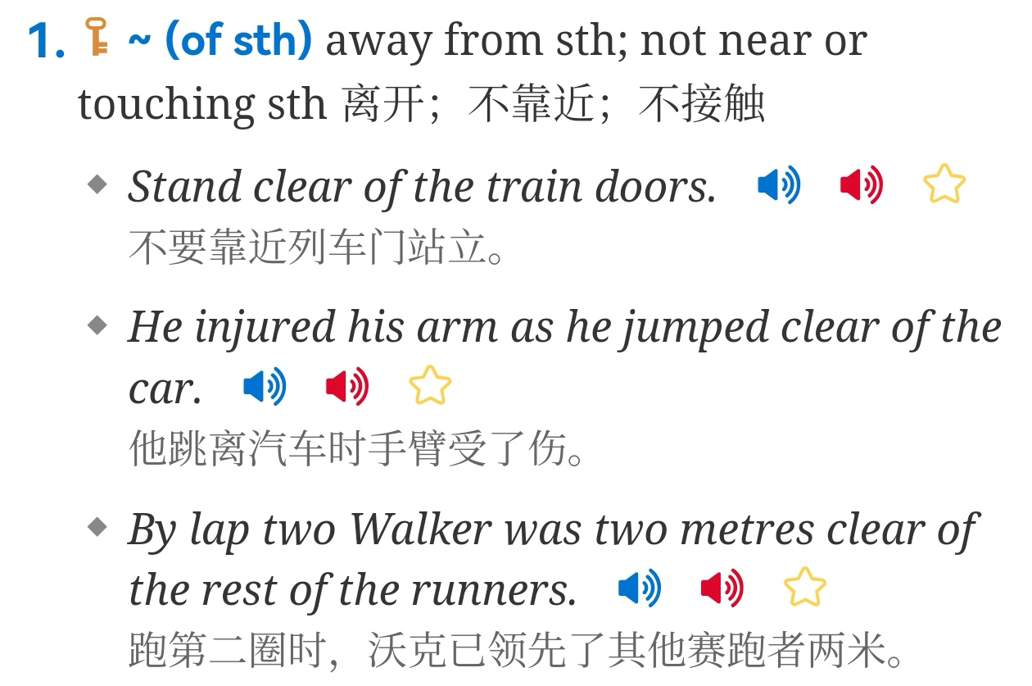
lean (rest) against 倚靠
He leaned against the wall, lost in thought.
The words on the wall read: no leaning.

Slide 9
shift one’s weight换支撑脚（表示紧张、不耐烦等）
He shifted his weight from one foot to the other.
(pull one’s weight?)
如果我们想让项目成功，就必须每人都尽力。
plant one’s feet firmly稳稳站立
He planted (dug) his feet on the start line, ready to burst (explode) forth.
坐姿
slouch懒散坐（走）
He slouched on the couch watching TV.
perch轻坐
She perched on the edge of the chair.
(主要指鸟栖息）The bird was perching on the fence.

Slide 10
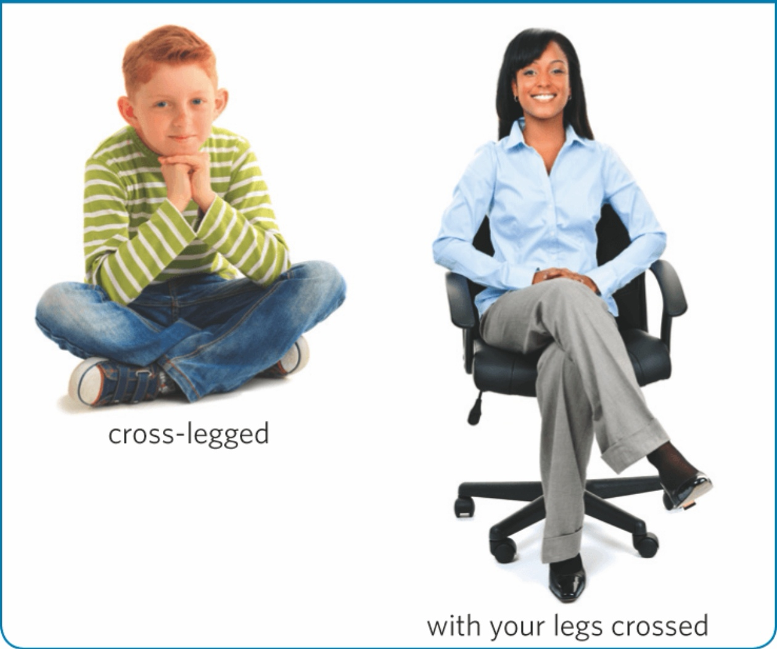
cross one’s legs二郎腿
fold one’s legs盘腿

Slide 11
curl up =huddle (up)蜷缩
Tim curled up in the blanket, trembling uncontrollably.
rock back and forth前后摇晃
步行动作
walk briskly快步走
In high spirits, she set off at a brisk walk.
stride大步走（只有strode，无过去分词）
Head high, stride firm, the lecturer mounted the platform.
pace踱步
She paced the floor / room restlessly.
drag oneself, trudge, plod沉重地走、疲惫地走
She trudged home after the frustrating exam.

Slide 12
back away / back off后退
She backed away, startled by the noise.
(猜猜：The noise gave me a start.)
注意：他疲惫地回家了：He went back home, tired. //He backed home.是倒退着回家了。
limp / hobble跛行
She limped off the court, wincing with pain.
tail / shadow / dog都可以表达跟踪、尾随
The detective tailed the suspect to gather information.
Questions are dogging Donald Trump’s pick to lead the US Department of Defense.
accompany该词为vt. 一定不加with.

