Slide 1
《读后续写工具箱》二十八

Slide 2
A recent survey conducted in our school has shed light on students' major concerns regarding online safety. According to the results, half of the respondents view information leakage as their primary worry. Meanwhile, exposure to misleading content and online fraud accounts for 33% and 12% respectively, while the remaining 5% cite other potential cyber risks.
To address these issues, practical measures should be taken. Students are advised to enhance privacy settings and refrain from oversharing personal information. It is also essential to recognize and avoid suspicious links and untrustworthy websites. Furthermore, cultivating critical thinking can help assess the reliability of online content. Schools and parents are encouraged to offer regular guidance to foster responsible digital behavior.
I am firmly convinced that with our concerted efforts, students' awareness of internet security will be greatly heightened, paving the way for a safer and more trustworthy online environment for all.

Slide 3


Slide 4
P₂₆₈ 20.4体育活动
The stadium roared with excitement as athletes lined up at the starting line, their hearts racing with the promise of victory.
(拓展) on your mark(s), get set, go.
The referee fired the starting gun and we launched ourselves forward like an arrow.
The basketball court echoed with the bounce of the ball and the sound of shoes squeaking against the floor, as both teams fought fiercely for the win. (写得不错)
(拓展) 比分平了。双方都在全力以赴，争取打破僵局，赢得比赛。
With the score tied, both teams were pushing hard to break the deadlock and secure the win.
The final race began, the runners’ feet pounding the track as they pushed themseleves to the limit, the crowd cheering them on with every stride.

Slide 5
The coach’s whistle blew, signaling the start of another round of drills, pushing them to their physical limits while building their mental toughness.
所有的球员都在挥汗如雨地训练，他们心中充满了坚定：一定要赢得比赛的胜利。
With sweat raining down on the court, every player trained with intense extertion, determined to claim victory in the coming game.
杜致礼很有性格，她意志坚定，可以说，她和杨振宁是天作之合。
Du Zhili was a woman of strong character and resolute will. It can be said that her marriage to Chen-Ning Yang was a match made in heaven.
The park was alive with energy as people strolled along the paths, the air fresh with the scent of flowers.
公园里人声鼎沸。春天的到来让蛰伏了一个冬天的人们迫不及待地拥抱绿色。
Park was abuzz with people. The arrival of spring sent those who had stayed indoors all winter rushing to embrace the greenery.

Slide 6
The volleyball court buzzed with energy as players leapt and dove, each point a testament to their skill, teamwork and determination.
The coach shouted encouragemens as the athletes pushed their bodies to the edge, knowing that every drop of sweat was a step closer to their goals.
The tennis match was a battle of endurance and skill, each point earned with sweat and determination, leaving both players exhausted but fulfilled.

Slide 7
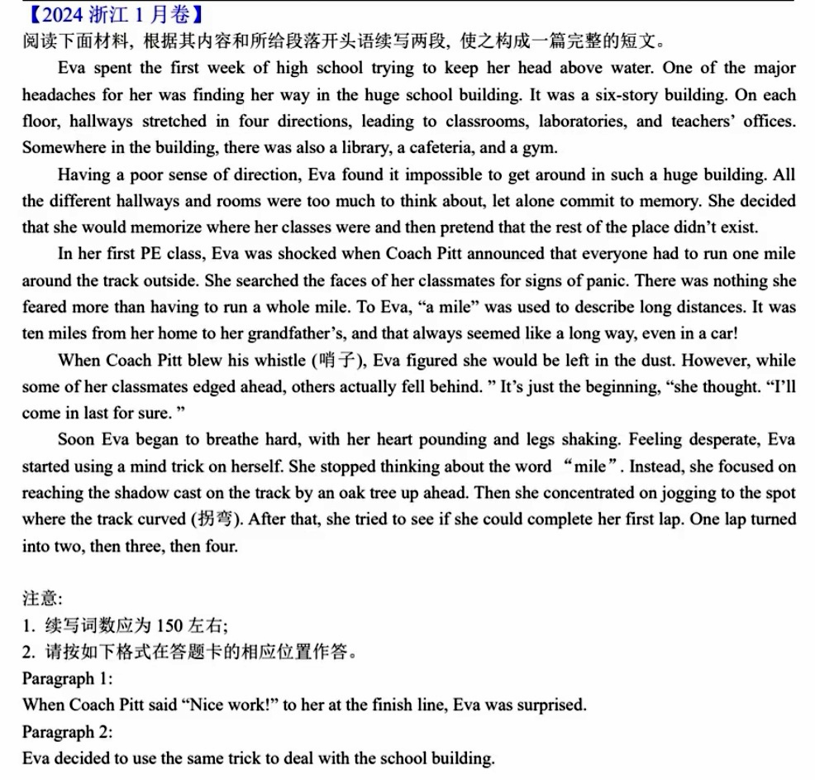

Slide 8
When Coach Peter said “Nice Work!” to her at the finish line, Eva was surprised. She bent over, her heart pounding frantically and sweat dripping incessantly onto the track. A great sense of accomplishment surged through her: Not only did she complete the mile but kept pace with many of her classmates. The shadow-chasing trick had worked. Focusing on tiny goals made the impossible achievable. “If I could conquer the track step by step, why not the terrifying maze of hallways?” Eva thought, sparks of determination and confidence blazed in her eyes.
Eva decided to use the same trick to deal with the school building. She began to view the six-storey structure not as an overwhelming maze, but as a combination of fragments. First, she focused on memorizing the route from the entrance to her first class. Gradually, she added other landmarks to her mental map. Day by day, what was once a maze became a series of familiar pathways. A sense of achivement rippled through her mind, wrapping her in a cocoon of jubilation. It dawned on Eva that big fears shrank when tackled in small paces, whether running miles or navigating life.

