Slide 1
《读后续写工具箱》二十五

Slide 2
基础巩固：
1. occur的过去式和名词 2. necessary名词 3. access形容词 4. definately 5. analysis复数
6. 外国人 7. maintenance 8. 难以忘记的 9. prefer名词 10. pronounced progress
11. burst into laughters 12. 我被感动哭了。 13. benefit形容词 14. influence形容词
15. number形容词 16. recognize名词 17. 满意（n.) 18. broad名词 19. acquire名词
20. concerted efforts 21. 敲门 22. 耐心的解释 23. 提交作品 24. affect的名词
25. angle, angel 26. convenient, conventional 27. content, context, contest
28. attach, attract, attack 29. contact, contrast, contract 30. crown, clown
31. eliminate poverty 32. prosperity名词 33. rivalry 34. split the assignments evenly
35. overcome the obstacle 36. Drinking porridge regularly enhances blood sugar level.
37. raise livestock 38. fertile imagination 39. Greek myth 40. The release of the prisoners was used as a bargaining chip.
1-20 刘子淳 21-40 Siri
1-20 晟熙 21-40鹏博

Slide 3
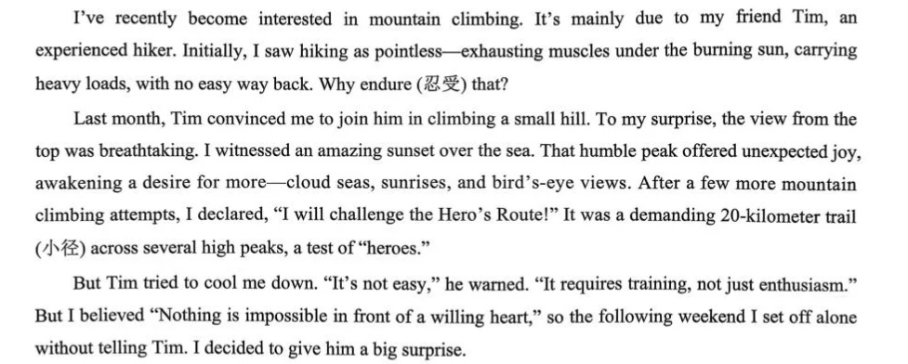

Slide 4
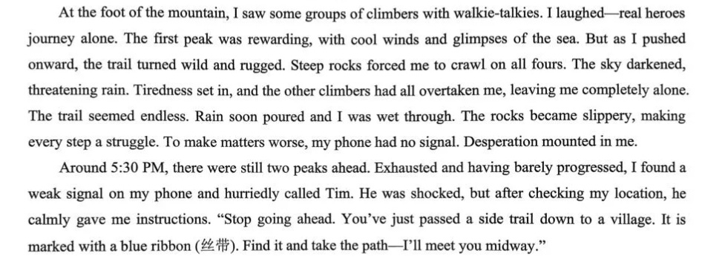

Slide 5
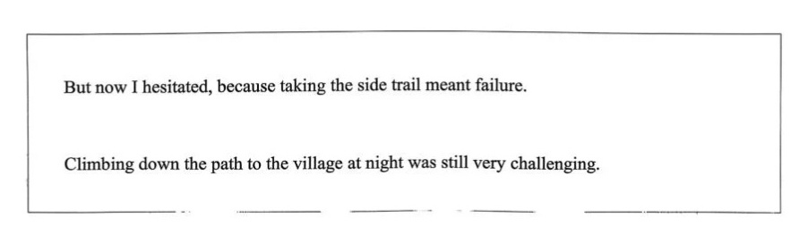

Slide 6
But now I hesitated, because taking the side trail meant failure. The image of myself standing triumphantly on the final peak clashed violently with my miserable state. Soaked wet from head to toe, I trembled uncontrollably, holding fast to my lifeline: the cellphone. The thunder rumbled in the distance, just like the pride inside my heart. With cold rain pouring, my reason finally replaced my pride. Swallowing the bitter taste of defeat, I turned back and began to search for the blue ribbon. Braving the stinging rain, I finally found the path and began my descent.
Climbing down the path to the village at night was still very challenging. Darkness enveloped the mountain, and the relentless rain made each step a struggle. Just as despair threatened to consume me, a beam of light pierced the gloom, followed by Tim's voice. Overwhelmed with relief, I felt tears mixed with rain on my face. Supported by him, I stumbled into the village. "I should have listened," I murmured. Tim simply patted my shoulder. It was then that I understood the greatest summit we conquer is our own pride, and the wisest path often begins with a brave retreat.
翻译全文，烨童，昊宇

Slide 7
P₂₅₀
跑步动作
dash猛冲
我急忙吃了几口饭，然后急忙去赶公交车。
race快速移动
伤者被紧急送往医院。
charge冲向
The dog charged at the intruder.
跳跃动作
jump跳
He jumped over the puddle.
He couldn’t wait to jump at the golden opportunity.

Slide 8
leap大跳、强调跃
The cat leapt onto the windowsill.
Keep it in mind that we should think before we leap.
bounce =bound跳行
跳过屋子，那只狗子像发射的炮弹一样进入了我的怀里，油腻腻地舔我。
spring to one’s feet跳起来，spring into action开始行动，spring into / to life突然恢复生机
Under the conductor’s guidance, the orchestra sprang to life.
The moment the bell rang, the classroom sprang to life with a burst of noise.
躺、卧动作
lie躺（过去式、过去分词？lay的过去式、过去分词？）
他躺在床上，盯着看天花板。
lie on one’s back躺着
lie on one’s stomach趴着
The boy lay on his stomach, flipping through a comic book.

Slide 9
sprawl伸开四肢坐（躺）；蔓延
I tripped and went sprawling.
The town sprawled along the side of the lake.
(难句理解）The new accessibility of land around almost every major city sparked an explosion of real estate development and fueled what we now know as urban sprawl.
collapse +介词=sink +介词=slump+介词
Hearing the sad news, the mother collapsed into the chair, tears coming out.
爬行动作
climb通常为垂直爬
She climbed up the mountain with determination.
crawl水平爬
The traffic crawled in the rush hour.
My skin crawled when I heard the story.

Slide 10
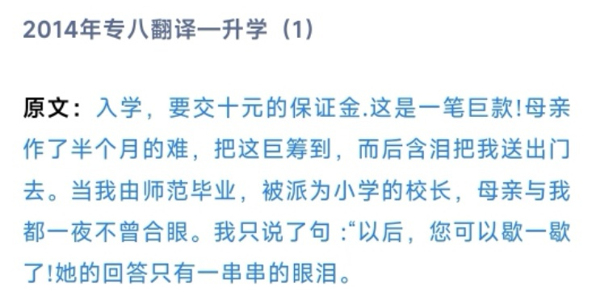
creep悄悄移动（crept, crept)
I crept up the stairs, trying not to wake my parents.
P₂₅₆
第19章 心理行为
19.1 情绪反应
哭
choke back / fight back / hold back tears忍住眼泪

Slide 11
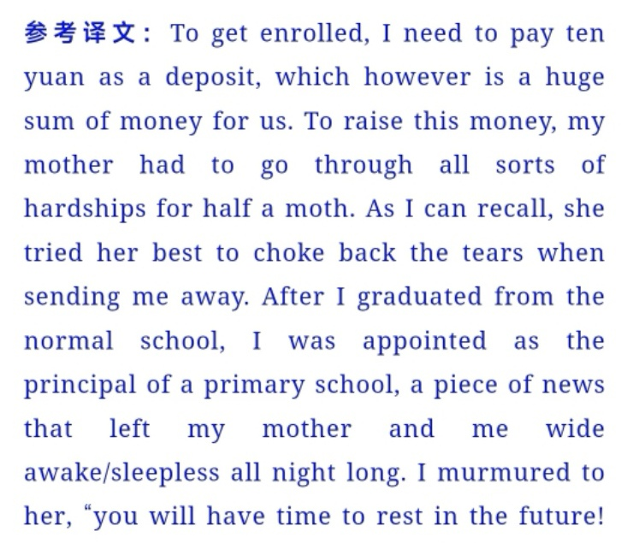

Slide 12
burst into tears突然哭了，burst into laughter突然笑了
一听到这个难过的消息，他一下子哭了，将脸深埋在双手中。
shed tears流泪
She shed tears of joy when her son graduated with flying colors.
tear-streaked / tear-stained face泪水打湿的脸
下节从P₂₅₇开始

Slide 13
P₂₅₇ 笑与欢乐
burst out laughing =burst into laughter 突然大笑
He burst out laughing when he saw the ridiculous costume.
burst out crying =burst into tears突然大哭
最常用的：smile
a broad smile, force / manage / squeeze a smile, flash a bright smile, a faint smile, crack a smile
一听到这个好消息，他就笑了， 眼睛里重新焕发了生机。
smirk得意地笑
She smirked at his failed attempt to impress her.
stifle / contain / suppress a smile憋笑
老师说的话太好笑了。我们赶忙用手去捂嘴以防笑出声来，但是还是笑出来了。

Slide 14
紧张羞怯
fidget焦虑不安
She fidgeted nervously with her hands while waiting for the interview.
还有其他表述吗？
blush / flush脸红
当男孩想起那次令人耻辱的比赛失利时，他就脸红脖子粗。
shy away (from) 躲避
He shied away from the group conversation, feeling out of place.
tug at one’s sleeve拉袖子
tug at one’s heartstrings拨动心弦

Slide 15
基础巩固：
1. occur的过去式和名词 2. necessary名词 3. access形容词 4. definately 5. analysis复数
6. 外国人 7. maintenance 8. 难以忘记的 9. prefer名词 10. pronounced progress
11. burst into laughters 12. 我被感动哭了。 13. benefit形容词 14. influence形容词
15. number形容词 16. recognize名词 17. 满意（n.) 18. broad名词 19. acquire名词
20. concerted efforts 21. 敲门 22. 耐心的解释 23. 提交作品 24. affect的名词
25. angle, angel 26. convenient, conventional 27. content, context, contest
28. attach, attract, attack 29. contact, contrast, contract 30. crown, clown
31. eliminate poverty 32. prosperity名词 33. rivalry
34. split the assignments evenly
35. overcome the obstacle
36. Drinking porridge regularly enhances blood sugar level.
37. raise livestock
38. fertile imagination
39. Greek myth
40. The release of the prisoners was used as a bargaining chip.

Slide 16
愤怒压抑
clench one’s fists握紧拳头（愤怒、下定决心）
grit / clench one’s teeth咬紧牙关（愤怒、坚持）
高山耸立，他咬紧牙关，下定决心征服它。
牙齿打颤？火堆燃烧，他也停止了瑟瑟发抖。
19.2 认知动作
思考
think 是vi.,加介词才可以加宾语。
如：他想出了一个好主意。
ponder深思、仔细考虑（直接加宾语即可）
他把自己关在书房里，仔细考虑说实话的影响。
devise发明、设计、想出
The team devised a strategy to improve sales.

Slide 17
analyze, analyse分析
分析数据？进行比较？得出结论？
reflect on反思
回忆？
evaluate, assess, judge评估、评价
We need to evaluate the (effective) of the new policy.
评委团将评估所有表演并据此颁奖。
scrutinize仔细查看、仔细审查
The statement was carefully scrutinized before (publish).
Before signing, he scrutinized the contract’s fine print, aware that his future depended on it.
当我把制作的微型老房子端给妈妈的时候，她竟无语凝噎，仔细大量着这个充满了美好回忆的复制品。下节从P₂₆₁开始

Slide 18
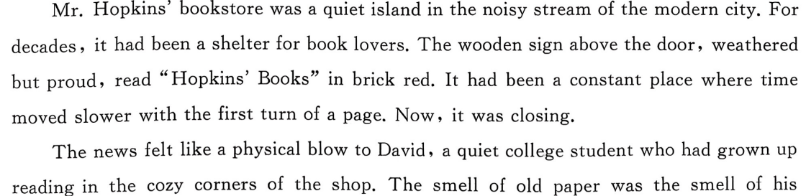
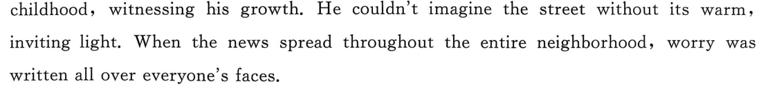
T8读续

Slide 19
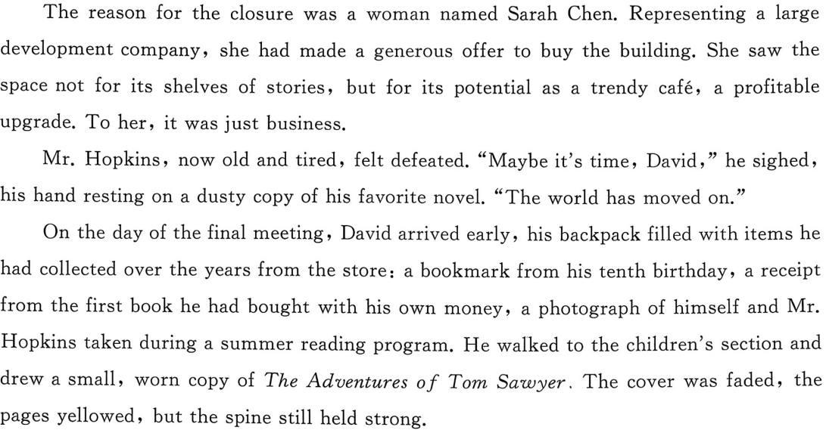

Slide 20
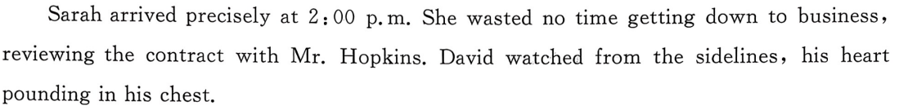

Slide 21
He couldn’t let this happen—not without trying to make his voice heard. Just as Sarah reached for the pen, David stepped forward, his quiet demeanor replaced by a firm resolve. "Please," he said with a pleading tone, "this store is more than a space. It is where children discover magic and where lonely souls find companionship." He opened his backpack, spreading its humble treasures across the counter. Each item, weathered yet cherished, was a living proof of timeless grace. Sarah paused, her eyes lingering on the faded photograph of a young boy beaming beside Mr. Hopkins. A solemn expression emerged on her face before she made a decision.
A decision was made to combine a bookstore and a café in one project, and the construction began. The original wooden sign was carefully restored, its brick-red letters gleaming anew. Shelves of stories remained, with the gentle murmur of coffee machines and the warm scent of freshly baked pastries. When it reopened, streams of customers poured in, captivated by the cozy atmosphere. Mr. Hopkins, a consultant now, patiently introduced different books. David expressed gratitude to Mrs. Sarah: “Thanks Mrs. Sarah! It’s you that rejuvenated this bookstore.” David realized modern facilities acted as an enhancement rather than a replacement to his beloved bookstore.

Slide 22
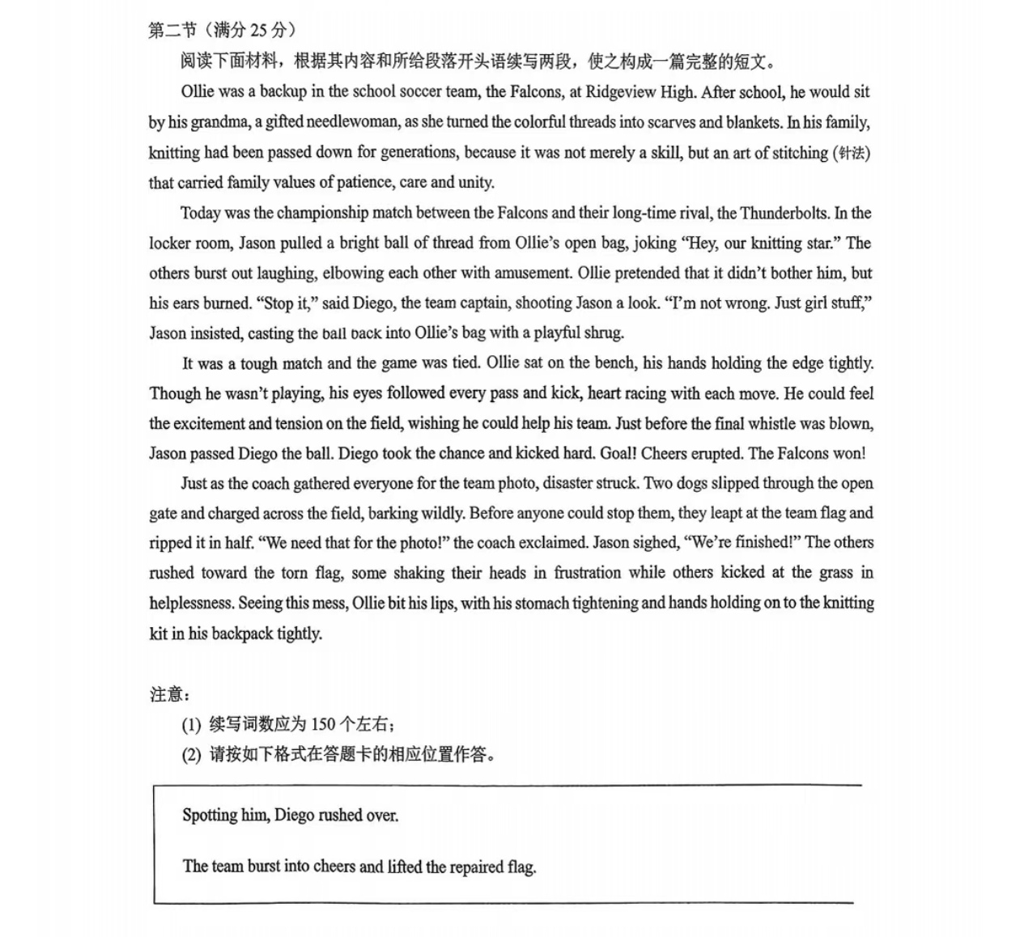

Slide 23
Spotting him, Diego rushed over. He found Ollie still on the bench, clutching his backpack. "Ollie, can you help fix the flag?" Diego asked urgently. With a firm nod, Ollie strode towards the torn flag, knelt by it and pulled out the needle and thread. Quickly and gracefully, the needle wove across the fabric with shining brilliance in the sunlight. The whole team watched with bated breath. Jason apologized to Ollie: "I was wrong. That's not 'girl stuff.'" Focusing on his stitches, Ollie just smiled before he let out a sigh of relief and said: "Done!"
The team burst into cheers and lifted the repaired flag. It was at that time that they saw a soaring falcon adorned the tear. They hadn't expected Ollie had such an exceptional command of sewing skills. Diego, with a big smile, asked Ollie to stand in the center with the flag right in front of him, and the whole team gathering around. With a press of the button, the coach captured this unforgettable moment. The whole team understood that Ollie not only mended a broken flag, but more importantly, showed values of patience, care and unity.

Slide 24
P₂₆₁
想象、幻想
imagine
She imagined herself living in a small cottage by the sea.
(2020山东) Many museums are lively places and they attract a lot of visitors. As well as looking at exhibits, visitors can play with computer simulations and imagine 42 (they) living at a different time in history or walking through a rainforest.
My mother can’t imagine (I) growing up.
My mother can’t imagine (I) grown up.
派生词：imaginable, imaginary, imaginative
visualize想象、可视化
It pays to visualize yourself being admitted into Haval University.
Ultrasound is a technique that uses sound waves to visualize internal structures.

Slide 25
fantasize, fantasy, fantastic
fantasize about ... / fantasize that ...
daydream=a pipe dream
dream of / about sth.梦想、梦想做
fabricate编造
老师并没有看穿他编的故事，坚定地相信他是一个正直的学生。
reminisce about回忆、追忆
They spent a whole evening reminiscing about their gold old days.

Slide 26
回忆
recall=recollect回忆、想起
I don’t recall seeing any cars parked outside.
I can’t recall who it was that gave me the information.
look back (on sth.)回顾
look ahead (to sth.)展望
When I look back at my childhood, I feel grateful for the memories.
bring sth. to mind想起
The smell of the ocean brought to mind the summer vacation of my youth.
call up memories of唤起回忆

Slide 27
决策判断
vacillate（立场）摇摆不定
She vacillated between two job offers for weeks before making a decision.
(waver：She never wavered in her determination.)
make up one’s mind (mind有单复数)
After much deliberation, he finally made up his mind to go back to school.
weigh权衡
He weighed the pros and cons before agreeing to the deal.
翻译：在决赛场上，面对对手连珠炮似的提问，她陈卓冷静，权衡回答，一一应对，赢得了阵阵掌声。(上海2026春考)
“泰山盟主之各大门派齐聚光明顶联考”之后，从P₂₆₅开始

