Slide 1
《读后续写工具箱》二十五

Slide 2
基础巩固：
1. occur的过去式和名词 2. necessary名词 3. access形容词 4. definately 5. analysis复数
6. 外国人 7. maintenance 8. 难以忘记的 9. prefer名词 10. pronounced progress
11. burst into laughters 12. 我被感动哭了。 13. benefit形容词 14. influence形容词
15. number形容词 16. recognize名词 17. 满意（n.) 18. broad名词 19. acquire名词
20. concerted efforts 21. 敲门 22. 耐心的解释 23. 提交作品 24. affect的名词
25. angle, angel 26. convenient, conventional 27. content, context, contest
28. attach, attract, attack 29. contact, contrast, contract 30. crown, clown
31. eliminate poverty 32. prosperity名词 33. rivalry 34. split the assignments evenly
35. overcome the obstacle 36. Drinking porridge regularly enhances blood sugar level.
37. raise livestock 38. fertile imagination 39. Greek myth 40. The release of the prisoners was used as a bargaining chip.
任务1：答对32题，相当于打卡5次；答对35题，相当于打卡7次；全对，相当于打卡10次；
任务2：全部答对且用时4分钟以内，相当于打卡20次。
提醒：1-11中有单词拼写错误，在回答时需要同时改正，否则，该题算错误。
你有2分钟的准备时间。

Slide 3
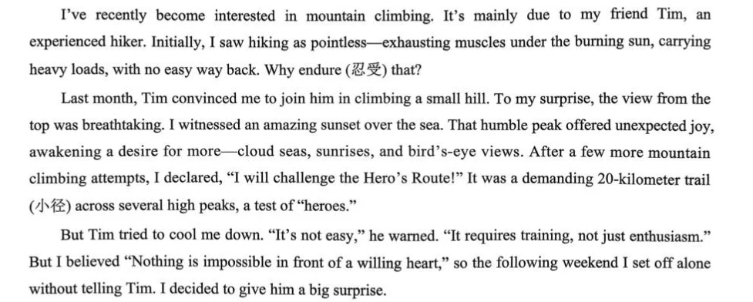

Slide 4
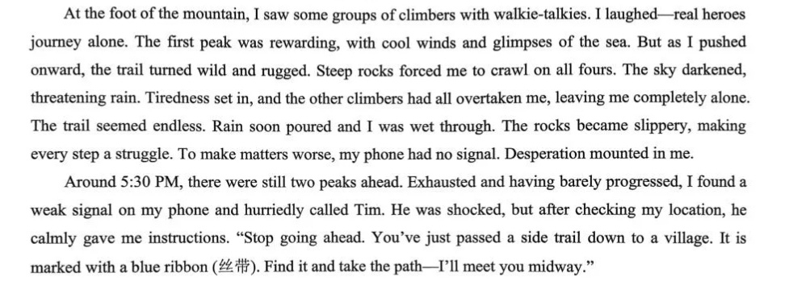

Slide 5
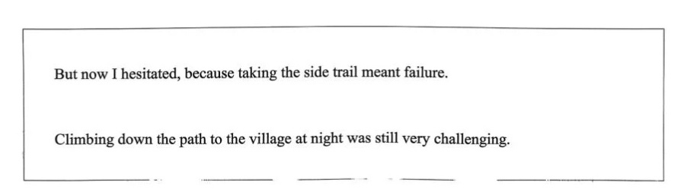

Slide 6
But now I hesitated, because taking the side trail meant failure. The image of myself standing triumphantly on the final peak clashed violently with my miserable state. Soaked wet from head to toe, I trembled uncontrollably, holding fast to my lifeline: the cellphone. The thunder rumbled in the distance, just like the pride inside my heart. With cold rain pouring, my reason finally replaced my pride. Swallowing the bitter taste of defeat, I turned back and began to search for the blue ribbon. Braving the stinging rain, I finally found the path and began my descent.
Climbing down the path to the village at night was still very challenging. Darkness enveloped the mountain, and the relentless rain made each step a struggle. Just as despair threatened to consume me, a beam of light pierced the gloom, followed by Tim's voice. Overwhelmed with relief, I felt tears mixed with rain on my face. Supported by him, I stumbled into the village. "I should have listened," I murmured. Tim simply patted my shoulder. It was then that I understood the greatest summit we conquer is our own pride, and the wisest path often begins with a brave retreat.

Slide 7
P₂₅₀
跑步动作
dash猛冲
我急忙吃了几口饭，然后急忙去赶公交车。
race快速移动
伤者被紧急送往医院。
charge冲向
The dog charged at the intruder.
跳跃动作
jump跳
He jumped over the puddle.
He couldn’t wait to jump at the golden opportunity.

Slide 8
leap大跳、强调跃
The cat leapt onto the windowsill.
Keep it in mind that we should think before we leap.
bounce =bound跳行
跳过屋子，那只狗子像发射的炮弹一样进入了我的怀里，油腻腻地舔我。
spring to one’s feet跳起来，spring into action开始行动，spring into / to life突然恢复生机
Under the conductor’s guidance, the orchestra sprang to life.
The moment the bell rang, the classroom sprang to life with a burst of noise.
躺、卧动作
lie躺（过去式、过去分词？lay的过去式、过去分词？）
他躺在床上，盯着看天花板。
lie on one’s back躺着
lie on one’s stomach趴着
The boy lay on his stomach, flipping through a comic book.

Slide 9
sprawl伸开四肢坐（躺）；蔓延
I tripped and went sprawling.
The town sprawled along the side of the lake.
(难句理解）The new accessibility of land around almost every major city sparked an explosion of real estate development and fueled what we now know as urban sprawl.
collapse +介词=sink +介词=slump+介词
Hearing the sad news, the mother collapsed into the chair, tears coming out.
爬行动作
climb通常为垂直爬
She climbed up the mountain with determination.
crawl水平爬
The traffic crawled in the rush hour.
My skin crawled when I heard the story.

Slide 10
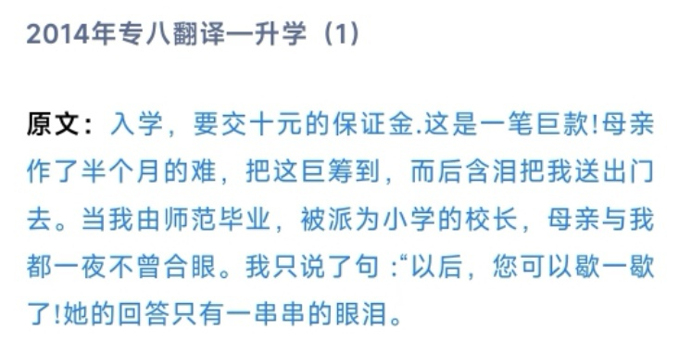
creep悄悄移动（crept, crept)
I crept up the stairs, trying not to wake my parents.
P₂₅₆
第19章 心理行为
19.1 情绪反应
哭
choke back / fight back / hold back tears忍住眼泪

Slide 11
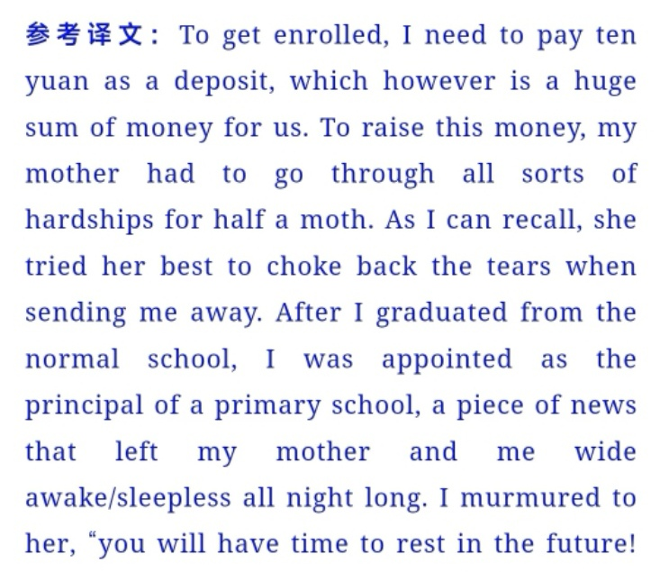

Slide 12
burst into tears突然哭了，burst into laughter突然笑了
一听到这个难过的消息，他一下子哭了，将脸深埋在双手中。
shed tears流泪
She shed tears of joy when her son graduated with flying colors.
tear-streaked / tear-stained face泪水打湿的脸
下节从P₂₅₇开始

