Slide 1
《读后续写工具箱》二十九

Slide 2
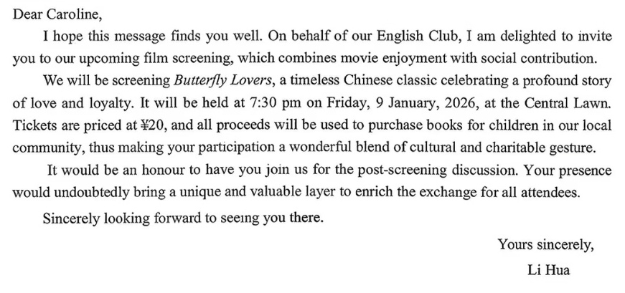

Slide 3
When Coach Peter said “Nice Work!” to her at the finish line, Eva was surprised. She bent over, her heart pounding frantically and sweat dripping incessantly onto the track. A great sense of accomplishment surged through her: Not only did she complete the mile but kept pace with many of her classmates. The shadow-chasing trick had worked. Focusing on tiny goals made the impossible achievable. “If I could conquer the track step by step, why not the terrifying maze of hallways?” Eva thought, sparks of determination and confidence blazed in her eyes.
Eva decided to use the same trick to deal with the school building. She began to view the six-storey structure not as an overwhelming maze, but as a combination of fragments. First, she focused on memorizing the route from the entrance to her first class. Gradually, she added other landmarks to her mental map. Day by day, what was once a maze became a series of familiar pathways. A sense of achivement rippled through her mind, wrapping her in a cocoon of jubilation. It dawned on Eva that big fears shrank when tackled in small paces, whether running miles or navigating life.

Slide 4
P₂₇₀ 20.5文化活动
下棋
move a piece 移动棋子
make a move 走棋
check 将军，checkmate将死
capture a piece 吃棋子
书法
write with a brush用毛笔写字
brush strokes画笔的笔触
The artist’s brush strokes were bold and precise.
齐白石先生以画虾享誉天下，笔墨所至，虾姿栩栩如生，宛若游于清波之中。
Mr. Qi Baishi is celebrated worldwide for his shrimp paintings, where each brushstroke brings the creatures to life, as if swimming through clear, rippling waters.

Slide 5
假定你是李华，你校将举行第一届学生校园书画展，并进行部分书画拍卖，所得善款用于偏远山区小学生图书购买。请给校园广播站写一篇宣传稿，内容包括：
1. 活动简介；2. 诚邀参加。
Your attention, please! Our school is due to launch its first Campus Art Exhibition from January 22nd to 23rd in the school gym. The exhibition will showcase exceptional works where every brush stroke reflects the creativity and imagination of our students.
The highlight is a charity auction of selected artworks starting at 14:00 on the afternoon of 23rd. All proceeds will fund books for primary school students in remote mountainous areas, transforming these delicate brush strokes into lasting stories for young readers.
We warmly invite every member of our school to attend the exhibition and participate in the bidding. Your support will not only celebrate campus artistry but also fuel a noble cause. Let's unite to share beauty and extend love. Thanks for your attentive listening!

Slide 6
practice calligraphy练习书法
calligraphy practitioner书法练习者
dip the brush in the ink将毛笔蘸进墨汁中
他蘸墨挥毫，在纸上画下一匹奔马。不仅马儿栩栩如生，一股清雅的墨香也仿佛在空气中弥漫开来。
He dipped the brush in the ink and painted a galloping horse on the paper. Not only did the horse appear lifelike, but a delicate scent of ink seemed to permeate the air.
绘画
draw a sketch画素描、画草图
mix colors调色
He mixed the colors to create a custom shade of blue. (=custom-made)

Slide 7
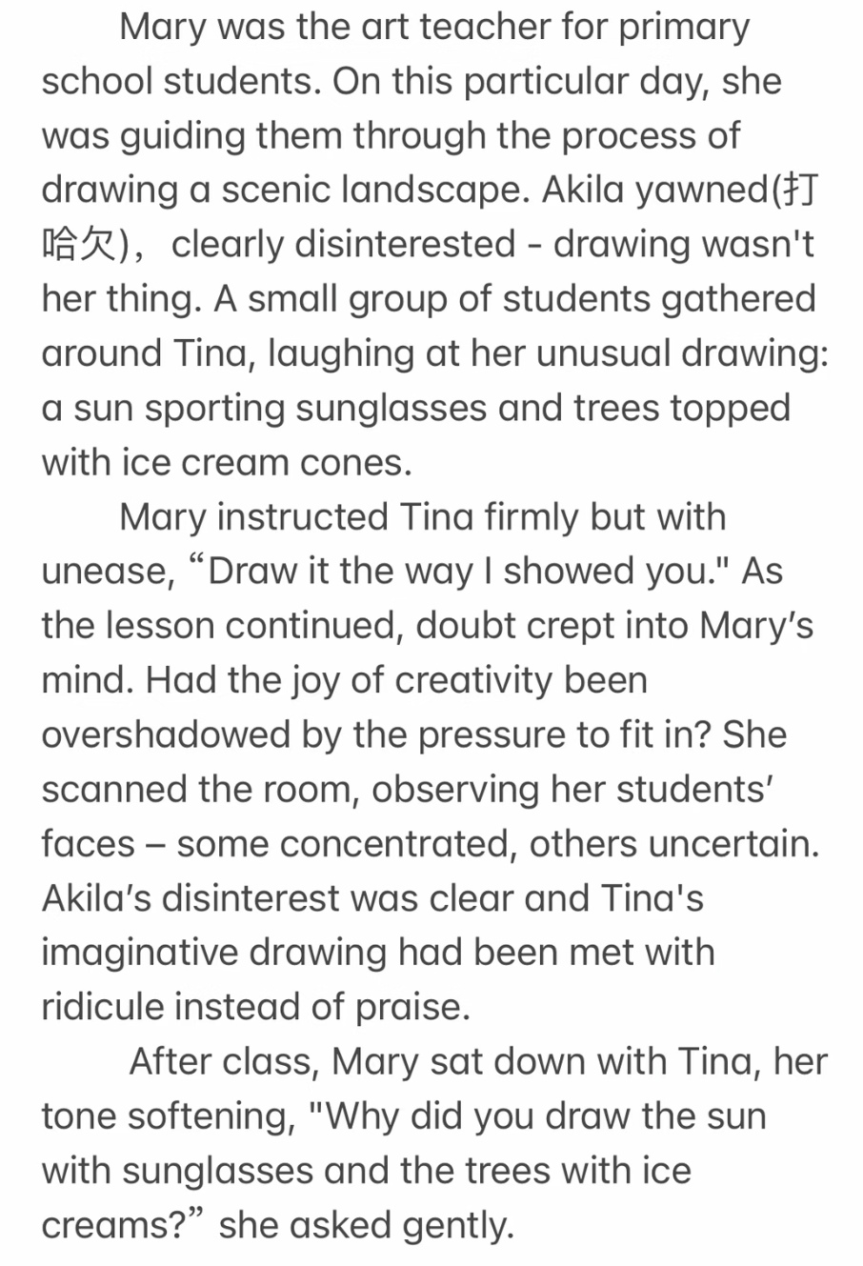
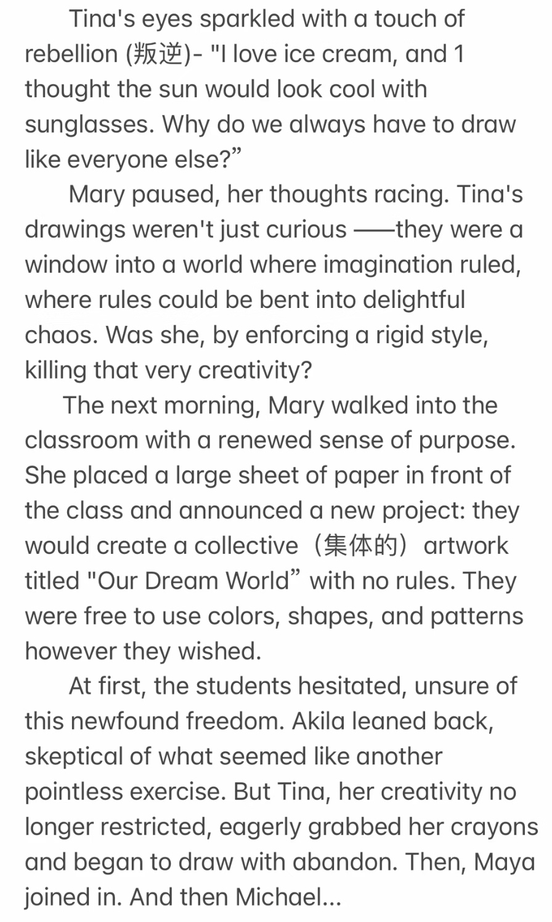

Slide 8
As the students worked, Mary observed them with curiosity. Excitement on their faces, their crayons rustled on the paper, drawing creative shapes and patterns. From time to time, they would pause, tilting their heads thoughtfully, or gazing out the window, pondering. Tina was thoroughly absorbed in her imaginative way of drawing. Even Akila, who showed no interest in drawing at all, was fully occupied in her creation. Amid the harmonious sound of crayons and relaxed laughter, the collaborative work was ultimately completed.
Mary stood back and surveyed the creation. Lying before her were pictures in different styles. Never in her wildest dreams could she anticipate these students should be so creative. Overwhelmed with pride and excitement, she couldn’t resist saying: “Kids, you did a fantastic job and I am so proud of you.” Afterwards, big applause lingered in the classroom accompanied by cheers. In that moment, Mary truly grasped the profound lesson she had learned: the true magic of education lay not in dictating steps, but in opening the door and setting imagination free.

Slide 9
20.6 音乐活动
吹
blow a whistle吹哨子
The referee blew the whistle to signal the start of the match.
弹
jam 即兴演奏
They jammed together in the garage to create new music.
(a jam session临时音乐会)
其他的即兴：play it by ear, improvise on a melody / a tune ...
唱
harmony和声，harmonize和声
They harmonized beautifully during the choir performance.

Slide 10
20.7 志愿者活动
The soup kitchen steamed with quiet warmth, hands moving steadily over ladles and plates.
Voices dropped to murmurs as we folded blankets, each crease a gesture of care.
Leaves rustled under our sweeping brooms, the street slowly returning to calm.
Shadows deepened outside as we kept wrapping meals, one after another, without a word.

Slide 11
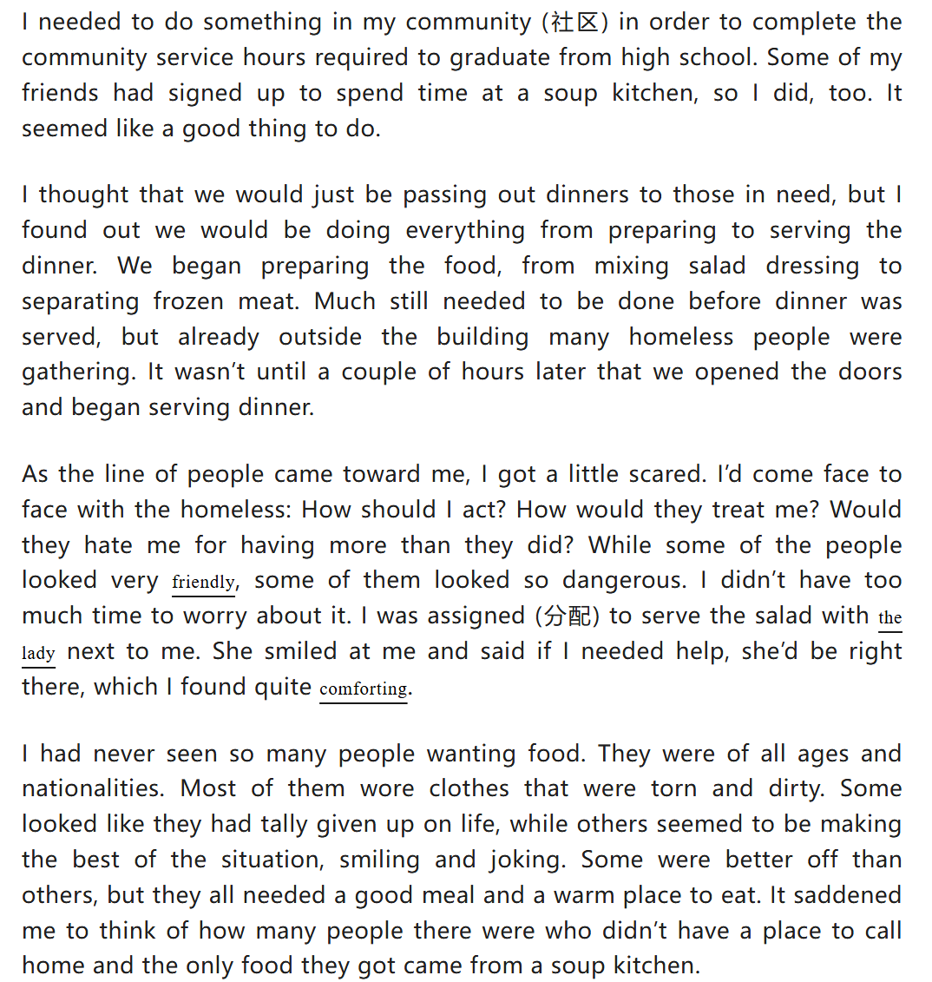

Slide 12
As they came in my direction, I put on my brightest and happiest smile. What I did was reciprocated with their genuine reaction. An elderly man with worn eyes paused before me, whispering a sincere “thank you” as I placed salad on his plate. A young mother, guiding her toddler’s hand, flashed me a warm smile. Each plate became more than a meal; it was a moment of connection. My initial apprehension melted, replaced by a profound sense of purpose. Their dignity, amid hardship, softened my heart, and by the time the line ended, my smile was no longer a forced act but a spontaneous gesture.
I was so happy that I had earned my service hours in this way. Unlike my friends who merely logged time, I received an education in empathy that no textbook could provide. Witnessing the human dignity amidst hardship reshaped my understanding of “community” and my place within it. Those hours in the soup kitchen became the most meaningful line on my high school transcript—not because they allowed me to graduate, but because they marked the moment I truly began to learn. The requirement was fulfilled with a signature, but my perspective was expanded with a compassion that will guide my steps long after graduation.

