Slide 1
《读后续写工具箱》二十三

Slide 2
新加难度词汇再复习
portrait, currency, exceed, poverty, prosperity, reinforce, rejuvenate, rival, slave, split, status, supplement, transfer, valid, bias, conscious, controversial, curve, intellectual, loyal, metaphor, numerous, principal, yield, bully, collaborate, dedicate, empathy, exhaust, fulfill, mutual, alert, drone, ethical, modify, compass, craft, ethnic, fable, legend, magnificent, miracle, myth, patriotism, porridge, eliminate, fertile, irrigate, livestock, marine, migration, proportion, rhythm, capture, orchestra

Slide 3
P₂₃₀ 动鼻子
snort喷鼻子（表示气愤、逗乐、鄙视）
He snorted at the ridiculous idea.
“You suck!” he snorted contemptuously.
The old horse snorted and shook its mane, steam rising from its nostrils in the cold morning air.
twitch one’s nose鼻子抽动
His nose twitched when he lied.
His lips twitched slightly when he felt nervous.
rub one’s nose揉鼻子
I rubbed my itchy nose. I think I was allergic to pollen.

Slide 4
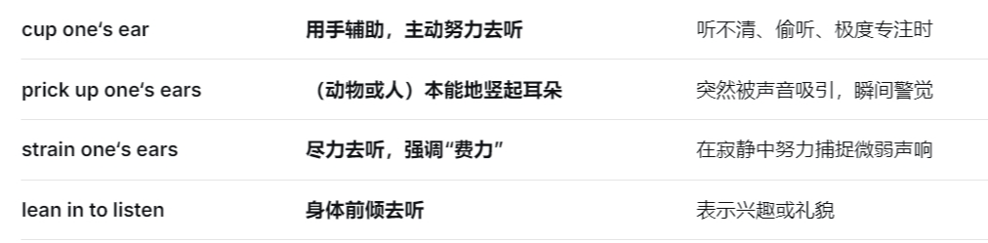
擤鼻涕、抠鼻屎、捏鼻子英语咋说？
blow one’s nose, pick one’s nose, pinch one’s nose
动耳朵
prick (perk) up one’s ears 或one’s ears prick up仔细听
Her ears pricked up at the sound of his name.
cup one’s ear (用手托耳，便于听清）

Slide 5
动嘴巴
purse one’s lips噘嘴
drop one’s mouth corners或one’s mouth corners drop 嘴角下压
part one’s lips微张嘴唇
She parted her lips in disbelief.
smack one’s lips吧唧嘴
zip / button / seal one’s lips守口如瓶

Slide 6
P₂₃₄ 第18章 身体动作
nod
She nodded slowly, as if weighing each unspoken word.
tilt one’s head歪头（好奇或疑惑）
The problem was beyond students, so they tilted their heads in confusion.
lower one’s head, droop / drop / bow one’s head低头
She lowered her head in great shame.
18.1 手部操作
beckon招手
The gril beckoned (to) us to come over.
The trails through the forest beckon to the adventurous hikers, offering an escape into the wonders of nature.

Slide 7
grasp, grab, grip, cling, clutch都表示抓紧，但有侧重
I grasped the girl the sleeve and pulled her up.
cross / fold one’s arms双臂交叉放于胸前
Some students crossed their arms, eyes shooting rays of resistance.
(双手叉腰英语咋说）
drum one’s fingers 用手指敲打
She drummed her fingers on the table, eyes fixed on the clock.
rub one’s hands 搓手（寒冷或期待）
tug at one’s sleeve拉袖子
stroke抚摸
My light stroke quickly settled the cat, which curled around my foot in comfort.

Slide 8
精细动作
pinch捏
She pinched his cheek with a grin.
tap轻点、轻敲
Tap the icon to open the app.
He was convinced his phone was being tapped.
(海浪拍打海岸用哪个单词？)
pat轻拍（多带感情色彩)
The teacher gave Tim an encouraging pat on the shoulder.
knock at / on the door敲门

Slide 9
推拉举放物品
pull拉
(一词多义：The magnetic pull of the city was hard to resist.)
drag, haul使劲拖拉
Students drag themselves out of bed every day.
snatch抢夺
He snatched the toy car from Tim, saying it was bought by his father.
toss / flip轻抛、轻扔
The referee flipped the coin and then the game started.
tuck塞进、藏入
She tucked up her trousers and waded into the water.

Slide 10
tip倾倒、翻倒
He tipped the cup, spilling water everywhere.
The car stopped suddenly, nearly tipping me out of the seat.
cup双手捧着住
Carefully, I cupped / embraced / cradled the bird in my palms.
nestle温柔安置
The kitten nestled in her cupped hands.
下节从P₂₄₂开始

Slide 11
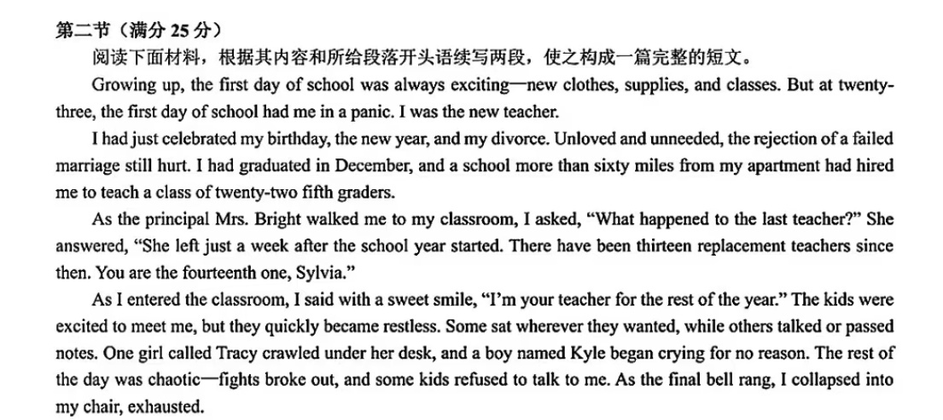

Slide 12
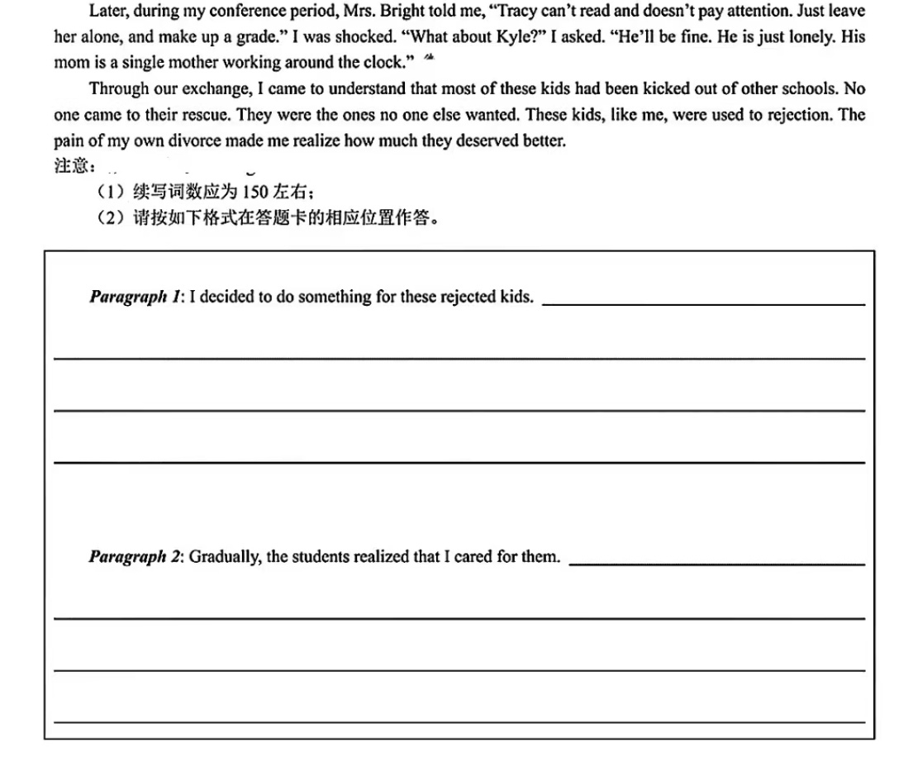

Slide 13
人物：
Mrs Bright (校长), I (23岁离婚), 22个5年级小朋友，Tracy (女孩，文盲), Kyle (男孩，被人忽视）
核心词汇：
rejection (学生自己的感受，校长的态度，作者自己的感受）
升华句：?

Slide 14
I decided to do something for these rejected kids. I started by learning about each one. For Tracy, I found books that matched her interest, hoping to spark her curiosity. For Kyle, whose face was often stained with tears, I made time for gentle chats after school, listening without judgment. "I won't give up on you. You all matter a lot," I told them with affection, trying to make everyone in the class feel loved and needed. Not only did I let them feel my love, but I clarified class requirements and maintained teaching routines. I tried my best to care for them both emotionally and academically.
Gradually, the students realized that I cared for them. With distrust melting away, they listened to me in class and comfortingly, they began to share with me their little secrets. Tracy showed a growing interest in class and Kyle smiled more often. Constant noise and fights gave way to hearty laughter and mutual help. Even Mrs. Bright was extremely surprised at this transformation, saying: "You really did an amazing job." Hearing this, I felt all my efforts were worth it and deep inside I knew that teaching is mutual healing, for I left behind my failed marriage and no longer felt rejected.

Slide 15
P₂₄₂ 18.2上半身动作
胸部（书上的不用记）
A knot tightened in his chest.他胸口一紧。
Her chest swelled with pride when she heard her name announced.
Seeing the safe return of his dog, a heavy weight lifted from his chest.
胳膊
swing one’s arms摆臂
He walked briskly, swinging her arms.
wrap one’s arms around sb.环抱
肩膀
shrug one’s shoulders 耸肩
He shrugged his shoulders with resignation.

Slide 16
tense one’s shoulders肩膀紧绷
The tight skirt tensed her shoulders. When she tried to get off the swing, a rip cut through the quiet afternoon air. Her hands flew to her back, and her heart sank. Her beloved dress was damaged with a split. A blush crept up her neck as she desperately tried to press the fabric together, her eyes darting around to see if anyone had noticed.
slump one’s shoulders垂肩
Her shoulders slumped in defeat.
square one’s shoulders / square oneself挺起胸膛
Hearing Tim’s encouraging words, she squared her shoulders, readying herself to face the unknown.

Slide 17
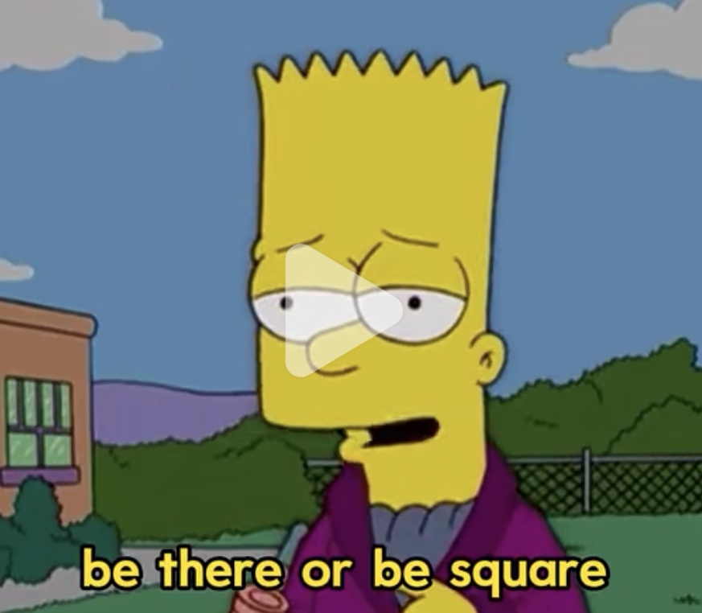
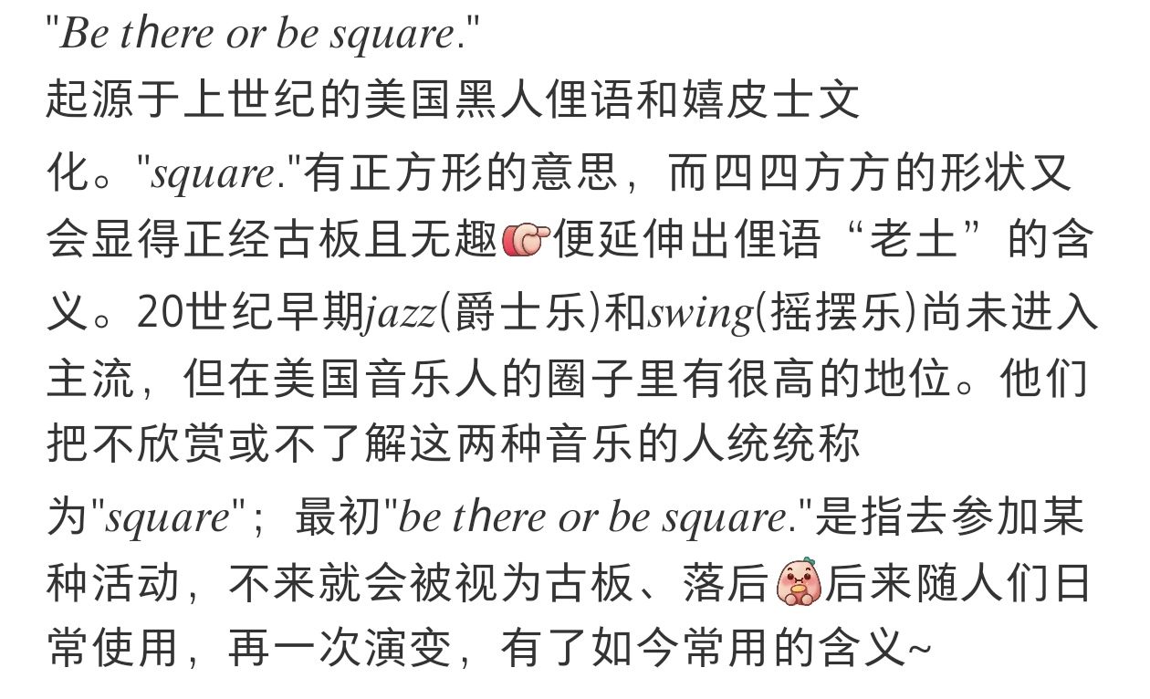

Slide 18
背
straighten one’s back挺直背
He straightened his back with determination.
bend one’s back弯腰驼背
He bent his back under the heavy load.
arch one’s back弓起背(多用于猫）
Unaware of the danger, the bird pecked at the ground. Behind it, the cat arched its back, ready to pounce.
腰
twist one’s waist扭腰、扭伤腰
She twisted her waist to dodge the ball.

Slide 19
rotate one’s waist转动腰部（用于热身或舒展）
Athletes rotated their waists before the game to prevent injuries.
与腰有关的表达：
throw out one’s back闪了腰
love handle? spare tire? crow’s feet? eye bags? dark rings? blackhead?
膝盖
kneel跪下（knelt, kneeled都行）
knee- He went down on one knee and asked for her hand.
She was on her knees searching for something.

Slide 20
腿部动作
cross one’s legs二郎腿
She crossed her legs and leaned back.
stride 大步走（strode，无完成时）
I was gaining on the other runners with every stride.
She strode into the room without hesitation.
limp / hobble一瘸一拐地走
He sustained a critical injury and limped off the court.
stagger踉跄
shuffle拖着脚走路
squat / crouch蹲下
卧虎藏龙？

Slide 21
脚的动作
stamp one’s foot跺脚
tap one’s foot点脚（等待、音乐）
He tapped his foot the beat of the music.
tiptoe脚尖，rise on tiptoe, walk on tiptoe, stand on tiptoe
下节课从P₂₄₇开始

