Slide 1
《读后续写工具箱》二十七

Slide 2
2026.1.14周三晚间及周四早读任务（清楚单词拼写及意思，可能会有单词意思拓展）
1. humor形容词, mystery形容词, harmony形容词
2. 发光的珠宝
3. 看穿（短语）
4. eliminate widespread s （怀疑）
5. 婚姻（n.)
6. nest eggs
7. 文件的原件
8. 忠诚（n.)
9. leak confidential information
10. 他比我大五岁（senior).
11. acquire (n.)
12. 浪漫的
13. contract, contact, contrast
14. 找到丢失的奖牌
15. 说一下什么时候双写最后的辅音字母，并举例。

Slide 3
16. 优先 (p开头的单词)
17. 低调
18. muscle的形容词，miracle的形容词
19. 为解决该问题，采取混合策略是合理的。(It’s ... to do ...)
20. The band played all my old (favorite).
21. 我们应该在学习和娱乐之间求得平衡。（strike)
22. modest的名词
23. （symbol) of peace, the dove is widely loved by the young and old.
24. 换个心情（scenery)
25. take in the breathtaking views
26. be in one’s element
27. beat the heat
28. supplement
29. 超出期望
30. 繁荣，横向打印

Slide 4
P₂₆₆ 20.2 公共区域
The common room was filled with ....(略)
The hallway buzzed with energy as students hurried to their next class, their footsteps echoing off the walls. (这个句子写得不错)
老句子背诵：Jane垂头丧气地拖着脚走过走廊。
In the cafeteria, trays clattered as students lined up for lunch, ...
(区分：clatter, shatter, chatter)
翻译：天气太冷了，他不停地跺脚搓手，但还是冻得牙齿打颤。
The cold was so profound that despite his constant stamping and rubbing, his teeth would not stop their chattering.
The courtyard, bathed in sunlight, became a gathering spot for students to take a break and enjoy the warmth of the day.

Slide 5
The library offered a quiet refuge, where the sound of turning pages was the only interruption to the stillness. (refuge啥意思）
学生喜欢去图书馆，书页翻动的声音可以让他们感到放松，但是很多书被撕毁或者涂抹，影响了他们的看书的体验。
那片树林是Tom的避风港。他经常去那里看茂密的枝叶，听鸟儿啁啾的声音，这些都让他得以舒缓俗事带来的纷扰。
Students lounged in the lounge ... (略)
The school plaza came alive ... (略)
The art room was a haven of creativity, where students worked on projects, their brushes dancing across canvases. (这个句子写得不错)
The gym echoed with the sound of basketballs bouncing, students sweating and competing under the bright lights. (读一下就可以)

Slide 6
20.3 教师办公室
He sat across from the teacher ... (略)
The teacher’s voice was calm yet firm as she explained the consequence of his actions, making him fully understand the gravity of the situation. （注意划线句的意思)
When the award was handed to him, a wave of pride and accomplishment washed over him, confirming that his hard work had been worth it.
(注意worth的用法：当他回首过去的时候，他感到他的努力是值得的。）
这本有着精美插图的书是值得读的（分别用worth，deserve造句)
He listened carefully to the teacher’s advice ... (略)
The office felt quiet, the weight of the teacher’s stern words sinking in as he realized the importance of responsibility. (stern严厉的，该句子了解一下)

Slide 7
Receiving the award felt like the culmination of ... (略)
The teacher’s gentle yet clear guidance ... helped her understand the strengths and weaknesses, renewing her confidence in her studies.
(注意划线的表达：优点和缺点，优势和劣势)
The recognition felt surreal as he stood in front of the class, the applause echoing in his ears. (这个句子写得不错)

Slide 8
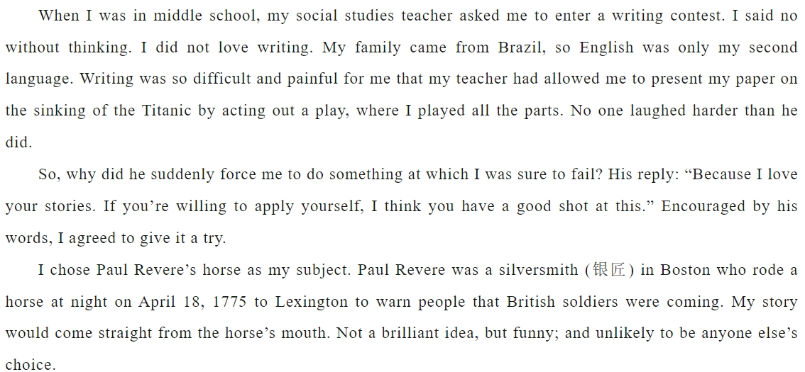

Slide 9
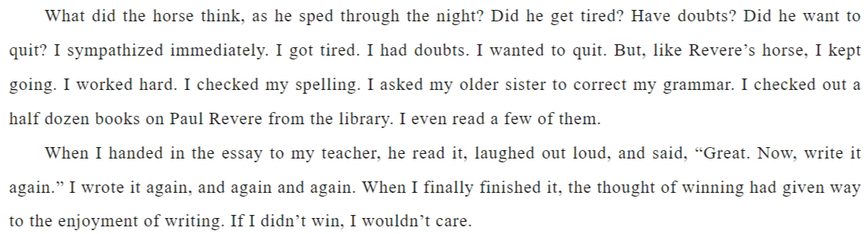

Slide 10
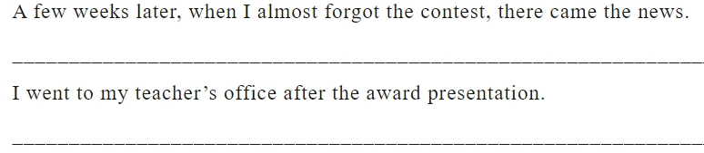

Slide 11
A few weeks later, when I almost forgot the contest, there came the news. It was exciting to learn that I had gained the first prize and an award ceremony would be held in three days. Stunned by the news, I was choked with emotion while my classmates were raising their hands in triumph. Then came the big day! When my name was announced, I mounted the stage against wild cheers and thunderous applause. With the award certificate in one hand, I threw my eyes at my teacher, who gave me a thumbs up, with his eyes twinkling with pleasure and pride. It was at that moment that I was overwhelmed with gratitude to my teacher.
I went to my teacher’s office after the award presentation. There was nobody inside. I slipped in and gingerly set a note on her desk saying, “It’s a glory for both of us!Your inspiration seems a beacon guiding my way ahead.” My enthusiasm about writing led me to choosing literature as my major in university and accordingly, being a writer became my career after graduation. So far, my published stories have won the hearts of numerous readers, bringing me a sense of fulfillment and happiness,which I attributed to my teacher’s recognition and guidance.

