Slide 1
《读后续写工具箱》精编（九）

Slide 2
I stood in the batter’s box, looking out at the pitcher’s mound. Standing on the mound was none other than the legendary New York Yankees relief pitcher, Rich “Goose” Gossage. There were two outs, the bases were loaded, and my Philadelphia Phillies were trailing by three runs in the decisive Game 7 of the World Series. As I dug into the batter’s box, the gravity of the moment was not lost on me. The Philadelphia crowd roared in anticipation, a sea of fans clad in red, and their last hopes were pinned on me and me alone.
Gossage glared with his signature menacing stare complete with his FuManchu mustache. He received his signals from his catcher, paused, and went into his windup before unleashing a 100-mile-per-hour fastball. Time slowed to a crawl. The ball cut through the chilly October air. I took a mighty swing that was followed by a distinctive CRACK. It’s the sound that only a baseball hitting a bat just right can make. The sound echoed throughout Veterans Stadium; it was so loud that it temporarily drowned out the 50,000 Phillies fans who were in attendance. The baseball soared into the night sky, clearing the left-field wall. The fans erupted, and I could hear the radio call from legendary Phillies announcer Harry Kalas.

Slide 3
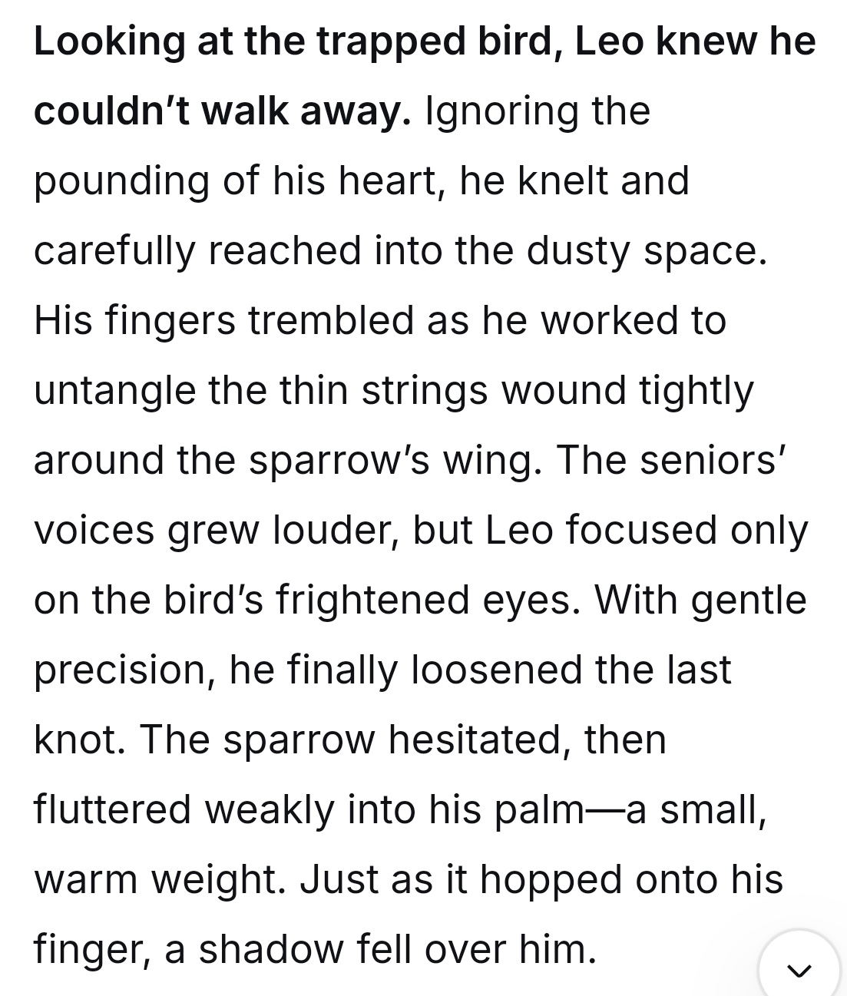
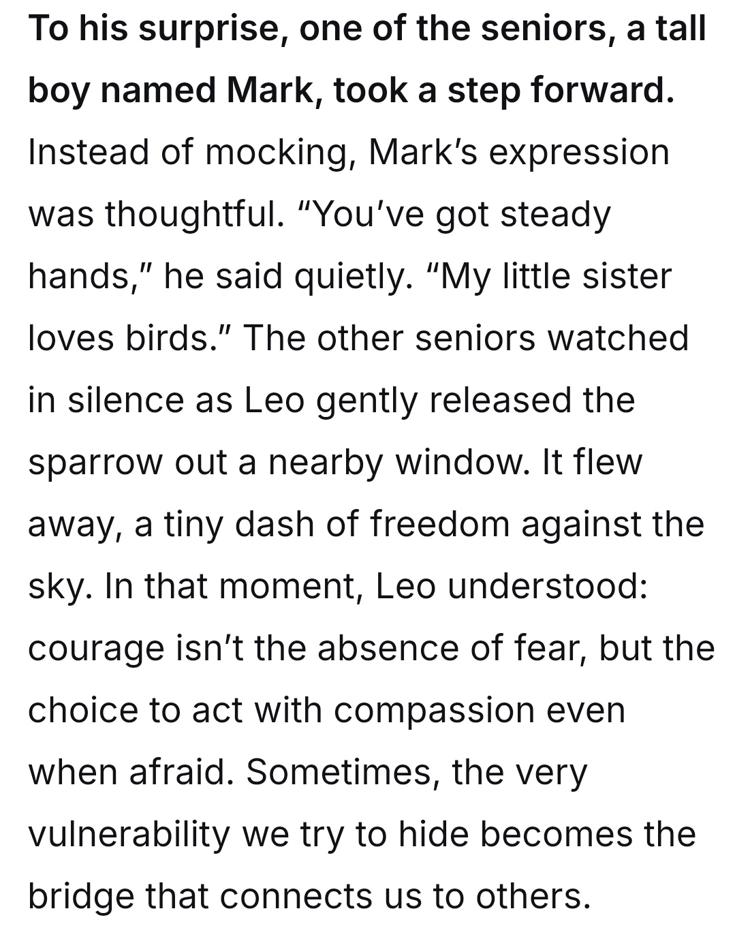

Slide 4
... Every instinct screamed at him to flee the approaching seniors, but the bird’s desperate fluttering mirrored the panic in his own chest. He saw himself in its trapped, helpless state. Taking a deep breath, he blocked out everything else. His slender fingers, usually skilled only at sketching delicate wings, now worked with frantic urgency to pick at the knots confining the creature. The messy tangle of string and debris finally gave way, and the sparrow, with a grateful chirp, shot into the dim hallway just as footsteps halted right behind him.
... He wasn’t smirking like others. Instead, he watched the sparrow disappear out of a high window before looking back at Leo, who was still crouched on the floor, braced for ridicule. “It takes courage to stop for something when you are running for yourself,” Mark said, his usually harsh voice turning soft. After this, he reached a hand to Leo and tugged him up to his feet. “Are we good?” The question was gentle, accompanied by a smile that disarmed Leo's lingering tension. It was at that moment that Leo understood his moment of vulnerability had unexpectedly bridged the gap between two different souls.

Slide 5
P₁₅₄ 第14章 复杂情绪
Unexpected +情绪surged within me like a relentless tide, pushing me forward with an unyielding force. (这个句子可以背诵）
14.1勇敢
courageous
Despite the overwhelming odds, she made a courageous decision to stand up for what she believed in.
They secured a victory in the face of overwhelming odds.
Against all odds, he made a full recovery.

Slide 6
bold大胆的
His bold move to start a business during the recession paid off in the end.
The poster, with its title in bold letters, featured a central image of an open book beside a willow tree, whose branches were fluttering in the breeze.
take a leap of faith做出大胆的决定、信仰之跃

Slide 7
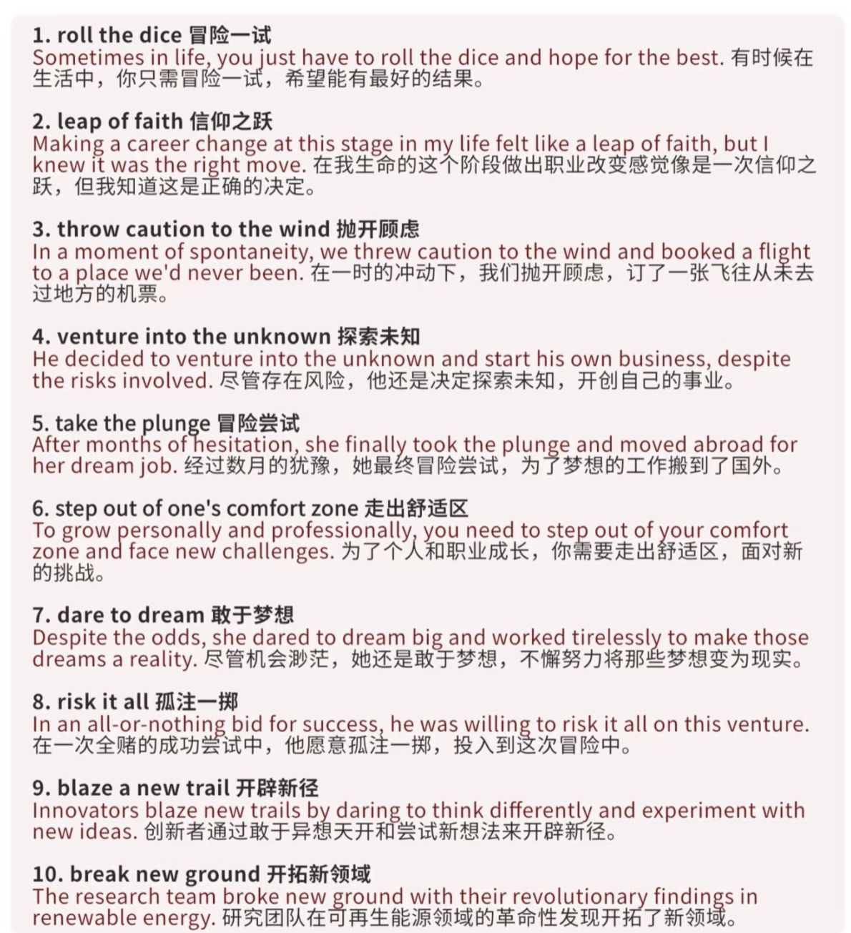
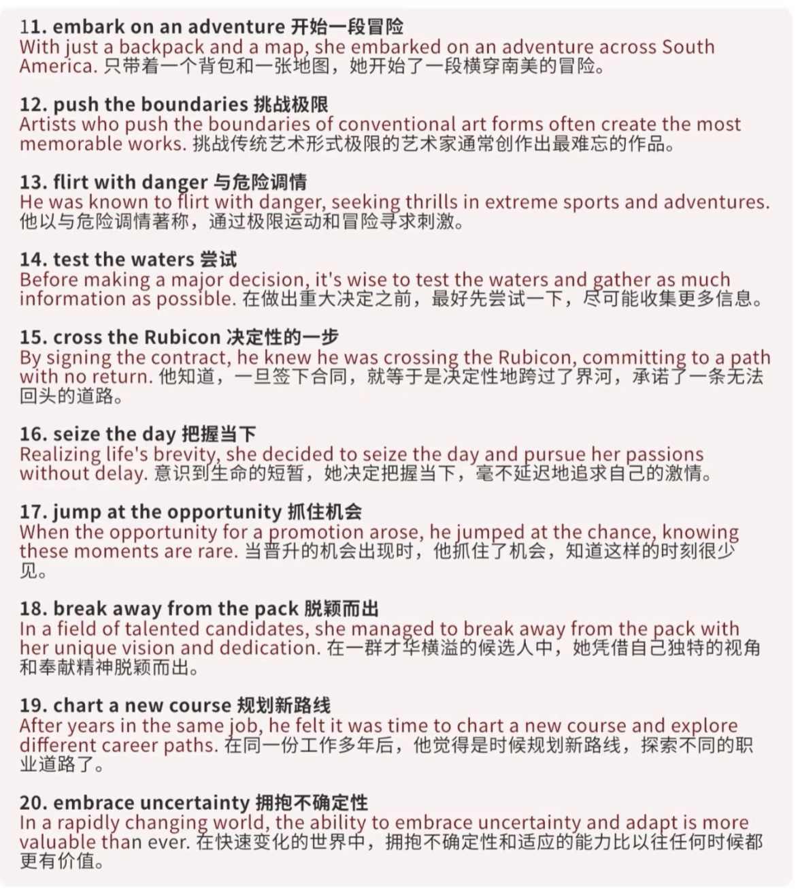

Slide 8
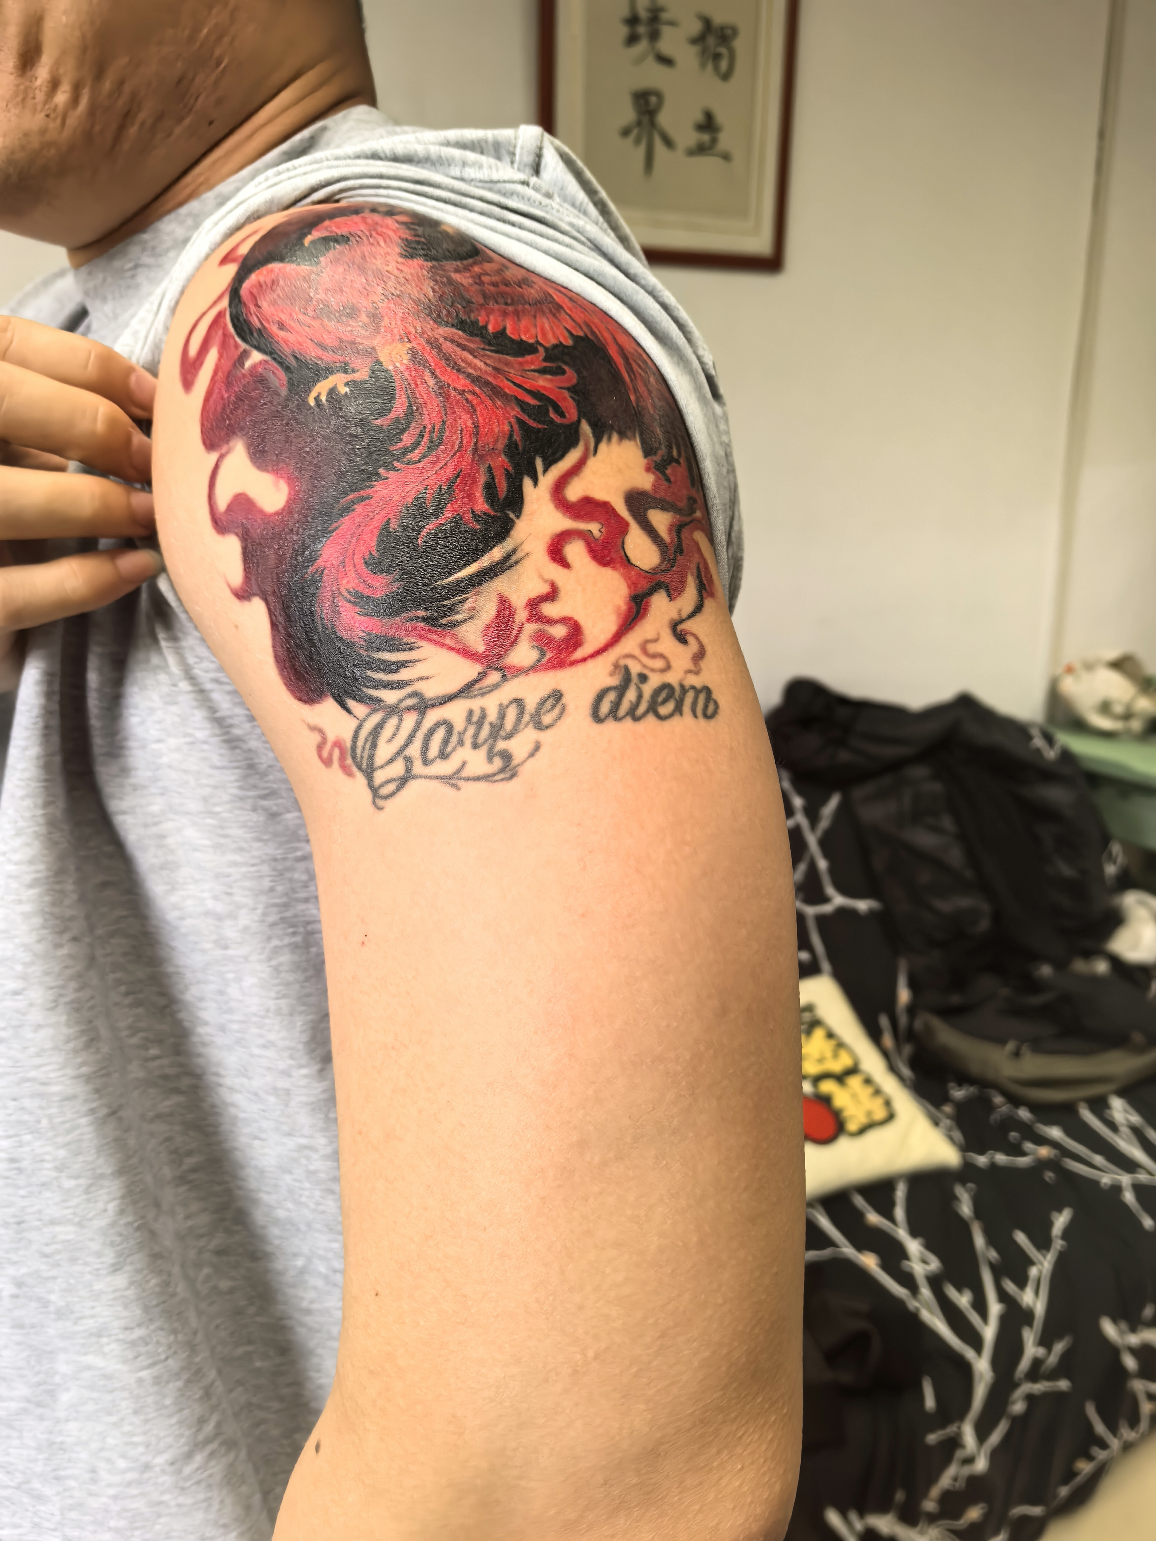

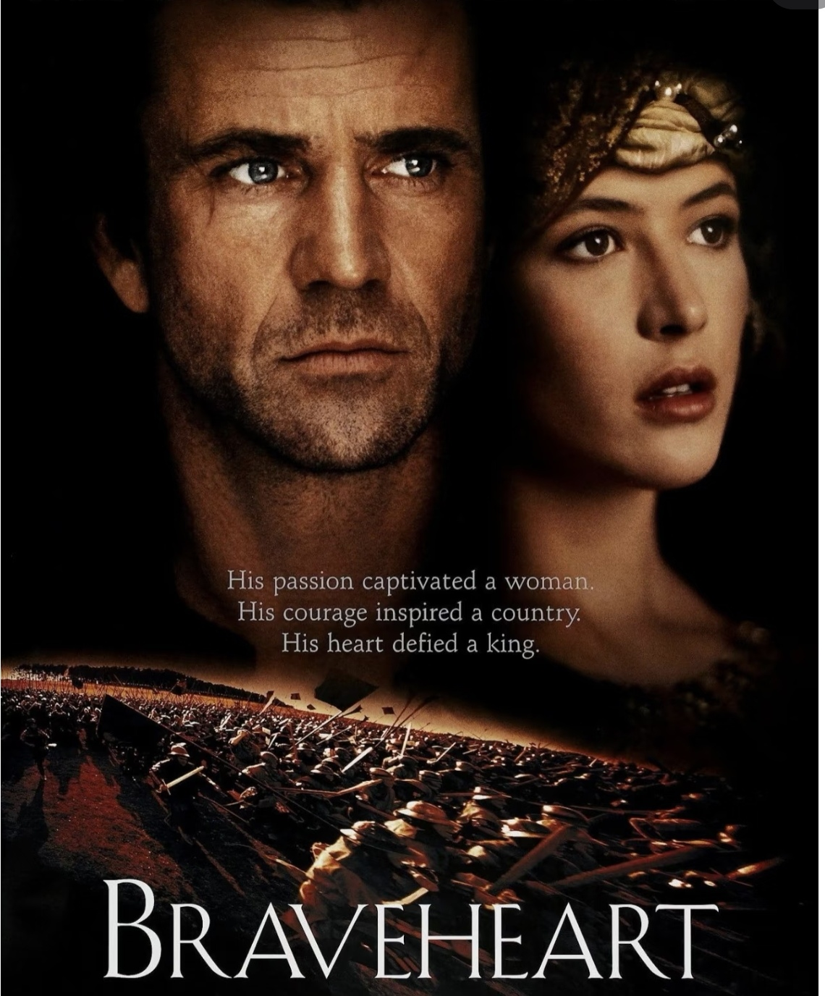
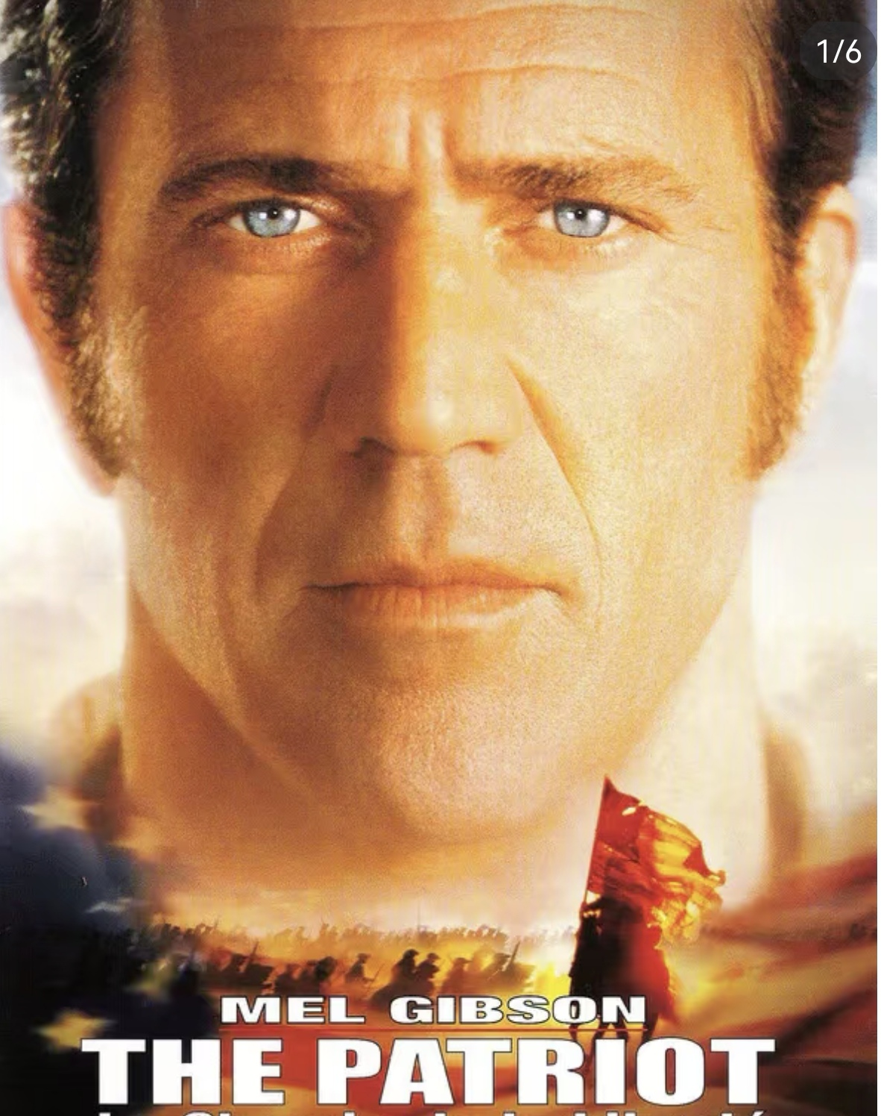
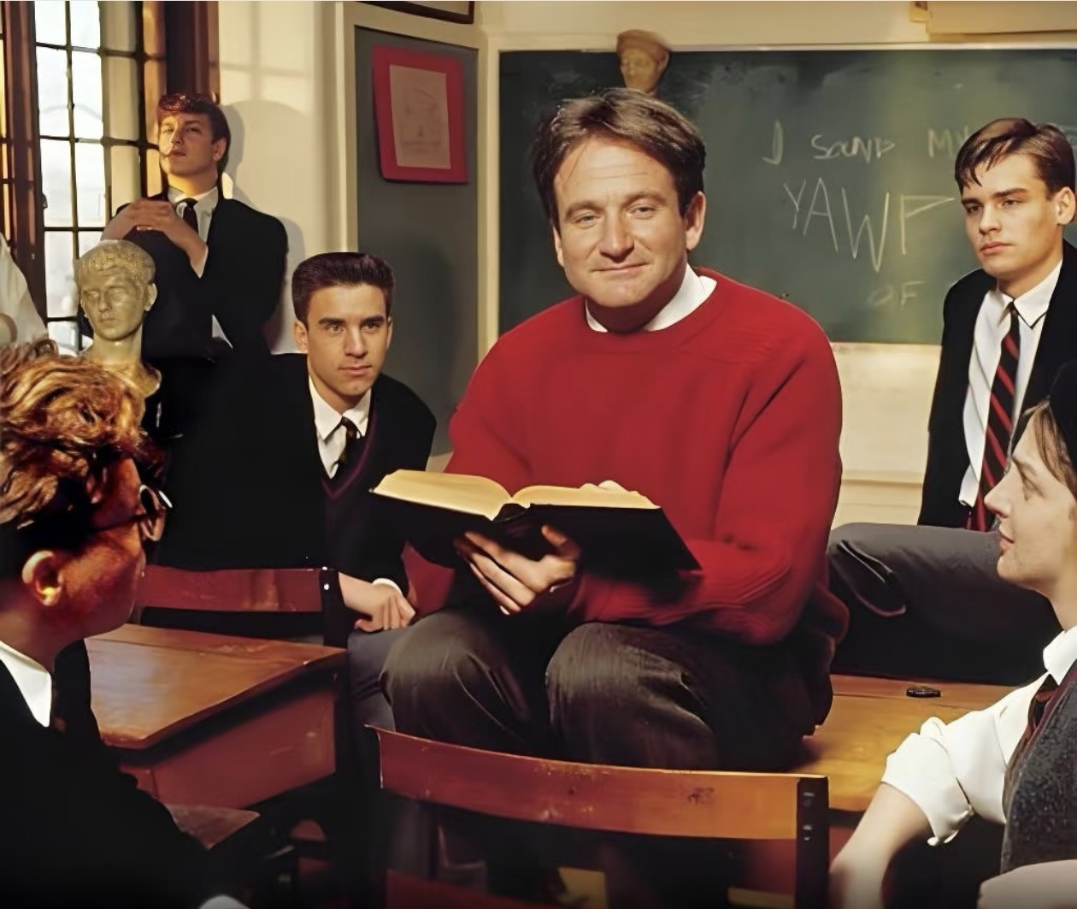
Where does the phrase appear?

Slide 9
face the music 迎接现实、面对挑战（地道表达）
After making the mistake, he had no choice but to face the music.
go out on a limb冒险、豁出去了（地道表达）
I‘ve hit rock bottom emotionally lately. It may be because I caught up with my family the other day, when they guilt-tripped me into returning home to find a job. My parents aren’t control freaks. They don’t have a hold over me. They simply want me to be physically present in their lives. As for what I want to do, for all they care. Logically, I can put things into perspective. Growing up, they struggled to make ends meet, so I walked on eggshells to avoid adding to their burden. I was afraid to go out on a limb.
put oneself on the line将自己置于危险中
The politician put himself on the line by standing up for the controversial issue.
take the bull by the horns勇敢面对问题

Slide 10
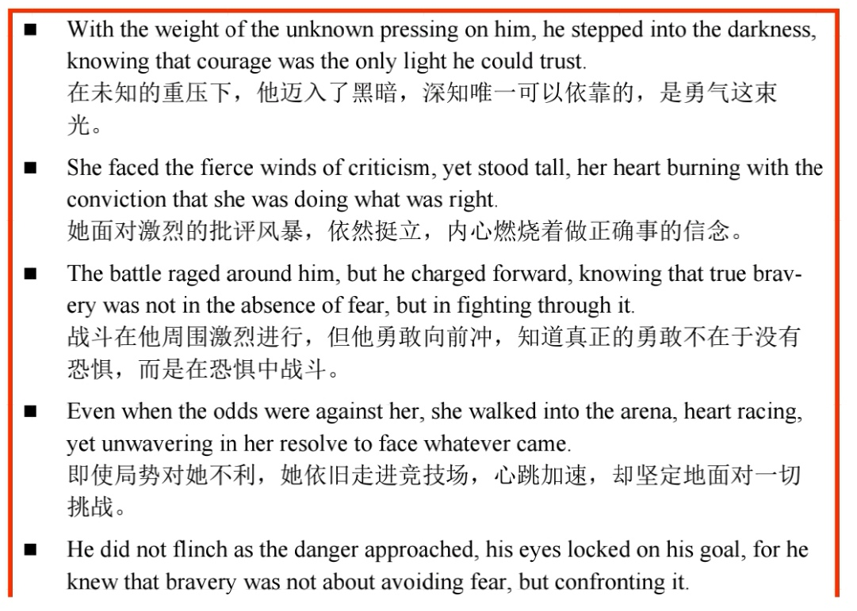
brave the elements勇敢面对风雨
They braved the elements during the storms, refusing to stop their expedition.
bite the bullet咬紧牙关、硬着头皮

Slide 11
14.2 坚持不懈
perseverance, persevere坚持不懈
Her perseverance through years of struggle earned her the recognition she deserved.
tenacious, tenacity坚持不懈
The tenacity he showed during the project allowed him to finish it despite many setbacks.
resilience韧劲
Her resilience in the face of hardship is what helped her bounce back after losing her job.
His resilience in the face of this challenge was instrumental to our team's ultimate success.
Her proven resilience and intellectual vigor convince me that she will not only adapt to your rigorous program but will actively contribute and flourish.

Slide 12
endurance耐力
unwavering focus不动摇的专注
unwavering support不动摇的支持
unwavering determination不动摇的决心
relentless / unrelenting efforts不懈的努力
relentless / unrelenting pursuit不懈的追求
Her relentless effort to master the piano paid off with a grand performance.
stay the course坚持到底
keep your nose to the grindstone埋头苦干
He kept his nose to the grindstone to accumulate dirty jokes and was eventually became a master.

Slide 13
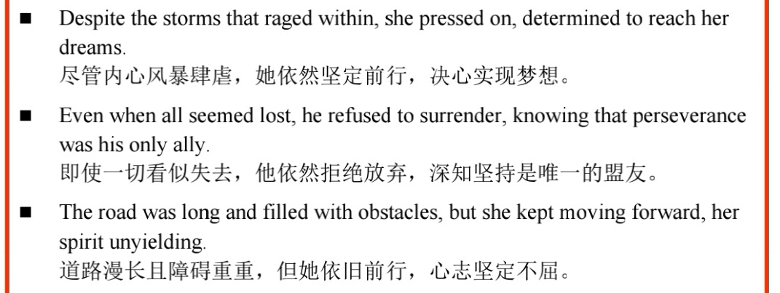

Slide 14
14.3 理性、明智
prudent谨慎的
His prudent approach to spending saved him a lot of money in the long run.
rational理性的
rational numbers, irrational numbers
deliberate深思熟虑的、从容不迫的
Her deliberate actions in the negotiation helped secure a favorable deal.

Slide 15
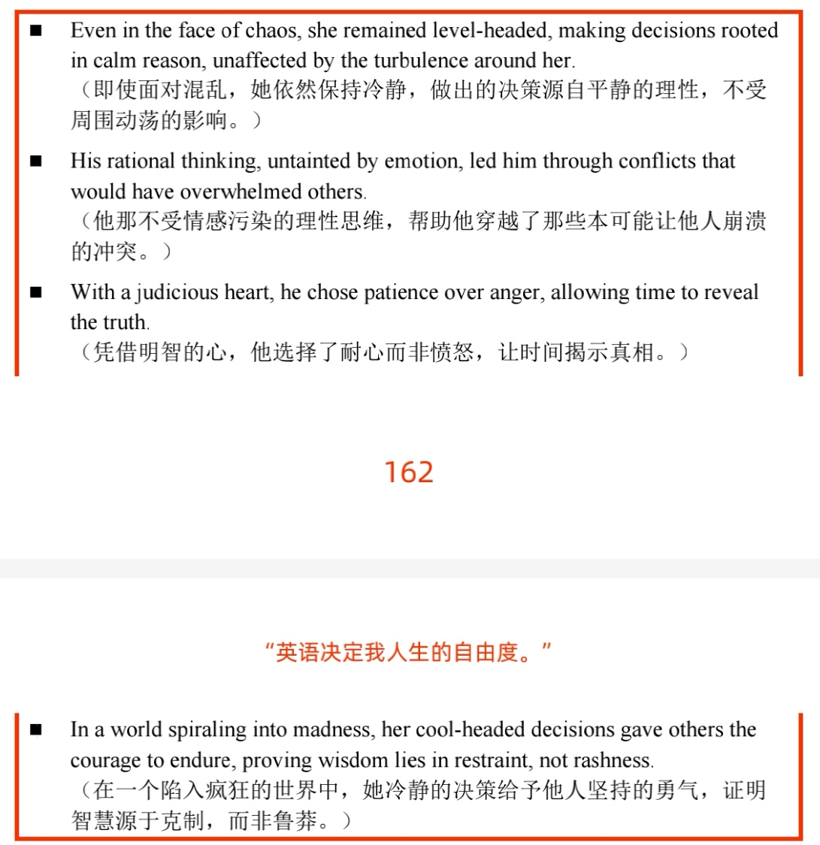
下节从P₁₆₃ 进取、拼搏开始

