Slide 1
读后续写精编（三）

Slide 2
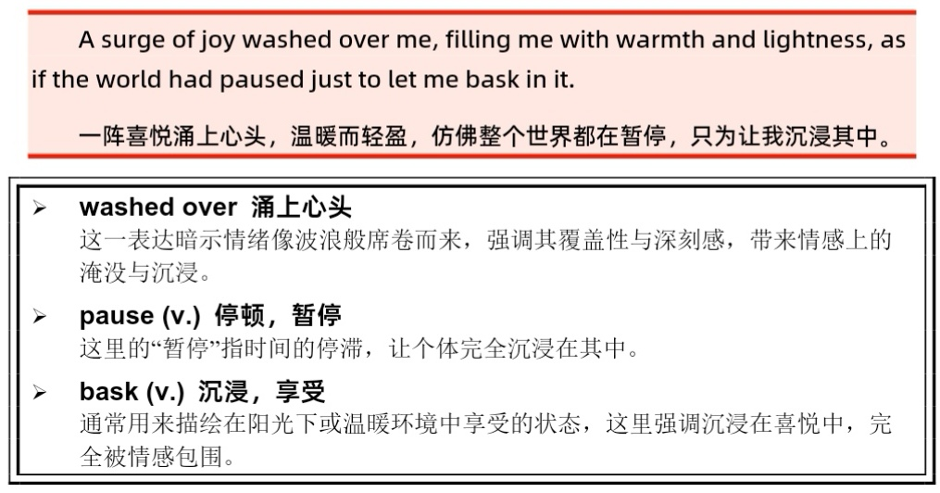
P₉₇
A surge of joy washed over me, filling me with warmth and lightness. 是不是更好?

Slide 3
7.1 平静与满足
a sense of tranquility (serenity) 宁静感
A sense of tranquility washed over him as he watched the sunset.
As the sun dipped below the horizon, painting the sky in hues of orange and purple, a profound sense of tranquility washed over him. The chatter of the world faded into a gentle hum, until all that remained was the quiet rhythm of his own breath, steady and calm.
unwind放松、解压
He took a deep breath, allowing his tense shoulders to unwind.
They took a stroll in the garden, breathing in the floral aroma to unwind from the hectic school life.
Hitting the gym is a great way to unwind from the daily grind.

Slide 4
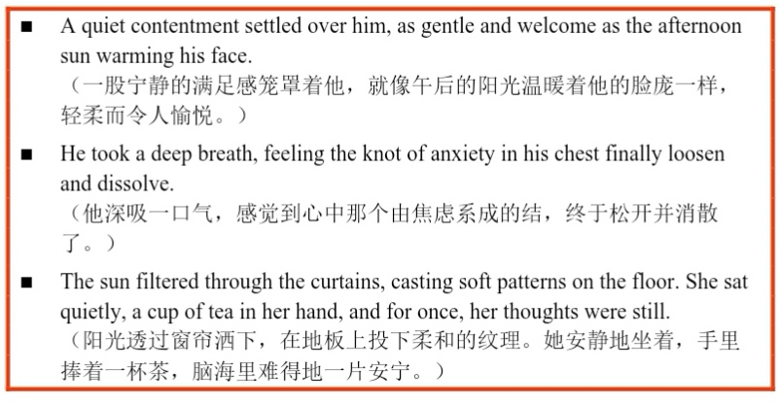
第二个句子可以背诵一下，写得还是不错的！loosen有的时候也可以loosen one’s grip，反义是tighten one’s grip。如：Just as she was about to give up, a faint light appeared in the distance. It was a search party! As the beam grew stronger and voices became audible, the panic that had held her captive began to loosen its grip. A sob of relief escaped her lips; she was going to be saved.

Slide 5
7.2快乐与兴奋
burst with joy充满喜悦（极为高兴）
类似表达：brim with joy, overflow with joy, swell with joy, overwhelmed with joy等，写作时注意这些词多用-ing形式，注意主句主语和-ing形式的一致性。
如：Bursting with joy, he scooped the wriggling dog into his arms, burying his face into its soft fur.
burst into laughter突然大笑（laughter不加s)
burst into tears嚎啕大哭

Slide 6
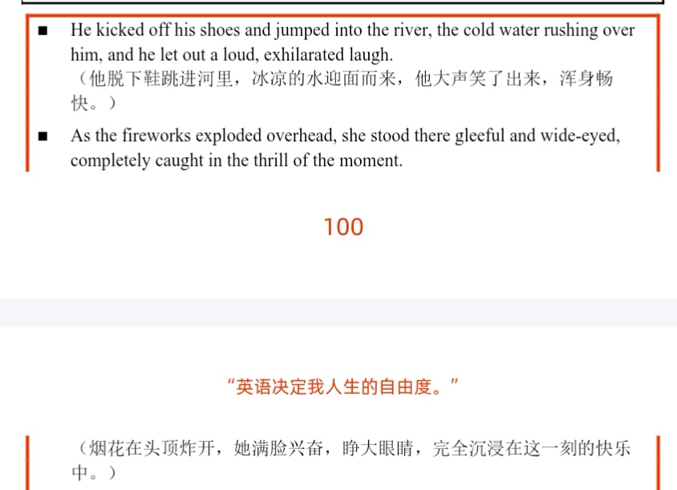

Slide 7
7.3自信与自豪
triumphant胜利的、欢欣鼓舞的、洋洋得意的，a triumphant smile
He gave a triumphant grin as he crossed the finish line.
更高级：He flashed a triumphant grin as he crossed the finish line, wild cheering erupting from the spectators. (或... accompanied by the erupting cheers from the crowd.)
beam with pride自豪地笑
a beam of satisfaction满意的笑容
“We made it!” he exclaimed, beaming as he held up the hard-won trophy.
radiate confidence散发出自信
emanate confidence表现出自信（注意：animate)

Slide 8
7.4兴趣与热爱
engrossed 全神贯注的（be engrossed in)
He was so engrossed in the experiment that he didn’t notice it was already midnight.
（考试时，使用so置于句首的倒装句，但务必注意did ... +原形）
be immersed in / immerse oneself in沉浸于
She immersed herself in the world of botanical illustration, often working late into the night with unwavering focus. (这个写得不错）
lose track of time忘记时间
建议背诵：So much fun did we have that we lost track of time.
be intrigued by感到好奇
The new boy spoke to no one and always sat alone. Sarah, however, found herself intrigued by his quiet demeanor, so different from the boisterous boys in her class.

Slide 9
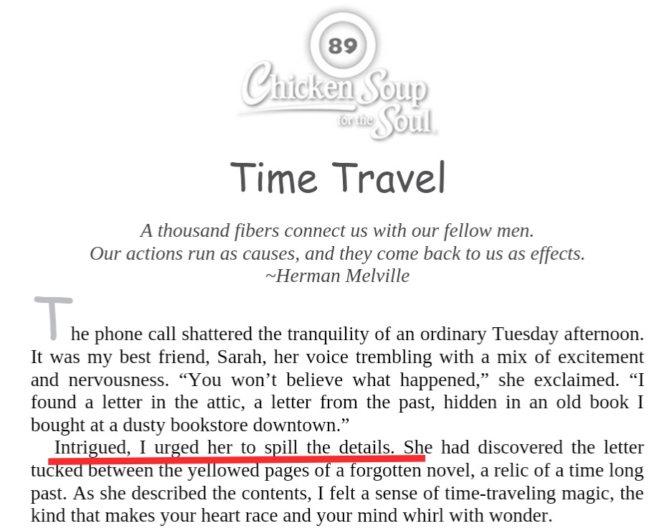

Slide 10
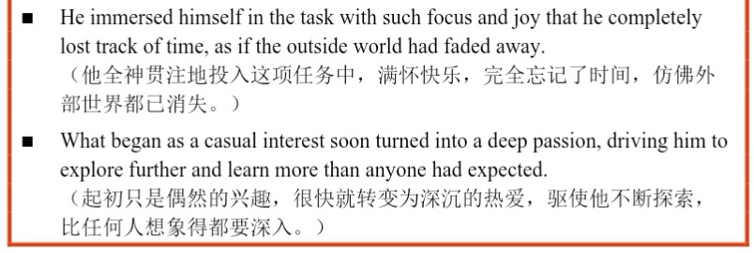

Slide 11
7.5 兴奋与期待
tingle with excitement兴奋不已
Tingling with excitement, she carefully tore open the wrapping paper, hoping she would see the doll.
with bated breath屏住呼吸
The audience waited with bated breath for the winner to be announced.
go into raptures =ecstatic欣喜若狂
Most of my friends live in the city, yet they always go into raptures at the mere mention of the country. Though they extol the virtues of the peaceful life, only one of them has ever gone to live in the country.
下节从 P₁₀₇ 第8章 悲伤

Slide 12
