Slide 1
《读后续写工具箱》三十

Slide 2
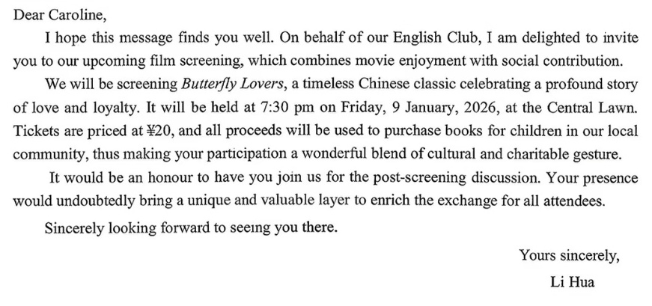

Slide 3
假定你是李华，你校将举行第一届学生校园书画展，并进行部分书画拍卖，所得善款用于偏远山区小学生图书购买。请给校园广播站写一篇宣传稿，内容包括：
1. 活动简介；2. 诚邀参加。
Your attention, please! Our school is due to launch its first Campus Art Exhibition from January 22nd to 23rd in the school gym. The exhibition will showcase exceptional works where every brush stroke reflects the creativity and imagination of our students.
The highlight is a charity auction of selected artworks starting at 14:00 on the afternoon of 23rd. All proceeds will fund books for primary school students in remote mountainous areas, transforming these delicate brush strokes into lasting stories for young readers.
We warmly invite every member of our school to attend the exhibition and participate in the bidding. Your support will not only celebrate campus artistry but also fuel a noble cause. Let's unite to share beauty and extend love. Thanks for your attentive listening!

Slide 4
(2026.01.20周二晚间任务：2026.01浙江应用文，阅读至少5遍）
假如你是李华，你发现校图书馆的藏书存在被勾画涂改的现象。请你向校园电台投稿，内容包括：
1. 具体陈述现象；
2. 呼吁爱护书籍。
Recently, exploring the shelves of our school library, I have been deeply disheartened to see many beloved books bearing the marks of thoughtless handling. Words are scribbled in margins, pages are torn out, and covers are creased and worn. Such rude actions not only damage the books physically but also disrespect our shared intellectual space, robbing future readers of the joy of reading.
Books serve as gateways to knowledge and imagination, opening doors to endless possibilities. Our library’s collection is a shared treasure, and it is our collective responsibility to preserve it. Le’s handle each book with the utmost care, safeguarding it from damage and ensuring its prompt return.
By doing so, we guarantee that these invaluable resources can continue to enrich our academic lives for years to come. A book in good hands benefits us all. Let’s act now!

Slide 5
20.8 礼堂活动
The audience fell silent as the award recipients walked to the stage, their steps slow and measured, reflecting the weight of their hard-earned achievements.
recipient接受者
recipient. recipe, receipt?能区分这三个单词吗？
The sole reason Maxwell was not a recipient of the Nobel Prize in Physics was that the prize did not exist during his lifetime.
The Nobel Foundation’s limit of three recipients per prize, each of whom must still be living has long been outgrown by the collaborative nature of modern research, as will be demonstrated by the inevitable row over who is ignored when it comes to acknowledging the discovery of the HIggs boson (希格斯玻色子).
measured缓慢谨慎的、慎重的、克制的
He walked down the corridor with measured steps.

Slide 6
The crowd erupted in applause as the award winner stepped forward, his face lit up with a mixture of disbelief and joy.
其余的句子不用看
翻译：这个奖杯不仅仅反映了我们过去的努力，也必将激励我们实现更大的目标。
The trophy was not just a testament to our efforts, but also an impetus for future pursuits.
The trophy crowned our past efforts and served as a stepping stone toward greater aspirations.
The trophy was not merely the epitome of our past efforts, but also the seed of future endeavors.

Slide 7
20.9 应急医疗
As the emergency medical team arrived, they swiftly assessed the situation, their calm demeanor reassuring the panicked students.
demeanor行为、举止
Despite the intense pressure, her calm and professional demeanor never wavered.
The teacher’s stern demeanor kept the classroom in order.
其余句子选择性阅读
（阅读下面的读续，2023届济南三模)
Brandon-Father
两个儿子-Louie大儿子，Everett小儿子
事情：Louie不小心落入井中，Brandon让小儿子到路边去寻求他人救援

Slide 8
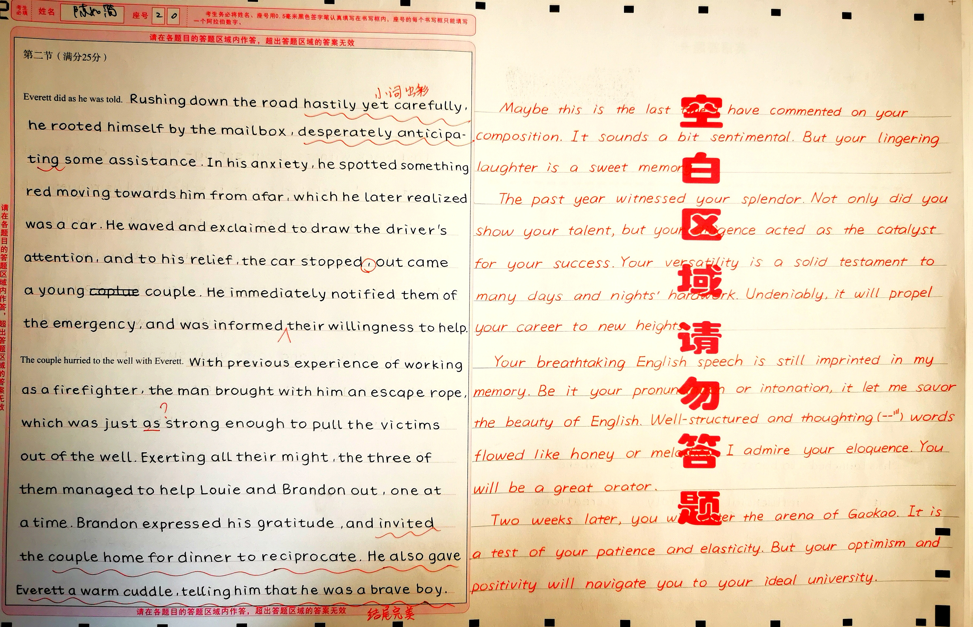

Slide 9
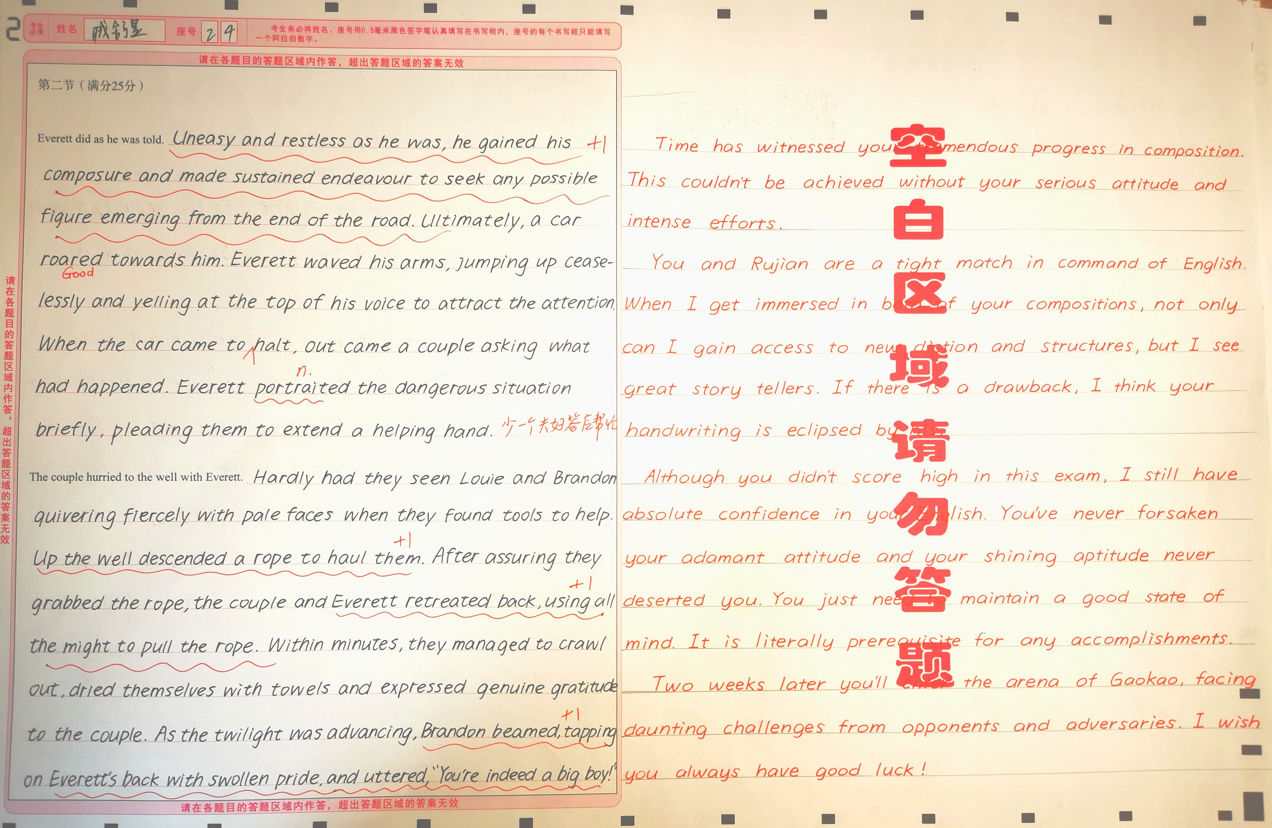

Slide 10
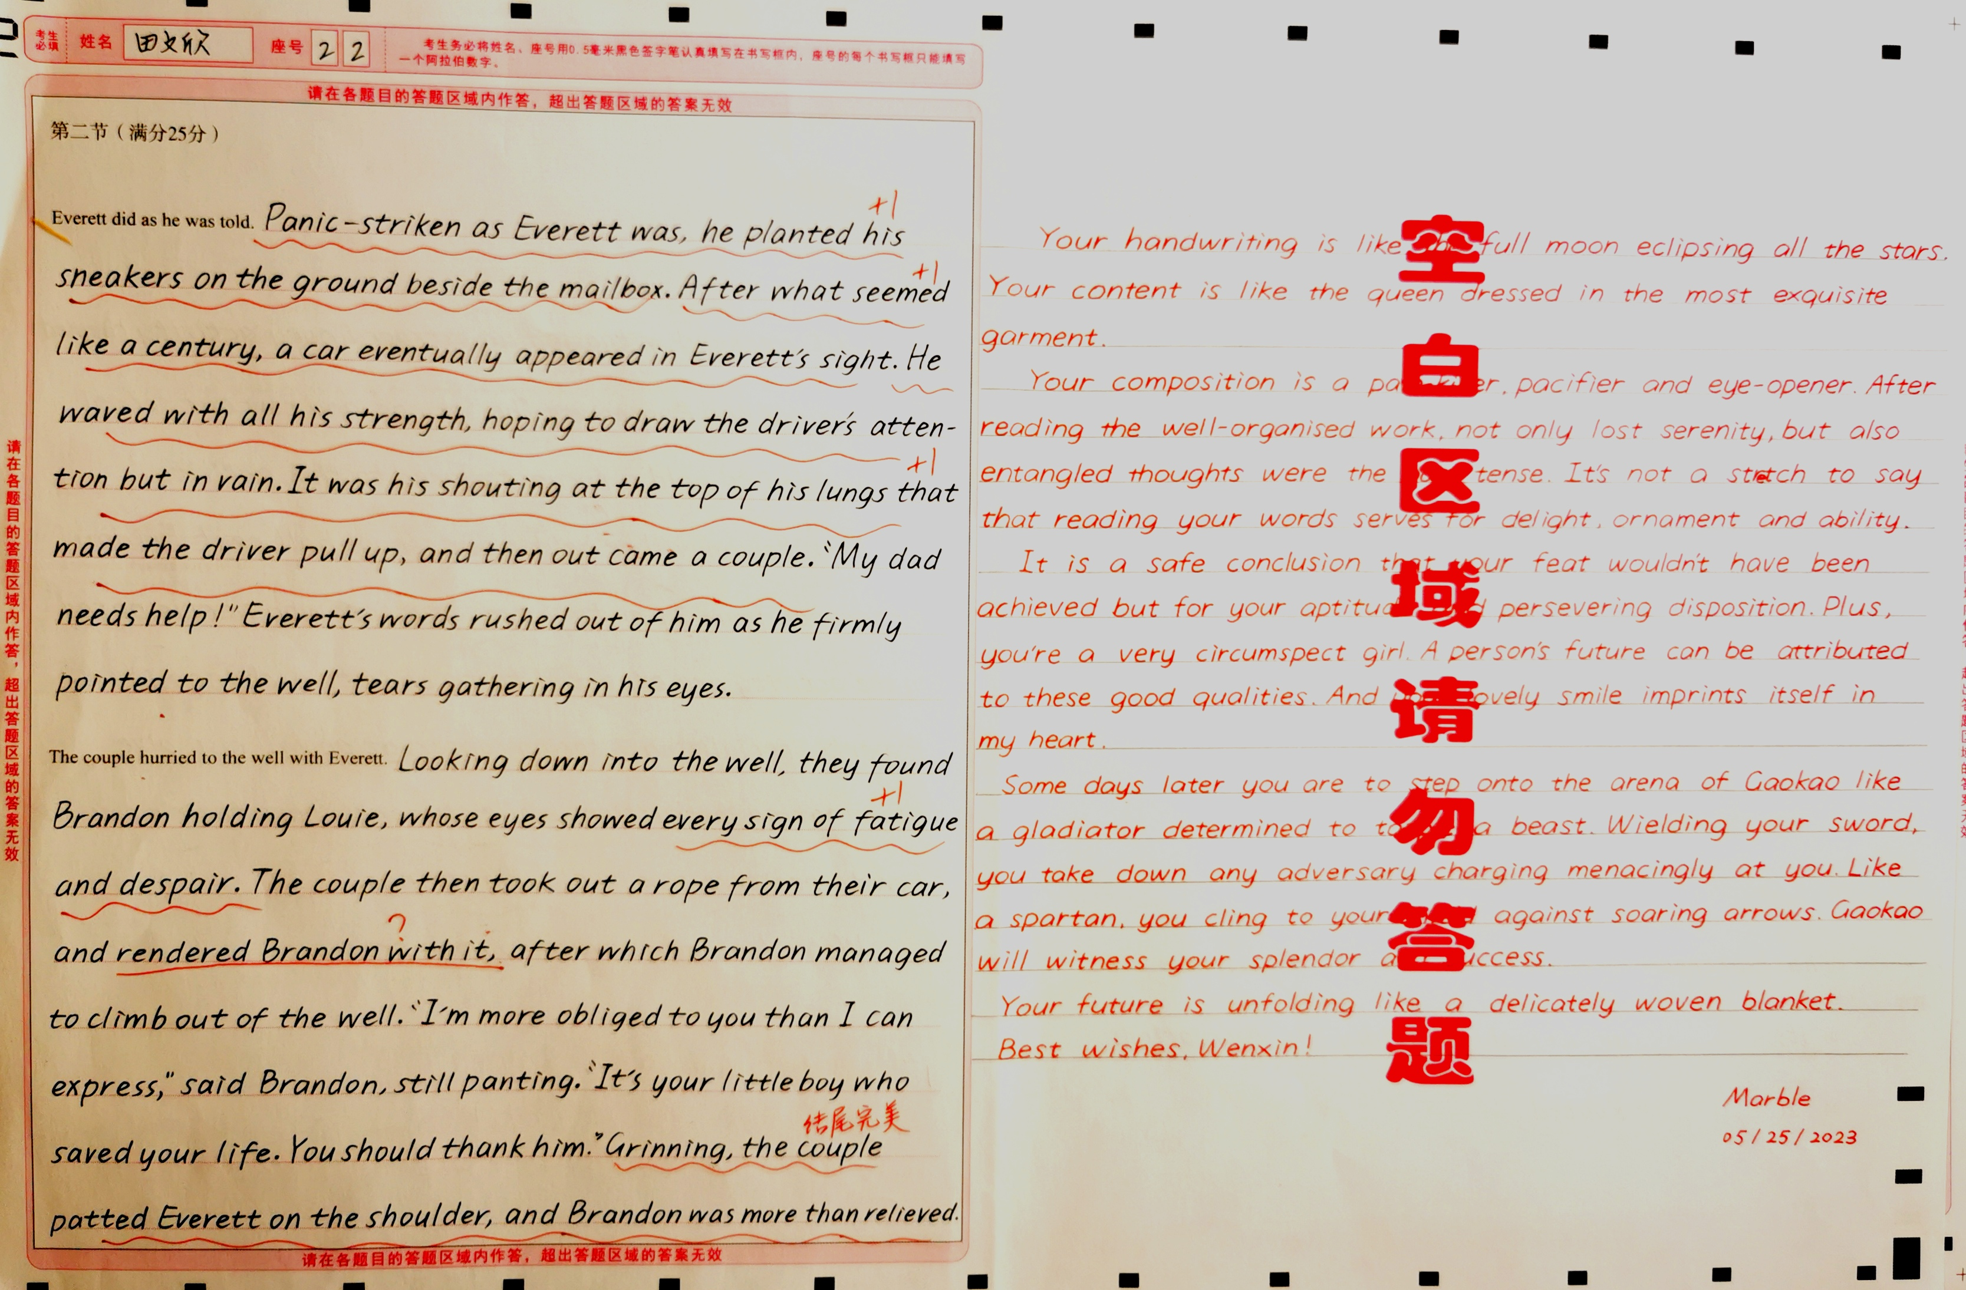

Slide 11
20.10安全演练
应急演练：emergency drill
有序撤离：file out in an orderly way, orderly evacuation
指定集合点：designated assembly area
演练顺利结束：The emergency drill concluded with a success.
模拟火灾演练：the mock fire drill
Fire alarms blared, and students quickly filed out of the building, each following the desginated exit.
其余的句子不用看

Slide 12
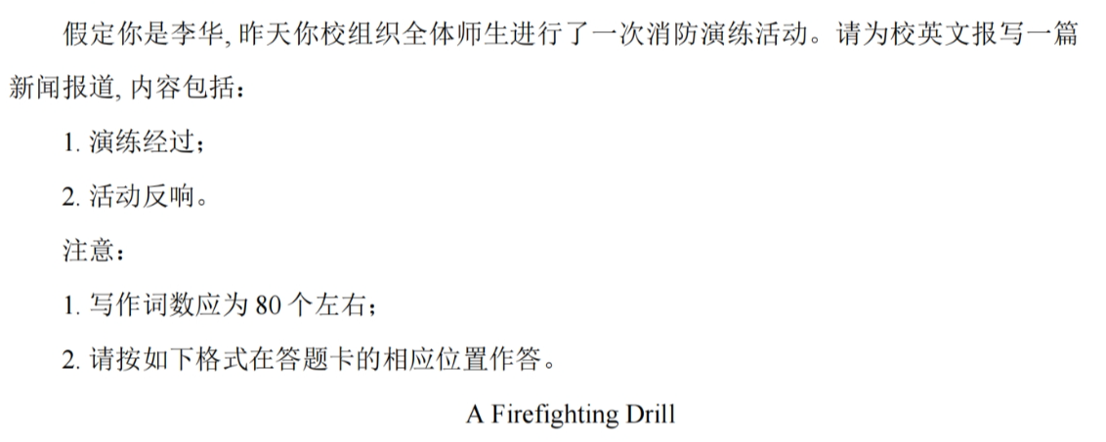

Slide 13
Yesterday morning, a comprehensive fire drill was successfully conducted across our school campus, involving all faculty and students.
The drill began with the piercing sound of the alarm, prompting everyone to evacuate classrooms immediately and in perfect order, following designated routes to the assembly points. Subsequently, firefighters demonstrated the proper use of fire extinguishers, with several students and teachers gaining hands-on experience.
The activity was met with widespread positive feedback. Participants expressed that it was an eye-opening and practical lesson, which significantly heightened their awareness of fire safety and their confidence in responding to emergencies.

