Slide 1
《读后续写工具箱》三十二

Slide 2
P₂₉₅ 21.7冲突与对抗
作业检查
1. 相互理解和尊重是和谐人际关系的关键。（mutual）
2. 推迟购买刚发布的手机是一种明智之举。（postpone）
3. transmit, submit意思及名词
4. 修辞手法
5. rise to the occasion
6. 利用（至少3个）
7. 电子书的优点（至少一个句子，不少于12个单词）
8. 如果你有任何问题，请随时问我。
9. 开拓视野，丰富经历
10. success, succession区别；presence, presentation区别；completeness, completion区别

Slide 3
假定你是李华，你校英语话剧社拟举办英语话剧展演活动。请你写一篇开幕词，内容包括：
1. 表示欢迎；2. 活动介绍。
Dear teachers and fellow students,
Welcome to the English Drama Club’s exhibition! We are thrilled to have you join us today, and so excited to share our love for drama and the English language with you.
Today, we will present a series of plays that our talented students have worked hard to prepare. These performances include a mix of classic and contemporary stories, showcasing both creativity and language skills. The event will feature five short plays, each highlighting different themes and genres. Between the performances, there will be brief intermissions allowing you to interact with the cast and enjoy refreshments.
We believe drama not only entertains but also educates and inspires. ‌Through this showcase, we hope to foster a deeper appreciation for theatrical arts within our school. ‌Thank you for your presence and support. Now, let the show begin!

Slide 4
dispute争议、争论
The two companies disputed over the terms of the contract.
indisputable, undeniable, irrefutable不可辩驳的
It is indisputable that a good head and a kind heart are a formidable combination.
Digital screens offer indisputable advantages over print, functioning as a portable “walking encyclopedia.” They are not only lighter than a stack of books but also cater to nighttime readers with adjustable fonts and brightness, ensuring a personal reading experience that won’t disturb a sleeping partner.
debate 辩论 be open to debate, be up in the air
provoke激起、引起、挑衅
Dairy products may provoke allergic reactions in some people.
The lawyer claimed his client was provoked into acts of violence by the defendant.

Slide 5
threaten, intimidate威胁
threatening, intimidating
threateningly, intimidatingly
我小心翼翼地放了食物在那只瘦骨嶙峋的小狗面前，本以为它会狼吞虎咽，没想到却发出了威胁性的吼叫。所以我就远远地退开观看。这时，小狗试探性地吃了一口，然后便大嚼起来。
I cautiously placed the food in front of the emaciated puppy, expecting it to devour the meal instantly. To my surprise, it responded with a threatening growl. So I stepped back and watched from a distance. Just then, the puppy tentatively took a bite, and soon began to eat heartily.
其他的单词了解一下

Slide 6
21.8 仪式与礼节
clap one’s hands, rub one’s hands, cup one’s hands
acknowledge致意
He nodded to acknowledge the audience’s applause.
He passed me without even acknowledging me.
participate in a wake参加守夜
The relatives participated in the wake to honor the deceased.

Slide 7
21.9 救死扶伤
rescue 营救
Just as I was about to lose hope and become desperate, it was Steve, the stray dog that I rescued, that fetched help for me.
bring someone back from the brink把某人从悬崖边拉回来
The rescue team’s swift actions brought the hiker back from the brink of death.
extend a lifeline伸出生命的救生索
In the storm, the boat captain threw a roap, extending a lifeline to those stranded in the sea.
rescue sb. from the jaws of death从鬼门关里救回来
Against all odds, the surgeon managed to rescue the child from the jaws of death.

Slide 8
底下的红色方框
The doctor’s calm presence in the storm of crisis became an anchor of hope for the desperate.
The miracle of recovery bloomed like a flower in spring, testament to the power of dedicated care.

Slide 9
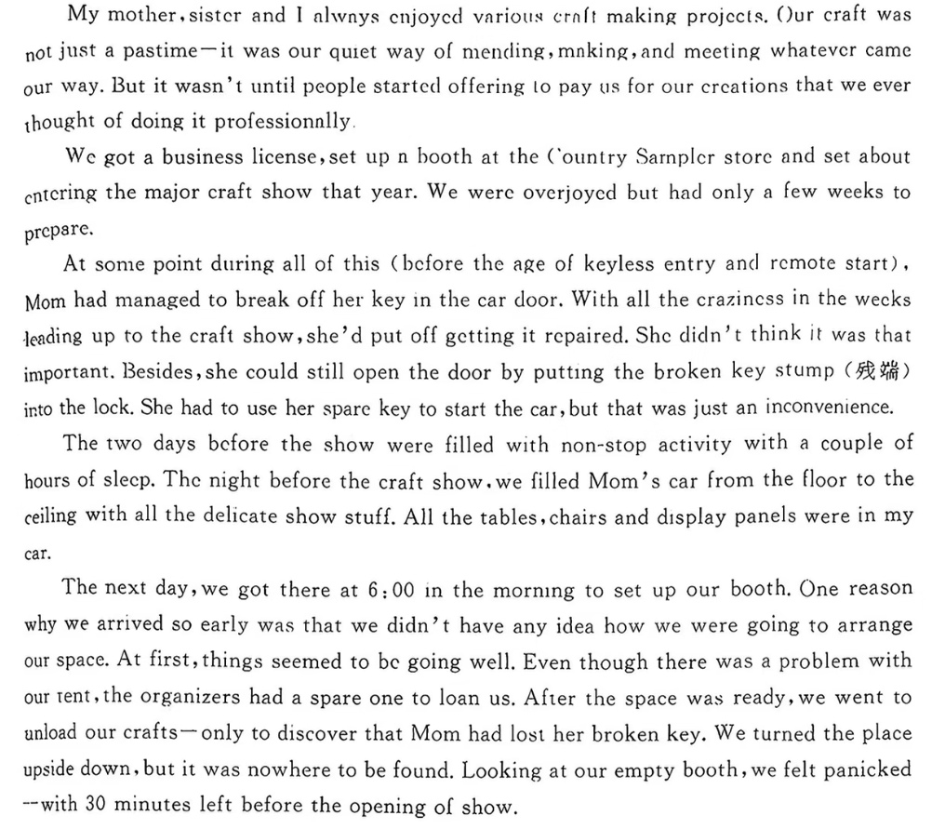

Slide 10
Wild thoughts on how to open the door raced through our heads. Smash a window? But doing that might spoil our delicate craft stuff. Turn to a locksmith? But the nearby locksmith would be unavailable until 9:00 a.m. In desperation, I even attempted to unlock the car with my own car key. No luck. Peering through the car window at our precious crafts, we seemed to have to resign ourselves to the fact that we might have to wait. Our golden chance for a head start was slipping away. Seeing my mother’s look of self-blame, I kept racking my wits for a solution.
It hit me that some spare wires in my car might help. I hurried to my car, opened the trunk and grabbed the wires out. Immediately, my sister and I got down to shaping the brass wire into a slender, precise hook using the jewelry pliers. Then Mom carefully guided it into the keyhole, felt for the broken key fragment inside, and to our relief and delight, the door was unlocked. We swiftly unloaded our crafts and proceeded to host a remarkable show. What proved decisive was our crafting skill, which transformed a moment of panic into a moment of triumph.

Slide 11
P₃₀₃ 其他补充行为
22.1 和动物相处
tame an animal驯化动物
He managed to tame the wild bird, and now it sits on his shoulder every day.
其他的不用看
(补充)

Slide 12
22.2 工具与日常操作
operate a machine操作机器
(operate on a patient给病人做手术)
wield a screwdriver使用螺丝刀
handle a wrench使用扳手
saw锯（sawed, sawed)
drill a hole打孔（bore: The tomb raider bored a hole through the tomb.)
press the pedal =slam the pedal踩踏板
shift gears换挡

Slide 13
22.3 做饭
chop切块
slice切片
rinse=cleanse清洗
drizzle淋、浇
season调味
She seasoned the salad with salt and freshly ground black pepper.
stew炖
He stewed the beef for several hours until it was tender.
simmer慢煮
She simmered the soup for an hour to blend the flavors. (煮酒论英雄？)
set the table摆放餐具

