Slide 1
《读后续写工具箱》三十三

Slide 2
范文1 I’m glad you’re interested in our school’s traditional Chinese culture courses. I strongly recommend the “Chinese Paper-cutting” course to you. Firstly, paper-cutting is a vivid symbol of Chinese folk art, with a history of over 1,500 years. In class, you’ll learn to cut patterns of animals, flowers, and lucky characters, which are widely used in festivals like the Spring Festival. Secondly, the course is hands-on—you’ll create your own works and even exchange them with classmates, making it both fun and cultural. It’s a perfect way to experience Chinese creativity up close!

Slide 3
I’m delighted to hear you’re exploring our school’s traditional Chinese culture courses, and I’d like to wholeheartedly recommend the “Chinese Paper-cutting” course. With a history spanning over 1,500 years, paper-cutting is a cherished folk art that reflects Chinese people’s love for life and nature. In this course, you’ll not only learn the cultural stories behind classic patterns—such as the double happiness character for weddings and the zodiac animals—but also practice creating your own works under the guidance of experienced local artists. The hands-on sessions and group sharing will let you immerse yourself in the charm of this ancient art, making it both educational and deeply rewarding. I’m sure you’ll find it a wonderful window into Chinese culture.

Slide 4
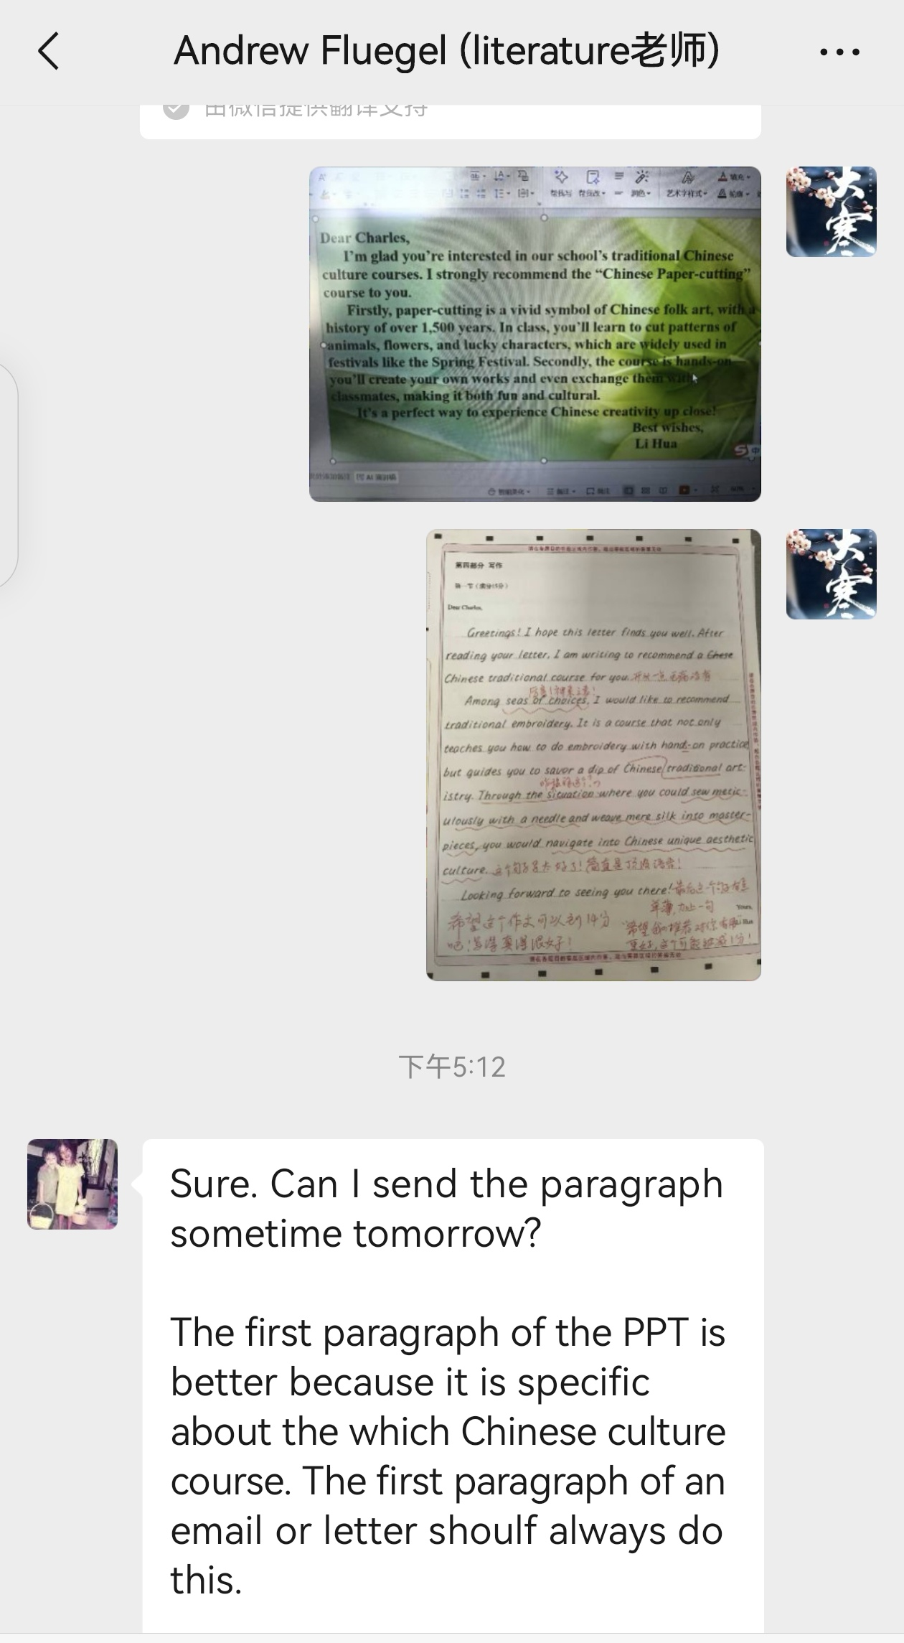
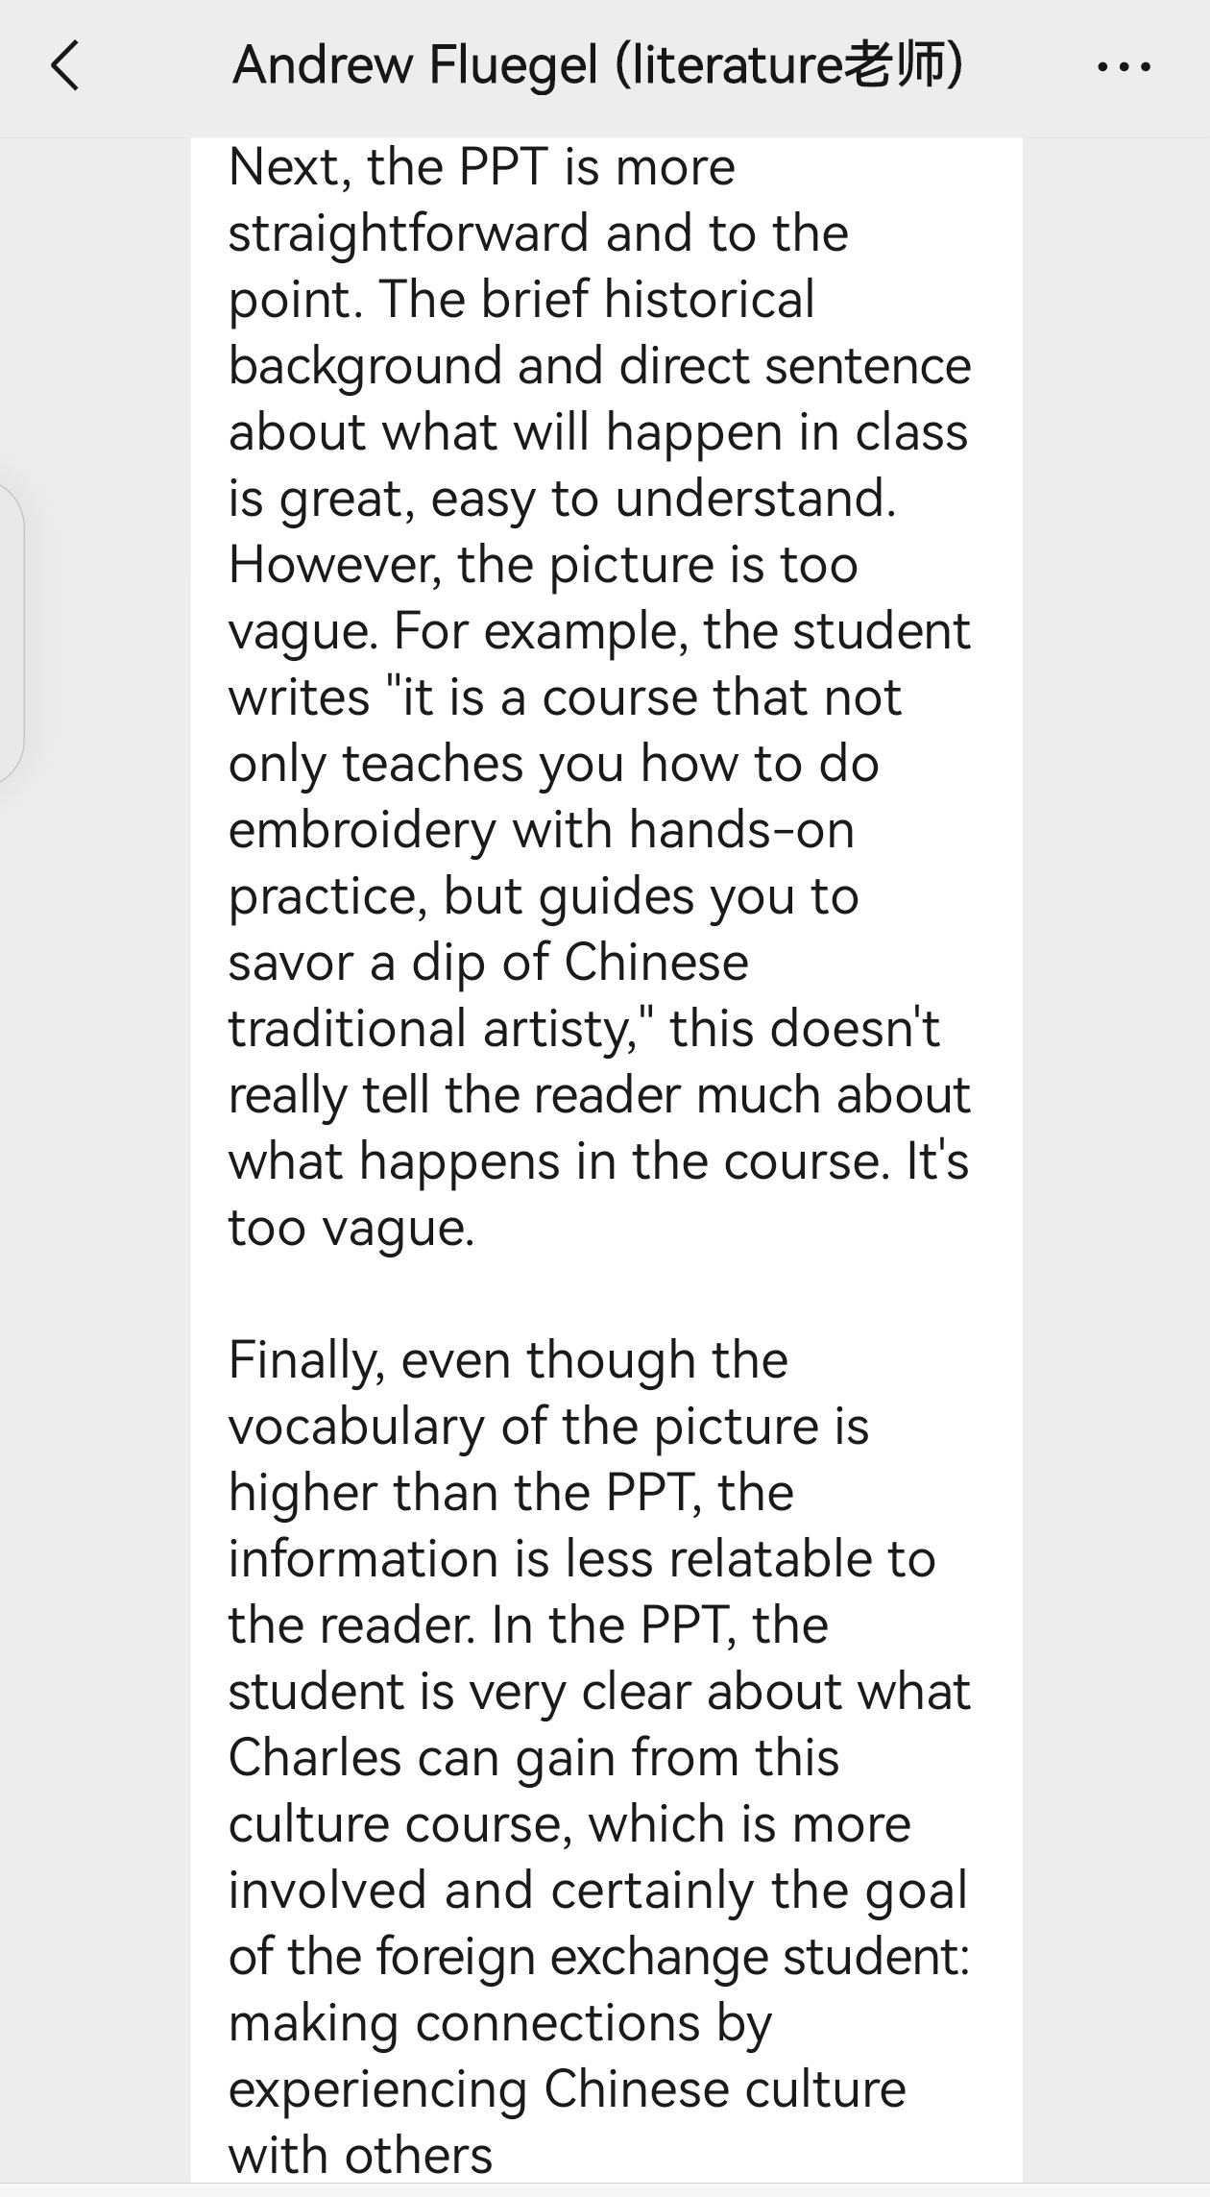

Slide 5
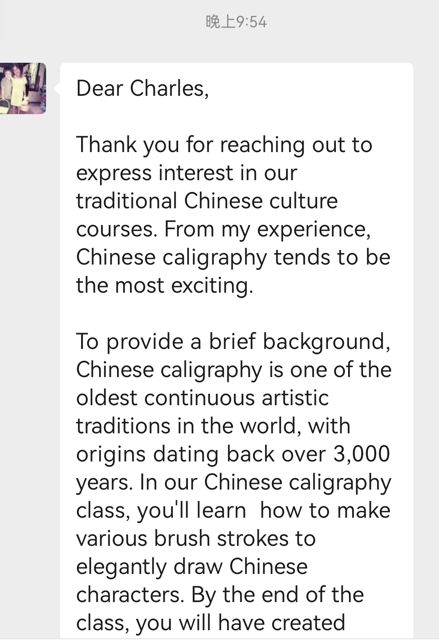
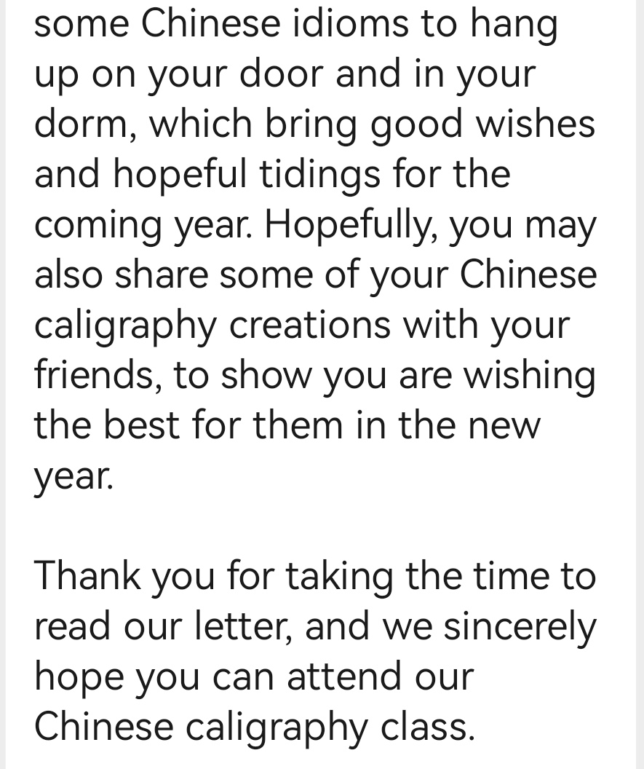

Slide 6
Nick soon started experimenting. He fetched his old skateboards from the corner, wiped off the dust, and began to carve. At first, his hands, still weak from recovery, shook a lot, and the shapes were rough. But he didn’t give up—every night after exercises, he sat at the table, carefully shaping the wood. The volunteers often stopped by to help sand the boards or fetch tools. Gradually, his works became more refined: some looked like tiny skateboards with vivid patterns, others were shaped like dogs he’d seen in the park. He posted photos of his sculptures on Etsy, and to his surprise, many people showed interest, and some even bought them. With the money he earned, Nick chose to give back. He donated a part of it to Riseup, the organization that had supported him through his tough times. He also used some to buy wood and tools, and started a small workshop at home, inviting other people recovering from illnesses to join him. "Skateboarding used to connect me with friends, and now these wooden sculptures connect me with more people," Nick said. Every week, they gathered to carve, share stories, and encourage each other. Nick’s small act not only helped himself regain purpose but also brought warmth to others in similar situations.

Slide 7
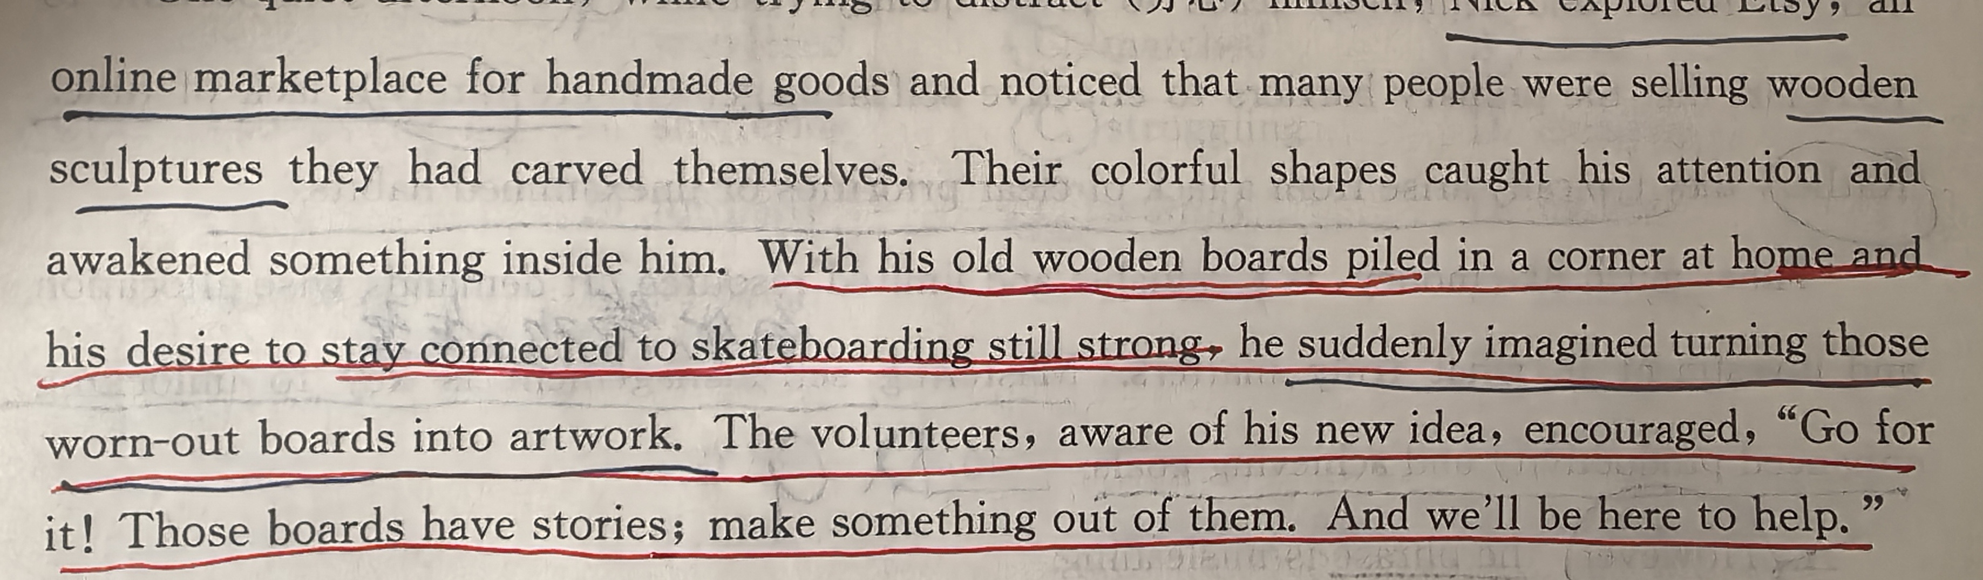

Slide 8
Nick soon started experimenting. He dragged his old skateboards from the corner, sanding their worn surfaces smooth and sketching colorful designs inspired by his favorite skate tricks. With the volunteers’ help, he carved the wood into small, vibrant sculptures—miniature ramps, skateboard wheels, and even tiny figures mid-jump. Each piece held a memory of his days on the board, and he sold them on Etsy under the name “Board Art Revival.” To his delight, orders poured in from skate lovers and art enthusiasts alike, who were touched by his story and the warmth in his creations. With the money he earned, Nick chose to give back. He donated a portion of his profits to Riseup, the nonprofit that had supported him through recovery, to fund art therapy programs for other patients rebuilding their lives. He also hosted workshops where he taught people with disabilities to turn their old sports equipment into art, helping them find new ways to stay connected to their passions. For Nick, what began as a way to distract himself had become a new mission: proving that even when one door closes, creativity and kindness can open another.

Slide 9
P₃₁₂ 22.4 数字设备使用
tap the screen 轻触屏幕
drag拖动
She dragged the file into the folder to organize it.
scroll滚动
Use the arrow keys to scroll through the list of files.
When I scrolled through the Instagram, a piece of news hit me hard: Alex scaled solo the world’s tallest skyscrapers with nothing but his bare hands and a chalk bag, millions of free soloing fans tuning in. Netflix kept a 10 second delay. If Honnold fell, the feed would have cut.
enter输入
He entered his password to log in / on to the system.
(About 500, 000 candidates entered the civil servants exam last year.)

Slide 10
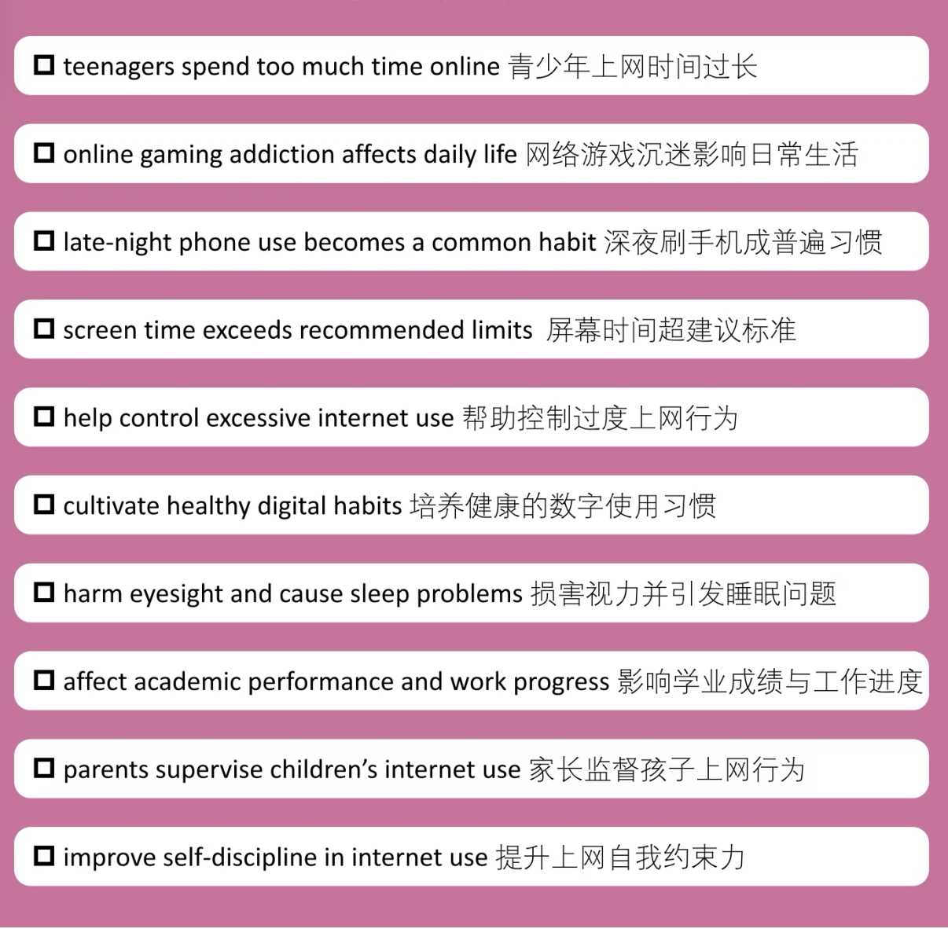

Slide 11
22.5 清洁与整理
个人健康
apply sunscreen涂防晒霜
He applied sunscreen before going out for a run in the sun.
take medication服药
He took his medication after breakfast to manage his condition.
包扎伤口？
医生告诉他，三天之后回诊所换药，以防止感染。
家务与卫生
dust除尘
He dusted the furniture before the guests arrived.
stack堆放
She stacked the plates on the counter.

Slide 12
整理着装
put on / wear穿上
He put on his jacket before going out.
button（up）扣上纽扣
She hurriedly buttoned (up) her blouse.
或She did up / undid her buttons.
zip up / unzip 拉上拉链、拉开拉链
23.2 时间过渡
P₃₂₂
The past, once a blur, now stands clear, as though it had never left.
What unfolds today will shape the future (in ways we cannot yet fully understand.)
What lies before us is veiled in uncertainty, but the seeds of tomorrow are planted in the actions of today.

Slide 13
The path ahead is unclear, but the steps we take now will carve the road for what is to come.
P₃₂₇
The clear, bright room grew dim as the storm clouds rolled in, the light receding into the distance as the darkness pressed closer.
The darkness of the night slowly lifted as the first rays of dawn broke through, casting light over the sleeping world.
The room, once consumed by shadow, was now bathed in the soft glow of the morning light.
下节课从P330开始

