Slide 1
《读后续写工具箱》精编（三十一）

Slide 2
假定你是李华，你校将举行第一届学生校园书画展，并进行部分书画拍卖，所得善款用于偏远山区小学生图书购买。请给校园广播站写一篇宣传稿，内容包括：
1. 活动简介；2. 诚邀参加。
Your attention, please! Our school is due to launch its first Campus Art Exhibition from January 22nd to 23rd in the school gym. The exhibition will showcase exceptional works where every brush stroke reflects the creativity and imagination of our students.
The highlight is a charity auction of selected artworks starting at 14:00 on the afternoon of 23rd. All proceeds will fund books for primary school students in remote mountainous areas, transforming these delicate brush strokes into lasting stories for young readers.
We warmly invite every member of our school to attend the exhibition and participate in the bidding. Your support will not only celebrate campus artistry but also fuel a noble cause. Let's unite to share beauty and extend love. Thanks for your attentive listening!

Slide 3
Yesterday morning, a comprehensive fire drill was successfully conducted across our school campus, involving all faculty and students.
The drill began with the piercing sound of the alarm, prompting everyone to evacuate classrooms immediately and in perfect order, following designated routes to the assembly points. Subsequently, firefighters demonstrated the proper use of fire extinguishers, with several students and teachers gaining hands-on experience.
The activity was met with widespread positive feedback. Participants expressed that it was an eye-opening and practical lesson, which significantly heightened their awareness of fire safety and their confidence in responding to emergencies.

Slide 4
P₂₈₁ 第21章 社交行为
21.2 亲密与友爱
cuddle亲密的拥抱
huddle取暖
They cuddled on the couch while watching a movie.
其他的单词了解
红色方框里的句子：
She found solace in his quiet presence, knowing that words were unnecessary between true friends. (这个句子写得还可以)
In moments of vulnerability, she knew she could trust him with her deepest secrets and fears.
Their friendship had weathered storms that would have destroyed lesser bonds, growing stronger with each trial.

Slide 5
The gentle touch of her hand on his shoulder conveyed understanding that transcended spoken words.
The warmth of their connection filled the cold room, creating a sanctuary of love and acceptance.
21.3善良与助人
thoughtful, considerate, understanding体贴的
lend / extend a helping hand伸出援助之手
翻译：万一别人遇到任何困难，他总是第一时间伸出援助之手。
Her generous spirit moved her to share what little she had, knowing that giving brings its own reward.
The volunteers selfless dedication illuminated the path forward for those who had lost their way.
With gentle hands and patient words, she tended to the wounded, healing more than just physical pain.

Slide 6
21.4 报答与感恩
express / convey gratitude (appreciation, gratefulness) to sb. for sth.
I want to express gratitude for your unwavering support.
owe sb. a favor, return sb. a favor
be indebted to sb. for sth.
She felt indebted to her mentor for the guidance she had received.
reciprocate
在他上大学的那一刻，他就下定决心好好学习回馈社会。
Upon entering university, he resolved that his education would not merely be for personal gain, but to equip him to reciprocate the opportunities he had received by serving the community.

Slide 7
底下红框里需要注意的句子：
The scholarship recipient’s achievement became a testament to the power of investing in others’ potential.
21.5 合作与顺从
合作？(2)
They ... to complete the project on time.
work in sync同步操作
The team worked in sync to finish the task efficiently.
give consent (assent) 同意
The manager gave his consent for the project to proceed.
endorse (公开且正式）支持、赞同
The celebrity endorsed the new brand of skincare products.
He endorsed the check for it to be cashed in the bank.

Slide 8
comply with=adhere to坚持、遵守
服从于？v.+ to
The employees ... to the new regulations without protest.
底下的红框：
The team’s seamless collaboration transformed a daunting challenge ito an achievable dream.
Their diverse talents wove together like threads in a tapestry, creating something beautiful and strong.
21.6协商与谈判
settle terms商定条款
They settled the terms of the deal after a a few rounds of discussion.
find common ground找到共同点

Slide 9
make concessions做出让步
They made concessions during the negotiations to finalize the deal.
draw up a contract / draft a contract起草合同
hammer out敲定、达成
The two parties hammered out a package deal after the lengthy negotiation.
strike a deal / bargain达成交易
call off negotiations取消谈判
reach a compromise达成妥协
reach a consensus达成一致
in good faith真诚地
They negotiated in good faith, aiming for a fair deal.
The tension in the room dissolved as both parties discovered their shared desire for resolution.

Slide 10
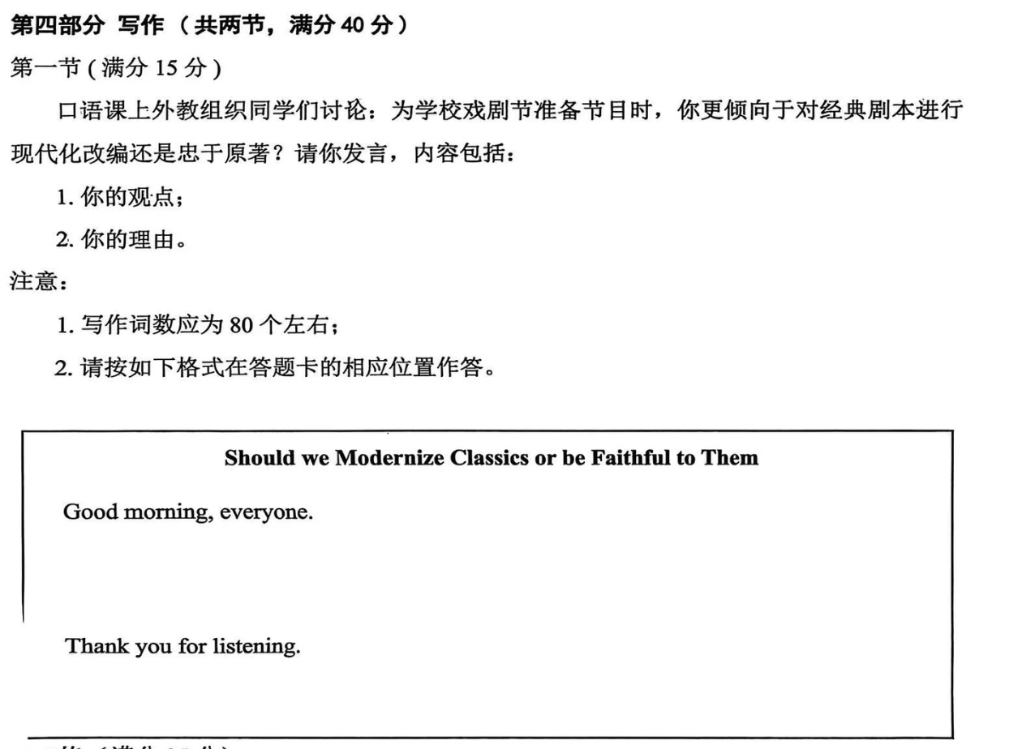

Slide 11
Good morning, everyone.
My view leans strongly toward the modernization of classic scripts for our school drama festival. While respecting the original works, I believe adapting them to reflect contemporary themes allows stories to resonate more deeply with today's audience.
First, modernized plots speak to our lives. By reimagining Remeo and Juliet as a story of two club leaders resolving conflicts, we turn distant characters into relatable peers, making the audience lean in, not zone out. More importantly, it unlocks our creativity. We’re not just actors; we are co-creators, injecting bits of our school life like group project stress into lines, which makes rehearsals feel like a fun challenge, not a rigid task.
In this way, classics stay alive not as dusty books but as stories we own. Thank you for listening.

Slide 12
假定你是李华，你校英语话剧社拟举办英语话剧展演活动。请你写一篇开幕词，内容包括：
1. 表示欢迎；2. 活动介绍。
Dear teachers and fellow students,
Welcome to the English Drama Club’s exhibition! We are thrilled to have you join us today, and so excited to share our love for drama and the English language with you.
Today, we will present a series of plays that our talented students have worked hard to prepare. These performances include a mix of classic and contemporary stories, showcasing both creativity and language skills. The event will feature five short plays, each highlighting different themes and genres. Between the performances, there will be brief intermissions allowing you to interact with the cast and enjoy refreshments.
We believe drama not only entertains but also educates and inspires. ‌Through this showcase, we hope to foster a deeper appreciation for theatrical arts within our school. ‌Thank you for your presence and support. Now, let the show begin!

