Slide 1
《读后续写工具箱》精编七

Slide 2
P₁₃₉惊讶
Surprise shot through me like an electric current before I had time to doubt it, making my heart race and my mind spin. (这个句子写得还行）
be taken aback惊讶
She was taken aback when the teacher called her name first.
(比较) She was taken aback when the teacher called her names.
be taken aback和be blown away
Ethan was taken aback by the sudden, frantic fluttering of the trapped bird.

Slide 3
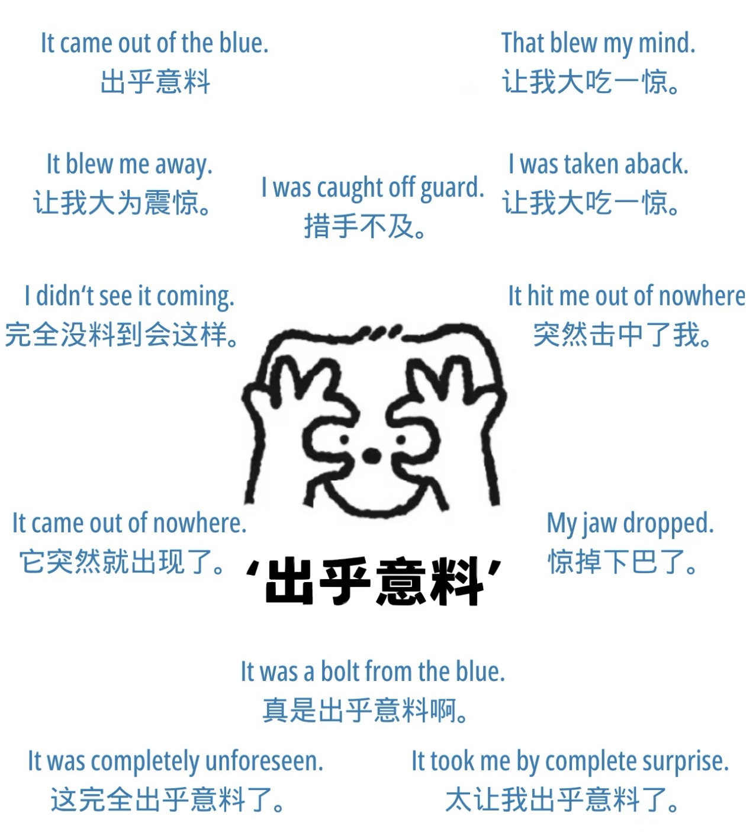

Slide 4
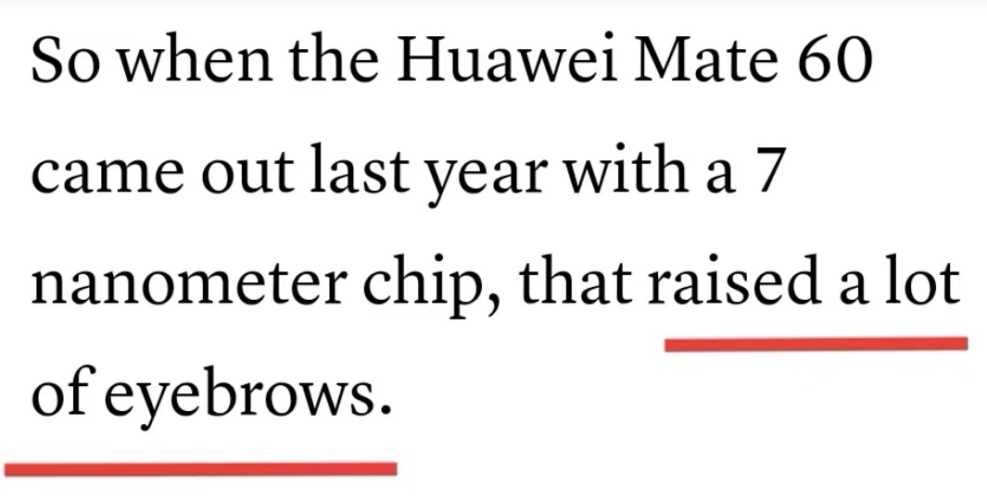
raise an eyebrow挑眉表示惊讶（底下的例句一般）

Slide 5
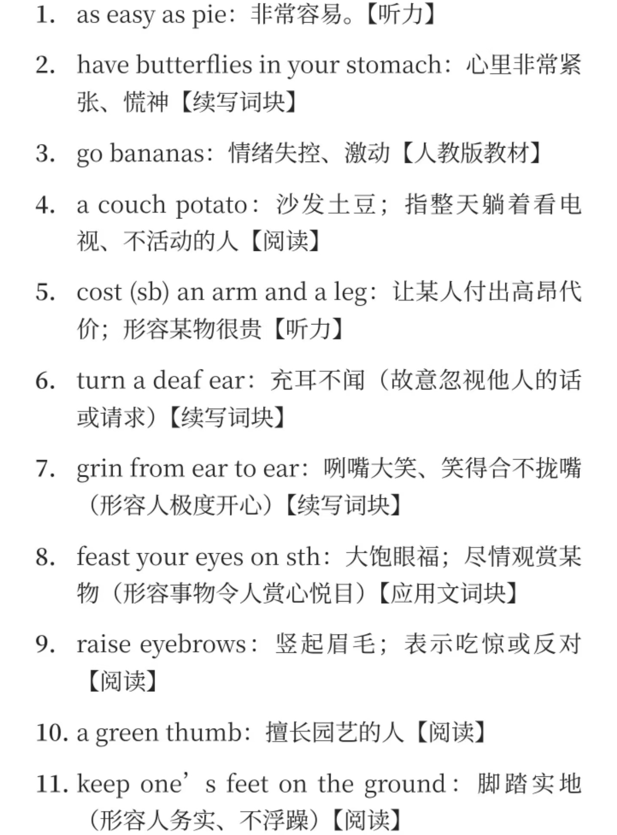

Slide 6
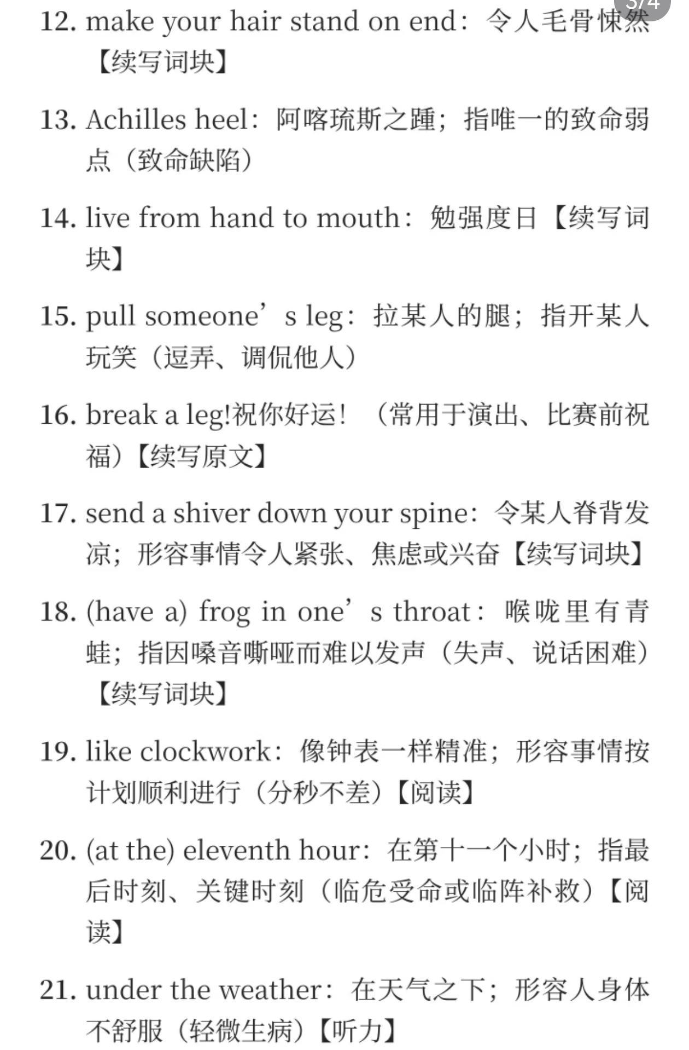

Slide 7
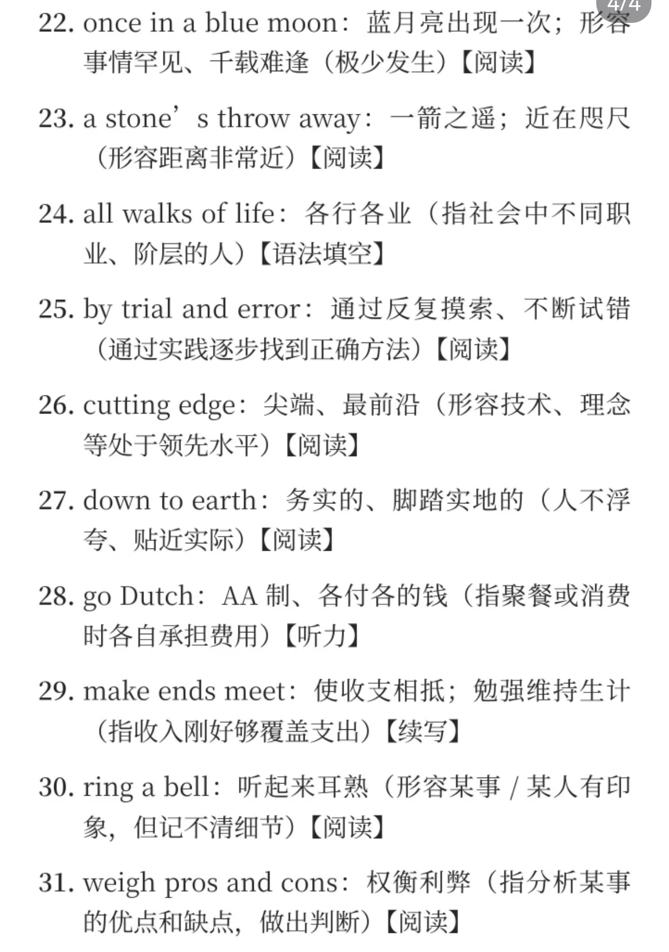

Slide 8
（红色方框最后一句）
Flipping through the library book, he came across an old train ticket dated ten years ago.
12.2 积极惊讶
astonished极为惊讶
They were astonished to learn they had won the lottery.
Astonished, he feasted his eyes on the lifelike dragon on the blackboard with shining scales and forbidding claws. It seemed as if it would come to life and soar in the sky!
astound极为惊讶（补充的）
Ambassadors from Western countries presented guns and cannons to Emperor Qianlong, only to see his arrogant look, which astounded them.
stunned极为惊讶；留下深刻印象
The wide expanse of rape flowers was so stunning that she lost herself in it.

Slide 9
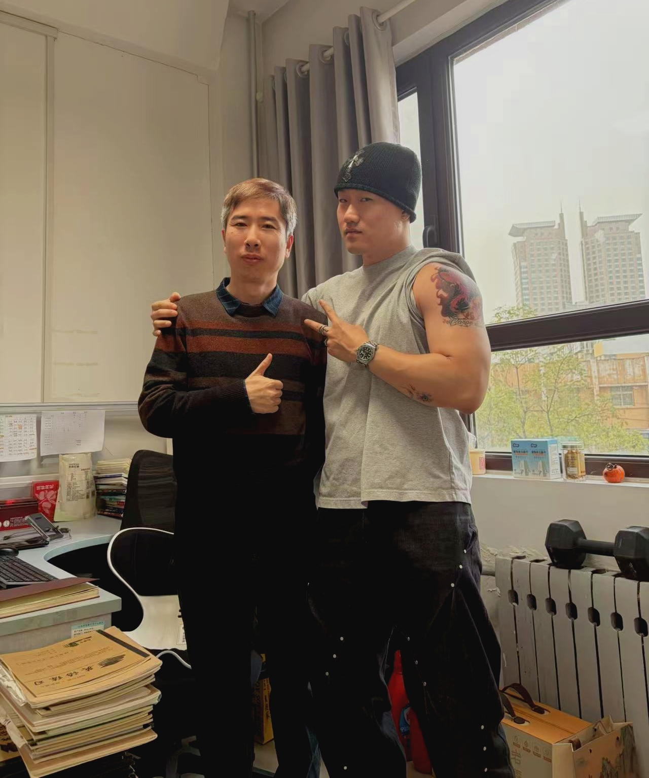
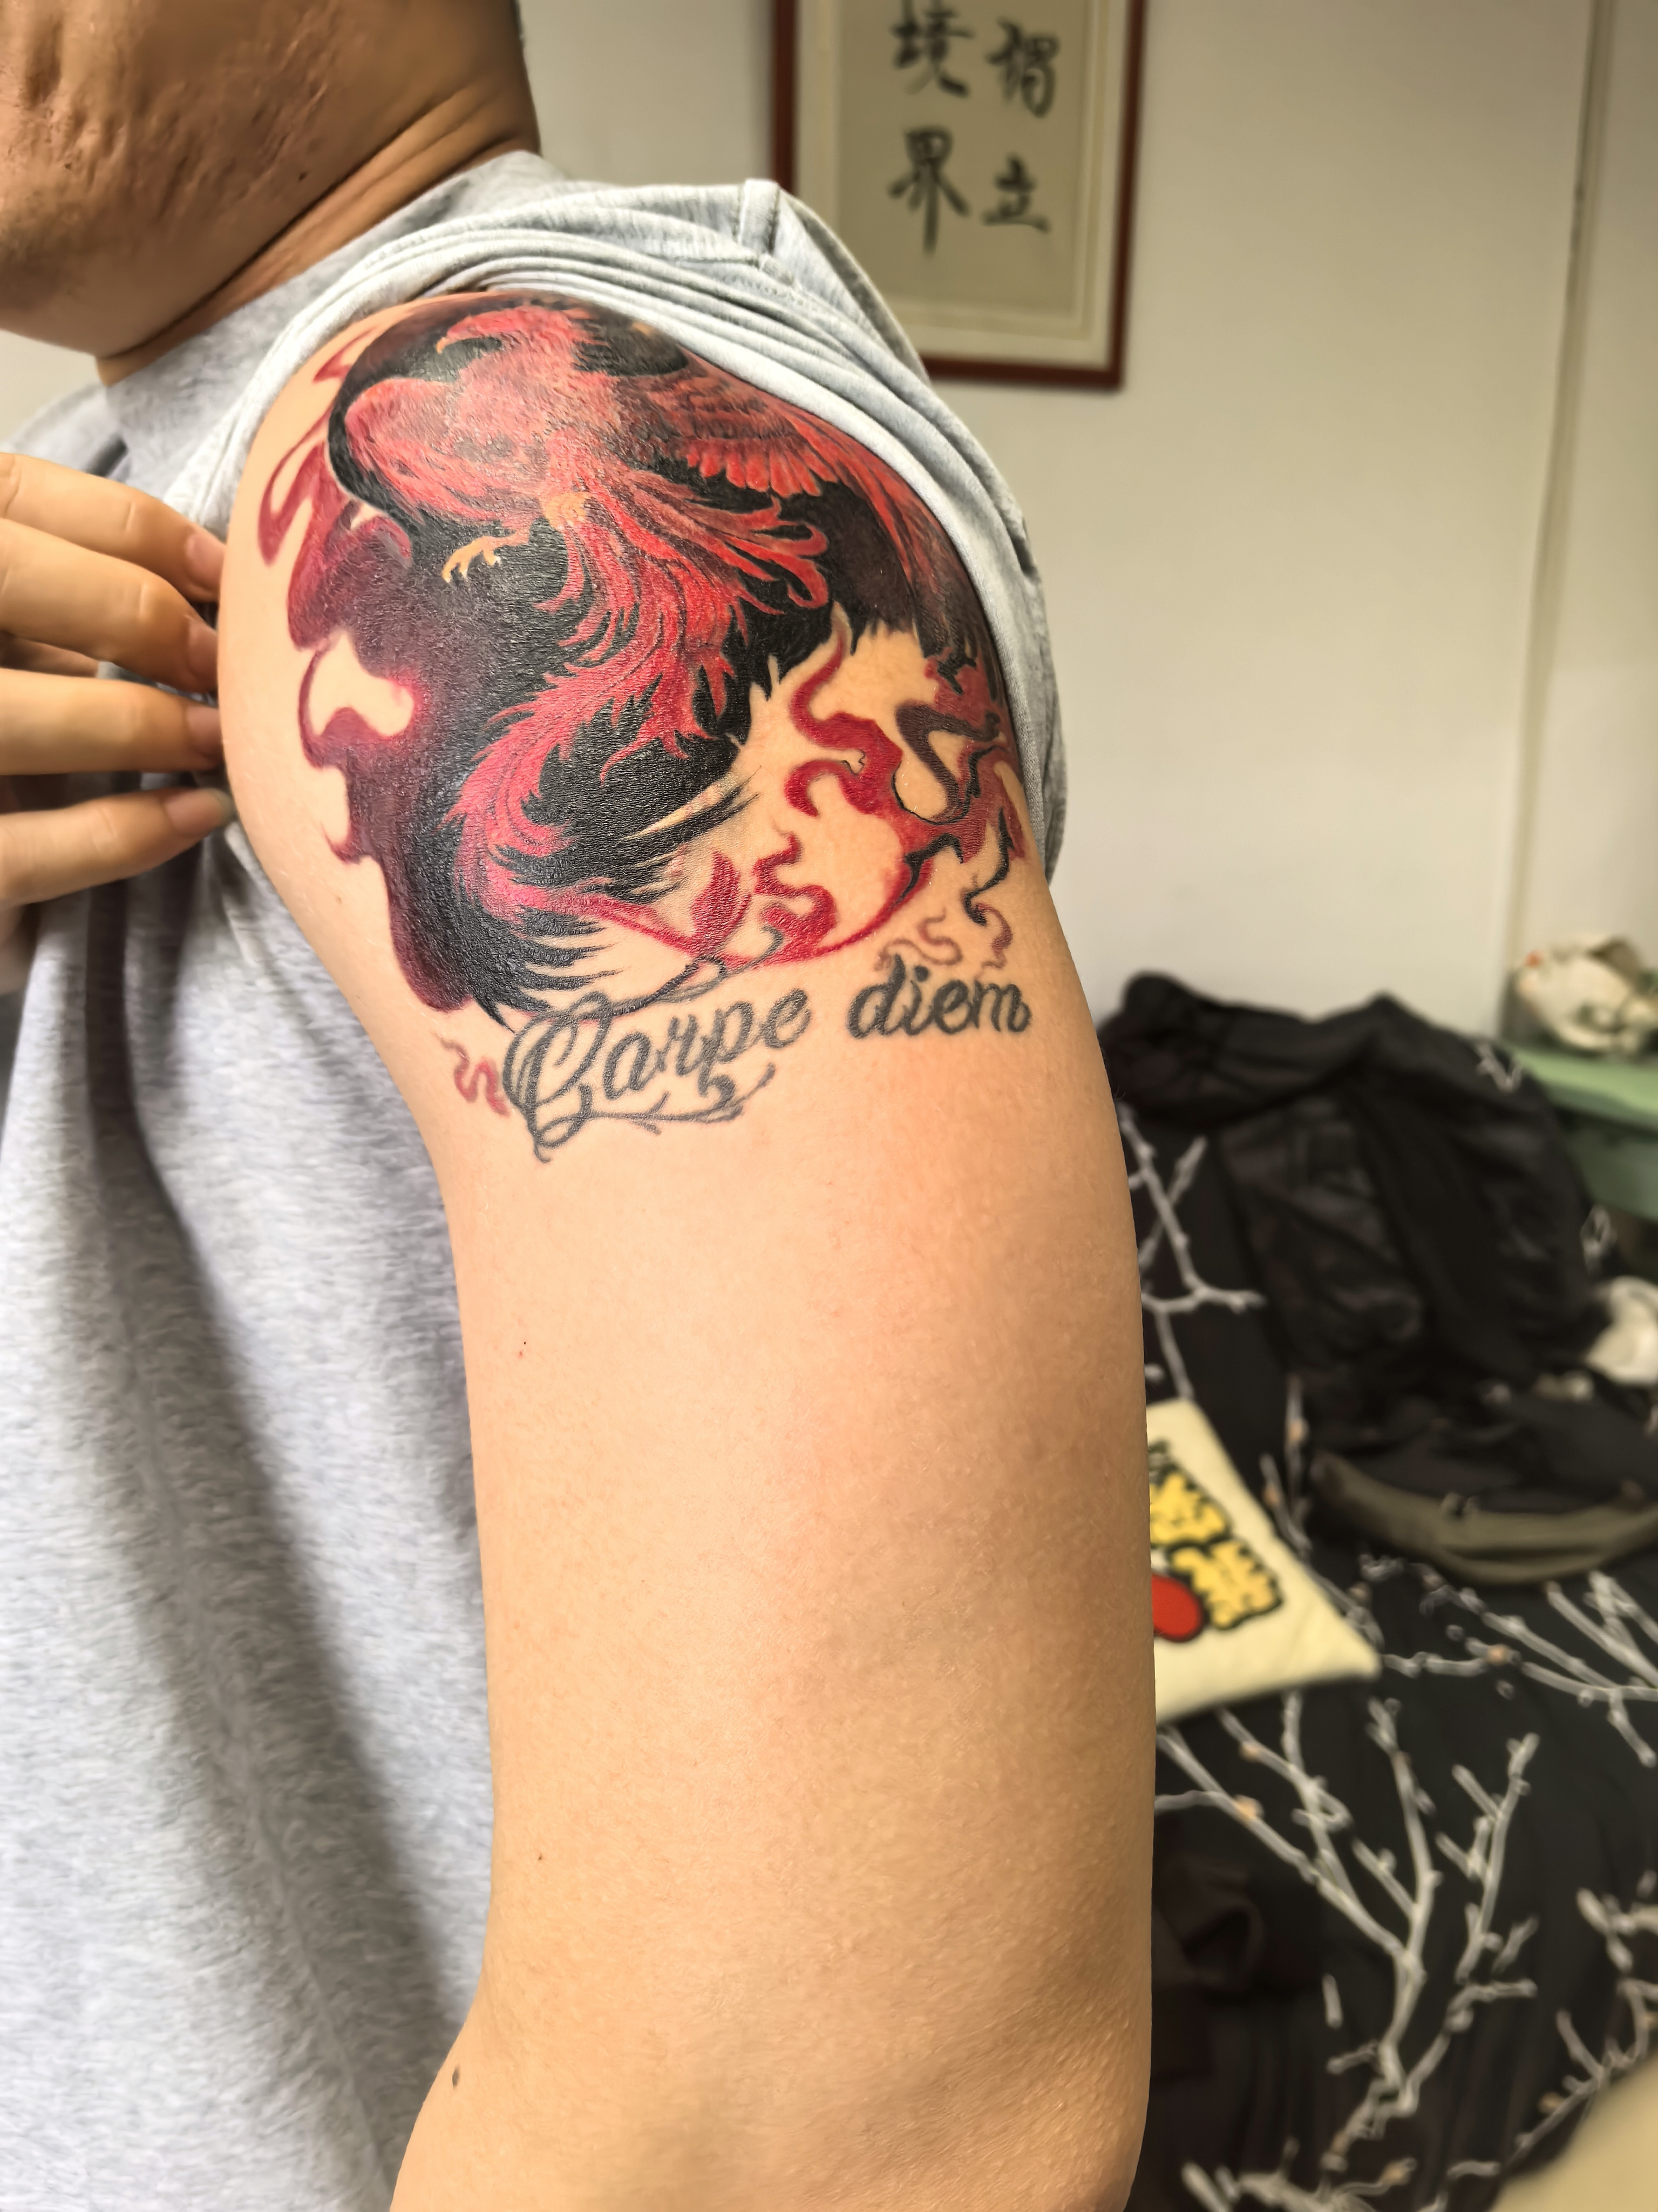
take ... by surprise惊讶（底下的例句写得不大行）
One of students’ tattoos really took me by surprise.

Slide 10
(红色方框内的句子）The garden behind the old wall was nothing like she had imagined: lush, fragrant, and glowing with unexpected life.
The garden behind the old wall was nothing like she had imagined: lush, fragrant, and glowing with unexpected life. Flowers of different colors strove to show their beauty, amid which were flying humming bees.
12.3 消极惊讶
dismayed惊愕且失望的

Slide 11
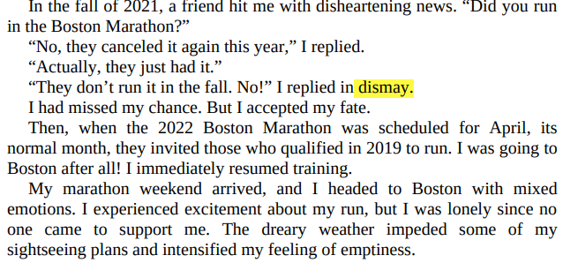

Slide 12
stagger感到震惊
He was staggered by the sudden accusation made against him.
P₁₄₅ 第13章 爱与感恩
It was a love that flowed through me like a gentle river, quietly nurturing every corner of my soul. (这个写得不孬）
13.1 亲情之爱
nurturing有养育之爱的、关爱的
These delicate plants need careful nurturing.
feel deeply cared for感到被深切关爱
She felt deeply care for when her grandmother brought soup all the way to her dorm.

Slide 13
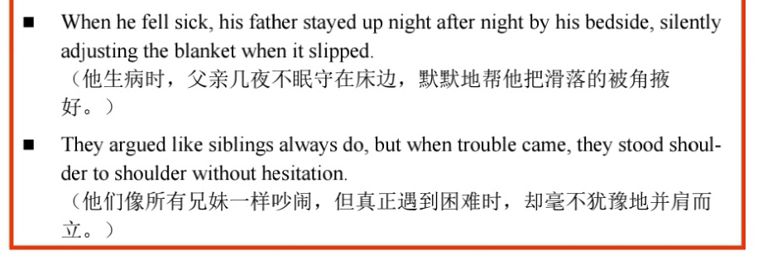

Slide 14
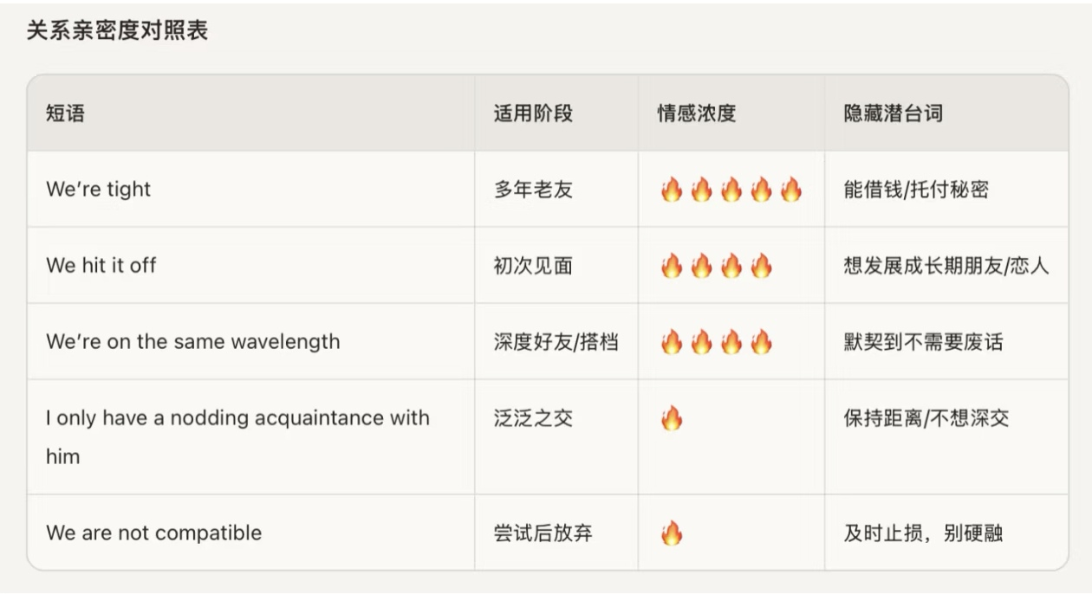
13.2友情之爱
understanding, considerate, thoughtful善解人意的、体贴的
She appreciated how understanding her best friend was...
confide in sb. 向某人透露
confide sth. to sb. 向某人吐露
confidence机密、秘密（I could never forgive Mike for betraying a confidence.)
下节课从P149 13.3感恩开始

