Slide 1
读后续写工具箱
精编（一）

Slide 2
P₃₅
第3章 读后续写的七大原则
3.1原则1：完成大于完美
3.2原则2：不跑题
3.3原则3：低水平仿写（21分以下），高水平原创（21分以上）
When all is said and done, it is not the fleeting moments, but the timeless, immutable essence of ... that redefines the course of our lives. (这句话慎用）
3.4原则4：多写动作和心理，少写对话
3.5原则5：尽量固定两段续写的句子数量（仅作参考）

Slide 3
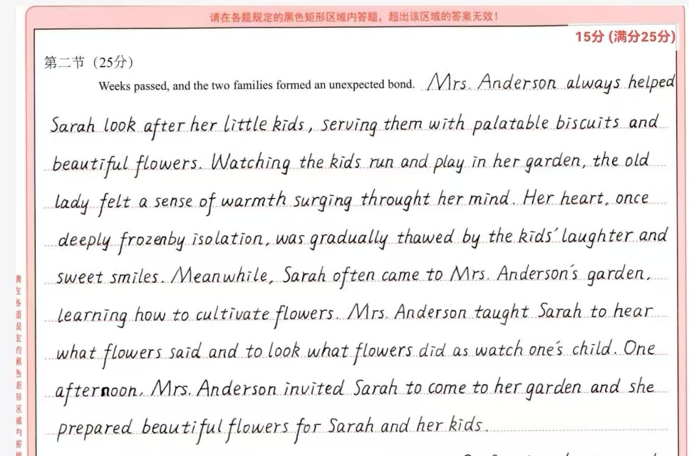

Slide 4
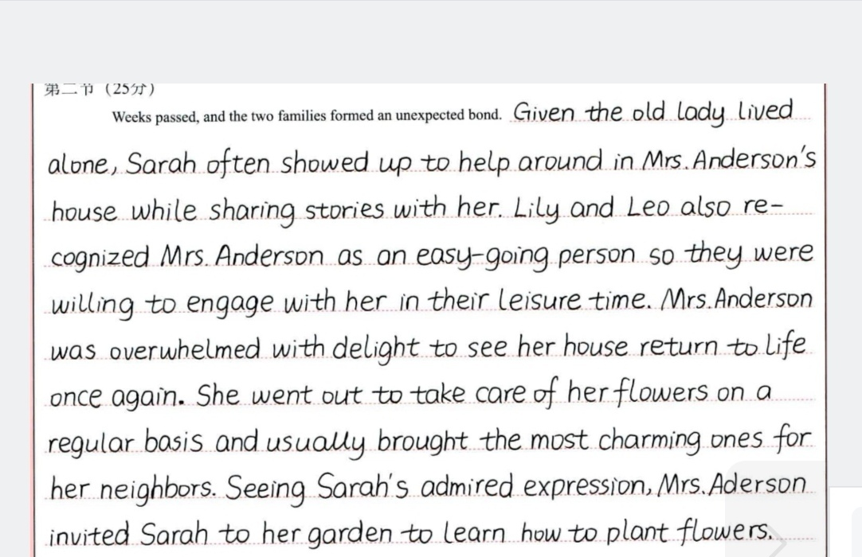

Slide 5
3.6原则6：在合理范围内超过150词为宜
3.7原则7：练字非常重要

Slide 6
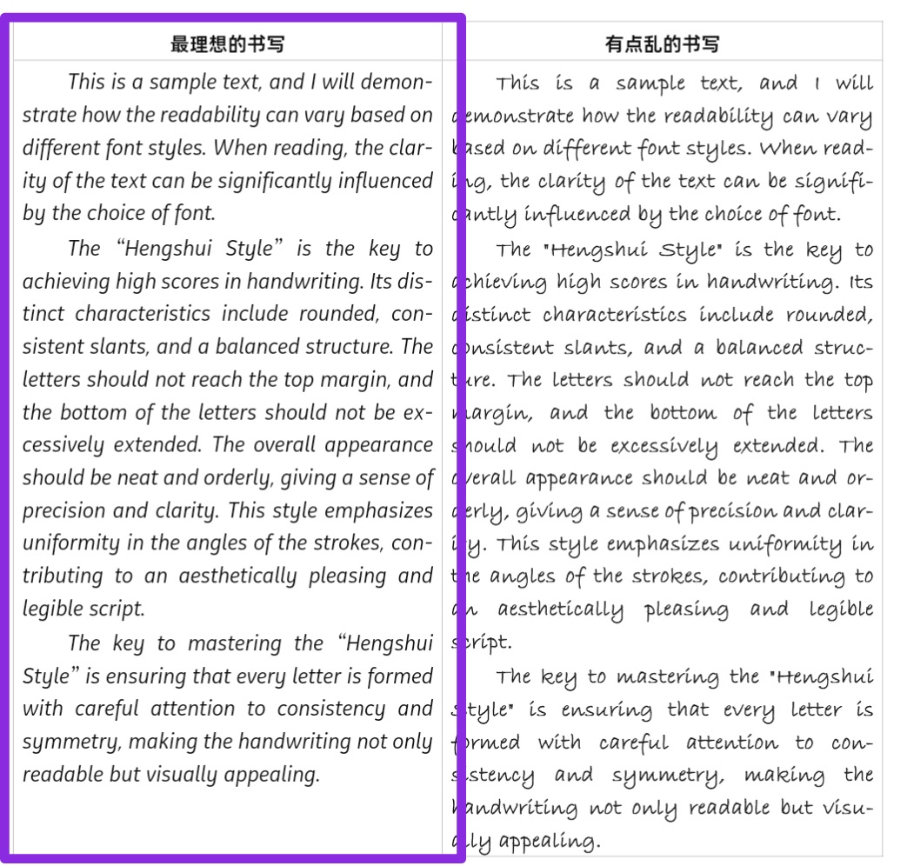

Slide 7
P₄₀ 第4章 读后续写的十大技巧
4.1. 不要总写主谓宾“傻瓜”句型
多使用从句、非谓语、介词短语、副词，串联动作和心理描写
He felt a surge of anger as he walked down the street, his fists clenched tightly.
升级版：He stormed down the street, his fists clenched so tightly that his nails bit into his palms.
拓展版：He stormed into the room, slammed the door shut and flung himself onto the bed, bursting into tears.
提升版：With a slam of the door, he stormed into the room and flung himself onto the bed, bursting into tears.

Slide 8
She stepped cautiously into the room, her heart pounding with anxiety.
升级版：Cautiously, she stepped into the room, a knot of anxiety tightening in her chest.
As the door creaked open, she froze in fear, wondering what would happen next.
升级版：With a knock on the door, it creaked open and she stood rooted to the ground.
升级版：She knocked on the door and with a creak, it swung open, leaving her rooted to the ground.
He clenched his jaw, trying to control his urge to scream, but his frustration bubbled up uncontrollably. (感觉这句话的frustration换成panic, fear之类的更合适）
His legs moved swiftly, fueled by the panic that surged through him as he raced toward the door, hoping it wasn’t too late. (这个句子写得不错）

Slide 9
介词短语和副词：
Frantically, the mother searched for her missing daughter, tears of grief welling up in her eyes.
Under the unbearably scorching sun, he was soaked in sweat, but still wore a brilliant smile.
Quietly but rather determinedly, she took the leave and headed for the house.
I crawled into bed, burying myself in the pillow, feeling physically and emotionally broken.
When she finished playing, the audience sat in stunned silence before leaping to their feet with an extraordinary outburst of applause.
Realizing his mistake, Mike, embarrassment and guilty, ducked his head in great shame.

Slide 10
4.2不要总是人做主语（无灵主语的使用）
Fear gripped her heart as she stepped into the room.
Time seemed to slow down as he waited for the verdict.
The silence in the room was overwhelming, pressing against her chest.
Justice often feels distant in times of crisis, like a dream out of reach.
其他：
A good opportunity never knocks twice.
The sight of a small cave offered a glimmer of hope.
Dusk found the child huddling under a blanket on the floor.
Moonlight danced on the lake, shimmering like a blanket of diamonds.
A hush fell upon the classroom, making it easy for us to hear a pin drop.

Slide 11
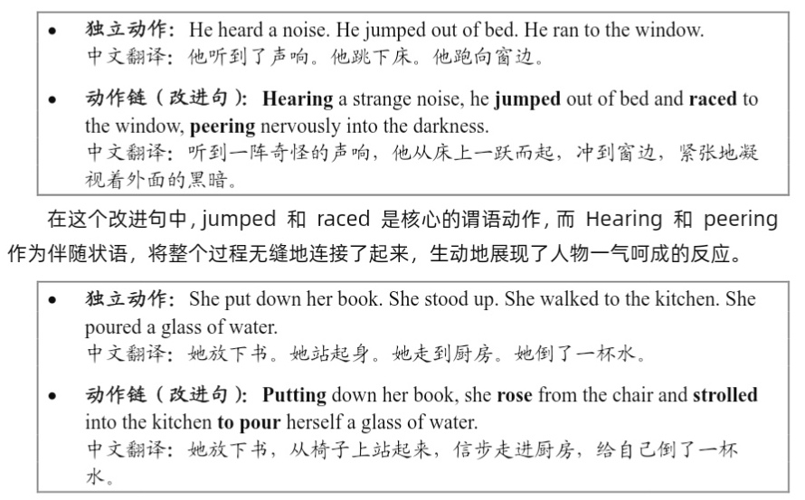
4.3不写独立的动作，学会串联动作链
原因：避免太碎、太短的句子。五六个单词构成的句子往往会让阅卷老师认为考生水平差，这种错误的认知迫使考生只能将独立动作放进连贯动作链条里，实属无奈。

Slide 12
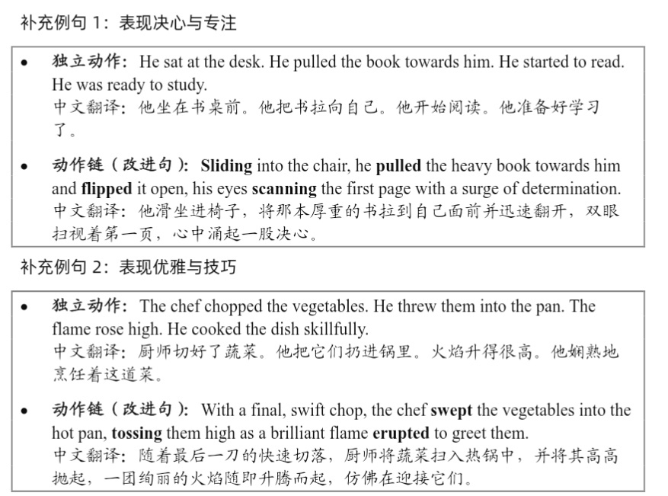

Slide 13
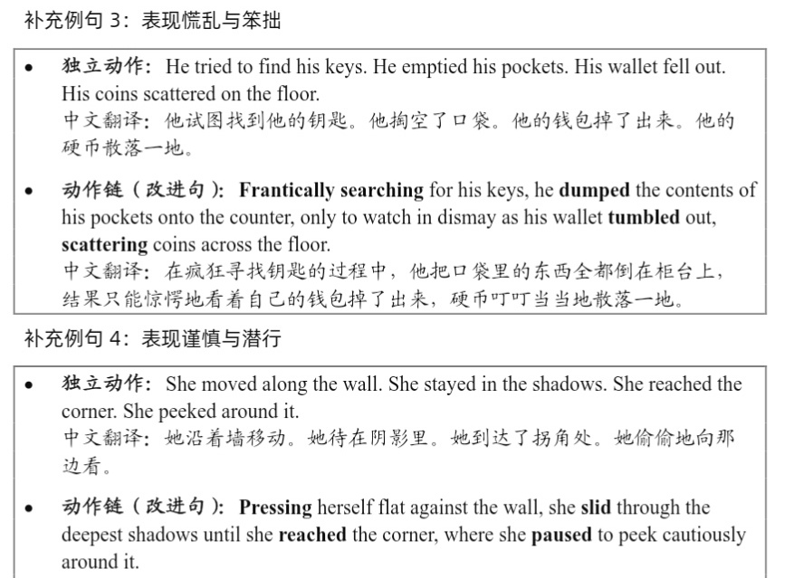

Slide 14
4.4感官描写和心理活动同在
(P₄₆, 第二个方框）
She looked at the calm sea. It reminded her of her peaceful childhood.
升级：As she watched the waves gently lapping the shore, the rhythmic sound seemed to transport her to her peaceful childhood. (剩下的句子不用看)
补充例句1：表现喜悦与希望
He saw the lighthouse light. He knew he was safe. He felt very relieved.
升级：A single beam of light cut through (pierce也可) the stormy darkness. (中间可以省略) The tight knot of fear in his stomach finally loosened (its grip), replaced by a rising tide of relief. (这句话写得不错)
补充例句2：表现愤怒与烦躁（这个部分的例句不适合背诵，略去）
补充例句3：表现悲伤与怀旧（这个部分的例句不适合背诵，略去）

Slide 15
补充例句4：表现宁静与满足
The sun was warm on her skin. She heard the bees buzzing. She felt perfectly content.
升级：She tilted her face to the sky, feeling the sun’s warmth spread across her skin like a gentle blanket. The lazy buzzing of bees nearby was the only sound, a peaceful melody that settled her mind and filled her with a simple, profound contentment.
更升级：She turned her face to the sun, feeling its warmth spread through her like a blanket. In the stillness, the drowsy buzz of bees was the only sound, a peaceful murmur that quieted her mind and brought a contented calm.

Slide 16
4.5长短结合，留出呼吸感（但一定是长句多，短句少）
长句不是充斥着各种从句，而是包含着一到两个语法点的句子，单词数量在15个左右，不宜超过20个。短句也不宜6个单词以下，否则会给阅卷老师水平次的感觉。
P₄₇举例的长句
He stood at the edge of the cliff, gazing at the vast expanse of the ocean, his thoughts lost in the vastness of the horizon, as the wind whipped through his hair, carrying with it the scent of the saltwater and the promise of something beyond the limits of his understanding.
P₄₈长短句结合的技巧下面的例句略去

Slide 17
4.6有动词的地方，就主动加副词
如：walked slowly / briskly / cautiously, shouted hoarsely
climbed the stairs wearily, touched his shoulder tenderly
exclaim angrily, run hurriedly to
furtively slipped the letter into his pocket
joyfully splashed water, violently shoved the desk
remarked contemptuously, smile relievedly
hop over the fence agilely, deftly assemble the spare parts
4.7有名词的地方，就主动加形容词
crystal-clear water, pitch-black night (这两个其实挺好的)
4.8小短句也能写出大味道（用处不大）
4.9真实感是细节给的（略去）
4.10学会“一招鲜、吃遍天”
... surged within me like a relentless tide, pushing me forward with an unyielding force.
如：excitement, panic, nervousness ...

Slide 18
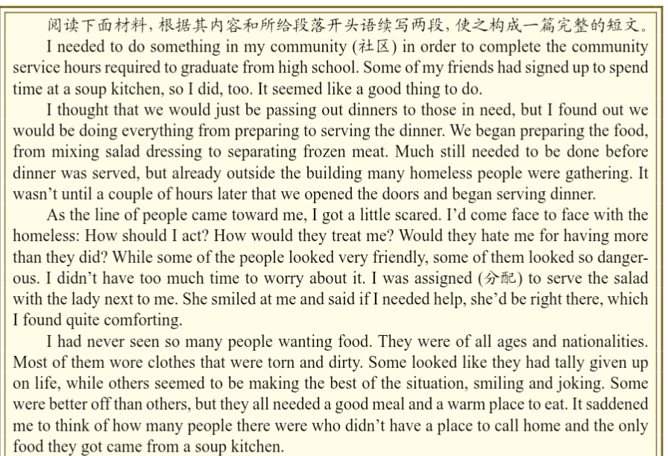
P₆₁
第5章 带你拼出一篇读后续写

Slide 19
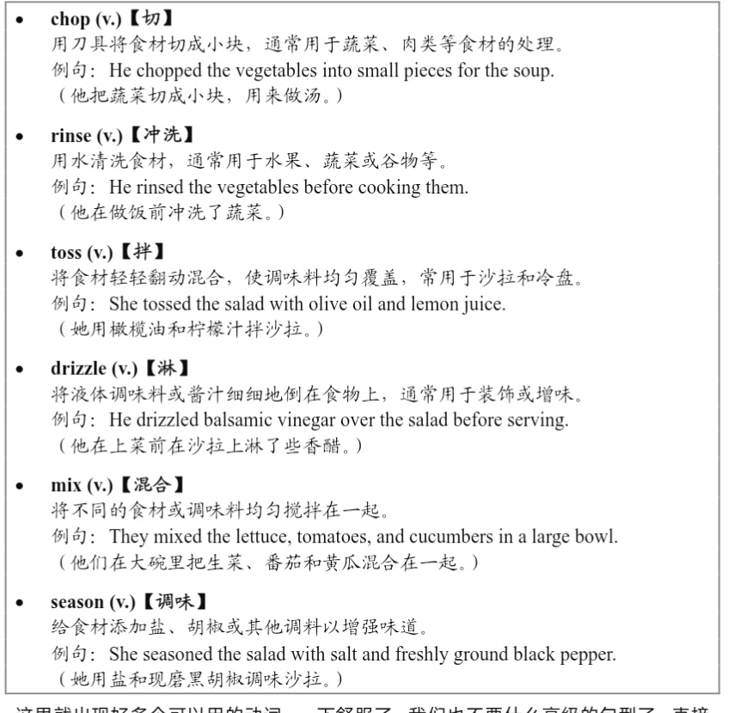
As they came in my direction, I put on my brightest and happiest smile.
I was so happy that I had earned my service hours in this way.

Slide 20
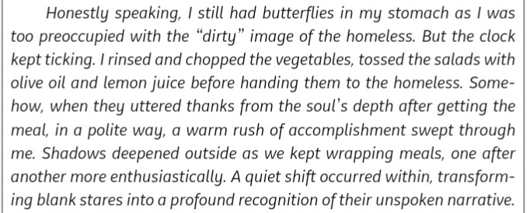

Slide 21
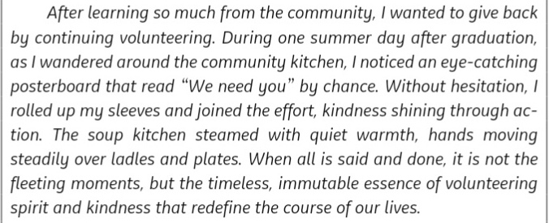

Slide 22
下一节从P₇₇第6章 高考真题精讲开始

